Slide 1
Vulcan Activity Tracker
CMSC-4920-Senior Project 2
Group2
Team: Margo Bonal, John Gerega, Luke Ruffing

Slide 2

Description
The Vulcan Activity Tracker is an athletic app that allows for the tracking of all campus athletics activities.
In one combined platform, the Vulcan Activity Tracker aspires to meet student organization needs, social interaction, and exercise goal planning in a free accessible way!

Slide 3
Features
Secure Login
Dashboard
Activity
Maps
Challenges
Clubs
Official Teams
Leaderboard
Settings
Friend View

Slide 4
Development Stack
Client
Html
Server
Python Flask Framework
Database
MSSQL-Azure Edge v18
JS
CSS
Docker Containerized for local development

Slide 5
Collaboration Method
Software Development Life Cycle: Agile
GitHub Shared Repository Practiced Branch Policies
Assigned Task Tickets
Merged branched upon completion

Slide 6
User Data Encryption
2 Step Data Encryption:
SHA-256 & Argon2
SHA: fast pre-hash on client side, allows for platform reaction time
Argon2: slow hash server side
Prevents GPU, ASIC, rainbow, and Parallel attacks
Additional Salt, layered architecture
Account Creation and Login verification
Users stored as unique id
Usernames unique
User information never sent as raw data

Slide 7
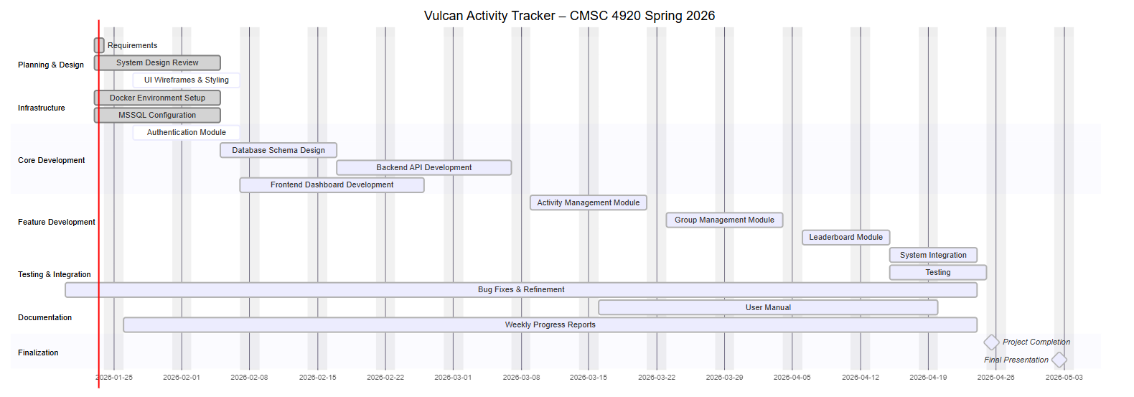
Gantt Chart

Slide 8


External Resources
Map API Leaflet (2025) https://leafletjs.com/
OpenWeather (2026) https://openweathermap.org/api

Slide 9
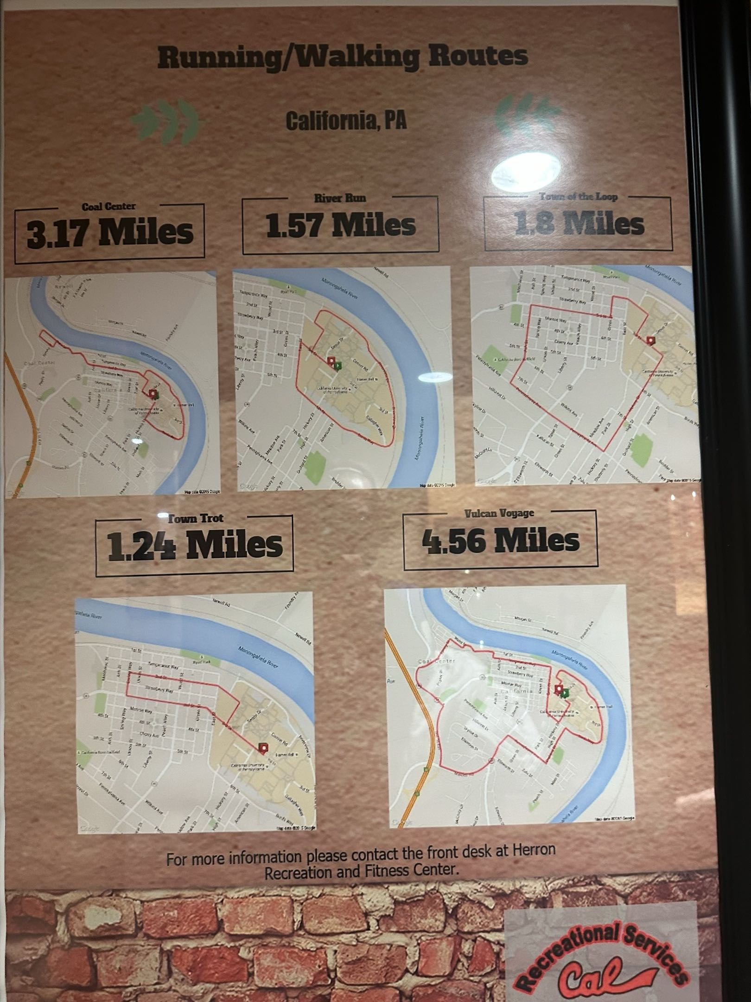
California Campus Routes

Slide 10
Business Model
Hosting:
Microsoft Azure Hosting
Monthly Cost :
Database:
Hosting platform:
Domain:
Maintenance :

Slide 11
https://jjdeuce06.github.io/VulcanActivityTracker/
Questions?

