Slide 1
Vulcan Activity Tracker
CMSC-4920-Senior Project 2
Group2
Team: Margo Bonal, John Gerega, Luke Ruffing

Slide 2

Description
The Vulcan Activity Tracker is an athletic app that allows for the tracking of all campus athletics activities.
In one combined platform, the Vulcan Activity Tracker aspires to meet student organization needs, social interaction, and exercise goal planning in a free accessible way!

Slide 3




Development Stack

Slide 4


Collaboration Method
Shared Team Repository, Implemented Branching policies
SDL: Agile, assigned tasks merged upon completion

Slide 5
Project Goals
Modern UI
Aid Students overall organization by reducing app paywall
User Data Protection
SHA-256 & Argon2 paired with salt
Prevents GPU, ASIC, rainbow, and Parallel attacks
Users stored as unique id
User information never sent as raw data

Slide 6
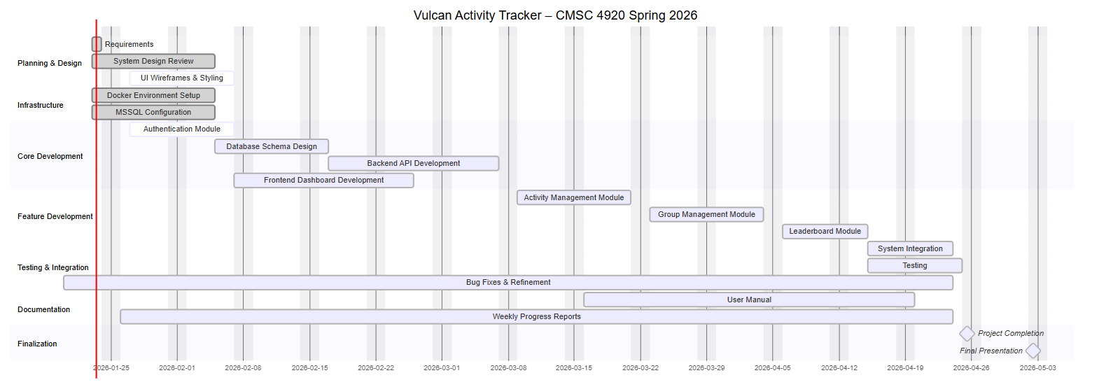
Gantt Chart

Slide 7
Business Model
Estimated Production for 100 users/month:
Microsoft Azure SQL Server | $7 – $15
Azure Database | $7 – $20
Render Hosting | $7 – $15
Domain: | ~$1
Monthly Maintenance: | $5 – $10
Total: | $27 – $61

Slide 8
Live Demonstration

Slide 9

Questions
Documentation: https://jjdeuce06.github.io/VulcanActivityTracker/
Live: https://vulcanactivitytracker.onrender.com

