Slide 1
LOFAR Self-Calibration
Using a Blackboard
Software Architecture
ADASS 2007
Marcel Loose
ASTRON, Dwingeloo

Slide 2
Overview
The Setting
Architectural Design
  Design Considerations
  Blackboard Pattern
System Overview
  Subsystems
  Strategies and Steps
Current Status and Future Work

Slide 3
The Setting
Raw UV-data must be calibrated iteratively to
  Correct for instrumental effects, like
    Band-pass
    Beam shape
  Correct for ionospheric effects
    Faraday and phase rotation
  Create a local sky model, containing
    Point sources
    Gaussian sources
    Extended sources

Slide 4
Architectural Design
Design Considerations
  Data Volume
  Distributed Processing
  Scalable Architecture
Blackboard Pattern

Slide 5
The Challenge
Data Volume of an average observation will be tens of terabytes.
  Size must be reduced, otherwise…
    Long-term archiving will be impossible
    Local (post-)processing will be impossible
Data Rate will be in the order of a gigabyte per second.
  Data must be distributed, because…
    A single hard-disk cannot write a GB/s
    A single computer system cannot handle a GB/s
Notes:
Ref. Ger van Diepen’s talk: data rate: 700 MB/s; data size: 12 TB
Data must be calibrated within a few days, due to limited intermediate storage capacity (a few hundred terabytes).

Slide 6
Divide and Conquer
Data should be distributed such that, for all processing:
  It does not have to be reordered
  Large chunks can be processed locally
  Only little data have to be exchanged

Slide 7
Divide and Conquer
Data could be distributed along a few axes
  Time is a bad choice
    The data size of a single time-slot is too large to be sent to a single machine
  Baseline is a better choice
    However, it will lead to imaging problems
  Frequency is the best choice
    Images are usually made per channel, so imaging could be done locally

Slide 8
Scalable Architecture
Heterogeneous cluster
Decouple the computing nodes
  Process locally. Bring the process to the data
  Communicate through a global shared memory
Several architectural patterns describe this approach
Notes:
A heterogeneous cluster will be a fact of life. Hardware will be bought in stages and will be replaced in stages.

Slide 9
Blackboard Pattern
Ideal for solving problems for which no predetermined algorithm is known. But…
“Best” Self-Calibration algorithm can be chosen from a relatively short list of strategies in advance
The Shared Repository pattern is probably a better match
Notes:
The Blackboard architecture is ideal for solving problems for which no predetermined algorithm or solve strategy is known. However, for the design of the BBS system, we’ve come to the conclusion that the operational system will benefit in terms of performance when using a predefined solving strategy. The ”best” algorithm to perform a self-calibration run can be chosen from a relatively short list of calibration strategies in advance (based, e.g., on heuristics, or suggested by research done with the MeqTree system).
The Shared Repository pattern, which can be seen as a generalization of the Blackboard pattern, is probably a better match for the BBS system. It realizes indirect communication using a repository as shared memory. Components put their output into memory that is accessible by other components and retrieve their input from this shared memory (also called a repository).

Slide 10
Shared Repository Pattern†
Specialization hierarchy of patterns based on the Shared Repository pattern
Controller
pattern
Blackboard-based Control pattern
Shared Repository pattern
Blackboard pattern
Hierarchical Blackboard
pattern
Repository Manager pattern
† Philipe Lalanda, in Proceedings of PLoP’98
Notes:
Controller pattern
Introduces a control component in the system that rules the system and schedules activation of other components
Can be applied to deterministic problems where sequences of components activation can be determined off-line and coded in the controller
Repository Manager pattern
Is applicable in a distributed environment
Introduces a repository manager that sends notification of data creation or modification to the software components
Blackboard pattern
Refines the Controller pattern to deal with non-deterministic problems

Slide 11
Shared Repository Pattern
Controller pattern
  Introduces a control component in the system that rules the system and schedules activation of other components
  Can be applied to deterministic problems where sequences of components activation can be determined off-line and coded in the controller
Repository Manager pattern
  Is applicable in a distributed environment
  Introduces a repository manager that sends notification of data creation or modification to the software components
Blackboard pattern
  Refines the Controller pattern to deal with non-deterministic problems

Slide 12
Separation of Concerns
Maximize scalability by complete separation of global and local controller
  Global controller issues sequences of commands
  Local controllers control the so-called
  “kernels” that execute the commands
  A database system acts as a shared memory for storing commands and results

Slide 13
Blackboard Self-Cal System
Subsystem overview
  BBS Control
    Takes care of the distributed processing by means of the Blackboard pattern
  BBS Kernel
    Does the actual processing; it executes a series of steps, where each step consists of an operation like SOLVE or CORRECT
  BBS Database
    Consists of two databases — Command Queue and Parameter Database — that together form the blackboard

Slide 14
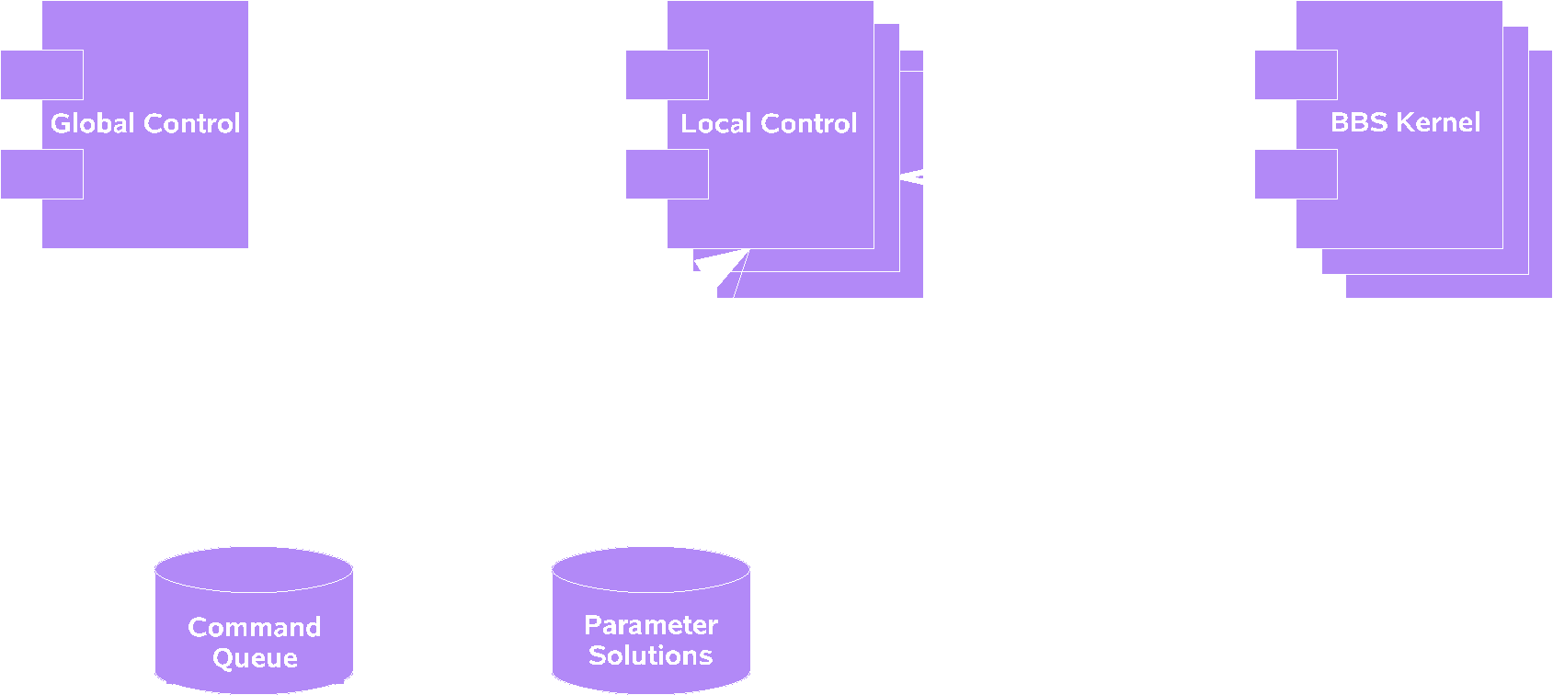
BBS Control subsystem
Global design of the BBS Control system
Notes:
Global Control posts commands to the Command Queue.
Commands are asynchronously fetched by Local Control and forwarded to BBS Kernel.
After execution of the command, the BBS Kernel returns the result to Local Control, which posts it to the Parameter Database.
Global Control checks quality of these solutions and takes appropriate action.

Slide 15
BBS Control subsystem
Global Control
  Acts as the main process
  Posts one or more commands (steps) to the Command Queue
Local Control
  Controls a BBS Kernel subsystem
  Fetches the next command from the Command Queue and forwards it to the BBS Kernel subsystem
Command Queue
  Stores the commands to be executed by the BBS Kernel and the status results returned by each kernel
Parameter Solutions
  Stores (intermediate) solutions of the model parameters calculated by the BBS Kernel.
Notes:
In principle, commands are executed in the order they were posted to the Command Queue by Global Control. However, it is possible to send a high priority out-of-band command.
Access to the Parameter Solutions database is minimized in order to avoid performance penalties. If partial solutions can be kept in memory of a local (kernel) node, they will not be written to the database, unless requested explicitly.

Slide 16
BBS Kernel subsystem
Implements the Measurement Equation
Consists of two components:
  The Kernel implements operations like PREDICT, SUBTRACT, and CORRECT
  The Solver calculates estimates for the model parameters by minimizing the difference between model and observation
Notes:
The Measurement Equation, or ME, models the response of an interferometer given a description of the sky (Sky Model), the environment (e.g. Ionospheric Model), and the interferometer (Instrument Model).

Slide 17
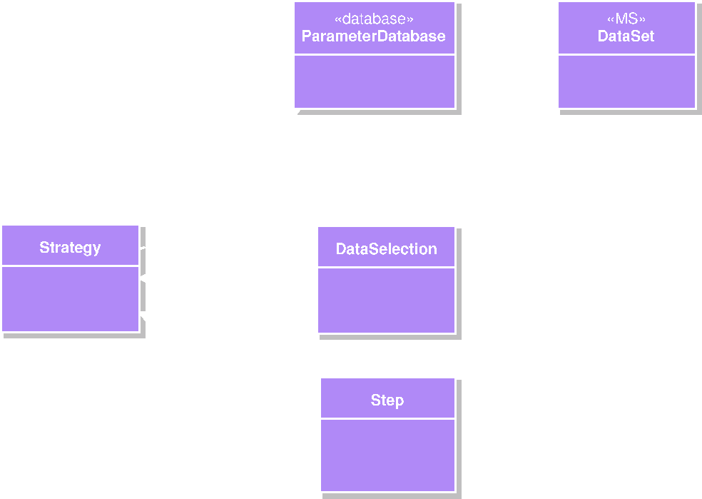
Strategies and Steps
Strategy
  One iteration in the so-called Major Cycle †
  Defines a relationship between the observed data and the model parameters.
  Defines the size of a work domain
  Consists of a number of steps
† J.E. Noordam, LOFAR Calibration Framework, ASTRON
Notes:
The observed data is currently stored in a Measurement Set
The Parameter Database contains (intermediate) values of the model parameters that are estimated as part of the self-calibration process.
At least two models are used in the current self-calibration setup: the Local Sky Model (LSM) and the Instrument Model.

Slide 18
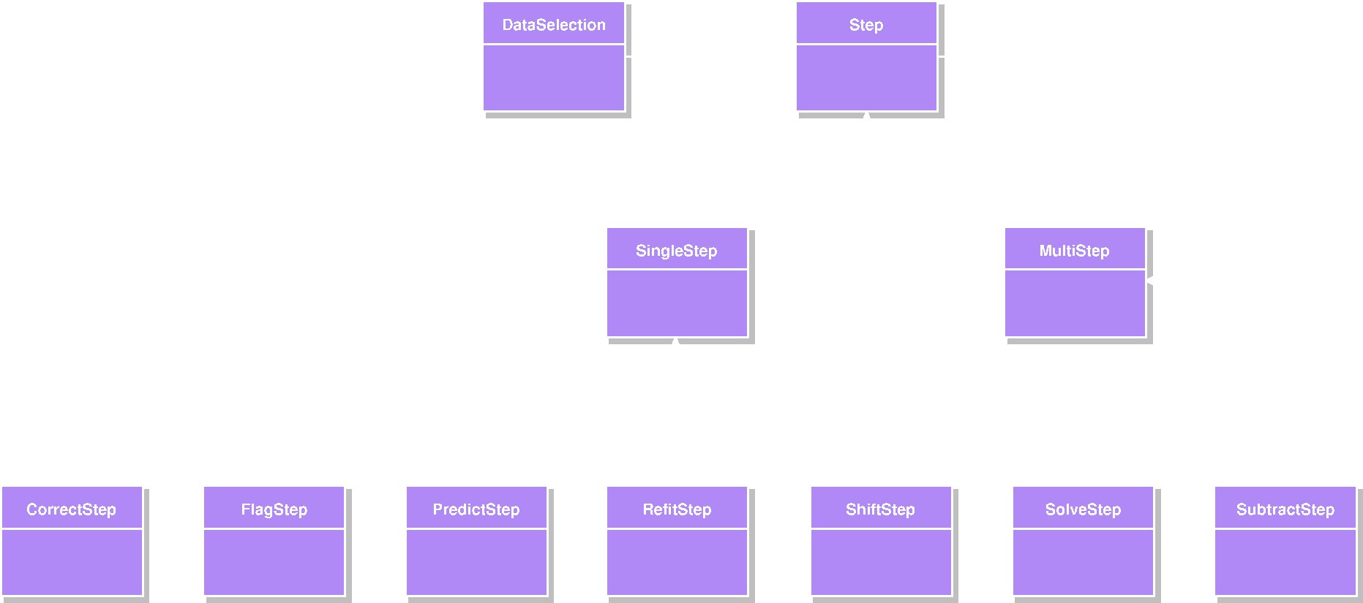
Strategies and Steps
BBS Step
  Is designed as a Composite pattern; each step can be made up of one or more (sub)steps
  Leaf classes define a single piece of work that can be handed over to the BBS Kernel subsystem

Slide 19
Strategies and Steps
Work domain
  A subset of the data that fits in RAM memory
  As many commands as possible are executed on these data before the next data chunk is accessed.
  A strategy defines the size of the work domain (in time and frequency)

Slide 20
Current Status
Control framework has been deployed on a 12 node cluster
PostgreSQL database is used as shared repository
First successful calibration runs on gigabyte-sized datasets

Slide 21
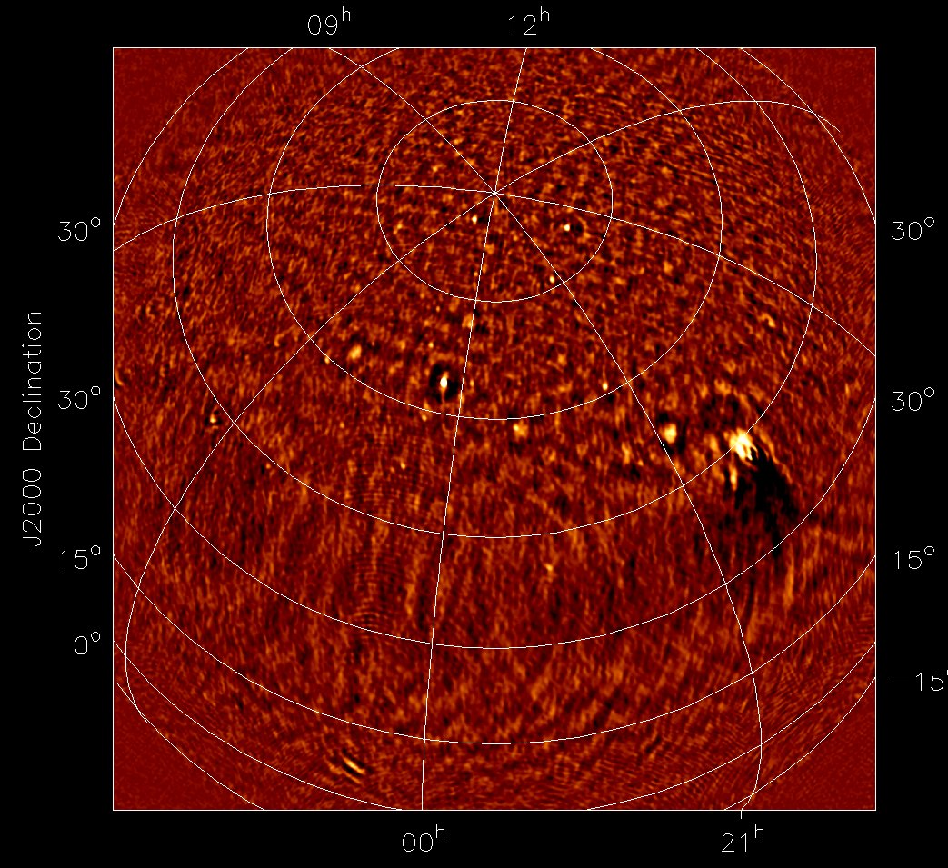
BBS Image
3CR184.1
3CR61.1
3CR390.3
3CR58
3CR427.1
Tycho
CasA (remnt)
CygA (remnt)
3CR410.1
3CR84
3CR452
SUN
Notes:
March 30, 07
MS1810
16 hours
6 Subbands
(BW~840 Khz)
Freq range 47.5-65MHZ
Freq averaging (smearing) in each SB
No MMSE
No post calib Flagging

Slide 22
Future Work
Test actual scalability of the control framework
Add support to kernel for calibration of
  Beam-shape
  Ionospheric effects
  Etc.

Slide 23
See Also
ADASS Presentations
  O4b.3: Distributed Processing of Future Radio Astronomical Observations
  P9.9: LOFAR Core Station 1 post-processing and inspection tools
  P9.15: Early LOFAR images with third generation calibration
Thank you for your attention!

