Slide 1
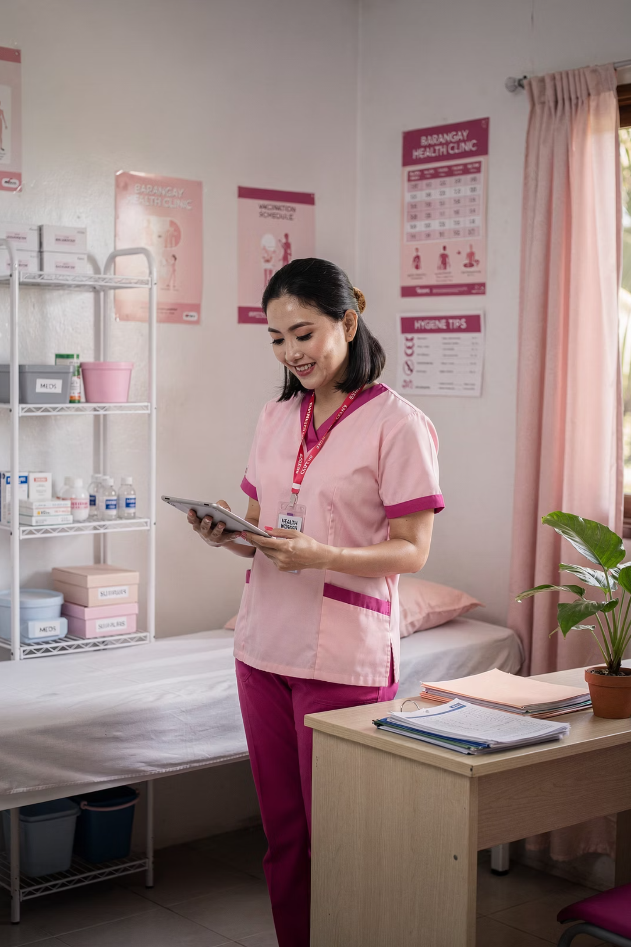
PCOS Screening Solution
AI-Powered Early Detection for Underserved Communities
Bridging healthcare access in the Philippines — from barangay to diagnosis in under 5 minutes.
Prepared for: Department of Health, LGUs, Healthcare Foundations
Presenter: Jumeil John D. Navares
Date: March 2026

Slide 2
The Problem
1 in 10 Filipino Women Has PCOS — Most Don't Know It
1.2M
80%
Women Affected
Undiagnosed
Of reproductive age in the Philippines
Due to specialist scarcity in rural areas
18mo
P456B
Avg. Time to Diagnosis
Annual National Burden
In rural and remote communities
From preventable complications
Type 2 Diabetes
Infertility
Cardiovascular Disease
50–70% of PCOS patients develop it
Leading cause in Philippine fertility clinics
4× higher risk for undiagnosed women

Slide 3

The Healthcare Access Crisis
The Scale
The Access Gap
PCOS affects 1 in 10 Filipino women of reproductive age (~1.2M women)
80% are undiagnosed or diagnosed late due to specialist scarcity in rural areas
Delayed diagnosis leads to Type 2 Diabetes (50–70%), infertility, and cardiovascular disease (4x higher risk)
Resource
Urban
Rural/Remote
OB-GYN within 1 hour
85%
18%
Ultrasound facility
78%
12%
Wait for specialist
2 weeks
6+ months
Annual national burden from complications: ~P456 Billion. Up to 80% preventable with early intervention.

Slide 4

How It Works
A trained ML model analyzes basic clinical data — vitals, symptoms, lab results — and delivers a risk assessment in seconds. No specialist or expensive equipment required for the initial screen.
CHW Data Collection
ML Risk Analysis
Stratified Recommendation
Specialist Confirmation
No Specialist Required
Under 5 Minutes
Community health workers operate it independently
vs. months-long diagnostic journey in rural areas
Works Offline
Transparent AI
Suitable for areas with limited connectivity
Every recommendation includes an explanation of why

Slide 5

Model Performance
Trained on 541 real patient records, validated on a held-out test set of 109 patients.
88.9%
93.0%
81.7%
Recall (Sensitivity)
AUC-ROC
Accuracy
Catches 9 out of 10 PCOS cases
Excellent at distinguishing PCOS from non-PCOS
Correct in 8 out of 10 screenings overall
Top Predictive Factors
1
Follicle counts
2
Symptom patterns
3
Cycle regularity & AMH levels
Ovarian morphology — strongest predictor
Skin darkening, hair growth, weight gain
Hormonal markers for ovarian dysfunction
Tested across age groups and BMI categories — no significant bias detected in primary brackets.

Slide 6
Results Translated to Business Value
Pilot Projection: 100 Barangays, Year 1
Screening Economics
Outcome
Projection
Cost to screen 18,000 women
Women screened
18,000
P2.7M (18,000 × P150/screening)
True PCOS cases caught early
~1,600
Cases previously missed
~1,280
Savings from early detections
~P192M (1,280 × P150K avoided complications)
Potential healthcare savings
~P192M
Return per peso invested
~P71 in avoided complications

Slide 7

Recommendations
Months 1–3: Validate
1
Collect 200–500 Filipino patient samples. Partner with 3–5 barangay health centers.
2
Months 4–6: Pilot
Deploy in 5–10 barangays. Train 30 CHWs (8-hour program). Monitor volume and accuracy.
Months 7–18: Scale
3
Expand to 100 barangays. Add multi-language support. Pursue PhilHealth reimbursement.
Clinical integration includes establishing OB-GYN referral pathways, a specialist feedback loop, and integration with existing NCD screening programs.

Slide 8

Risks & Considerations
Key Risks & Mitigations
Ethical Commitments
Risk
Likelihood
Impact
Mitigation
Screening, Not Diagnosis
Final clinical decisions rest with specialists
Model underperforms on Filipino population
Medium
High
Local validation before scale-up
CHW adoption resistance
Medium
Medium
Co-design training + P20/screening incentive
Transparent AI
Every prediction includes contributing factor explanations
False negatives cause missed diagnoses
Medium
High
Position as screening, not diagnostic; specialist SOP
Bias Monitoring
Ongoing fairness audits across demographic groups
Data privacy concerns
Low
High
Encryption, DPA 2012 compliance, patient consent
Known limitation: Training data from India — local validation is essential before deployment.
Regulatory delays (FDA SaMD)
Medium
Medium
Pre-submission consultation, Class A pathway

Slide 9
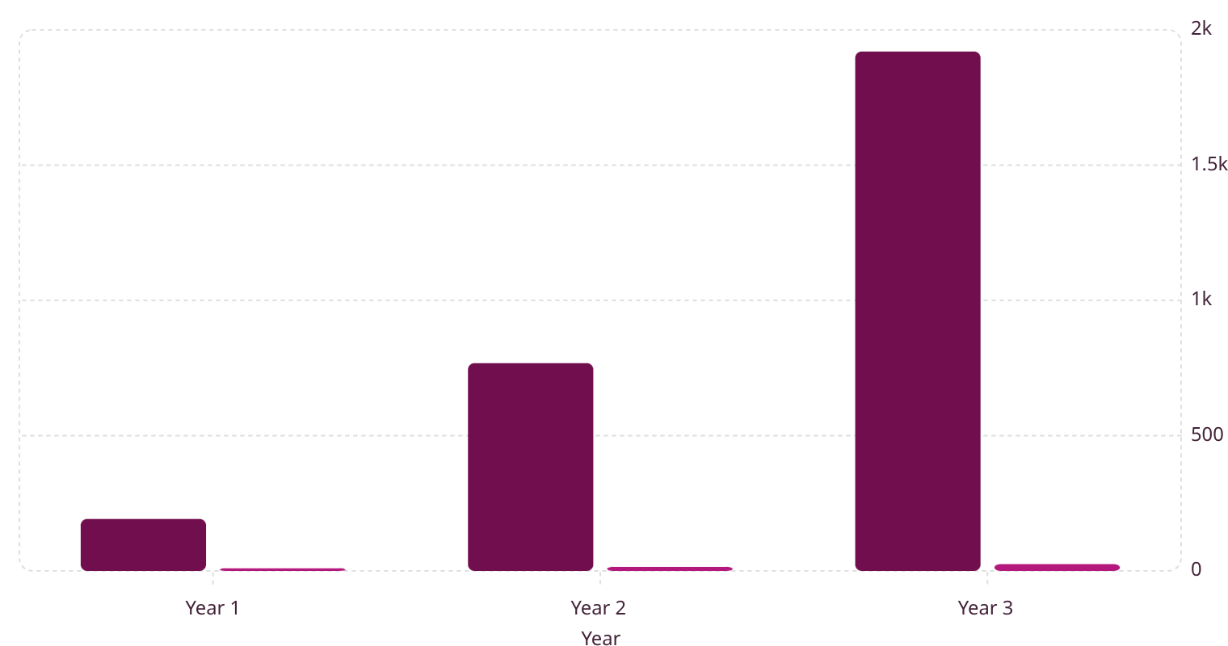
Investment & 3-Year ROI Projection
Investment Required
Healthcare Savings (P M)
Program Cost (P M)
Phase
Timeline
Investment
Deliverable
1.92k
Validation
Months 1–3
P1.5M
Clinical validation on Filipino data
Pilot
Months 4–6
P2.5M
10 barangays live, 1,800 screenings
768
Scale-up
Months 7–18
P5.5M
100 barangays, 18,000 screenings
192
9.5
15
25
Total
18 months
P9.5M
Operational program
180K
16K
Women Screened
Early Detections
By Year 3
By Year 3
P1.9B
P71
Healthcare Savings
Return Per Peso
Projected Year 3
In avoided complications

Slide 10

Call to Action
What We Need
Next 30 Days
01
Schedule validation study protocol review
P9.5M Funding
18-month pilot and scale-up program
02
Confirm 5 pilot barangay partnerships
03
Partnerships
Initiate FDA SaMD pre-submission consultation
DOH, LGUs, PhilHealth, healthcare foundations
04
Begin CHW training program design
Clinical Partners
OB-GYN referral networks in pilot regions

Slide 11

Every Filipino Woman Deserves Early Detection
Regardless of geography or income — access to PCOS screening through her local barangay health center.

Slide 12

References & Methodology
Financial projections are estimates for illustrative purposes. Figures marked "estimated" or "projected" are derived from the sources below and should be validated with local data before investment decisions.
Key Sources
Projection Methodology
[1–3] Prevalence & Diagnosis Rate
[4–5] Access Gap Data
1
2
DOH National Health Facility Registry & PhilHealth Annual Report (2023). Access figures are modeled estimates.
Lizneva et al. (2016); PSA 2020 Census; March et al. (2010). 10% prevalence, 80% undiagnosed used as conservative estimates.
Prevalence Model
Detection Model
10% PCOS prevalence × target screening population = expected positives
Expected positives × model recall (88.9%) = true positives caught
[6–7] Complication Costs
[8–11] Intervention & Operations
Lim et al. (2022) for diabetes (P80K–P120K/yr); Tumanan-Mendoza et al. (2017) for CVD (P200K–P500K/event). P380K lifetime cost is a composite estimate.
3
Teede et al. (2018): lifestyle interventions reduce complications 40–80%. P150/screening = projected operational cost. CHW incentive benchmarked against DOH BHW allowance structures.
Savings Model
True positives × 80% previously undiagnosed × P150K avoided cost = healthcare savings
All financial projections are pre-validation estimates and will be refined after the local validation study (Phase 1).

