Slide 1

PCOS Prediction Model
Machine Learning for Early Detection in Community Healthcare Settings
Presenter: Jumeil John D. Navares
Program: Post Graduate Diploma in AI & Machine Learning
Date: March 2026

Slide 2

Presentation Overview
01
02
03
Problem & Data
EDA & Features
Modeling
PCOS burden, dataset overview, class distribution
Key findings, PCA, engineered features, selection
Pipeline architecture, 7 algorithms, results
04
05
Explainability & Ethics
Deployment & Next Steps
SHAP, LIME, bias audit, fairness metrics
Tech stack, API, limitations, future work
Objective: Build an interpretable ML model for preliminary PCOS screening — prioritizing recall, transparency, and clinical trust.
541
7
88.9%
Patients
Models
Recall
Dataset Size
Compared & Tuned
Target Recall

Slide 3

The Problem We're Solving
6–20%
Urban Gap
of women of reproductive age affected by PCOS globally
Specialist access in the Philippines is concentrated in major cities, leaving rural communities underserved
Cascade Risk
Delayed diagnosis leads to diabetes, infertility, and cardiovascular disease
ML Task: Binary classification (PCOS vs. Non-PCOS)
Primary Metric: Recall — minimizing missed cases is paramount in a screening context.

Slide 4

Dataset at a Glance
Source
Size
Kaggle PCOS dataset, 10 hospitals, Kerala, India
541 patients · 41 clinical features across 5 domains
Non-PCOS·67.28%
·67.28%
·
PCOS·32.72%
·32.72%
·
Quality
<5% missing values; Excel formula errors in 2 columns; 1 phantom column removed
Class distribution: 32.7% PCOS vs. 67.3% Non-PCOS — a 1:2 imbalance addressed with SMOTE.
📄 Refer to: https://github.com/jjdnavares/pcos-prediction-ml/docs/DATA_DICTIONARY.md for complete variable definitions

Slide 5
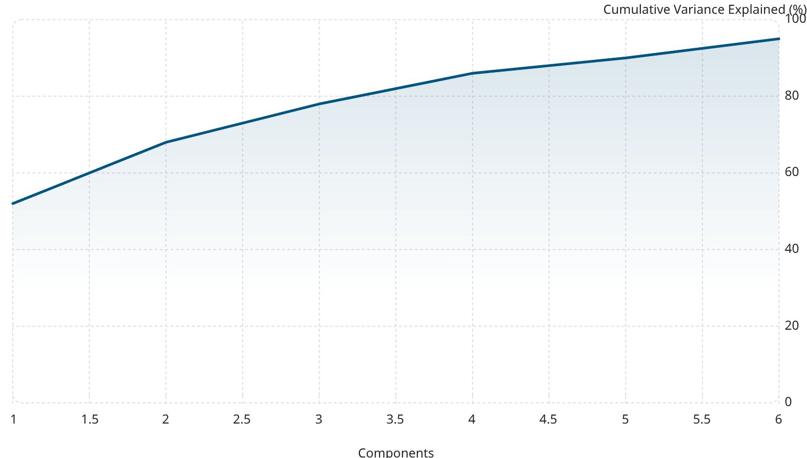
EDA Key Findings
Top Discriminating Features
Dimensionality Reduction (PCA)
Follicle counts (L & R) — strongest correlation with PCOS label
Cycle regularity — highly predictive of PCOS status
Skin darkening, hirsutism, weight gain — 2–3× higher prevalence in PCOS group
LH/FSH ratio & AMH — elevated in PCOS patients, consistent with clinical literature
90% of variance captured in just 5 components; t-SNE confirms partial class separability in 2D space.

Slide 6
Feature Engineering & Selection
6 Domain-Driven Engineered Features
3-Method Consensus Feature Selection
Feature
Clinical Rationale
RFE
MI
LH/FSH Ratio
Ratio >2 indicates hormonal imbalance
Recursive Feature Elimination
Mutual Information scoring
Total Follicle Count
Rotterdam criterion (≥12 diagnostic)
WHR Recalculated
Central obesity indicator
Corr
Symptom Burden
Composite severity score (5 binary symptoms)
Correlation with target
Features passing ≥2/3 votes retained → 16 final features
Age Group
Age-stratified risk (18–25, 26–35, 36+)
Data integrity: Stratified 80/20 split · SMOTE applied after split (no leakage) · StandardScaler fitted on training data only
BMI Category
WHO standard weight classification

Slide 7
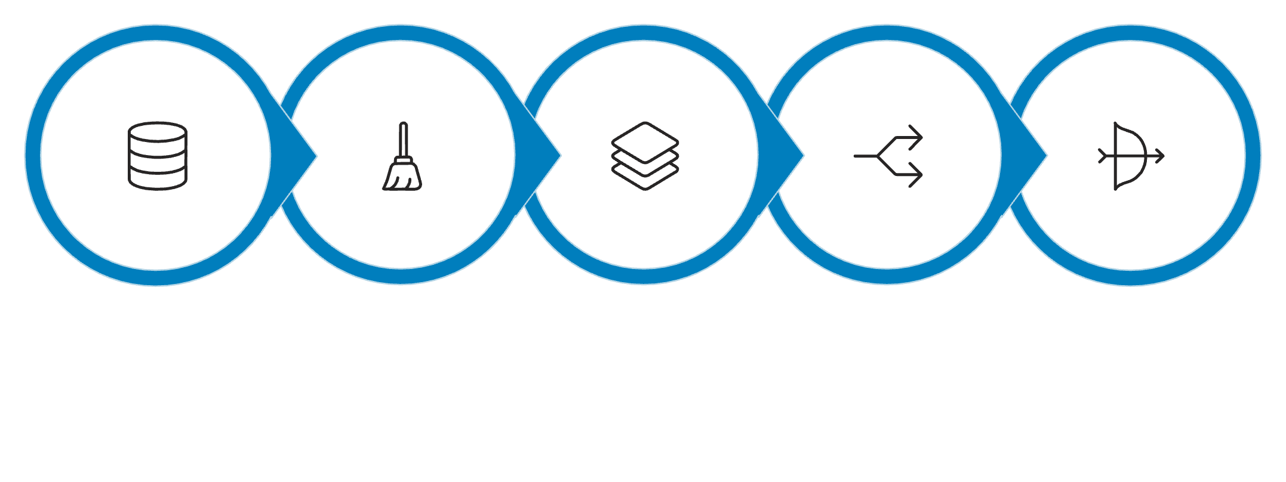
Model Selection & Methodology
Pipeline Architecture
Data Load
Clean
Features
Stratified Split
Scale
Our robust ML pipeline ensures data integrity and prevents leakage, moving from raw data to final model evaluation.
Training Protocol
Models Evaluated
7 algorithms evaluated with GridSearchCV (5-fold stratified CV)
Optimization target: Recall (minimize false negatives)
Hyperparameter tuning: Exhaustive grid search per model
Logistic Regression (L1, C=0.01)
Decision Tree
Random Forest
Gradient Boosting
XGBoost
LightGBM
SVM (RBF & Linear kernels)

Slide 8

Model Comparison Results
Test set performance on 109 held-out patients. Logistic Regression selected as the deployment model.
Model
Accuracy
Precision
Recall
F1
AUC-ROC
★ Logistic Regression
81.7%
66.7%
88.9%
76.2%
93.0%
Gradient Boosting
93.6%
93.9%
86.1%
89.9%
95.1%
Random Forest
92.7%
91.2%
86.1%
88.6%
94.3%
LightGBM
92.7%
91.2%
86.1%
88.6%
94.5%
XGBoost
91.7%
88.6%
86.1%
87.3%
94.2%
Decision Tree
90.8%
86.1%
86.1%
86.1%
93.9%
88.9%
93.0%
66.7%
Recall
AUC-ROC
Precision
★ Logistic Regression chosen for highest recall & full interpretability.
False positives → specialist referral; false negatives → missed entirely.

Slide 9
Feature Importance & Explainability
Model Coefficients
Feature direction & magnitude — bar chart of scaled coefficients
SHAP Global
Feature importance ranking — bee swarm & bar plots
SHAP Local
Individual prediction breakdown — waterfall plots per patient
LIME
Instance-level explanations — per-patient feature contributions
PDP / ICE
Marginal effect curves for top 6 features
Follicle Counts · Top SHAP feature
Skin Darkening · Strong signal
Symptom Burden · Engineered feature ranks highly
SHAP ≈ Rotterdam · Builds clinical trust

Slide 10
Bias Auditing & Ethical AI
0.70
Mitigation Proposals
1
Threshold Calibration
DI
Age-group-specific decision thresholds
36+ Age Group ⚠️ Below 0.80 threshold
2
Sample Reweighting
100%
Upweight underrepresented demographic groups
3
Post-Deployment Monitoring
TPR
Track fairness metrics across demographic strata continuously
Despite lower predicted positive rate
Fairness Analysis by Age Group
4
Human-in-the-Loop
Age Group
N
Recall
Accuracy
Pred. Positive Rate
DI
Model outputs are recommendations — not clinical diagnoses
18–25
9
80.0%
88.9%
44.4%
1.01 ✅
26–35
74
88.5%
78.4%
48.6%
1.11 ✅
36+
26
100.0%
88.5%
30.8%
0.70 ⚠️
The 36+ group fails the 4/5ths disparate impact rule (0.70 < 0.80 threshold), with a lower predicted positive rate despite 100% TPR.

Slide 11
Limitations & Future Work
Known Limitations
Recommended Next Steps
Limitation
Mitigation
Local Validation
Small sample (541 patients)
Bootstrap CIs, conservative thresholds
Collect 200–500 Filipino patient samples for retraining
India data → Philippine deployment
Local validation study required
Ensemble Exploration
Test stacking: Logistic Regression + Gradient Boosting
Cross-sectional only
Position as screening, not monitoring
No ethnicity/SES variables
Expand demographic data collection
Threshold Optimization
Calibrate per-age-group decision thresholds
Linear model (LR)
Acceptable trade-off for interpretability
Prospective Study
Lower precision (66.7%)
Screening context — refer to specialist
Validate temporal stability over 12 months

Slide 12
Technical Stack & Reproducibility
Technology Stack
Reproducibility Safeguards
Layer
Tools
/predict
/batch
ML
scikit-learn 1.5.2, XGBoost 2.1.3, LightGBM 4.5.0, imbalanced-learn 0.12.4
Single patient inference
Bulk patient scoring
Explainability
SHAP 0.51.0, LIME 0.2.0.1
/health
API
FastAPI 0.115.5, Uvicorn 0.34.0, Pydantic 2.10.3
Uptime & readiness check
Data
pandas 2.2.3, numpy 2.1.3
Deployment
Docker, docker-compose
Testing
pytest 8.3.4, httpx 0.28.1
Seed 42
Modular Pipeline
Pinned Deps
Docker
Fixed random seed across all operations
7 src/ modules with centralized config.py
requirements.txt locks all library versions
Containerized environment for full parity

Slide 13

Conclusion & Key Takeaways
88.9%
Recall
Fewest missed PCOS cases on held-out test set
93.0%
AUC-ROC
Strong discrimination between PCOS and non-PCOS
7
Models
Trained & compared with rigorous cross-validation
5
XAI Methods
SHAP, LIME, PDP/ICE, coefficients, RFE
Ovarian morphology is paramount
Simpler models win for clinical deployment
Follicle counts are the strongest predictors — fully consistent with Rotterdam diagnostic criteria.
Logistic Regression offers the best balance of recall and interpretability — no black-box trade-off.
Ethics must be proactive
Bias auditing revealed age-group disparities that require threshold calibration before deployment.

Slide 14
Q&A
Why not deep learning?
Why prioritize recall over accuracy?
541 samples is insufficient for deep neural networks. Logistic Regression achieves 88.9% recall with full interpretability — no black-box trade-off needed or justified.
In screening, a false negative (missed PCOS case) carries far greater clinical consequence than a false positive, which simply triggers a specialist referral.
How would this generalize to Filipino patients?
Can this replace specialist diagnosis?
No. This is a screening tool to help community health workers prioritize referrals. Final diagnosis always requires specialist clinical evaluation.
A local validation study is the critical next step. The pipeline is ready — only retraining on 200–500 local samples is required.

Slide 15

Thank You
Questions, collaboration, or feedback are welcome.
Project Repo
https://github.com/jjdnavares/pcos-prediction-ml/blob/main/README.md
LinkedIn
linkedin.com/in/jjdnavares
Email
jumeil.navares@gmail.com

