Slide 1

P-247 GROUP-6 Presenting
Resume Classification
Project Mentor
Mr Madishetti Rajashekar
Presented By
Ms. Sonal Chandrakant Sonawane
Ms. Sowmya Dontha
Mr. jiban jyoti dwibedi
Mr. Anmol Dewangan
Mr. Prathamesh Sandip Jadhav
Ms. Deshmukh Roshni Rajaram

Slide 2

Business Problem:
Objective:
The document classification solution should significantly reduce the manual human effort in the HRM. It should achieve a higher level of accuracy and automation with minimal human intervention

Slide 3


Data Preprocessing
Exploratory data analysis (EDA)
Converting to CSV
Project Architecture / Project Flow
Model Deployment
Model Building/ Evaluation
Data Scrapping
Understanding Data

Slide 4








Tools Used In Our Project

Slide 5
Exploratory Data Analysis (EDA) & Feature Engineering

Slide 6
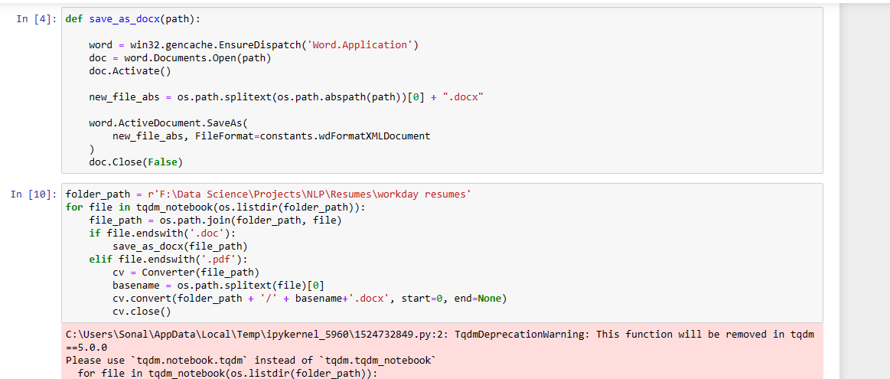
Conversion PDF/Doc File Into Docx File
We Have Resume Which Are In Different Formats. At First We Have Converted Them All Into Docx File By The Help Of Below Code

Slide 7
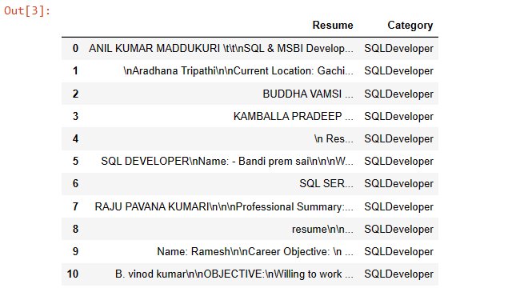
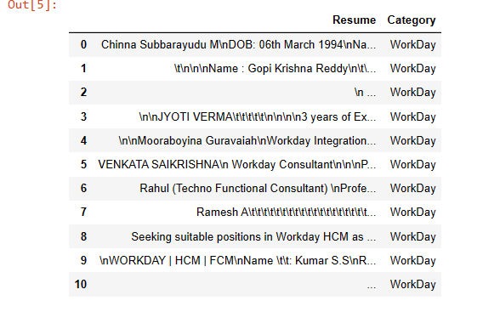
Data Set Details
We Have Given 1 Folder And Inside That Folder We Have 3 Sub Folders From That We Have Scrapped The Data, So We Have Separately Scrapped Every Data From The Folders
Preview of scrapped data from different folders which are peoplesoft resumes, SQL developer lightning insight, workday resumes, resumes.

Slide 8
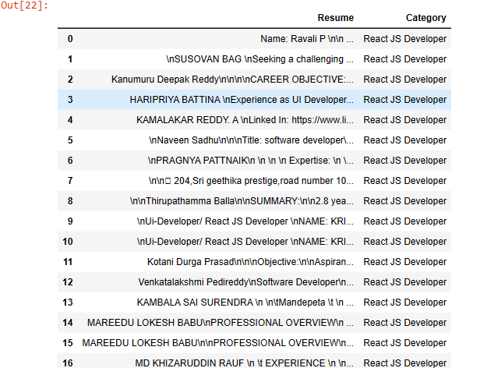
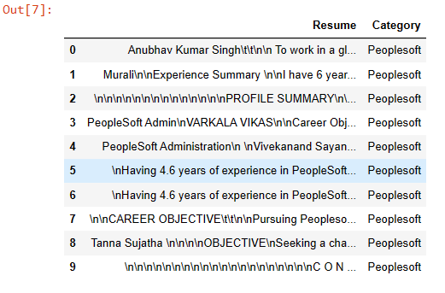
Data Set Details

Slide 9
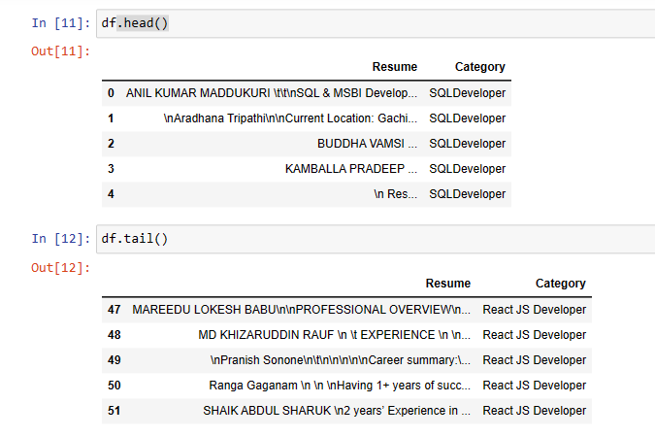
Concatenating All DataFrame Into One DataFrame
We Have Concatenated All The Data Frame To Make Our Final DataFrame

Slide 10
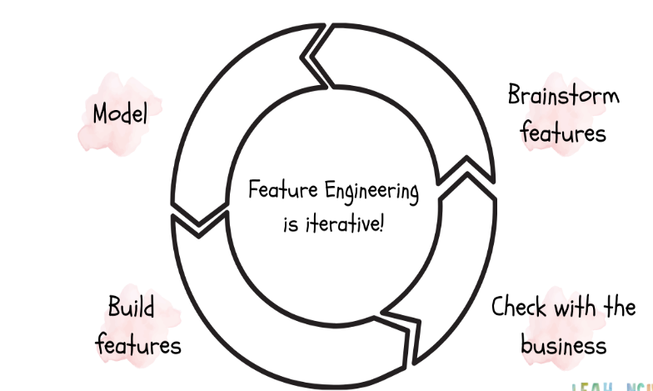

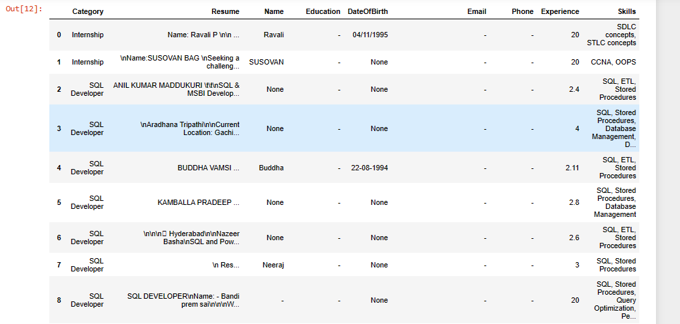
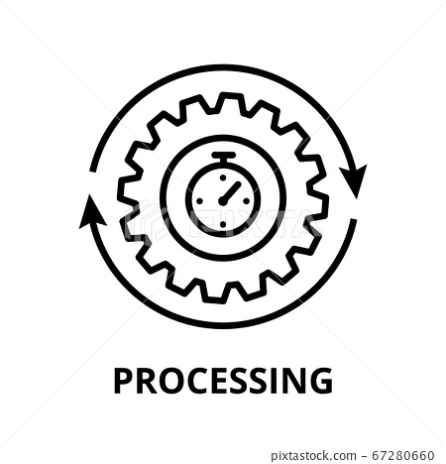
Feature Engineering
We Have Extracted Data And Created A New DataFrame With Multiple Features As Shown Below

Slide 11
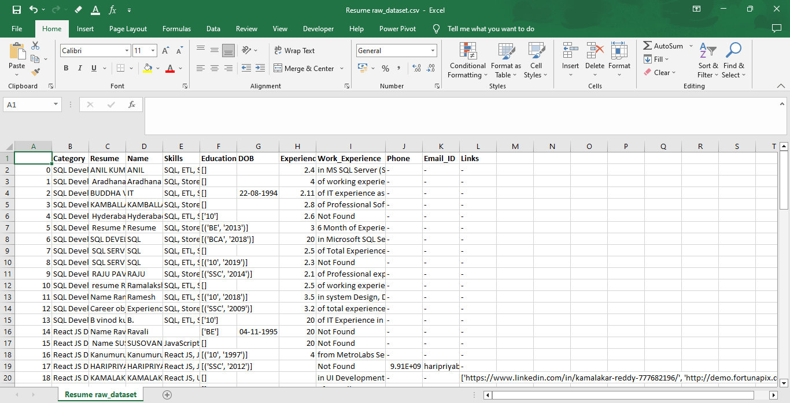
Conversion Of DataFrame Into CSV File
We Have Converted Our DataFrame Into CSV File Which Is “Resume raw_dataset.csv”

Slide 12



Exploratory Data Analysis (EDA)

Slide 13
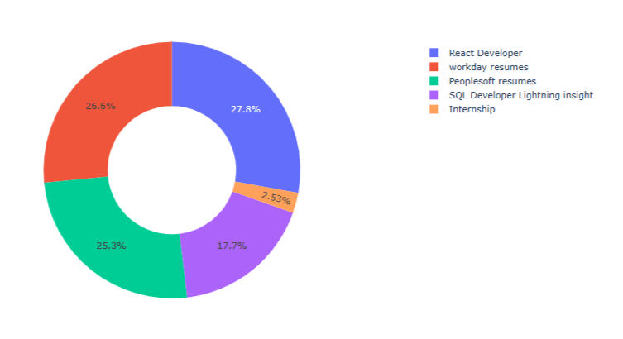
EDA
Analysing Category Column (Category Distribution)

Slide 14
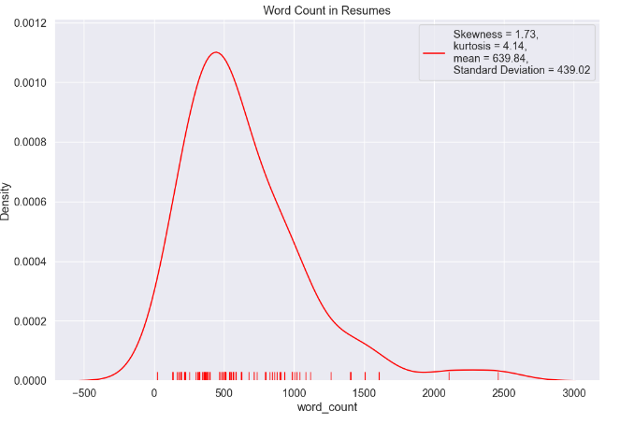
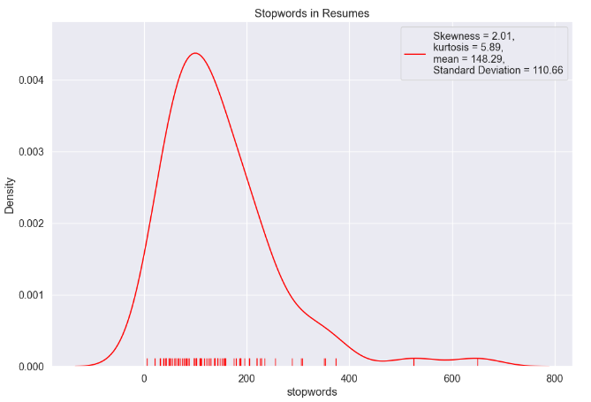
EDA
Analysing Resume Column

Slide 15
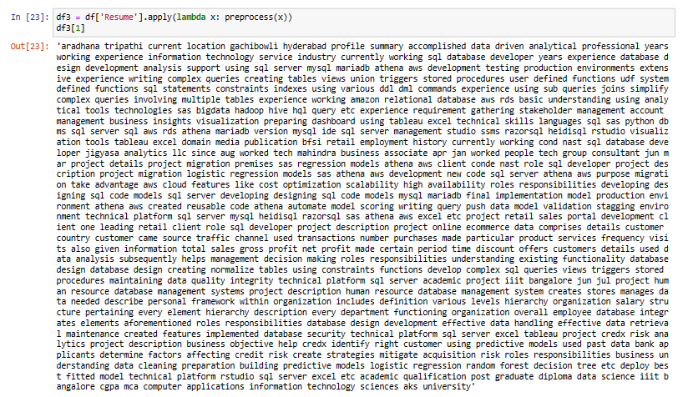
EDA
Lemmatization & Stemming
Here we have removed stop words and punctuations. After that we convert all letters into small case and tokenized with regular expressions in resume column.

Slide 16
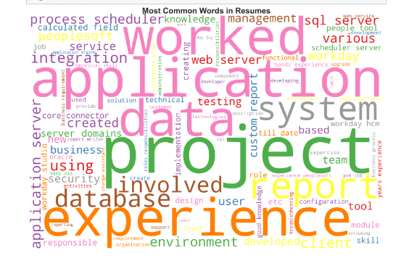
EDA
Word Cloud (Most Used Words)

Slide 17
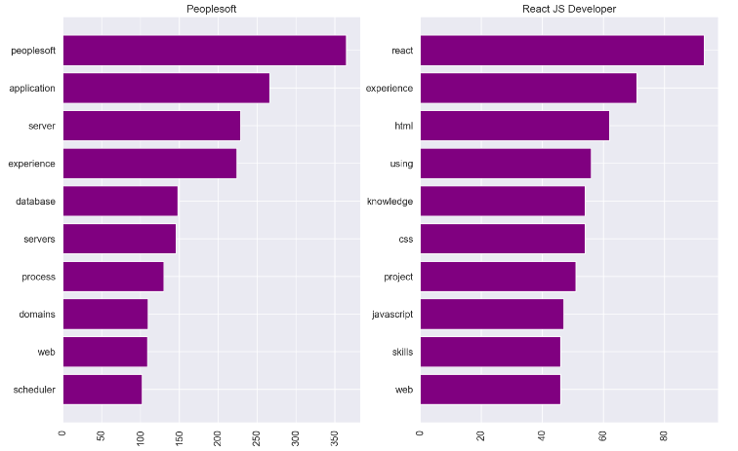
EDA
Most Frequent Words For Each Job Category

Slide 18
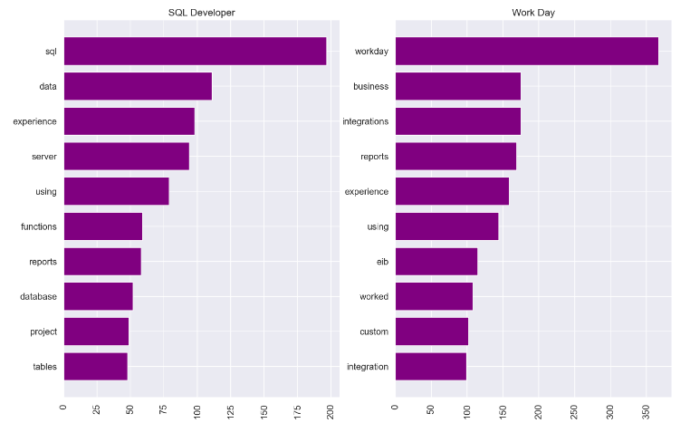
EDA
Most Frequent Words For Each Job Category

Slide 19
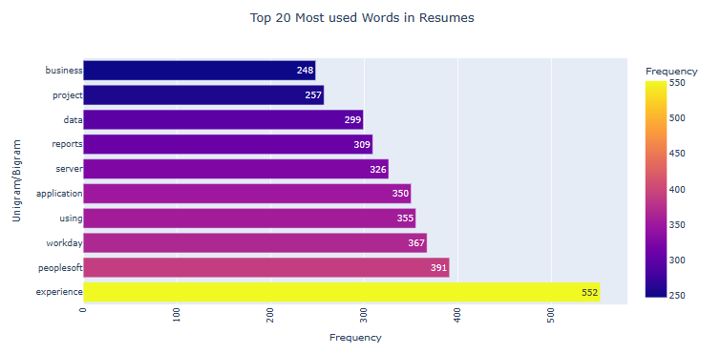
EDA
Count Vectorizer On N-Grams

Slide 20
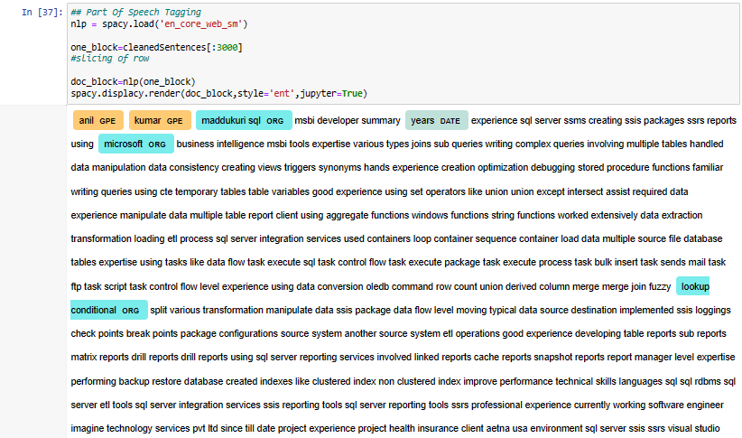
EDA
Named Entity Recognition

Slide 21
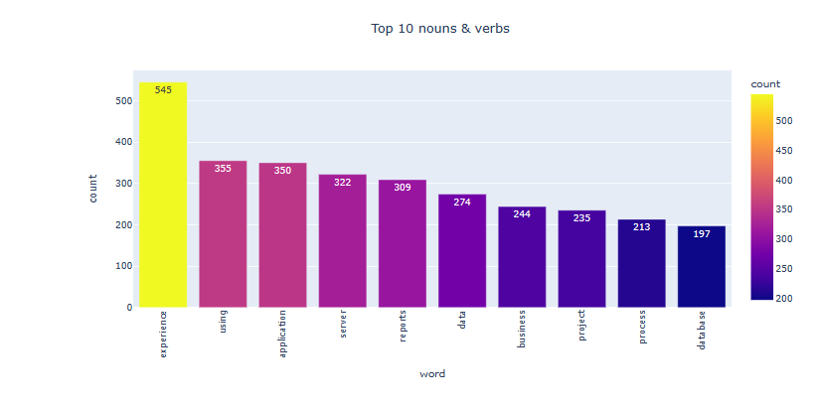
EDA
Visualizing The Result Of Top 10 Nouns And Verbs Most Frequently Present In The Resumes

Slide 22
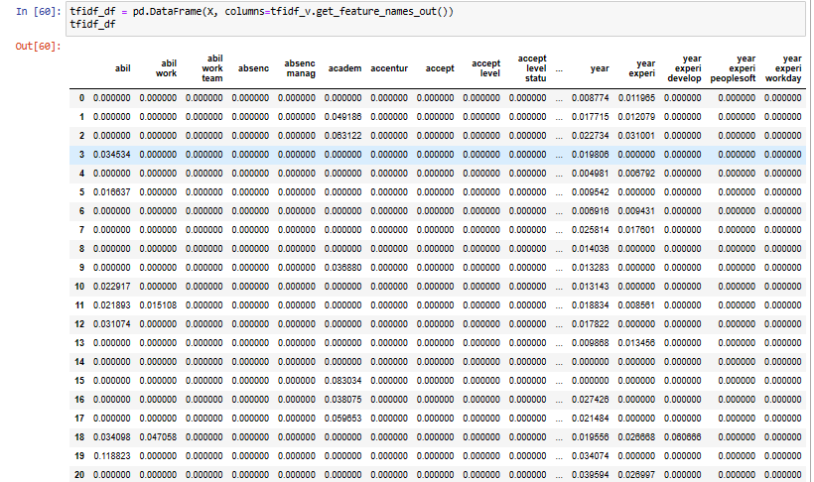
EDA
TF-IDF Vectorizer

Slide 23
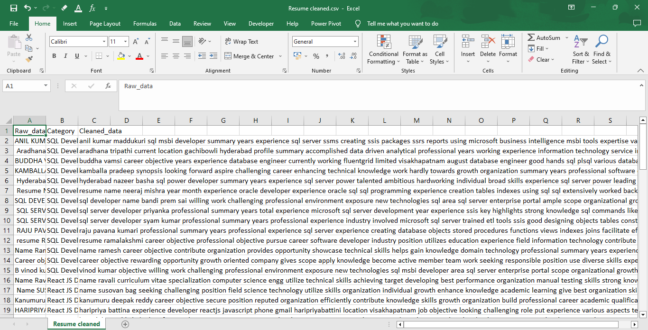
Cleaned Resume CSV File
We Have Obtain New CSV File Which Is “Resume cleaned.csv” After Cleaning Raw File

Slide 24
Model Building

Slide 25
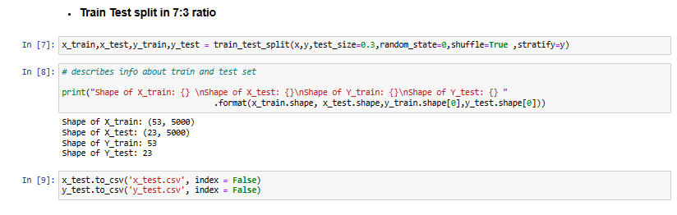
Train Test Split Ratio
We Are Splitting Our Data In Ratio 7:3

Slide 26
Model results presentation
Here We Can See Different Model Which We Have Created And Their Accuracy
Model Implemented | Accuracy Given By Model
Logistic Regression Model | 95.65 Accuracy
Random Forest Classifier | 91.3% Accuracy
Support Vector Machine Classifier | 91.3% Accuracy
K-Nearest Neighbour Classification | 100% Accuracy
KNN One Vs Rest Classifier | 95.65% Accuracy
Naive-Bayes Classifier | 82.61% Accuracy
AdaBoost Classifier | 73.91% Accuracy
Gradient Boosting Classifier | 95.65% Accuracy
XG-Boost Classifier | 95.65% Accuracy
LGBM-Boosting Classifier | 91.3% Accuracy
Decision Tree Classifier | 100% Accuracy

Slide 27
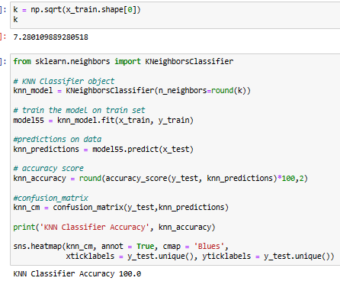
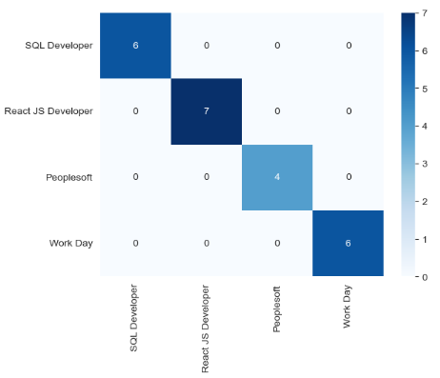
Finalizing Model
Model – K-Nearest Neighbour
Among all the models we have decided to go ahead wit k-nearest neighbour classification model because it is giving 100% accuracy.

Slide 28
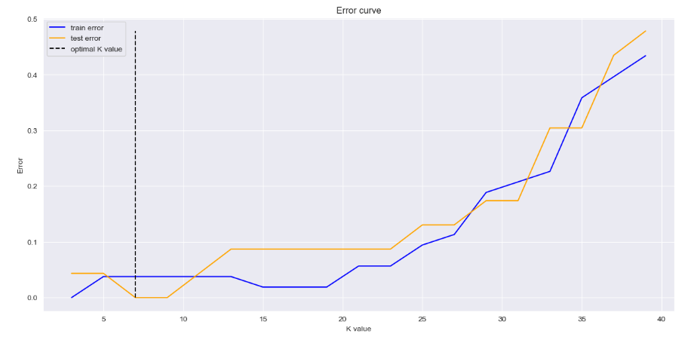
Finalizing Model
Test Train Line Graph Of KNN Model

Slide 29
Model Deployment using Streamlit.
Deployment Page
We have made 4 tabs in our deployment page HOME, ABOUT, RESUME DATA ANALYSIS & RESUME CLASSIFICATION
HOME - It is a interface which gives small information what is the project about
ABOUT – This tab gives information about our business objective, abstract and information of the project
RESUME DATA ANALYSIS – This tab provide graphical representation of data in which our model has trained
RESUME CLASSIFICATION – In this tab, we have to upload resume, after uploading our model will analyse resume and tells which category does that person belongs. We can also see all the skills on technical skills section and full resume of that person after clicking on view resume

Slide 30

Model Deployment using Streamlit.
Here Is “Home” Page Of Our Resume Classification Website Project

Slide 31
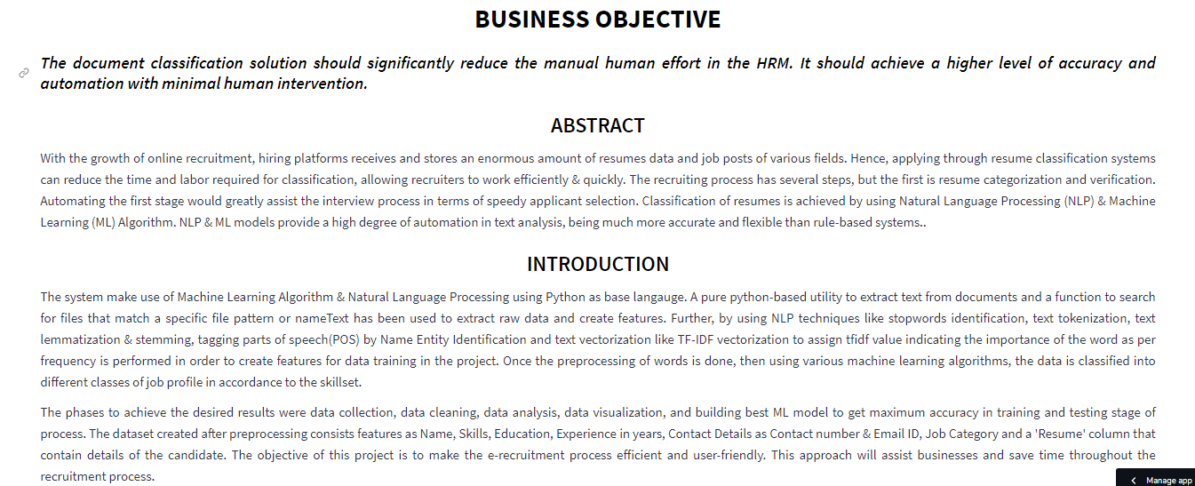
Model Deployment using Streamlit.
Here Is “About” Page Of Our Resume Classification Website Project

Slide 32
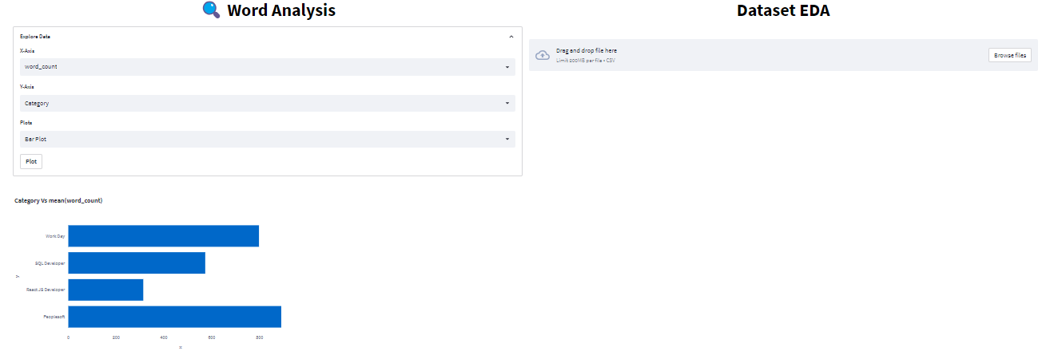
Model Deployment using Streamlit.
Here Is “Resume Data Analysis” Page Of Our Resume Classification Website Project

Slide 33
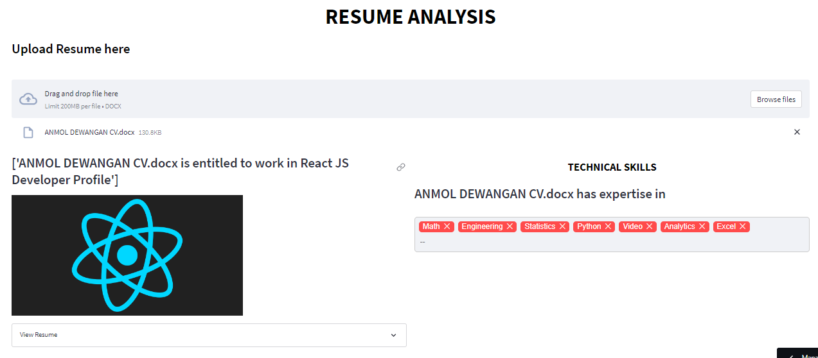
Model Deployment using Streamlit.
Here Is “Resume Classification” Page Of Our Resume Classification Website Project

Slide 34
Challenges faced?
Extracting raw data from all file formats
Creating features from raw data.
Handling imbalance data.
Selecting best model on the basis of accuracy
How did we overcome?
We Overcome All This Challenges By Discussion In Group Meeting & Taking New Ideas From Team Members.

Slide 35
Thank you

