Slide 1
Error
False positives and negatives distort the Site Frequency Spectrum

Slide 2
Introduction
Our HMM method both predicts CNPs that we can’t confirm and fails to predict CNPs we know a priori are present
We have estimated these error rates
The SFS we expect to observe from our array data will be influenced by these errors

Slide 3
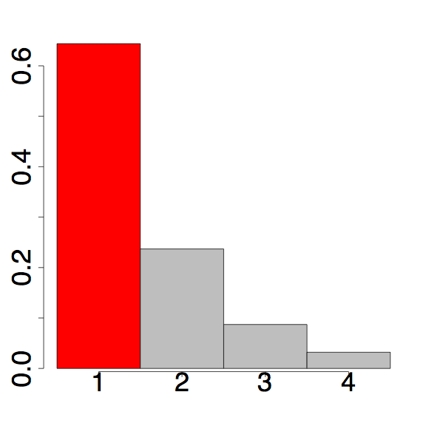
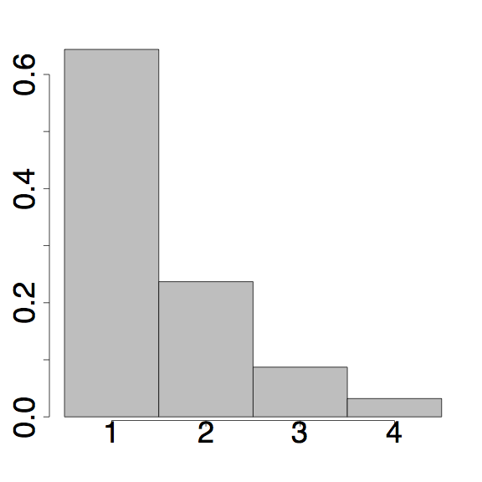
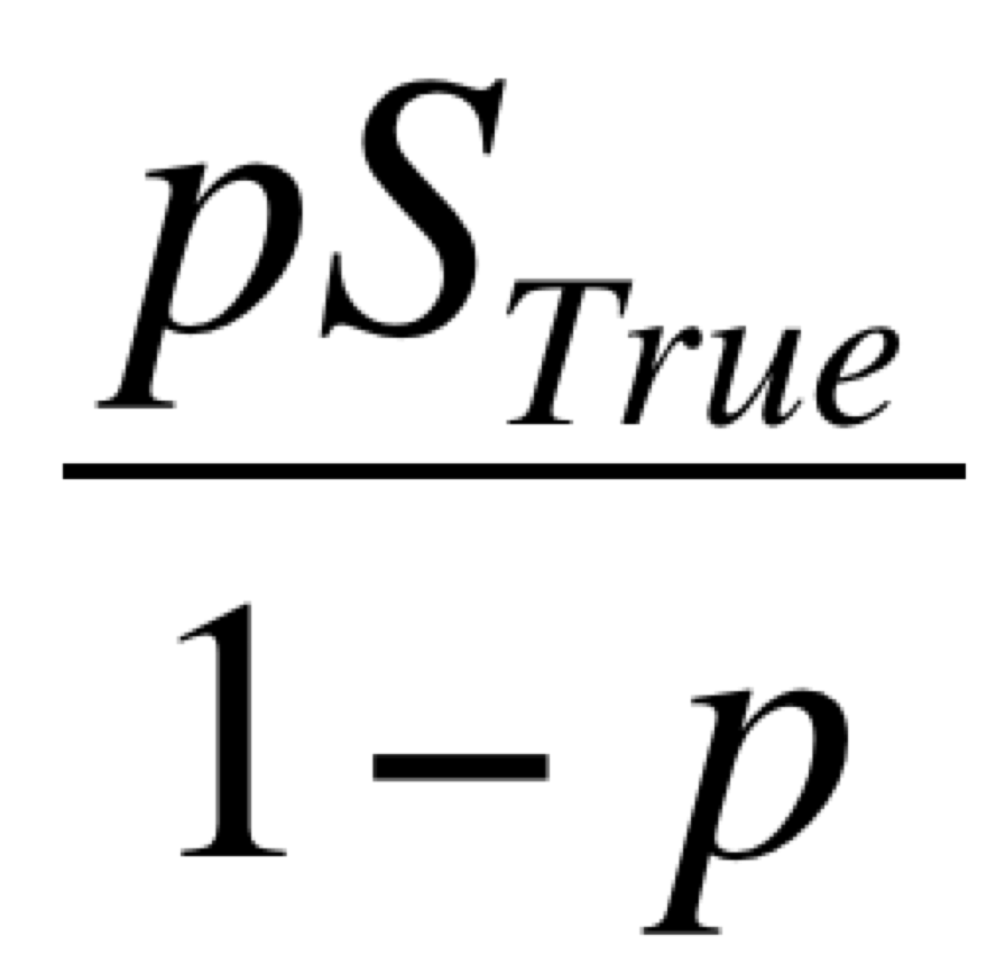
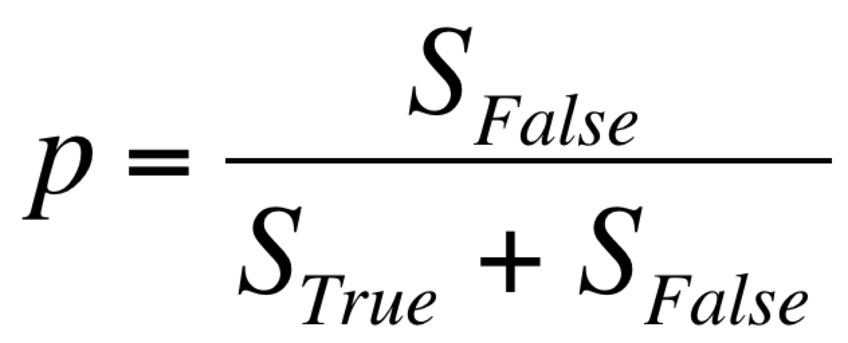
Incorporating false positives into our expectations
p is the false positive proportion of total observed mutations
Add this to singletons
Section 7.3 SOM (eqns 8 & 9)

Slide 4
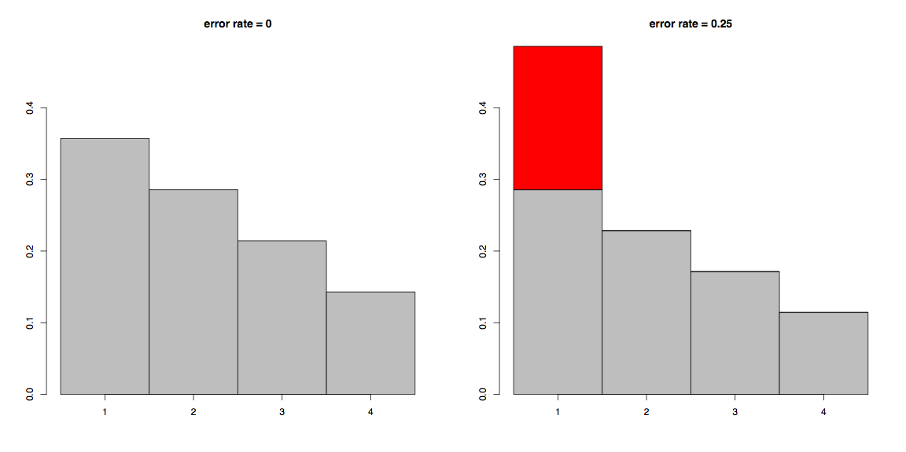
False positives distort the SFS

Slide 5
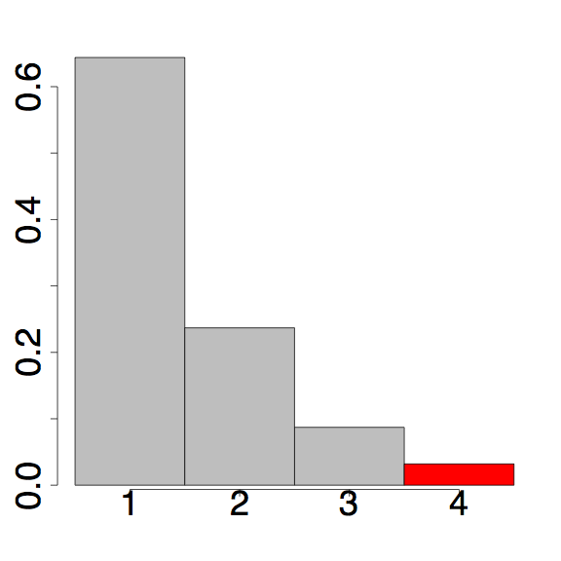
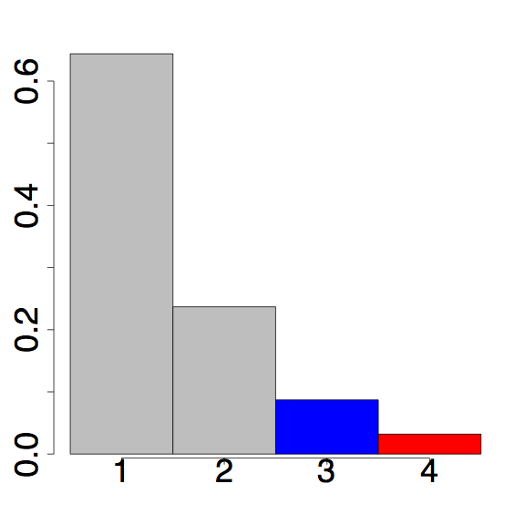
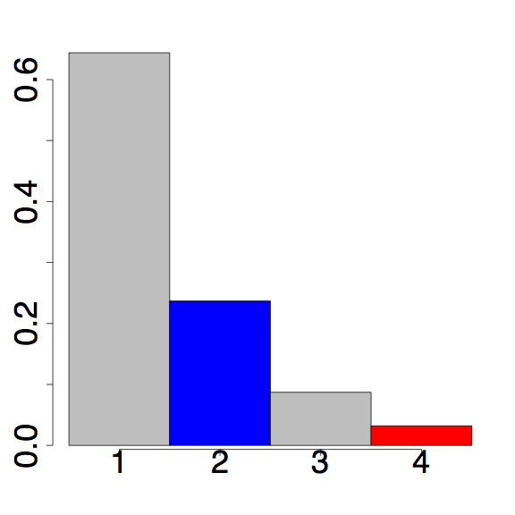
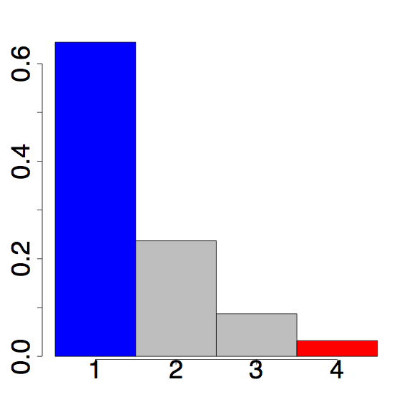
Incorporating false negatives into our expectations
False negatives move category k into categories k-1, k-2, …, 1 with a binomial probability
Thus, each bin is composed of the sites that “stay” and all of the of greater site frequency that “move down”
P = binom(k = 0;n = 4, p)
P = binom(k = 1;n = 4, p)
P = binom(k = 3;n = 4, p)
P = binom(k = 2; n = 4, p)
Moves 2 bins
Moves 3 bins
Moves 1 bin
Stays
Section 7.3 SOM (eqns 5,6, & 9)

Slide 6
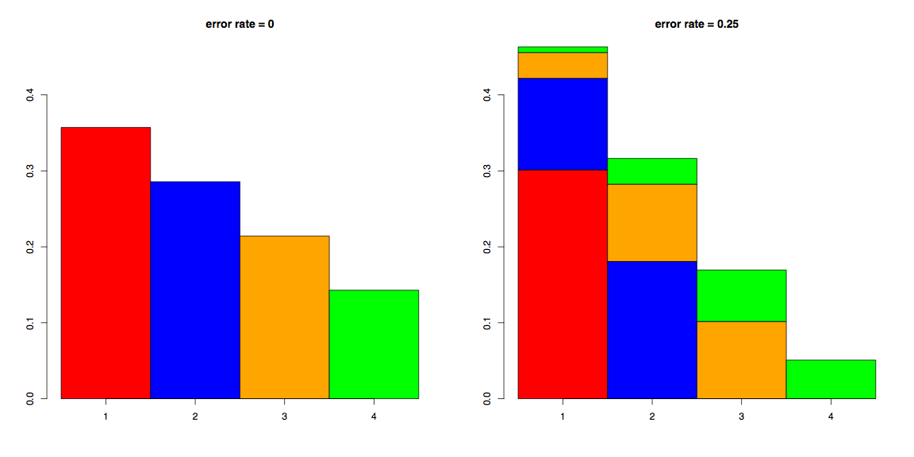
False negatives distort the SFS

Slide 7
Summary
Error rates aren’t even close to 0
The CNP SFS we observe contains both false +ives and false -ives
Thus, we need to adjust our expectations to incorporate the error rate
Our corrections are conservative with respect to inferring purifying selection

