Slide 1
Ascertainment bias
The probability of sampling a mutation is frequency dependent

Slide 2
Introduction
Microarrays are designed in such a way that mutations present in the reference genome are absent on the arrays designed from its sequence
Sequence for deletions isn’t present in the reference genome, therefore, probes can’t be designed for those regions
Redundant probes aren’t present on the arrays, thereby excluding duplicates present in the reference

Slide 3
Understanding ascertainment bias by example
Simulate 10,000 unlinked loci according to the standard neutral model with MS (6 samples)
Examine 100 loci for each allele frequency bin
If a derived allele is present in the first individual (representing the reference line) then we cannot ascertain that locus

Slide 4
A simulation example: i=4
1111010110011011111101111101111111011111001111100101111110100100001111111000111111010110010111000111
1100100011111111101000110111111001100111100111111000101101101011111011101111111010111011111011111110
1111111101101001110111011100000101101010010101110011000000110100100110001111011111101101101110111111
1010101111110110100011111011100110111001111110011110010111111111110100111111100010101001111001111001
0101011111001111011110001111111010111101111000101111111011011111011111110001000101010111001110111100
0011111000110100011111100010011111010110111011011111111111011011111001010110111101111110110101000011
0000000000000000000000000000000111111111111111111111111111111111111111111111111111111111111111111111
0000011111111111111111111111111000000000000000000000000011111111111111111111111111111111111111111111
1111100000000011111111111111111000000011111111111111111100000000000000000000000111111111111111111111
1111111111111111111111111111111111111100000000011111111100000000001111111111111000000000000001111111
1111111111111100000000011111111111111111111111100001111111111111110000000111111000000111111110000000
1111111111111111111111100000000111111111111111111110000011111111111111111000000111111000000000000000
Reminder: m = 6, i = 4
Sort
Keep only the loci where the reference lacks the derived allele
Throw out the reference line
Comparison:
Simulation = 31/100
Correction factor = (m-i)/m = (6-4)/6 = 1/3

Slide 5
A simulation example: i=3
0000000000000000000000000000000000000000000000000001111111111111111111111111111111111111111111111111
0000000000000000000000111111111111111111111111111110000000000000000000000000000000011111111111111111
0000011111111111111111000000000000001111111111111110000000000000011111111111111111100000000000001111
1111100000001111111111000111111111110000001111111110000000001111100000000001111111100000000011110000
1111111111110000001111111000000111110000010000000001111111110001100001111110000000000000111100000000
1111111111111111110000111111111000001111100000000001111111111110011110000000000000011111000000000000
0011011011101011110011010000100101000000111011100001110010001101011110100011010010100110001011011001
0000100101111000001001101000011010101110000000010100011101000001011010011101101111100010111011101010
1011010000010111101100001011011010111111111111101001010101001111100101010100010010011001001100010110
0101101000010010011110110110010000111011110110111110001101111010111001011010011101000010100100101000
1100001111000101100110100101100101010101001001010111100010110000000110100001100000111101110100100101
1110110110101100010001011111101111000000000100001010101010110110100001101110101101011101010011010111
Reminder: m = 6, i = 3
Sort
Keep only the loci where the reference lacks the derived allele
Throw out the reference line
Comparison:
Simulation = 51/100
Correction factor = (m-i)/m = (6-3)/6 = 1/2

Slide 6
A simulation example: i=2
0000111100101000000001000000000010010001100101001001000110000000111011110000000000100101010010001000
0110000000110011010100010111011101000011010001010000101100010100000000000000101000111000010000111001
1000100011000010101100101000001001101010001000000010000001100000100000000100010101000000001101000111
1010010010000001011010110100000010001100000000100101001001011010001100000010000100001110101000000010
0001000001010100100011000011100100110000010110100110110010100111000001001111001011000000100011010000
0101001100001100000000001000110000000100101010011000010000001001010110111001110010010011000100100100
0000000000000000000000000000000000000000000000000000000000000000000000111111111111111111111111111111
0000000000000000000000000000000000000000011111111111111111111111111111000000000000000000000001111111
0000000000000000000111111111111111111111100000000000000000000000111111000000000000000000000110000000
0000000001111111111000000000000011111111100000000000000011111111000000000000000000000011111000000000
1111111110000111111000001111111100000000000000011111111100000000000000000000000011111100000000000000
1111111111111000000111110000000000000000011111100000000000000000000000111111111100000000000000000000
Reminder: m = 6, i = 2
Sort
Keep only the loci where the reference lacks the derived allele
Throw out the reference line
Comparison:
Simulation = 70/100
Correction factor = (m-i)/m = (6-2)/6 = 2/3

Slide 7
A simulation example: i=1
0100000000100000000010100010000000010101000100010010000000000000000000000000000101010000000000010000
0000001100000000000001000001000000000000101000001001100001110010000011100000000000100000010000101110
0010010000000000000000000000101011000010000000000000010000000100110100000010011000000010000101000001
1000000001000100000000000100000000000000000000000100001000001001000000000101000010000000100010000000
0000100000001001110000010000010100001000010011000000000100000000001000000000100000000001000000000000
0001000010010010001100001000000000100000000000100000000010000000000000011000000000001100001000000000
0000000000000000000000000000000000000000000000000000000000000000000000000000000000000111111111111111
0000000000000000000000000000000000000000000000000000000000000001111111111111111111111000000000000000
0000000000000000000000000000000000000000000011111111111111111110000000000000000000000000000000000000
0000000000000000000000000000000111111111111100000000000000000000000000000000000000000000000000000000
0000000000000001111111111111111000000000000000000000000000000000000000000000000000000000000000000000
1111111111111110000000000000000000000000000000000000000000000000000000000000000000000000000000000000
Reminder: m = 6, i = 1
Sort
Keep only the loci where the reference lacks the derived allele
Throw out the reference line
Comparison:
Simulation = 85/100
Correction factor = (m-i)/m = (6-1)/6 = 5/6

Slide 8
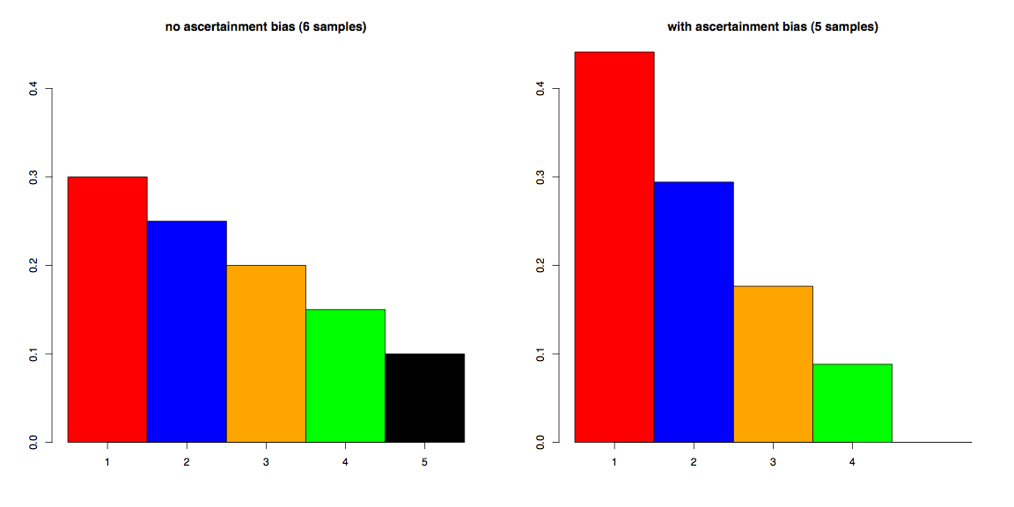
Ascertainment bias distorts the SFS
Section 7.2 SOM (eqn 3)

Slide 9
Summary
Ascertainment bias is a real factor due to array design
Correction allows for us determine correct any arbitrary SFS to conform to its expected shape under this bias
If our model is accurate, inferences following such correction will not be misled by ascertainment bias

Slide 10
Error
False positives and negatives distort the Site Frequency Spectrum

Slide 11
Introduction
Our HMM method both predicts CNPs that we can’t confirm and fails to predict CNPs we know a priori are present
We have estimated these error rates
The SFS we expect to observe from our array data will be influenced by these errors

Slide 12
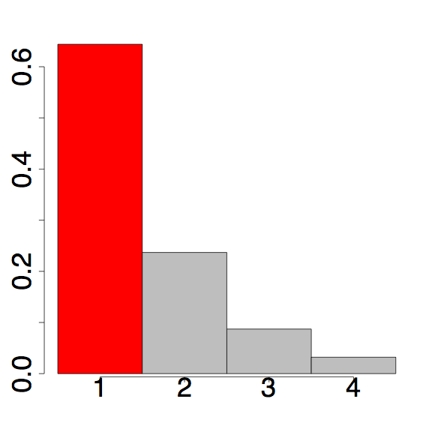
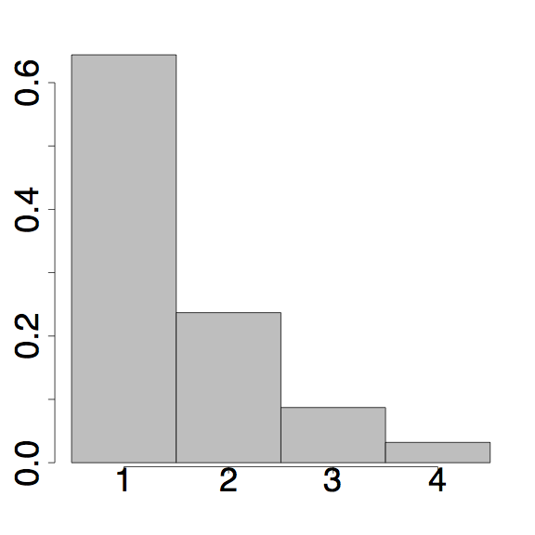
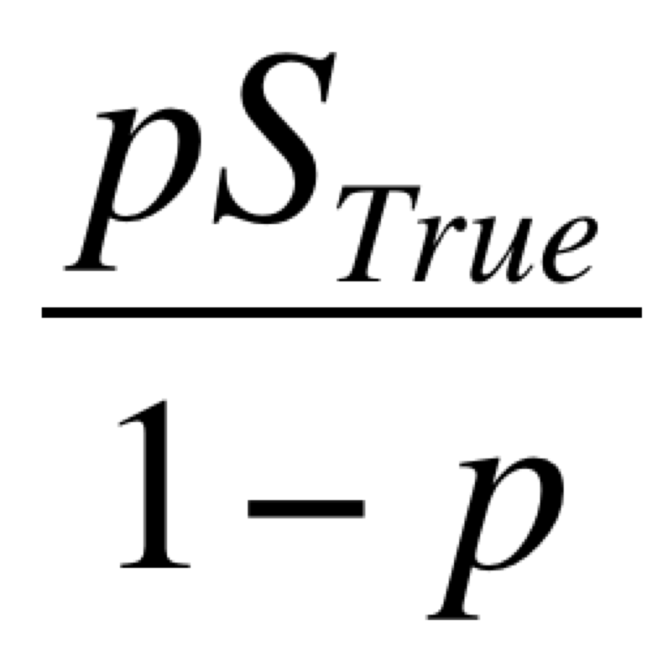
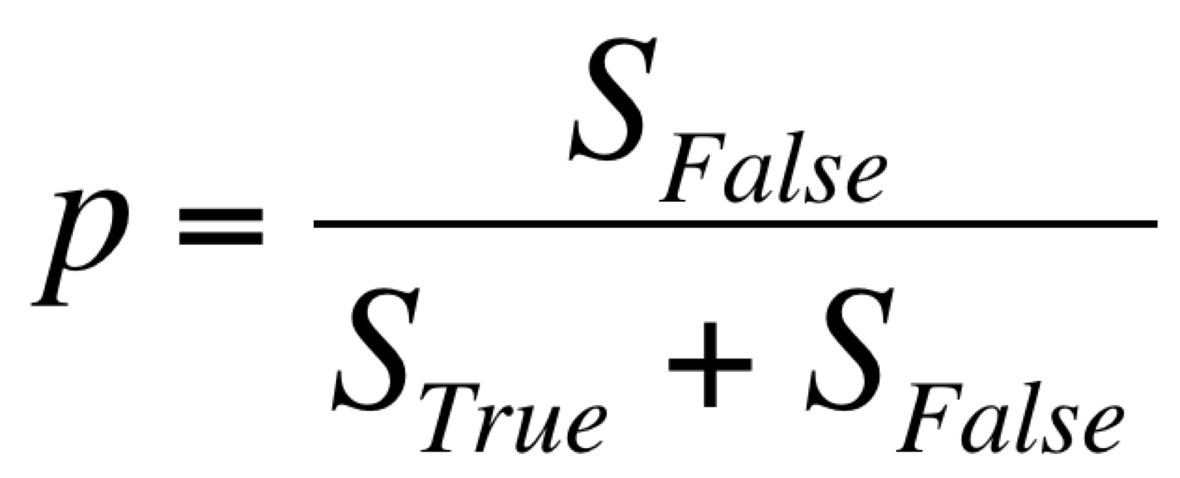
Incorporating false positives into our expectations
p is the false positive proportion of total observed mutations
Add this to singletons
Section 7.3 SOM (eqns 8 & 9)

Slide 13
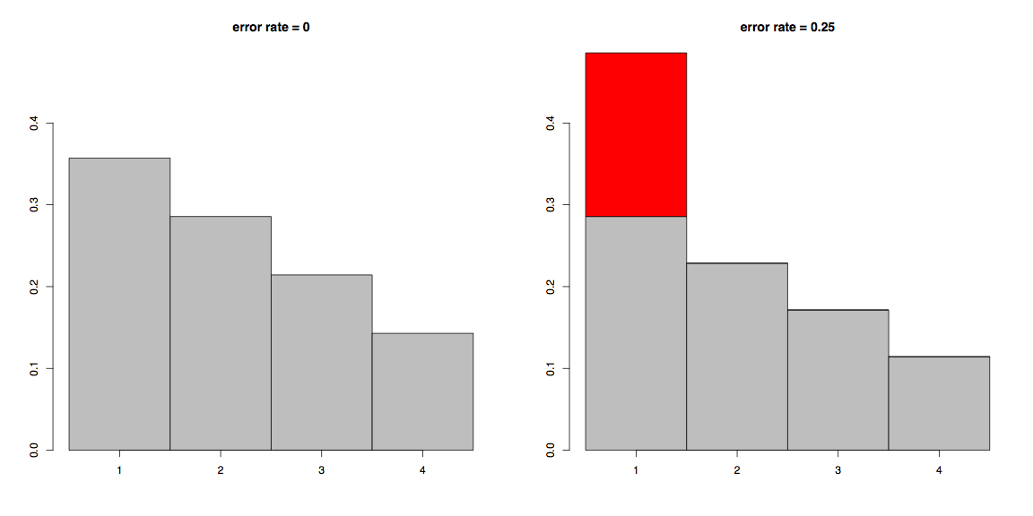
False positives distort the SFS

Slide 14
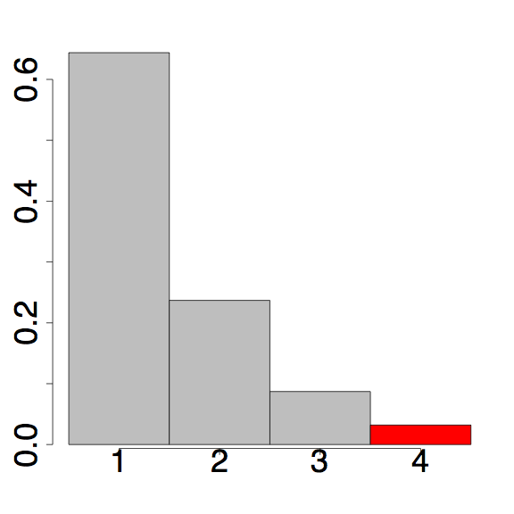
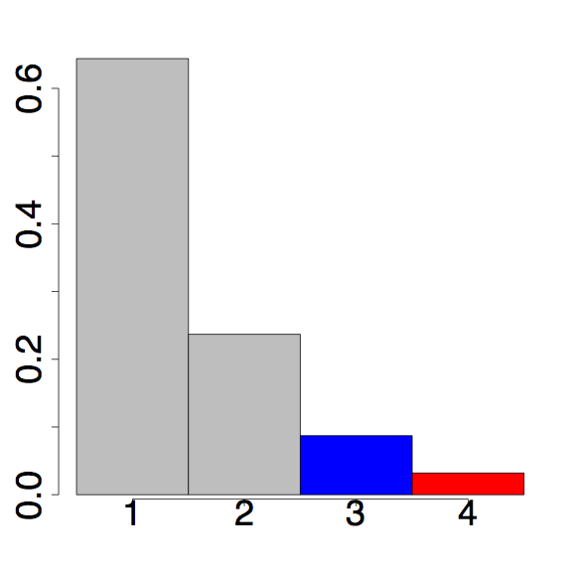
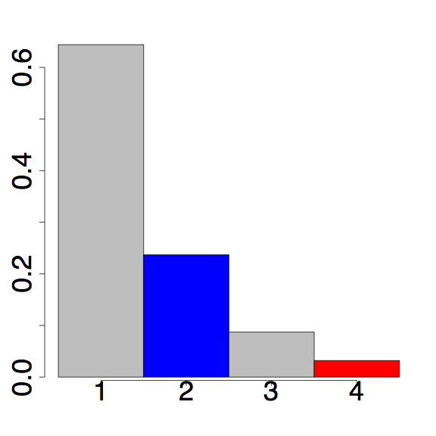
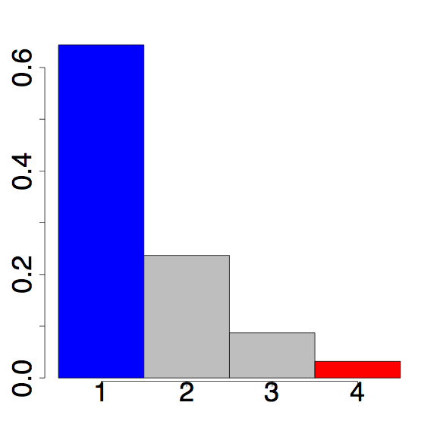
Incorporating false negatives into our expectations
False negatives move category k into categories k-1, k-2, …, 1 with a binomial probability
Thus, each bin is composed of the sites that “stay” and all of the of greater site frequency that “move down”
P = binom(k = 0;n = 4, p)
P = binom(k = 1;n = 4, p)
P = binom(k = 3;n = 4, p)
P = binom(k = 2; n = 4, p)
Moves 2 bins
Moves 3 bins
Moves 1 bin
Stays
Section 7.3 SOM (eqns 5,6, & 9)

Slide 15
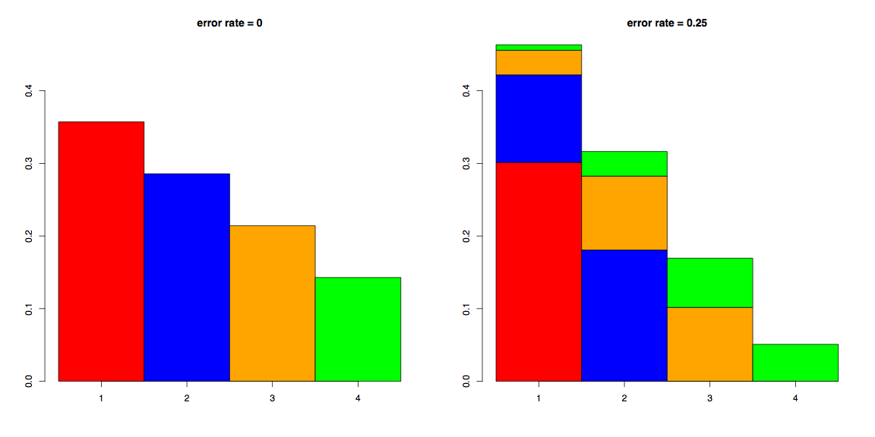
False negatives distort the SFS

Slide 16
Summary
Error rates aren’t even close to 0
The CNP SFS we observe contains both false +ives and false -ives
Thus, we need to adjust our expectations to incorporate the error rate
Our corrections are conservative with respect to inferring purifying selection

