Slide 1
Application of Infrared Image Registration and High-Resolution Reconstruction Techniques to Superresolution reconstruction of downsampled RGB Imagery
Time Aigbe, Ali Algahtani, Jeff Jenkins

Slide 2
OUTLINE
Project Goals
Introduction
Controlled Microscanning
The Sampling Model
Microscanning Process
Uncontrolled Microscanning / Image Registration
High Resolution Image Reconstruction / Restoration
Computer Simulation Results
Conclusions

Slide 3
Project Goals
Investigate controlled and uncontrolled microscanning algorithms in the context of low resolution data collected by Infrared imaging systems
Apply these techniques to higher resolution CMOS / RGB image data
Benchmark the performance of the algorithm (uncontrolled) with the ‘ideal’ bilinear interpolation
Develop a GUI to enable users to perform 2D Rigid (translation & rotation) registration on downsampled, transformed synthetic data and create a high resolution ‘Superresolution’ image
TBD – evaluate the effects of parameter selection w.r.t the Mean Absolute Error between the original image and superresolution image

Slide 4
Introduction
IR imaging systems generate degraded images due to aliasing, and other factors
It is difficult to build FPGAs with denser detector packing, so a strategy to improve existing FPGAs (microscan imaging) by reducing aliasing
Multiple spatially undersampled time frames of a scene to estimate one High Def image – each undersampled frame is shifted rel. to other frames.
Interlacing all shifted frames effectively samples the original scene at higher spatial sampling rate ‘Controlled Microscanning’ – the shift is known a-priori
When a sensor is on a moving platform, we must develop ‘Uncontrolled Mscan’
We need to accurately estimate the subpixel motion of scene w.r.t. FPGA to ensure shifts are uniformly distributed and estimate missing frames (shifts).
This paper mainly introduces Weighted Nearest Neighbor used for estimating missing shift images and other algorithms used to estimate shifts

Slide 5
Introduction (2)
To increasing mscan level, smaller subpixel shifts are required – leading to more images to interlace
One can improve the resolution up to twice the current sampling rate (look same)
MTF blurring of system creates bottleneck for mscan, but MTF can be modeled since camera parameters are known
Wiener filter can remove this MTF blur & improve resolution of mscan data
Wiener filter is done in discrete domain on sensor output image, but blurring is a continuous process
To avoid discrete aliasing when converting from cont. to disc., sample @ high enough frequency to meet Nyquist rate.
Mscan increases sampling rate & allows cont. functions to compose disc. W. F. for restoration
This approach can be used in real time FLIR imaging

Slide 6
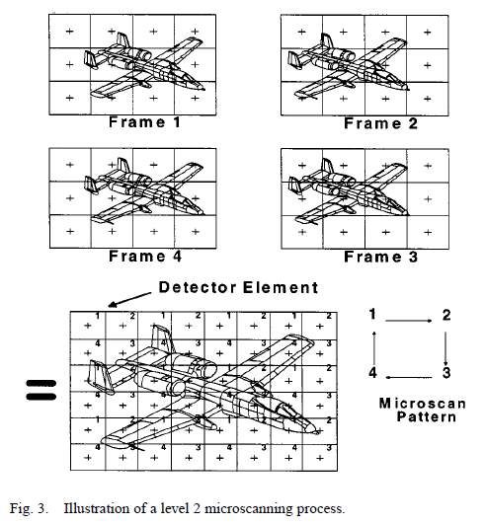
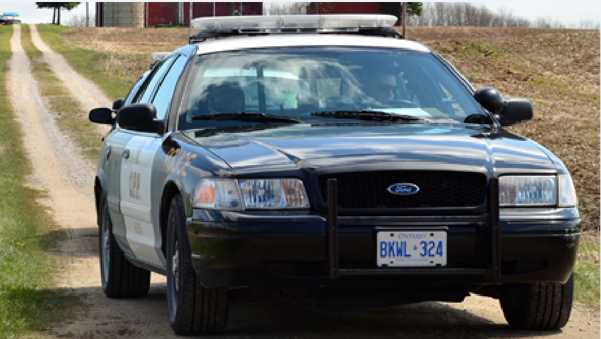
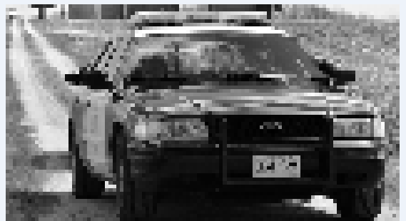
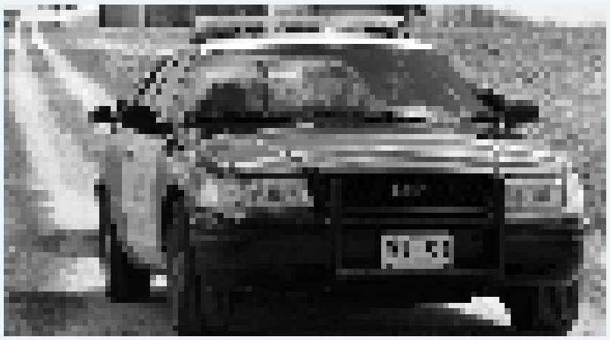
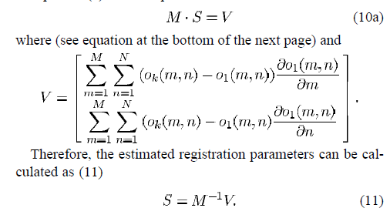
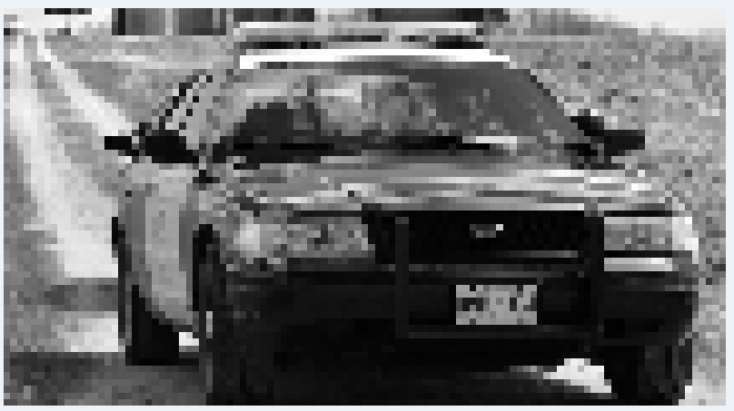
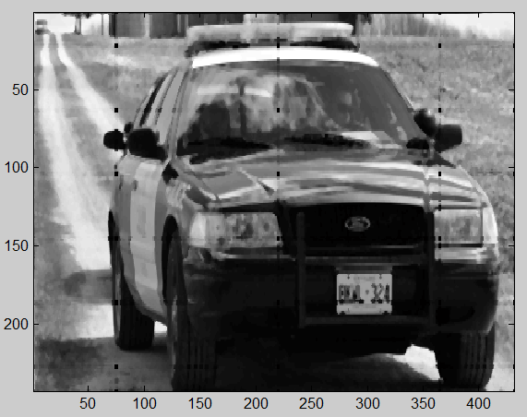
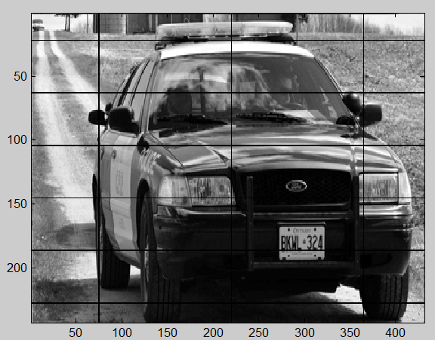
Controlled microscanning
Reference image
Reconstructed image
Shifted downsampled images

Slide 7
The Sampling Model
The PSF and square detector (assume flat response) functions are convolved with the original image
A comb function representing the sampling lattice is multiplied with a rect function which limits the detector array size
A staring image is acquired by convolving our original image with the PSF as well as the limiting rect function, then multiplying by the rect function times the comb

Slide 8
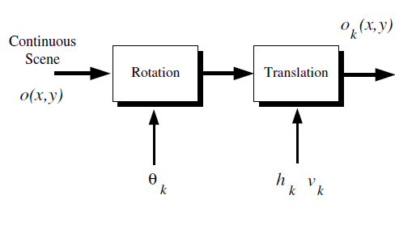
Microscanning Process
A controlled vibrating mirror produced the undersampled image frames with a pre-programmed pattern of known shifts
The sequence of frames is interlaced using the pattern – this can only be done when we know the shift pattern evolution (approximated by equation below)
Vibration is naturally caused by moving platforms (i.e. aircraft) and results in rotation and translation
Because random vibrational shifts are used, a microscan mirror/driver system is not needed
Rotation as well as translation is identified in the following block diagram:
These two effects can be represented by the following equation:
o_{k}(x, y) = o(x*cos(θ_{k}) – y*sin(θ_{k}) + h_{k}, y* cos(θ_{k}) + x*sin(θ_{k}) + v_{k})
for k = 1, 2, 3 …. p. Note that θ_{k} k represents the rotation of the k'th frame about the origin (i.e., x = 0, y = 0). The parameters hk and vk represent the horizontal and vertical shift associated with the k'th frame.
A level-L controlled mscan requires L^2 frames to be acquired to form HD image
An LXL pattern is used to interlace the staring frames, and yields a NL X NL sized frame, where N is the size of the sq. detector array.
This is how superresolution is achieved

Slide 9
Image Registration
Need to choose an algorithm to register the image shift parameters
Gradient approach is good, but only works for shifts on the order of one low-res pixel width
Iterative technique utilized to handle larger shift width
The first image (o_1(x,y)) is always the ‘fixed image’, that subsequent frames (moving images) are registered to.
Least squares method can solve for h,v shift
We try to move estimated frame closer to o_1 to minimize the registration estimates – final estimate obtained by summing all partial estimates

Slide 10
High-Res Image Reconstruction
After determining relative shifts for sequence of low-res frames, the frame are placed in High Def grid using weighted nearest neighbor.
WNN takes fixed image & places it in High-Res grid @ [0,0].
Series of moving images must be placed in High-Res grid (1/L intervals)
For any point on High-Res grid not having a value, find 3 nearest frames & provide them weights inv. Proportional to distance from desired point on High Def grid
Weighted frames are averaged to form the missing frame at each point on the grid

Slide 11
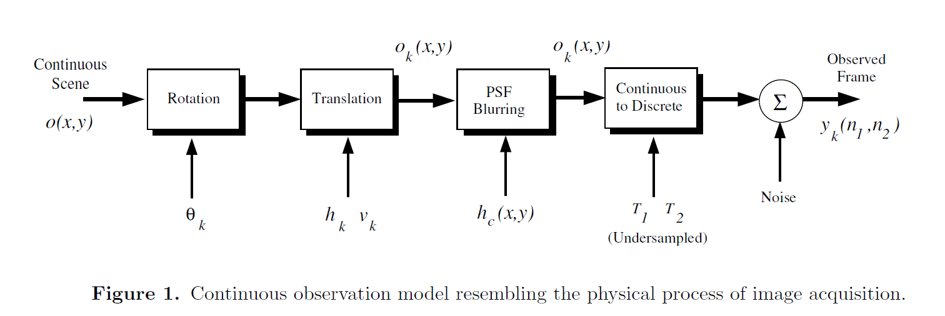
Continuous observation model

Slide 12
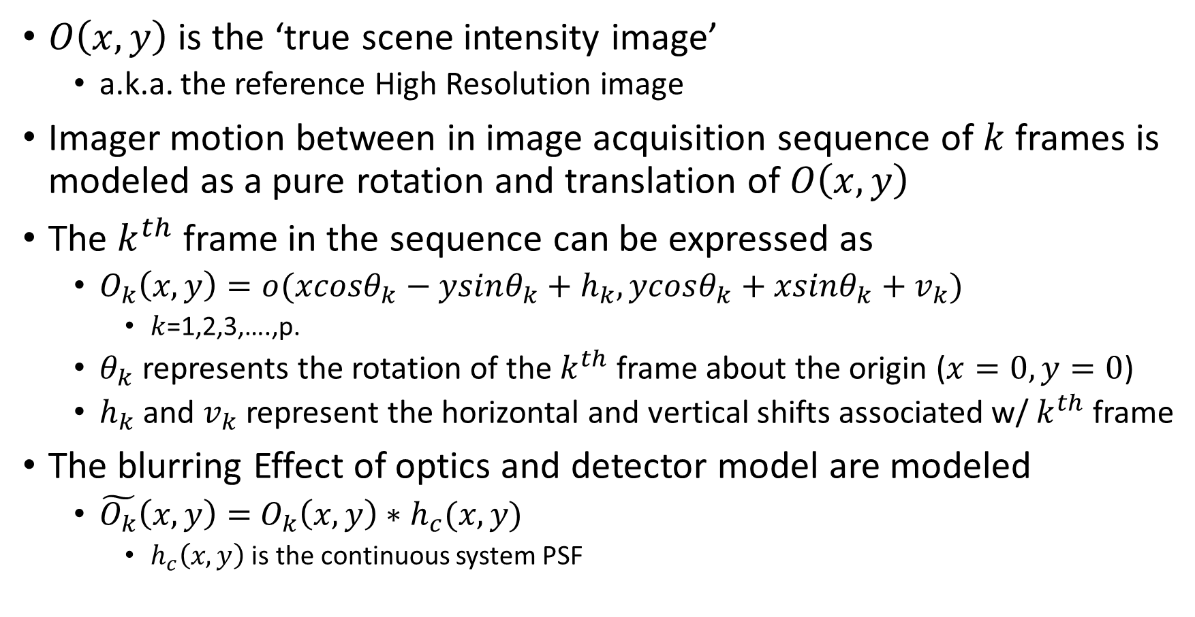
Continuous Observation Model – Physical Process
$O\left(x,y\right)$ is the ‘true scene intensity image’
a.k.a. the reference High Resolution image
Imager motion between in image acquisition sequence of $k$ frames is modeled as a pure rotation and translation of $O\left(x,y\right)$
The $k^{th}$ frame in the sequence can be expressed as
$O_{k}\left(x,y\right)=o(xcosθ_{k}−ysinθ_{k}+h_{k},ycosθ_{k}+xsinθ_{k}+v_{k})$
$k$=1,2,3,….,p.
$θ_{k}$ represents the rotation of the $k^{th}$ frame about the origin ($x=0,y=0$)
$h_{k}$ and $v_{k}$ represent the horizontal and vertical shifts associated w/ $k^{th}$ frame
The blurring Effect of optics and detector model are modeled
$\tilde{O_{k}}\left(x,y\right)=$ $O_{k}\left(x,y\right)∗h_{c}(x,y)$
$h_{c}\left(x,y\right)$ is the continuous system PSF

Slide 13
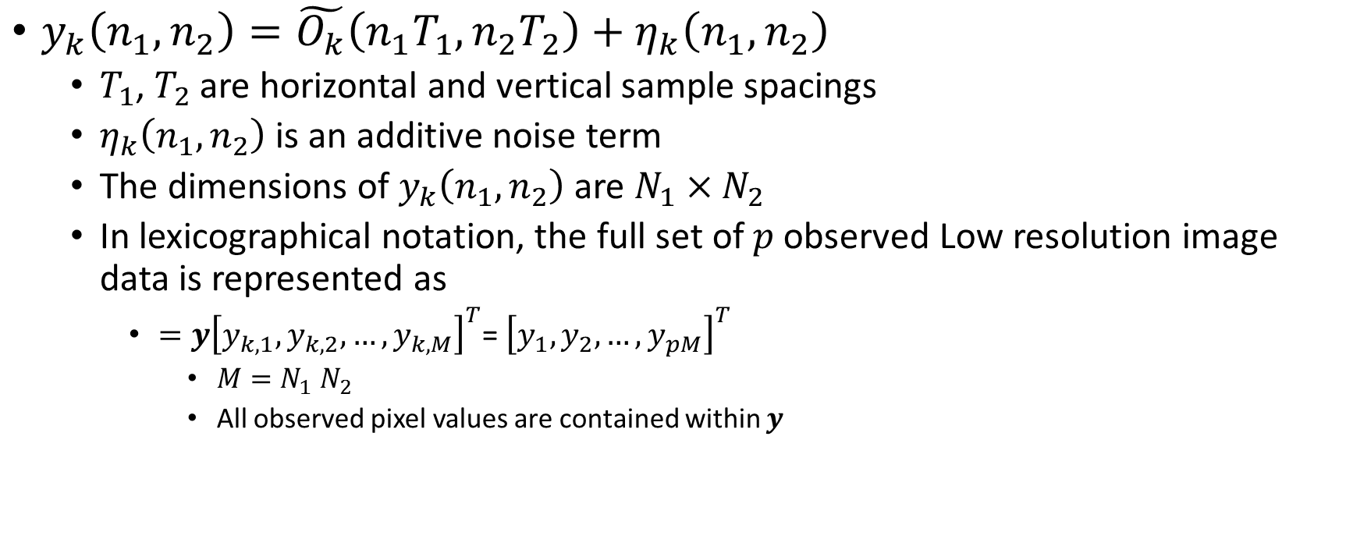
Low Resolution Observed frame
$y_{k}\left(n_{1},n_{2}\right)=\tilde{O_{k}}\left(n_{1}T_{1},n_{2}T_{2}\right)+η_{k}\left(n_{1},n_{2}\right)$
$T_{1}$, $T_{2}$ are horizontal and vertical sample spacings
$η_{k}\left(n_{1},n_{2}\right)$ is an additive noise term
The dimensions of $y_{k}\left(n_{1},n_{2}\right)$ are $N_{1}×N_{2}$
In lexicographical notation, the full set of $p$observed Low resolution image data is represented as
$=y{\left[y_{k,1},y_{k,2},…,y_{k,M}\right]}^{T}$= ${\left[y_{1},y_{2},…,y_{pM}\right]}^{T}$
$M=N_{1}$ $N_{2}$
All observed pixel values are contained within $y$

Slide 14
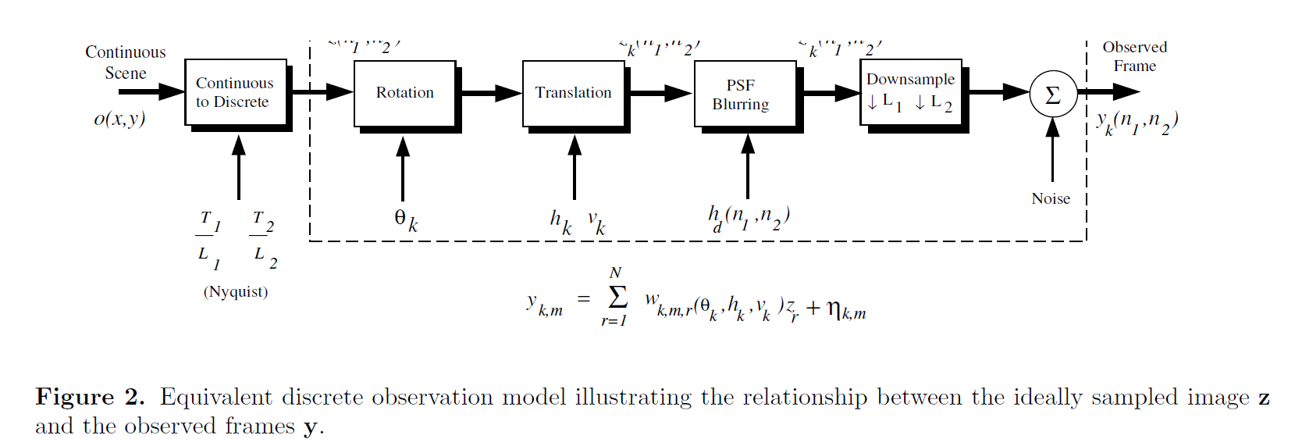
Discrete Observation Model
The discrete model is necessary to develop the high resolution reconstruction algorithm, equivalent to the Continuous model

Slide 15
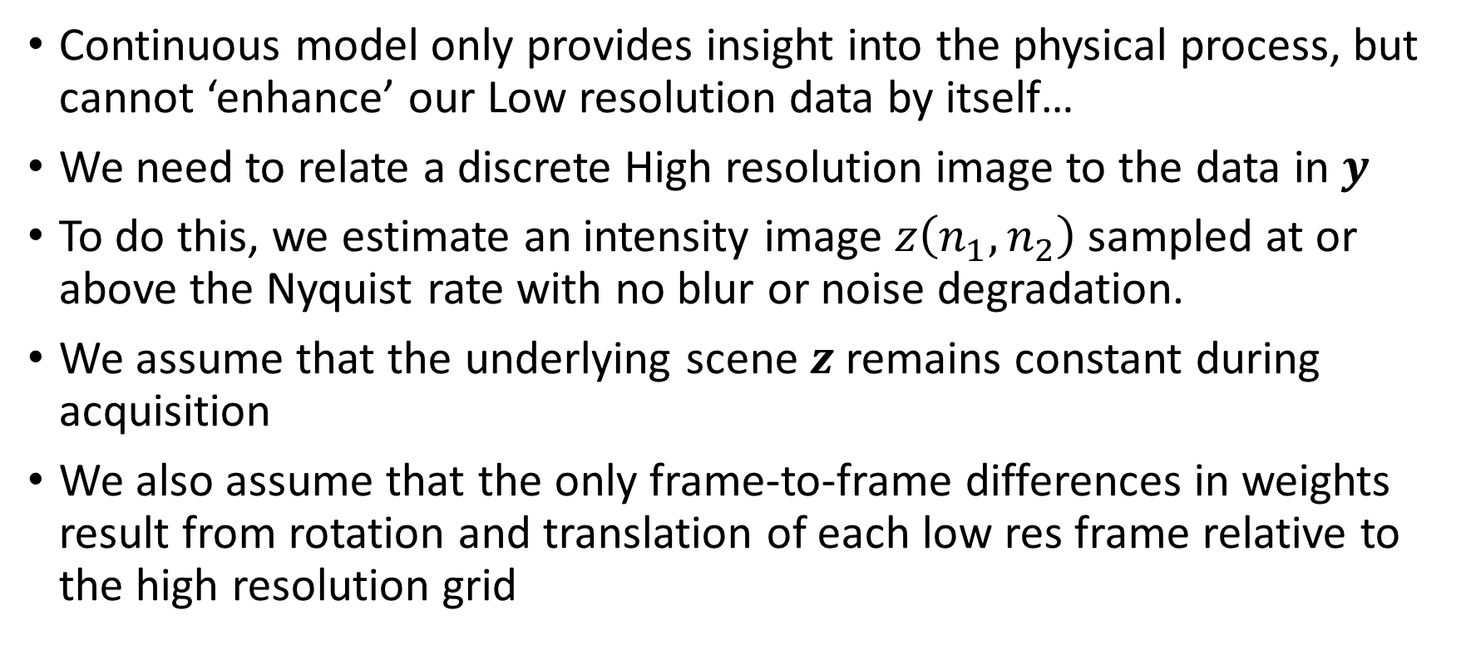
Discrete Observation Model – Philosophy
Continuous model only provides insight into the physical process, but cannot ‘enhance’ our Low resolution data by itself…
We need to relate a discrete High resolution image to the data in $y$
To do this, we estimate an intensity image $z\left(n_{1},n_{2}\right)$ sampled at or above the Nyquist rate with no blur or noise degradation.
We assume that the underlying scene $z$ remains constant during acquisition
We also assume that the only frame-to-frame differences in weights result from rotation and translation of each low res frame relative to the high resolution grid

Slide 16
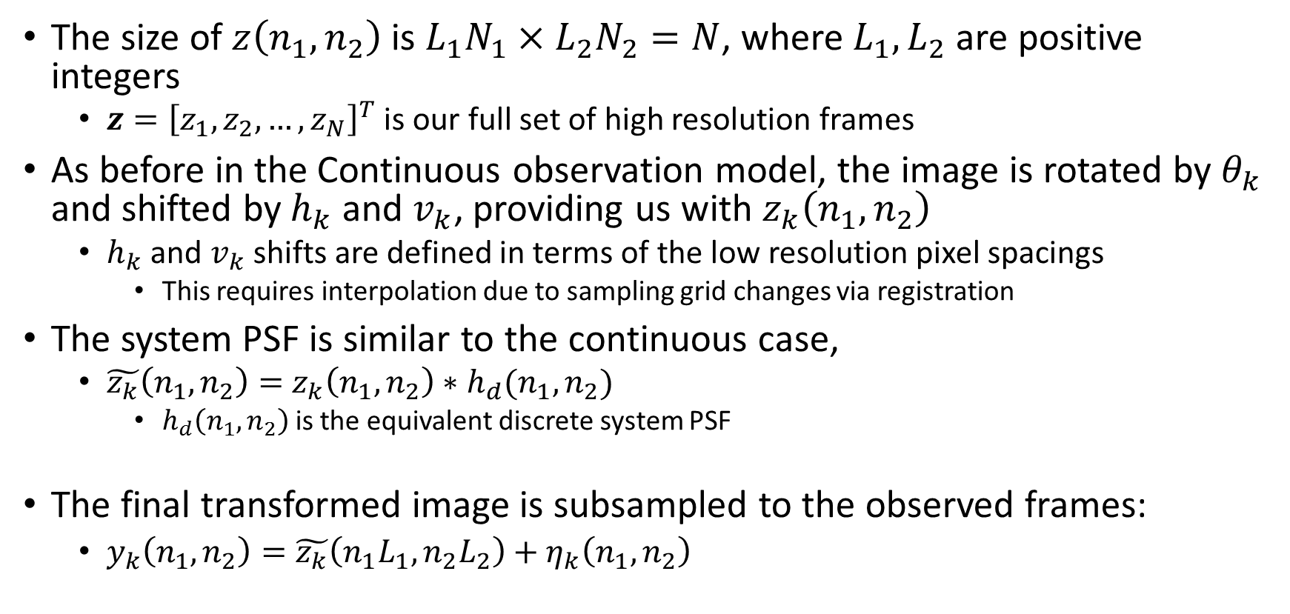
Discrete Observation Model – Procedure
The size of $z\left(n_{1},n_{2}\right)$ is $L_{1}N_{1}×L_{2}N_{2}=N$, where $L_{1},L_{2}$ are positive integers
$z={\left[z_{1},z_{2},…,z_{N}\right]}^{T}$ is our full set of high resolution frames
As before in the Continuous observation model, the image is rotated by $θ_{k}$ and shifted by $h_{k}$ and $v_{k}$, providing us with $z_{k}\left(n_{1},n_{2}\right)$
$h_{k}$ and $v_{k}$shifts are defined in terms of the low resolution pixel spacings
This requires interpolation due to sampling grid changes via registration
The system PSF is similar to the continuous case,
$\tilde{z_{k}}\left(n_{1},n_{2}\right)=$ $z_{k}\left(n_{1},n_{2}\right)∗h_{d}(n_{1},n_{2})$
$h_{d}\left(n_{1},n_{2}\right)$ is the equivalent discrete system PSF
The final transformed image is subsampled to the observed frames:
$y_{k}\left(n_{1},n_{2}\right)=\tilde{z_{k}}\left(n_{1}L_{1},n_{2}L_{2}\right)+η_{k}\left(n_{1},n_{2}\right)$

Slide 17
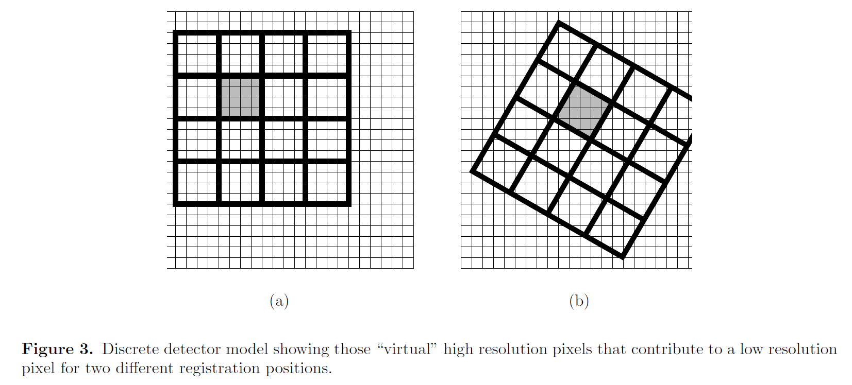
Visualizing the discrete observation model
Each low resolution pixel is the sum of ‘virtual’ high resolution pixels within the support of that low resolution detector
This model simulates the integration of light intensity impinging on the span of the low resolution detector

Slide 18
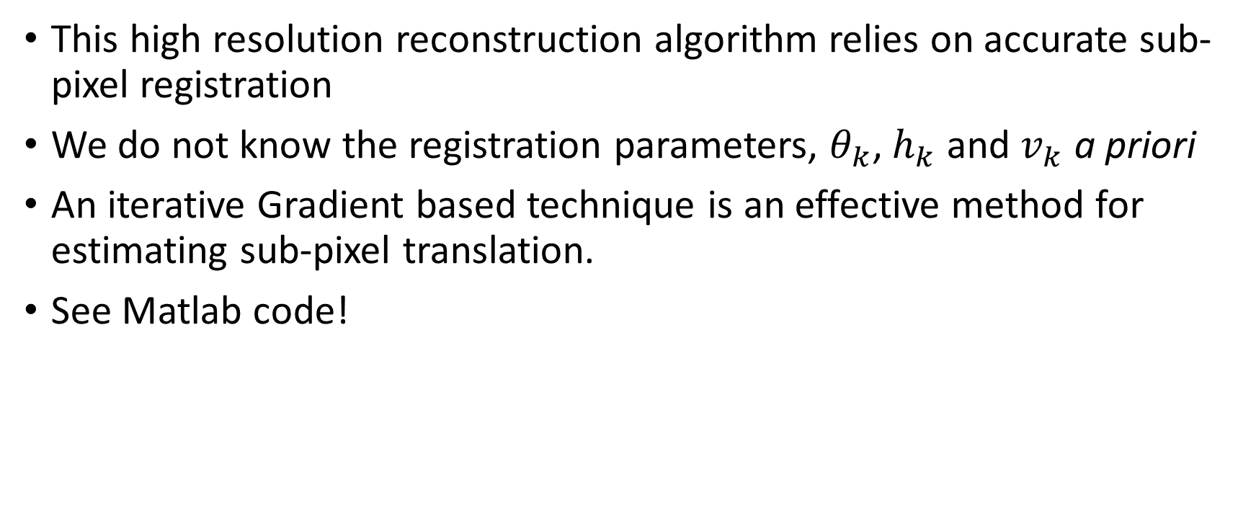
Uncontrolled Microscanning - Image Registration
This high resolution reconstruction algorithm relies on accurate sub-pixel registration
We do not know the registration parameters, $θ_{k}$, $h_{k}$ and $v_{k}$ a priori
An iterative Gradient based technique is an effective method for estimating sub-pixel translation.
See Matlab code!

Slide 19
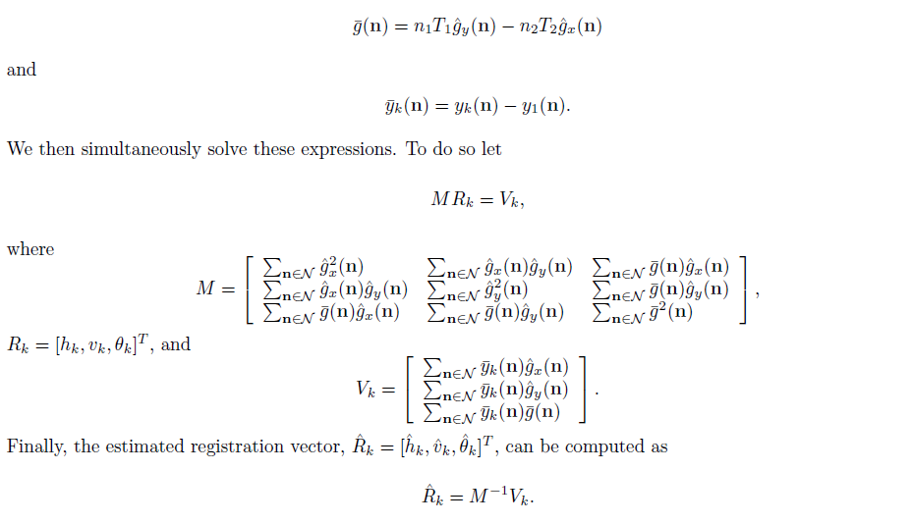
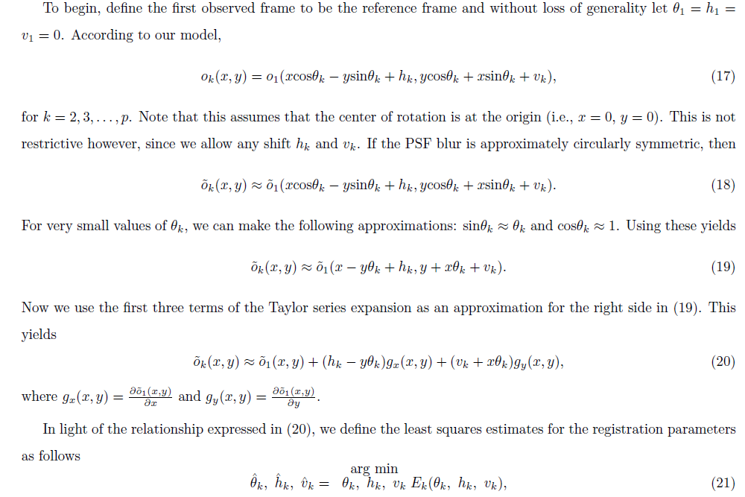
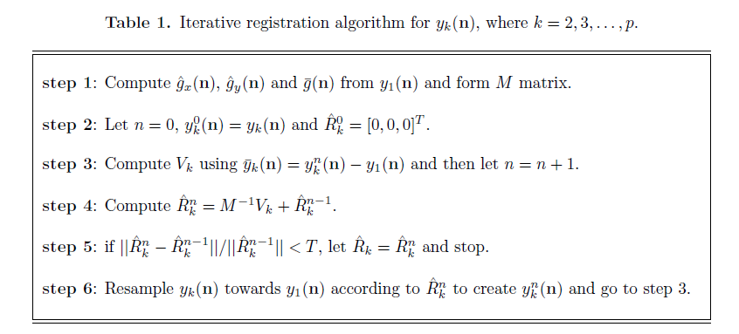
Image Registration

Slide 20
After Image Registration
Let’s go to the Paper and the Code/GUI!

Slide 21
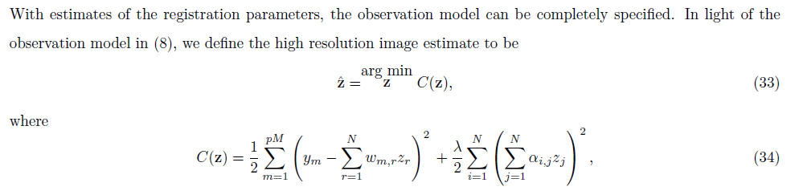
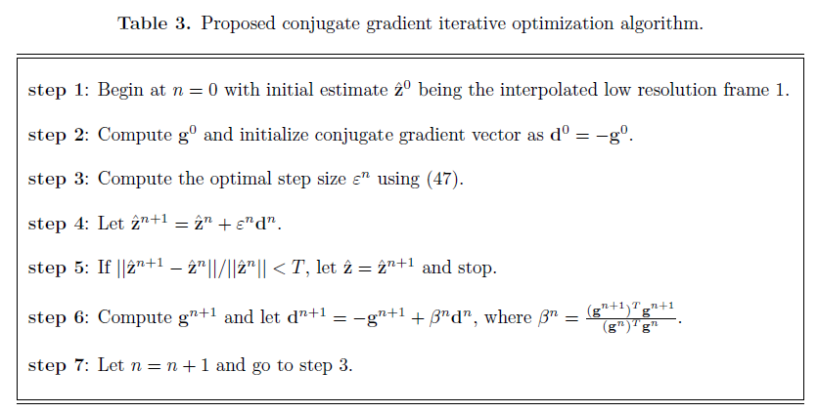
High Resolution Restoration
Gradient Descent approach was hard to debug (rls_restoration) and did not converge with our data – especially without a known psf model.
Conjugate gradient method yielded a result in ~4 iterations, much less than Gradient descent.

Slide 22
Restoration approach
Let’s go to the Paper and the GUI!

Slide 23
Results
More detailed coming soon to a pdf near you…

Slide 24
Conclusions
We investigated a Superresolution technique for enhancing a series of undersampled IR images called Uncontrolled microscanning
This technique was applied to RGB imagery (grayscale) by creating synthetic data having random translation and rotation shifts
The synthetic data was registered to a reference image using the algorithm proposed by Hardie et. al, then a high resolution image was reconstructed from the registered images
Due to the larger size of our imagery, it is not likely suited for real-time applications of creating superresolution images from HD cameras.
Many aspects of the original algorithm were not relevant since our detector specifications were much better than the target device (IR v. RGB)
Tested w/ simulated data; shows a minor improvement to original data so far, more investigation is necessary to discover parameter dependence on reconstruction quality

Slide 25
Final Exam Requirements
Each group of two will pick a technique and build a gui to perform superresolution technique. (CHECK)
There will be a 30 minutes presentation for each group. The presentation has to include scientific detailed description of the technique (equations). (CHECK, CHECK)
You also have to demonstrate by using matlab how your technique works and give results. I encourage you to develop your own code but you are allowed to use other people codes if you know how they work and fix the bugs in them. (CHECK, CHECK, SO MUCH CODE)
Also, you will write a final report on your work (COMING SOON)

Slide 26
Infrared Field Data Results
The algorithm was able to find shifts in real data (AFRL) but is limited at long distances due to detector undersampling
The resulting ‘high-res’ image showed large increase in image resolution – good performance on real translationally shifted IR frames
High-res IR images can also be reconstructed via MAP, MLE, EM.
All of these algorithms have large computational complexity & prohibits real time implementation.

