Slide 1
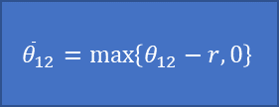
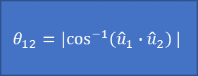
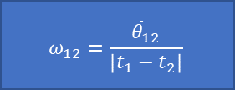
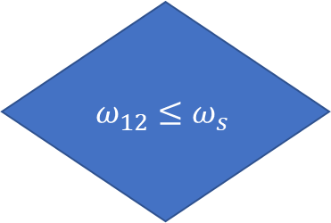
Satellite Plan
Available Access Point
$$θ_{12}={|cos}^{−1}\left({\hat{u}}_{1}∙{\hat{u}}_{2}\right)|$$
Access Point Joins Satellite Plan
Choose New Access Point
$${\overline{θ}}_{12}=\max\left\{θ_{12}−r,0\right\}$$
$$ω_{12}=\frac{{\overline{θ}}_{12}}{\left|t_{1}−t_{2}\right|}$$
$$ω_{12}≤ω_{s}$$
Yes
No

