Slide 1

TDD Hands on
madcoderspeak.blogspot.com
Gishu Pillai - 2009

Slide 2
Agenda
Try BDUF
TDD Review
TDD Styles (state / interaction)
SOLID Principles
CODE: Score a bowling game kata (2:15) [R]
DI / Mocks
CODE: Mocks101
GUI Patterns MVP
CODE: New feature requests! [R]
"It doesn't work!"
From the trenches...
Resources
BDD / Domain Driven Design teaser

Slide 3
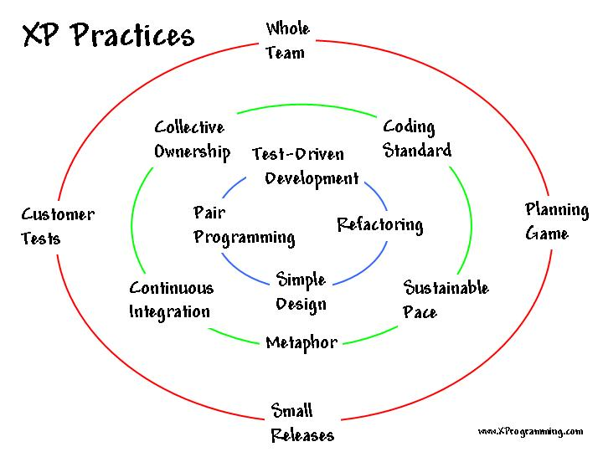
TDD - Origins
Kent Beck rediscovered TDD
1970: Waterfall - Winston W. Royce (good & bad)
1996: SUnit (Guide to better Smalltalk)
1999: XP First Edition
2002: TDD By Example
2005: XP Second Edition
Notes:
The waterfall myth
Winston Royce - "Risky and invites failure!"
FOCUS ON Design Documentation.
How is this procedure implemented? The following steps are required.
1) Begin the design process with program designers, not analysts or programmers.
2) Design, define and allocate the data processing modes even at the risk of being wrong.
3) Write an overview document that is understandable, informative and current. Each and every
worker must have an elemental understanding of the system. At least one person must have a deep understanding of the system which comes partially from having had to write an overview document.
Last responsible moment

Slide 4
"Simple Code That works"
Quote - Ron Jeffries, Kent Beck
  Criteria to evaluate that "it works"
    must pass all automated tests
  Criteria to evaluate Simplicity of Code
    Appropriate for target audience
    Communicates Intent
    Factored / No Duplication
    Minimal

Slide 5
TDD - In One Slide
Refactor
Green
Make changes so that all tests pass again
Write a new failing test *
Red
* A new test may pass without any changes ; either the test is wrong OR the code already has the behavior spec. by the test.

Slide 6
What makes a good unit test?
Source - Pragmatic Unit Testing by Dave Thomas, Andy Hunt
  Automatic
  Thorough
  Repeatable
  Independent (Isolated and tests one thing - AAA)
  Professional
  Fast ( < 0.1 sec)
  Worth the effort to write the test

Slide 7
Refactoring
Why?
  Improves the design
  Makes software easier to understand
  Helps you program faster
  Helps you find bugs
When?
  Three strikes and you refactor (guideline)
  Add behavior (or when the code doesn't let you)
  Need to fix a bug
  As you do a code review
Source - Refactoring by Martin Fowler
Define.
Code Smells: 'If it stinks, change it' *
Make it work > right > fast.. in that order**
Simple is almost always better than clever ***
Quotes attributed to *Grandma Beck **Kent Beck ***Jon Skeet

Slide 8
Agile Design - Design Smells
Source - APPnP book, Bob Martin
  Rigidity - Difficult to change
  Fragility - Breaks easily in multiple places when changed
  Immobility - Difficult to reuse parts
  Viscosity - Difficult to do the right thing
  Needless Complexity - Over design / Overengineer
  Needless Repetition - Duplication / Copy-Paste abuse
  Opacity - difficult to understand, gets worse with age

Slide 9
Agile Design - SOLID Principles
Source - APPnP book, Bob Martin
  SRP - 'A class should have only one reason to change'
  OCP - 'open for extension & closed for modification'
  LSP - 'Subtypes must be substitutable for base types'
  ISP - 'Clients should not be forced to depend on methods they do not use.'
  Dependency Injection
    'High level modules should not depend on low level. Both should depend on abstractions'
    'Details should depend on abstractions not the other way around.'

Slide 10
Open Closed Principle
Software entities must be open for extension but closed for modification -- Bertrand Meyer (1988)
When requirements change, you extend the behavior by adding new code not changing tried-n-tested existing code.
Strategic Closure: However no non-trivial program can be 100% closed. The key lies in the designer applying abstractions to parts that are likely to change.

Slide 11
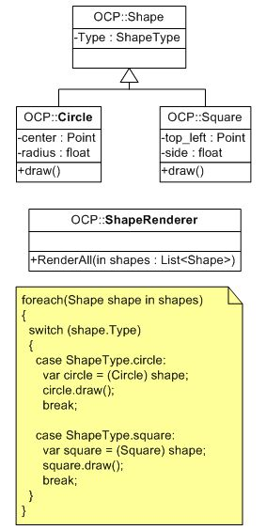
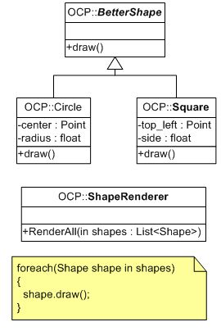


Open Closed Principle
Source - Bob Martin link
Notes:
the good variant is sill not closed against all changes... e.g. all squares must be rendered before circles

Slide 12
Liskov Substitution Principle
If the behavior of Program p defined in terms of type T is unchanged when objects of type S are substituted for T, then S is a subtype of T. -- Barbara Liskov (1988)
A violation of LSP is a violation of OCP.
DBC and LSP
Bertrand Meyer - when overriding a function in a derivation, you may only replace its precondition with a weaker one and its postconditions with a stronger one.
Notes:
#2 - switch case of OCP.

Slide 13
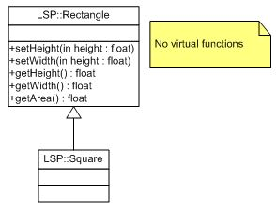
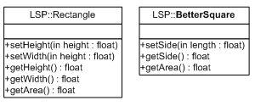
Liskov Substitution Principle
Source - Bob Martin link
Notes:
Check if behavior passes the IS A check before deriving

Slide 14
Dependency Inversion Principle
  High level modules should NOT depend on low level modules. Both should depend upon abstraction
  Abstractions should NOT depend on details. Details should depend on abstractions.

Slide 15
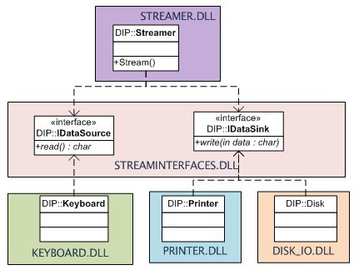
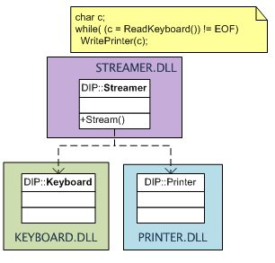
Dependency Inversion Principle
Source - Bob Martin link
Notes:
Layering may lead to transitive dependency
Button controlling Lamp example if anyone is interested
Button has Lamp

Slide 16
Interface Segregation Principle
Clients should not be forced to depend on interfaces that they do not use.
  Interface pollution - makes the class "fat"
  Separate Clients mean Separate Interfaces
  Clients may drive interface changes

Slide 17
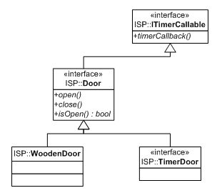
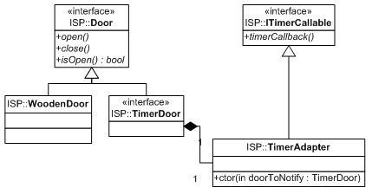
Interface Segregation Principle
Source - Bob Martin link
Notes:
TimedDoor sounds an alarm after a time-out interval
ATM UI example if anyone is interested

Slide 18
Single Responsibility Principle
There should never be more than one reason for a class to change.
A responsibility = an axis of change / reason for change
Simplest principle but the most difficult to get right
Symptoms:
  unintentional coupling > fragile designs
  unnecessary dependencies > longer build times / unwanted binaries dragged in.

Slide 19
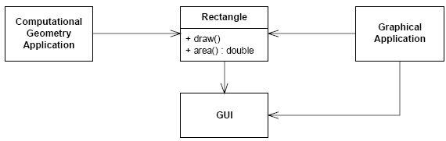
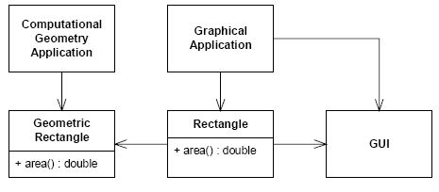
Single Responsibility Principle
Source - Bob Martin link

Slide 20
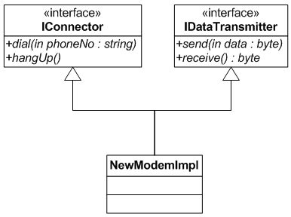
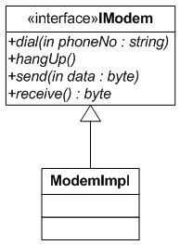
Single Responsibility Principle
Source - Bob Martin link

Slide 21

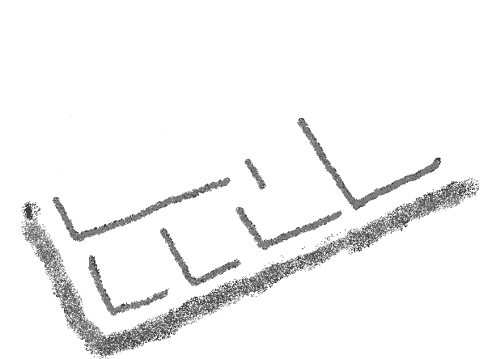
Bowling Game Kata
http://www.xprogramming.com/xpmag/acsBowling
Need: To score a bowling game
Assumptions: The input game would be complete... no need to check valid rolls.
Notes:
- compare with BDUF design
- discuss specs - answer questions if any
- make a test list
- AAA template
- obvious implementation, fake it, triangulate

Slide 22
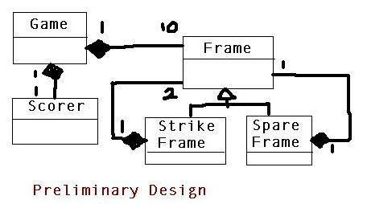
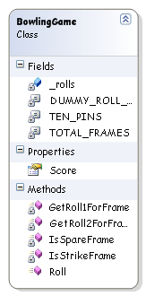
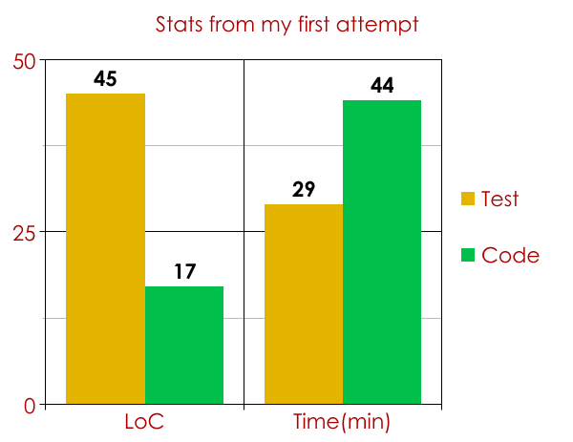
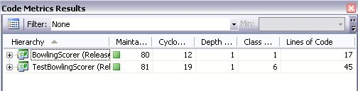
Bowling Game Kata - Review
Vs
test driven
design
Notes:
- take a look at the class diagram
- compare with BDUF design
- VS code analysis - complexity maintenance metrics

Slide 23
Mocks
  State-based or Interaction-based testing?
  Stubs, Fakes or Mocks? The definitive word
  Mock Frameworks - QuickStarts
    Rhino Mocks by Ayende Rahein - Cheat Sheet
      explicit record-replay mode
      major changes with v 3.5
    Moq by Daniel Cazzulino -QuickStart
    Anti Patterns
      I see mocks... everywhere! Fragile tests.
      Avoid the Mocker punch a.k.a testing mocks
      Don't mock stuff you don't own
  "Self-Shunt" is usually a lot simpler than picking up a new mock framework. Each one has a learning curve and quirks. However know when to switch - don't roll your own!
Notes:
Rhino Mocks has a learning curve.
Dynamic Mocks vs Strict Mocks vs Stubs

Slide 24
Mocks 101
Now in Rhino and Moq flavors!
Learn how to
  specify "expected" method calls
  specify expected arguments
  specify method should not be called
  simulate exceptional scenarios
  execute custom code when a method is called on a mock
  raise events from mocked collaborators
Notes:
Rhino Mocks has a steeper learning curve.
Dynamic Mocks vs Strict Mocks vs Stubs

Slide 25
Testing GUIs
TFUI
For "run of the mill" GUIs
  Use the Model View Presenter pattern (thin GUIs)
    Supervising Controller
    Passive View
A Modal dialog can throw a spanner in the works! Abstract them out. See Tim Haughton's User Interrogator article
For "frameworked" GUIs (e.g. Rails, ASP.Net, et. all)
No easy answer - the framework must be built with testability in mind ; find what others are doing and soldier on.
Notes:
The framework designers have a responsibility to lay down the law w.r.t. testing plugins
If not, it's just going to be a bit ugly -

Slide 26
Bowling Game - Changes!
- Design a UI (shown above) which shows real time updates with each roll
- The UI shall have a start button to start a new game
Given:
an interface that tells you
pins scored with each roll
as an event.

Slide 27
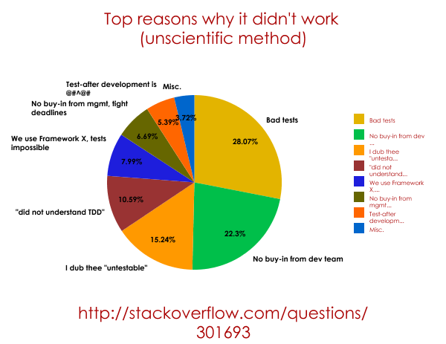
Lies, Damned Lies and Statistics!
42.7% of all statistics are made up on the spot -- Anon.
Notes:
Quoted reasons
Bad tests => high maintenance tests * missed real bugs * take too long to run * spurious failures * mock heavy * test code not maintained
No Buy-in = too much effort for low gain
Untestable = gui n business logic entangled * we have dependency issues *
Test -after => Project is already under way

Slide 28
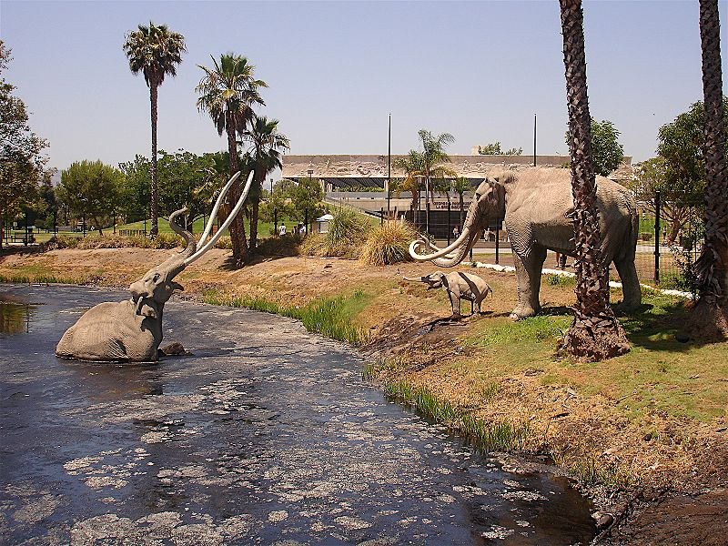

Code = X MLoC, Tests = 0 ; What now?
Buy and read Michael Feathers' book. It's going to be tough work.. Soldier on!
Image courtesy : 3Scandal0

Slide 29
Rule of Thumb
  Think from the client's perspective : Outside-In
  Aim for having at-most one red test case (max two)
  Go to green with the simplest possible change that can work - ugly ones too.
  YAGNI ; Fake it until you make it
  Refactor (ruthlessly) after each green light. Know when to stop refactoring - "BIEGE Principle"
  Keep track of new test cases or refactorings that you come up with on a piece of paper; get to them later and strike them off one by one.
  Factor code into Setup and Teardown - as long as it doesn't obfuscate the test
  Factor cryptic expectations on mocks into human-readable methods.
  Pair program to ensure test/code readablity

Slide 30

Navigating the Barrier Reef
  Understand the principles behind the practices.
  Automated test suite != TFD != TDD
  Start early in the project. Its difficult to change horses mid-race. Stick with it. Code without tests is legacy code. "Broken Windows"
  It's a change in culture. Management and dev/test teams need to buy-in. CHANGE IS HARD!
  High Discipline and expertise is assumed.
  Delay irreversible design decisions till the last responsible moment.
Image courtesy: Mila Zinkova
Notes:
#1 - http://c2.com/cgi/wiki?ShuHaRi
http://en.wikipedia.org/wiki/Dreyfus_model_of_skill_acquisition
#2 - TDD is not just about testing... the real takeaway is the design crystallizing incrementally if you learn to listen to the tests
#3 - Greenfield TDD is much easier than combating Legacy code
#5 - it is assumed that you always do the right thing; not take shortcuts.
Also good programmers create good software. Be aware of patterns / principles / practices reported from the trenches

Slide 31
Navigating the Barrier Reef
  Evaluate the cost to benefit ratio of writing the test. (Stop at Point of diminishing returns)
  Ensure "areas likely to break" have adequate test cover.
  Test code quality is non-negotiable. Tests are your safety net - Design + Defence + Docs.
  Technical Debt chokes velocity. Refactor mercilessly.Don't allow bugs to fester
  TDD Anti-patterns exist. *
* TDD anti-patterns catalogue. Image courtesy: Mila Zinkova
Notes:
#1 - stop writing tests when fear transforms to boredom

Slide 32
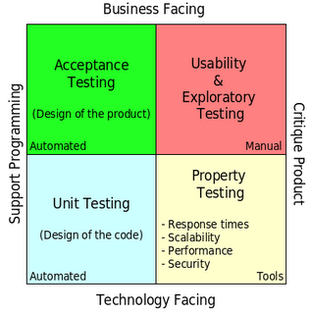
TDD is just one piece of the jigsaw
Source: Brian Marick
Notes:
The left half should be automated
Manual testing should be focussed on the right side.
TDD falls into the lower left quadrant
testers have a different role now.. they're tasked with helping the customers detail out acceptance criteria and working with the dev team to achieve them.

Slide 33

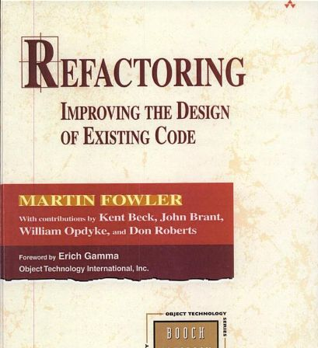
Resources
Books
Test Driven Development By Example - Kent Beck
Refactoring - Martin Fowler
Agile principles, practices and patterns - Robert Martin
Pragmatic Unit Testing with NUnit/JUnit - Dave Thomas, Andy Hunt
Extreme Programming Adventures in C# - Ron Jeffries
Test Driven Development - A Practical Guide - Dave Astels
Extreme Programming Explained - Kent Beck
xUnit Test Patterns - Gerard Meszaros
Online
http://c2.com/cgi/wiki?TestDrivenDevelopment * xprogramming.com * mockobjects.com * refactoring.com
Notes:
- mailing list

Slide 34
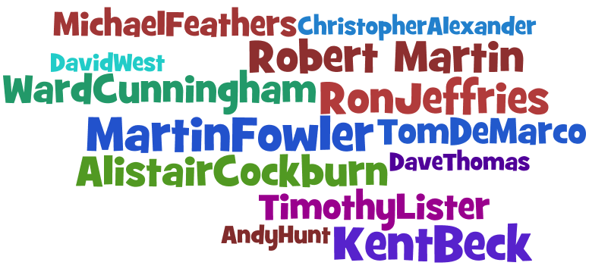
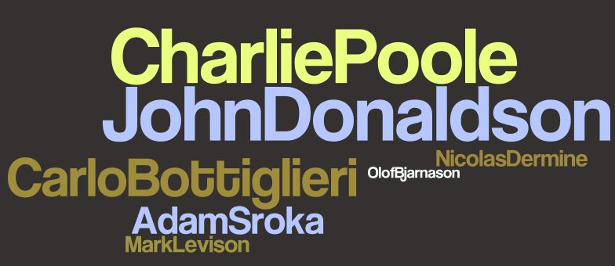
On the shoulders of giants..
Word Cloud from wordle.net
Thank You!
comments / suggestions
gishu.pillai@gmail.com
Thank you reviewers @
testdrivendevelopment yahoogroup

Slide 35
FAQ Wiki-wannabe slide (WIP)
How much unit testing is enough ?
What should I test ?
Is Design Dead? An answer
What about UML, Design patterns and all that good stuff ?
How do we build 'frameworks'?
What is this thing I keep hearing about "Metaphors"?
How much test coverage is enough ?

Slide 36

Idea ScratchPad (WIP)
Difficult to TDD (Maybe.. not impossible)
GUIs
Distributed objects
Database Schema design
Test third party/autogenerated code
Algorithm design
BDD - Domain
Who is TDD intended for ? - TODO
Why it doesn't work
Agile Programming in the Wild
We tried baseball and it didnt work
-

