Slide 1
BUILT IN A WEEKEND · ~950 LINES OF TYPESCRIPT
sandcastle-tdd
Sharpen your tools: fast prototyping, and a pattern
for building systems that actually leverage AI.
Parallel coding agents that can't mark their own work done and ask instead of guessing.
Zach Thieme · team walkthrough
Notes:
Open with the frame, not the repo. Two things I want you to leave with: (1) building your own tools is now a weekend, not a quarter — so build the one you wish existed; (2) making an AI dependable is an engineering problem with real patterns, and this repo is a compact worked example of them.
This is a real tool I use to run my backlog, not a demo. ~950 lines. Let it breathe, then go to the two takeaways.

Slide 2
WHY I'M SHOWING YOU THIS
Two takeaways, one small repo
01
02
Sharpen your tools
Leverage AI as a system
You can build the tool you wish existed in a weekend now. This repo is ~950 lines, 11 commits, 2 days — a real tool I use, not a demo.
Turning a model into something dependable is an engineering problem: who owns "done", what happens on ambiguity, how work stays isolated and resumable.
The bottleneck moved from "can I build it" to "do I know what I want."
The design patterns transfer to anything you build on top of an LLM.
sandcastle-tdd
1
Notes:
State the two threads explicitly so people know which one each later slide serves. Left = the meta-story (fast prototyping, sharpen your tools). Right = the transferable engineering patterns (who owns 'done', what happens on ambiguity, isolation, resume).
Line to land: the bottleneck moved from 'can I build it' to 'do I know what I want.' Everything after this hangs on one of these two hooks.

Slide 3
THE ONE-LINER
Run your backlog as parallel agents
Each task gets a container, a branch, and a TDD loop the orchestrator drives.
A Telegram message — or the local status page — tells you when one needs a decision; commits land on a branch when one succeeds.
Cannot self-certify
"Green" means your test command exited 0 — checked by the orchestrator, never the agent's claim.
Asks instead of guessing
An ambiguous task parks with a question to you rather than inventing an answer.
Parallel, isolated
One branch + worktree + container per task; concurrent tasks can't corrupt each other.
Resumable
A parked or failed agent resumes later with full context — new container, same session.
sandcastle-tdd
2
Notes:
The one-liner. Read it almost verbatim: run your backlog as parallel agents that can't mark their own work done and ask instead of guessing. Each task gets a container, a branch, and a TDD loop the orchestrator drives.
Don't go deep here — the four cards are just a map of the next section. If someone asks 'why not just let the agent run tests itself?', park it — slide 5 answers it.

Slide 4
WHY BUILD IT AT ALL
Raw agents have four failure modes
✕
They grade their own homework
Agents emit "I'm done" over a red test suite. A self-reported success is not a signal you can build on.
✕
They guess when unsure
Faced with an ambiguous spec, a model picks something plausible and moves on — the wrong default, silently.
✕
They step on each other
Run several at once on one tree and they corrupt each other's state; so you serialize, and lose the parallelism.
✕
They lose context on restart
A crash or a stall means starting over — re-deriving everything the previous attempt already figured out.
sandcastle-tdd
3
Notes:
Motivate the design by naming the failure modes everyone in the room has hit. Get nods. The killer is the first one: agents emit 'I'm done' over a red suite — a self-report is a claim, not evidence. The other three (guessing, stepping on each other, losing context) each map directly to a design decision on the next slide.
Transition: 'so the design is really four answers to these four problems.'

Slide 5
THE CORE OF THE DESIGN
Four decisions that make an agent dependable
The orchestrator owns "done"
After every "I'm done," the loop runs your gates inside the sandbox and reads the exit code. Only zero returns green — the agent's own claim decides nothing.
Park, don't guess
On BLOCKED, an exhausted turn budget, or an idle stall: the question + session id are written to disk, the container is torn down, and its slot returns to the pool.
Parallel by default, isolated by construction
One branch, worktree and container per task. A bounded pool keeps N slots full; a park frees its slot immediately, so one stuck task can't starve the other nine.
Resume with context, not restart
A red gate resumes the *same* session with the failure output attached. Answer a parked task days later — fresh process, full context restored from host-side JSONL.
sandcastle-tdd
4
Notes:
This is the intellectual core — slow down. Each principle is an answer to a slide-4 problem: orchestrator-owns-done answers self-certification; park-don't-guess answers guessing; isolation answers collision; resume answers context loss.
The single most important sentence in the whole talk: only a zero exit code is green; the agent's own claim decides nothing. If they remember one thing, make it that.

Slide 6
HOW IT FITS TOGETHER
Architecture at a glance
ORCHESTRATOR
Sandbox 1 agent/task-436
Docker · branch · worktree · TDD loop
GATE exit 0 → green
runs YOUR test command
red → resume same session
• reads your config
• spawns the pool
• runs the gates
• decides green / park
• merges greens
~950 LOC TypeScript
Sandbox 2 agent/task-611
Docker · branch · worktree · TDD loop
PARK → YOU
question to disk; reply in Telegram or the web page
Sandbox 3 agent/task-623
Docker · branch · worktree · TDD loop
COMMIT on agent/<task>
merging stays yours (or campaign)
bounded pool — QUEUE_SLOTS
Human-in-the-loop is asynchronous: a park pings you, frees the slot, and waits — reply from your phone, Telegram or the status page, hours or days later and that exact agent resumes.
sandcastle-tdd
5
Notes:
Walk it left to right, once. Orchestrator reads your config and keeps a bounded pool full. Each task is its own Docker container on its own branch/worktree — that's why they can't corrupt each other. After every 'done', the gate runs YOUR test command inside the box; green commits, red resumes the same session, blocked parks to Telegram.
Emphasise the bottom strip: the human loop is asynchronous — a park frees the slot and waits, so one stuck task never blocks the other nine.

Slide 7
THE HEARTBEAT
The gate → resume loop
1
Agent works test-first
Driven by Matt Pocock's tdd skill: red before green, one vertical slice at a time. Commits as it goes.
2
Emits COMPLETE
The signal contract — a <promise>COMPLETE</promise> — not a free-text "I think I'm done."
3
Orchestrator runs the gates
Inside the sandbox, the real test command. Reads the exit code, ignores the agent's opinion.
4a
Green → commit lands
Exit 0. The branch is left for you to merge (or hands off to campaign).
4b
Red → resume, don't restart
resumeSession re-enters the SAME agent with the failure output attached. It fixes the actual failure, keeping its context.
A failing test isn't a dead end — it's the next prompt. Context is preserved, so the agent converges instead of thrashing.
sandcastle-tdd
6
Notes:
The heartbeat. The non-obvious move is step 4b: a red gate doesn't restart the agent, it RESUMES the same session with the failure output pasted in. So the agent keeps everything it already figured out and fixes the actual failure.
Punchline at the bottom: a failing test isn't a dead end, it's the next prompt. That's why it converges instead of thrashing. Note COMPLETE is a structured signal, not free text.

Slide 8
THE AGENT'S CRAFT IS BORROWED TOO
gh / mattpocock / skills, baked into the image
The container mirrors the mattpocock-skills plugin (pinned to SKILLS_REF) at personal scope — /home/agent/.claude/skills/
The plain claude --print CLI auto-discovers them: no flag, no plugin machinery, zero per-run cost, and off every agent branch.
tdd
codebase-design
code-review
DRIVES THE LOOP
WHEN THE SEAM IS IN QUESTION
THE DEFERRED REFACTOR STAGE
Red before green, one vertical slice at a time, testing at seams, the anti-patterns. This skill governs HOW every agent works test-first.
Reached for when the interface shape itself is unclear — before committing to a contract under test.
The loop defers cleanup to this skill's rules once the test is green.
The load-bearing clause: skills govern how you work; the orchestrator's contract governs whether you're done. A skill's own "done" or internal loop never ends a turn — only the gate does.
sandcastle-tdd
7
Notes:
Callout slide for gh/mattpocock/skills — credit where due. The agent's craft (how to write a good test, test at seams, avoid anti-patterns) isn't mine; it's Matt Pocock's tdd/codebase-design/code-review skills, baked into the container image at build time and auto-discovered by the plain claude CLI. Zero per-run cost, off every agent branch.
The load-bearing clause is the bottom bar: skills govern HOW you work; my contract governs WHETHER you're done. A skill's own notion of 'done' never ends a turn — only the gate does. Ties straight back to slide 5.

Slide 9
ANSWER FROM YOUR PHONE
Blocking is a feature, not a failure
WHEN AN AGENT PARKS
🤖 sandcastle bot
Task 436 needs a decision
The question is written to disk
.sandcastle/parked/<task>.json — question, session id, branch, message id.
Cache key: per-user or global?
A — per-user, safer, slower
B — global, faster, riskier
The container is torn down
Parking is terminal for the slot, never a held container. One stuck task can't starve the pool.
You get a Telegram message
Its summary, detail, and the options the agent laid out.
↳ "Use approach B, note
why in the commit"
You reply → it resumes
Reply in Telegram or on the status page; the dispatcher routes it to that exact task — fresh container, full context, days later if you like.
reply in Telegram or the status page — that's the whole UI
one poller, run as a systemd user service (survives reboot)
sandcastle-tdd
8
Notes:
Reframe blocking as a feature. When an agent hits genuine ambiguity it writes its question + session to disk, tears down the container (frees the slot), and messages me. I reply to that message from my phone — hours or days later — and that exact agent resumes with full context.
The phone mock on the right is the entire UI. No dashboard. Mention it runs as a systemd user service so a park raised after I close my laptop still reaches me.

Slide 10
BEYOND ONE TASK
Campaign mode: merge the whole backlog safely
Hand the merge → test → next-batch chain to one command. Each quoted arg is a batch of disjoint tasks.
npx sandcastle-tdd campaign "436 611 623" "640 655"
1. Drain the batch
Run every task in the batch to green-or-parked.
2. Merge only its greens
--no-ff into the base. Parked tasks are never merged or cleaned.
3. Gate the MERGED base
The each-green-but-together-red case a per-task gate can't catch.
4. Advance — or halt & roll back
Success: prune branches, start next batch on the advanced base. Conflict or red: halt, restore the base, keep every branch, ping you.
sandcastle-tdd
9
Notes:
One level up from single tasks: hand the whole merge→test→next-batch chain to one command. Each quoted arg is a batch of disjoint tasks.
The clever bit is step 3: after merging a batch's green branches it re-runs the full gate on the MERGED base — catching the 'each green alone but together red' case a per-task gate structurally cannot see. And it's safe: a conflict or red merged base halts, rolls the base back, and keeps every branch. Nothing is lost.

Slide 11
SEE THE WHOLE CAMPAIGN
A live status dashboard
npx sandcastle-tdd status — a local web page for the whole run.
No new services: it reads the same JSONL the orchestrator already writes.
Waves at a glance
Answer parked issues inline
On your phone, over the tailnet
Every wave with its issue chips — green completed, yellow parked, blue running. Finished waves collapse behind a green check.
Blocked tasks jump to the top with an “N awaiting you” badge. Type a reply — here or in Telegram — and the dispatcher resumes that exact agent.
Toggleable auto-refresh, a dismissible detail bar, and tailnet access via --host 0.0.0.0 — reach it from your phone, and it never clobbers a reply you’re typing.
Reads state, writes answers — reply here or in Telegram, same dispatcher, same resume.
sandcastle-tdd
10
Notes:
This is the newest addition: a status command that serves a local dashboard for a running campaign. It's deliberately thin — it reads the orchestrator's JSONL event log and the parked/ records, and the only thing it writes is your answer to a parked task, which it hands to the same 'answer' path the CLI uses. Left card: every wave and issue is a chip color-coded by state; closed waves collapse to a green check so the active work is what you see. Middle card: parked issues — the only thing that needs a human — float to the top with a count badge; you answer inline and the dispatcher resumes that agent. Right card: it's usable from a phone on the tailnet, auto-refresh is a checkbox, and the refresh won't fire while you're mid-reply. The point: it's a read-only lens plus one write, not a second system to keep alive.

Slide 12
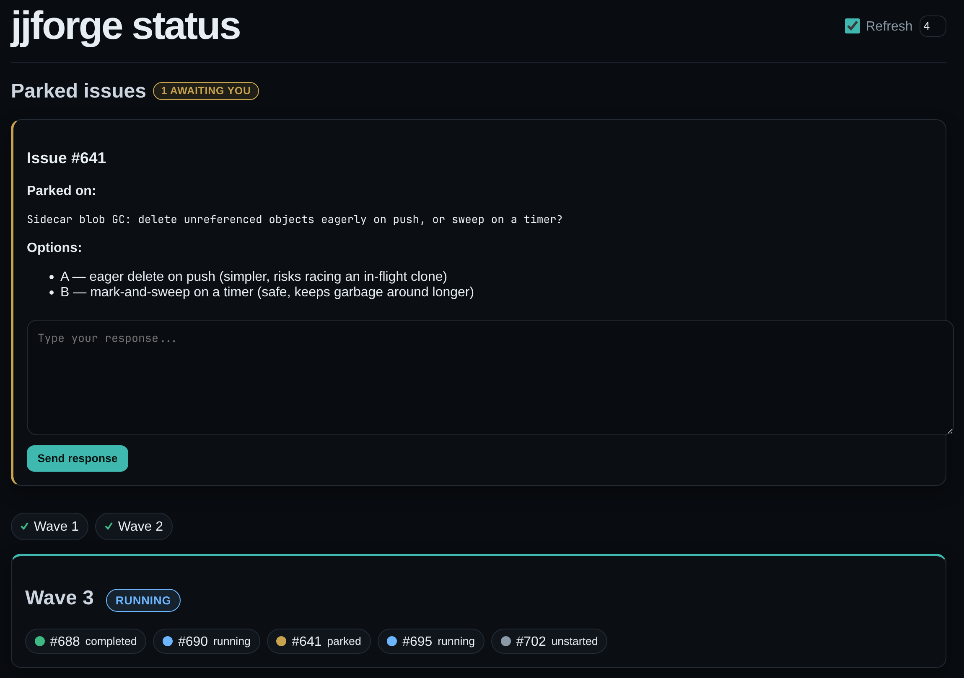
THE DASHBOARD, LIVE
The whole run, in one glance
Parked issues rise to the top
An “N awaiting you” badge; the blocked task sits above the waves.
Answer inline → it redrives
Type a reply and the dispatcher resumes that exact agent — the same redrive as answering in Telegram.
Served locally, reached anywhere
No new services — it reads the orchestrator's JSONL; open it from your phone over the tailnet.
sandcastle-tdd
11

Slide 13
FROM ZERO TO SHIPPED
What we built, and when
Four days, one small repo. Most of it is the loop; the rest is leverage.
Aug 16
Aug 17
Aug 18
Aug 19
Orchestrator
Skills baked in
Campaign mode + deck
Status dashboard
• Parallel TDD agents that can't self-approve
• Park instead of guessing
• ~950 lines, 13 files, no framework
• mattpocock tdd / codebase-design / code-review
• Mirrored into the agent image
• Auto-discovered, zero per-run cost
• Merge the whole backlog wave-by-wave
• Gate the merged base, halt & roll back on red
• Team deck: design + velocity proof
• Live campaign view, parked answers inline
• On your phone over the tailnet
• CHANGELOG + v0.1.0 tag
sandcastle-tdd
12
Notes:
A quick recap of the arc so it's clear how much of this is recent. Aug 16: the core orchestrator — the loop that owns 'done', parks on blocks, and resumes on red — in about 950 lines of TypeScript. Aug 16 to 18: campaign mode, which merges a whole backlog wave by wave and runs the gate on the merged base, plus baking the mattpocock skills into the image so every agent has them. Aug 18: this deck. Aug 19: the status dashboard we just walked through, plus housekeeping — a CHANGELOG and the v0.1.0 tag. The takeaway mirrors slide two: the leverage isn't volume of code, it's the loop plus borrowed tools.

Slide 14
BY THE NUMBERS
Small enough to hold in your head
~950
2
11
13
lines of TypeScript
days, Aug 16–17
commits, start to useful
source files, no framework
It's a thin orchestration layer, not a platform.
954 lines — yours ↓
~76,500 lines you didn't write · @ai-hero/sandcastle: Docker sandboxing, the agent, session capture
Your own code is 1.2% of what runs — and it's where “done” is defined.
sandcastle-tdd
13
Notes:
Step out and make the 'sharpen your tools' argument. ~950 lines, 2 days, no framework. Then the proportion bar: that 954 is 1.2% of what actually runs — the other ~76,500 lines are @ai-hero/sandcastle (Docker sandboxing, the agent, session capture), none of it mine and none of it counted.
The point isn't 'I wrote little.' It's that the leverage is in choosing the right primitive and wiring it with the right guarantee. That 1.2% is exactly where the 'agents can't grade themselves' rule lives. Segue: does it actually work?

Slide 15
DOES IT ACTUALLY MOVE WORK?
3 days on a real Go + Rust monorepo
Every agent/<task> merge on develop landed in one 3-day burst — starting the day sandcastle-tdd was first committed.
NOT A TOY TARGET — ONE MONOREPO, FOUR PARTS
Forgejo fork
jj fork
Sidecar
jjf CLI
⚠ a VCS whose whole job is
to never lose your work
Go · web forge
Rust · the VCS
Rust · sync + blobs
the platform client
69
184
43
day 0
tasks merged Aug 16–18
commits authored by the agent
tasks merged in the peak day
shipping the day the tool was born
BEFORE
One task at a time, by hand. Each agent run babysat: is it really green? did it just guess?
AFTER
A backlog drained in parallel — ~23 tasks/day merged, gated on real tests, questions routed to your phone.
(counts from git history on jjforge's develop; the tool was extracted from this exact project.)
sandcastle-tdd
14
Notes:
The evidence. Every agent/<task> merge on jjforge landed in one 3-day burst that starts the day this tool was first committed — built it and immediately shipped with it. 69 tasks merged, 184 agent commits, 43 in the peak day.
The chip row is the important context: this isn't a toy. jjforge is a four-part monorepo — a Forgejo fork (Go), a jj fork (Rust), a Rust sidecar, and a client — hosting a version-control system whose entire promise is that it can't lose your work. That's the highest-stakes place imaginable to trust a test gate, which is the whole point. (Numbers are straight from git history; be ready to show the log.)

Slide 16
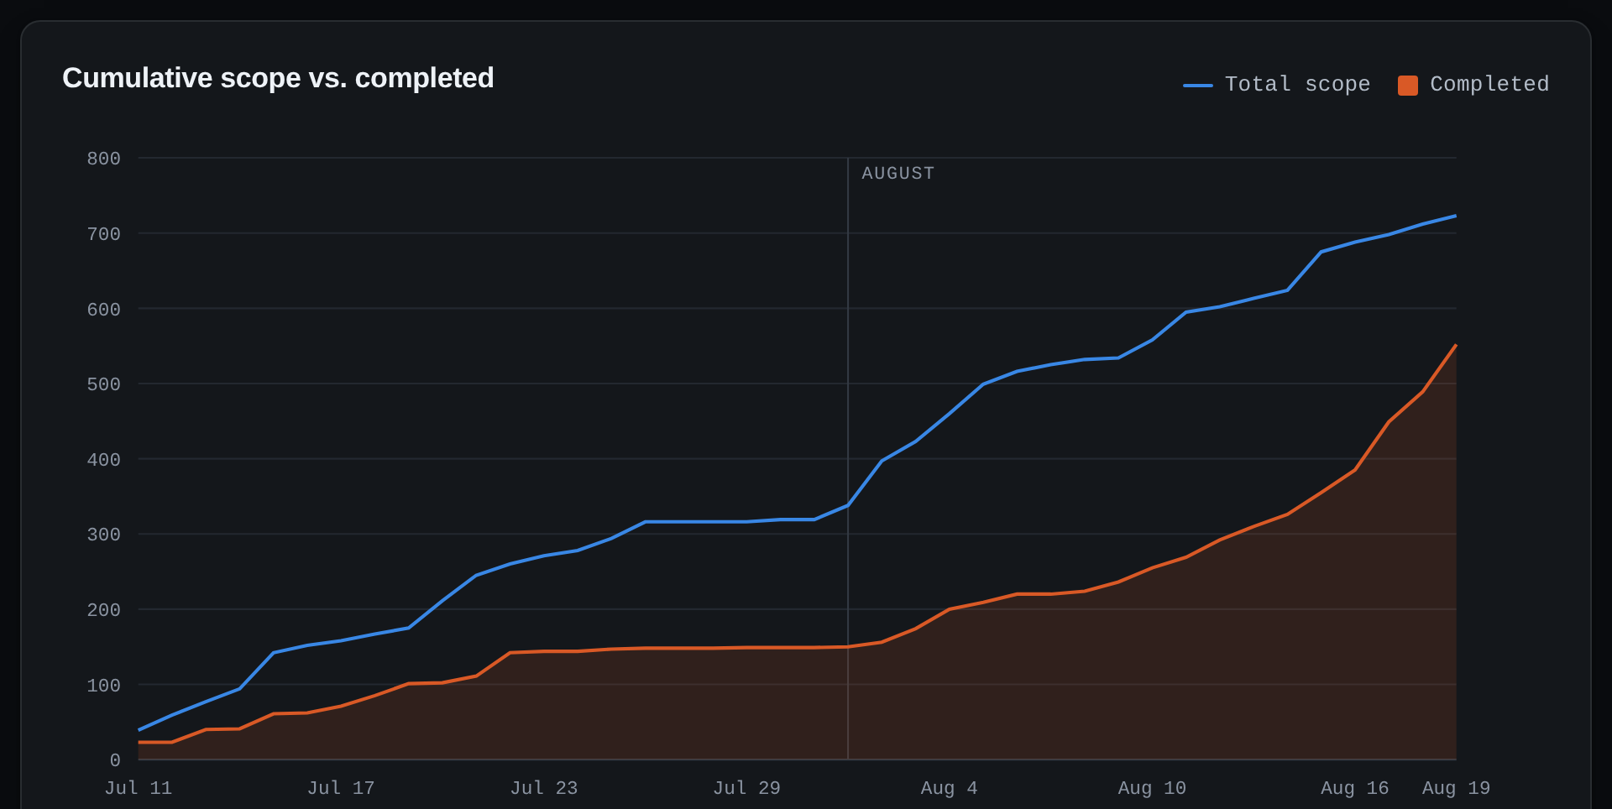
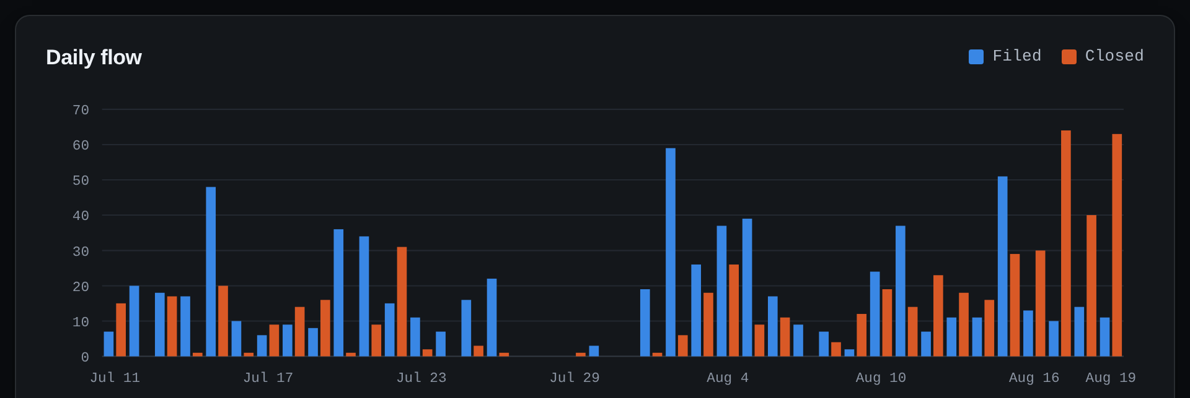
PROOF ON THE BURN-UP
Scope raced ahead — then the agents caught it
Filed vs. closed per day.
The Aug 16–19 closing spike is sandcastle-tdd draining the backlog — the same 3-day burst.
Total scope vs. completed across jjforge — 40 days.
From jjforge's own report — make issue-burnup, live GitHub issues.
sandcastle-tdd
15

Slide 17
HOW THE TOOL STAYS SHARP
Iteration tricks worth stealing
Cheapest failure first
baseline runs the toolchain probe + every gate with no agent. A failing baseline costs nothing; a passing one means any later red is the agent's doing.
Contract checks in ~1s
check-contract probes the upstream library's runtime behaviour (no Docker) — catches a renamed export that tsc alone would miss.
Warm caches, measured
Shared package caches took a cold gate from 2571s → 330s. Share caches; never share build outputs.
Config as typed code
defineConfig is a typed .mts file — a renamed field fails tsc, not a run. Everything project-specific lives in one place.
Skills baked into the image
The agent container mirrors a pinned skills plugin at build time — every task's agent gets them, zero per-run cost.
Rules paid for in failed runs
Each hard-won lesson is written down as a load-bearing operating rule, so it's never re-learned the expensive way.
sandcastle-tdd
16
Notes:
How the tool stays sharp — techniques that generalise. Cheapest-failure-first: baseline runs the toolchain + every gate with NO agent, so a broken image fails for free before you spend on a model. check-contract probes the upstream library's runtime behaviour in ~1s. Warm caches took a cold gate from 2571s to 330s — measured, not guessed.
Don't read all six; pick two that resonate with this audience and move. The meta-point: sharp tools come from fast, cheap feedback loops.

Slide 18
LESSONS ENCODED, NOT REPEATED
Operating rules paid for in failed runs
"Each of these was paid for in a failed run. They are not style preferences."
1
Never two runs of one task — Git refuses one branch in two worktrees — even your manual review worktree blocks that task's resume.
2
Share package caches; never build outputs — Caches are the single biggest win; a shared build dir converts parallelism back into lock contention.
3
Host-only env in hostEnv, not .env — .env reaches the container. GIT_CONFIG_GLOBAL is the classic trap that breaks a project's git tests inside the box.
4
Your gates set the concurrency ceiling — A full suite per turn is CPU-bound; 2–3 slots is realistic on one workstation, and agents share your rate limits.
5
Batch disjoint files, no dependencies — Crossover shows up as a visible merge conflict; a hidden dependency merges clean and green against the old contract.
sandcastle-tdd
17
Notes:
These are scar tissue — every rule was paid for by a failed run, so I wrote it down instead of re-learning it. Call out #2 (share package caches, never build outputs — that's the 2571→330 win, and sharing a build dir silently reintroduces the lock contention containers exist to kill) and #3 (host-only env in hostEnv, not .env — GIT_CONFIG_GLOBAL leaking into the container breaks the fork's own git tests).
The transferable habit: turn each incident into a written rule. That's what 'sharpening' actually is.

Slide 19
DON'T BUILD WHAT YOU CAN BORROW
What the ~950 lines actually leverage
@ai-hero/sandcastle
Claude Code CLI
Docker sandboxes + session capture. The primitive that makes park→resume survive a fresh process.
The plain claude --print CLI is the agent. No SDK, no custom runtime — runs on your subscription token.
mattpocock skills
git worktrees + branches
tdd, codebase-design, code-review — auto-discovered in the container. The agent's craft, borrowed wholesale.
The isolation primitive. One branch per task, and git itself refuses the double-run that would corrupt state.
Telegram bot API
Docker
The entire human-in-the-loop UI. Reply to a message; no dashboard to build or host.
Concurrency without collision. Containers turn a shared workstation into N isolated ones.
The skill isn't writing every layer — it's knowing which layers already exist and composing them with the right contract.
sandcastle-tdd
18
Notes:
Make the 'borrow the hard parts' point concrete. My value wasn't writing a sandbox or an agent — it was composing sandcastle + the Claude CLI + Matt's skills + git worktrees + a Telegram bot, with the right contract between them.
Tie back to the 1.2% from slide 11. The skill on display is knowing which layers already exist and refusing to rebuild them.

Slide 20
STEAL THESE
Patterns to take back to your own work
Never let an agent grade itself
Own "done" outside the model — a real signal (exit code, checksum, human), never its self-report.
Make ambiguity park, not guess
Design an explicit "I need a human" path. A blocked agent that asks beats a confident one that's wrong.
Isolate, then parallelize
Give each unit its own sandbox and branch. Parallelism is safe only when work can't collide.
Resume beats restart
Persist enough state that failure is the next prompt, not a reset. Context is the expensive part.
Borrow the hard parts
Sandbox, agent, skills, transport — compose what exists. Your value is the contract between them.
Encode every lesson once
Turn each failed run into a written rule. Sharpen the tool so you never pay that cost twice.
sandcastle-tdd
19
Notes:
The 'steal these' slide — the part I actually want them to apply Monday. Walk the six quickly: own 'done' outside the model; give ambiguity an explicit ask-a-human path; isolate before you parallelize; persist state so failure is the next prompt not a reset; borrow the hard parts; encode every lesson once.
These are provider- and project-agnostic — they apply to anything you build on an LLM, not just coding agents.

Slide 21
THANKS — LET'S TALK
Build the tool you wish existed.
The bottleneck isn't building anymore — it's knowing what you want
and giving the AI the guardrails to be dependable.
github: jjforge/sandcastle-tdd
Built on @ai-hero/sandcastle · Questions?
Notes:
Land the plane on the thesis: build the tool you wish existed. The bottleneck isn't building anymore — it's knowing what you want and giving the AI the guardrails to be dependable.
Invite them in: it's on github (jjforge/sandcastle-tdd), built on @ai-hero/sandcastle. Open for questions — and I can show a live park→answer round-trip if there's interest.

Slide 22
APPENDIX
Go
Rust
jjforge architecture — the target this ran against
CLIENTS
Web browser
jj fork · Rust
jjf CLI
the web forge UI
jj forge push / pull / clone
platform ops: repos, issues, reviews
Caddy — reverse proxy · TLS ingress
Forgejo fork Go · git subtree
Sidecar Rust
web UI · auth · issues · change-based code review
• jj sync protocol — push / pull / clone
• browse API for the forge UI
• content-addressed blob storage
VCSBackend interface
JjBackend (active) · GitBackend (present, unreachable)
JjBackend
PostgreSQL
forge metadata: users, issues, reviews
Blob storage
content-addressed object store
Flow: browser & jjf CLI → Forgejo; jj CLI → sidecar (native jj sync, no git-compat layer). Forgejo's JjBackend calls the sidecar's HTTP API for all repo content — git hosting is present but disabled. Both forks are vendored as git subtrees.
sandcastle-tdd · appendix
Notes:
Backup slide — pull it up only if someone asks 'what actually is jjforge?' or wants proof it's a serious target. It's jj-native repository hosting: push/pull/clone Jujutsu repos over a native sync protocol with no git-compat layer.
Four parts: a Forgejo fork (Go) for the web forge, a jj fork (Rust) for the CLI, a Rust sidecar that speaks the sync protocol and stores content-addressed blobs, and the jjf CLI. Browser and jjf CLI hit Forgejo; the jj CLI hits the sidecar. Forgejo dispatches all repo content through a VCSBackend interface — JjBackend calls the sidecar over HTTP; git hosting exists but is disabled. Both forks are vendored as git subtrees. Point: a full hosting stack where a green test genuinely protects people's version history.

