Slide 1

Monthly joint seminar of QFRG and DSLab, University of Warsaw, Faculty of Economic Sciences
Ontology as a hyperparameter: Task-aware knowledge graph construction using LLMs
Jan Frąckowiak, Piotr Wójcik and Michał Sierakowski
Monthly joint seminar of QFRG and DSLab 13th April 2026
Ontology as a hyperparameter: Task-aware knowledge graph construction using LLMs 13th April 2026
Notes:
I hope after todays presentation you will be at least half as interested about KGs as I am. Maybe you will be even able to think of example use case for them in your domain.

Slide 2

Agenda
Monthly joint seminar of QFRG and DSLab, University of Warsaw, Faculty of Economic Sciences
History Textbook Example
Knowledge Graph Structure
Motivation
Related Work & Positioning
Core Idea
Application: Financial News
Preliminary Results
Research Expansion & Expected Contributions
Ontology as a hyperparameter: Task-aware knowledge graph construction using LLMs 13th April 2026
Notes:
I will walk you through an example of a task involving knowledge graphs, then gradually move to the current state of research, which serves as my starting point, and finally present my idea.

Slide 3



History Textbook Example
Monthly joint seminar of QFRG and DSLab, University of Warsaw, Faculty of Economic Sciences
History textbook describing general history of Poland.
How using these texts can we predict the outcome of the next military conflict?
?
Ontology as a hyperparameter: Task-aware knowledge graph construction using LLMs 13th April 2026
Notes:
Let’s make this concrete with a simple example. Imagine we have a history textbook—say, on Polish or European history.
Now suppose we’re interested in military conflicts and we want to predict the outcome of the next one—will it be a victory or a defeat?—based on relevant information from the text.
What would you look at? Any thoughts?

Slide 4
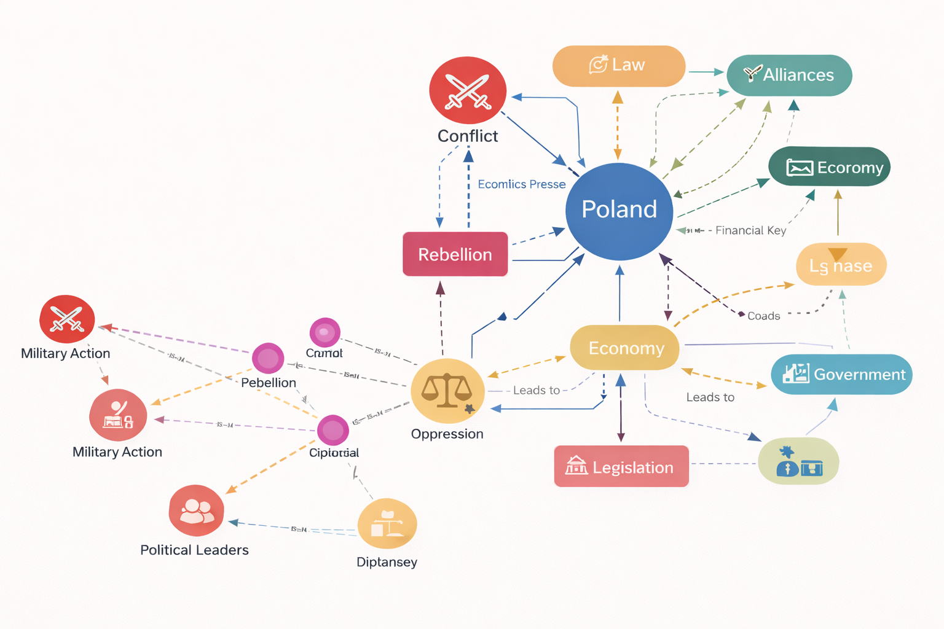
History Textbook Example
Monthly joint seminar of QFRG and DSLab, University of Warsaw, Faculty of Economic Sciences
Which events, actors, alliances matter?
Prediction depends on identifying correct entities and relations between them (representation/graph)
Ontology as a hyperparameter: Task-aware knowledge graph construction using LLMs 13th April 2026
Notes:
Michał, our historian, could probably point out all the flaws in our answers — but they all share one idea: representation.
The better we identify relevant entities and relationships, the better our predictions become and the fewer errors we make.

Slide 5
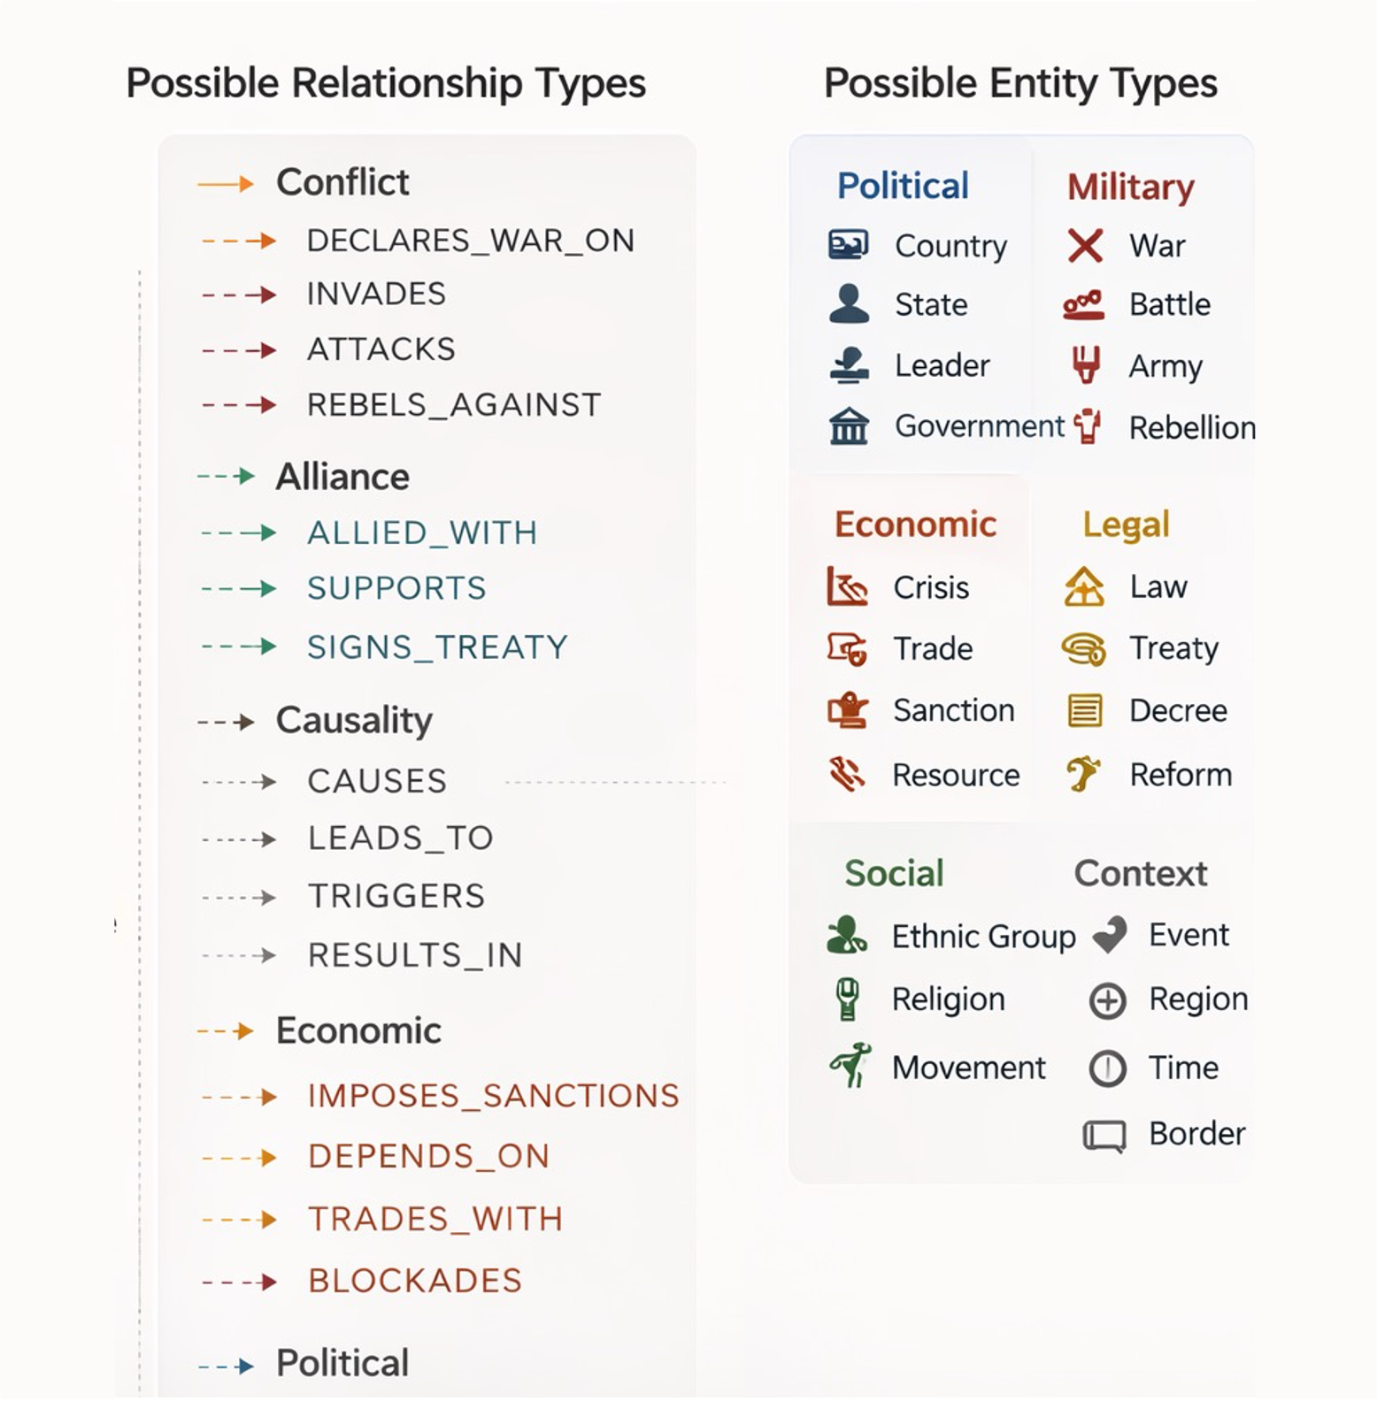
Monthly joint seminar of QFRG and DSLab, University of Warsaw, Faculty of Economic Sciences
Knowledge Graph Structure
Ontology = structure organising representation
Selecting relationships and categories changes predictions.
Graph geometry determines predictive power
Ontology as a hyperparameter: Task-aware knowledge graph construction using LLMs 13th April 2026
Notes:
Formally, what we discussed on the previous slide is called a knowledge graph.
A knowledge graph is a deceptively simple structure: it consists of entities—for example, political actors, economic factors, or events—and the relationships between them.
For instance, the price of a strategic resource may depend on an economic event, or one country may impose sanctions on another. These are all relationships captured in the graph.
The selection of entities and relationships shapes the geometry of the graph, and the other name for this selection is ontology. (I am sure the term rings a bell for philosphers)
A well-designed ontology is therefore critical for strong task performance.

Slide 6
Motivation
Monthly joint seminar of QFRG and DSLab, University of Warsaw, Faculty of Economic Sciences
Evolution of AI Systems: LLMs -> AI Agents -> Specialisation and tooling
Increasing reliance on knowledge graphs built from text
Multiple tasks: question answering, network analysis, prediction tasks
Limitations of current approach to KGs
Frameworks for KG construction are static (neo4j, llamaindex)
KG’s are mostly evaluated structurally.
Question: Can KG construction be optimized with a specific task in mind?
Ontology as a hyperparameter: Task-aware knowledge graph construction using LLMs 13th April 2026
Notes:
I think we can already see that knowledge graphs are very versatile structures
. But I want to argue that they also play an important role in the evolution of AI systems.
If you follow recent AI developments, you’ve probably seen the progression: first LLMs, then AI agents—systems that use LLMs to solve specific tasks.
Now, the focus is shifting toward specialization and tooling—making these systems more effective by giving them structure and memory.
This is where knowledge graphs come in. They act as structured memory for LLM-based systems, organizing information in a way that makes it usable.
Knowledge graphs are already used in many tasks: question answering, prediction, and network analysis.
However, current approaches are quite limited.
Most frameworks for knowledge graph construction are static—the structure is defined once and does not adapt.
At the same time, knowledge graphs are typically evaluated structurally (e.g. connectivity or size), rather than based on performance in a specific task.
This leads to a key question:
Can we treat knowledge graphs as dynamic, evolving structures and optimize their design for a specific task?

Slide 7
Related Work & Positioning
Monthly joint seminar of QFRG and DSLab, University of Warsaw, Faculty of Economic Sciences
Structural KG Evaluation Paulheim et al. (2024) — structural vs downstream quality metrics Choi & Jung (2020) — GEval framework
Task-Based Evaluation Frameworks using KGs GEval (2020), Kgbench (2022), LLM-KG-Bench (AKSW, 2024) Heist et al. (2023) — KGrEaT with KG as evaluation target
Task-Guided KG Construction Kovács et al. (2023) — competency-question-driven construction Li et al. (2025) — construction supported with RL methods
Gap : No lightweight error-driven ontology adaptation.
Ontology as a hyperparameter: Task-aware knowledge graph construction using LLMs 13th April 2026
Notes:
To answer this question, I first looked at the existing research in the field.
As mentioned earlier, there are well-established frameworks for structural evaluation of knowledge graphs. More recently, task-focused evaluation frameworks have also emerged.
Some work has started to move closer to my idea.
For example, Kovács et al. propose competency-question-driven construction, where the graph is guided by the questions. There are also approaches that use reinforcement learning to fine tune LLM extractor with respect to a task-specific reward.
However, these methods still do not fundamentally tamper with ontology.
They either guide construction without truly adapting the structure, or they rely on complex optimization setups.
What I did not find is a lightweight, iterative, error-driven approach to adapting the ontology itself.
And this gap is exactly what motivated my work.

Slide 8
Core Idea
Monthly joint seminar of QFRG and DSLab, University of Warsaw, Faculty of Economic Sciences
Treat Ontology as Hyperparameter
Close the Loop
Use evaluation results to refine construction
Adjust ontology settings for optimal performance
Evaluate Downstream Performance
Generate KG Variants
Create multiple versions of the knowledge graph
Assess graph effectiveness on specific tasks
Ontology as a hyperparameter: Task-aware knowledge graph construction using LLMs 13th April 2026
Notes:
My idea is to treat the ontology as a target of optimization and extract as much value from it as possible.
I generate multiple variants of the knowledge graph, evaluate them using a specific downstream metric, and then use these results to iteratively refine the construction process.

Slide 9
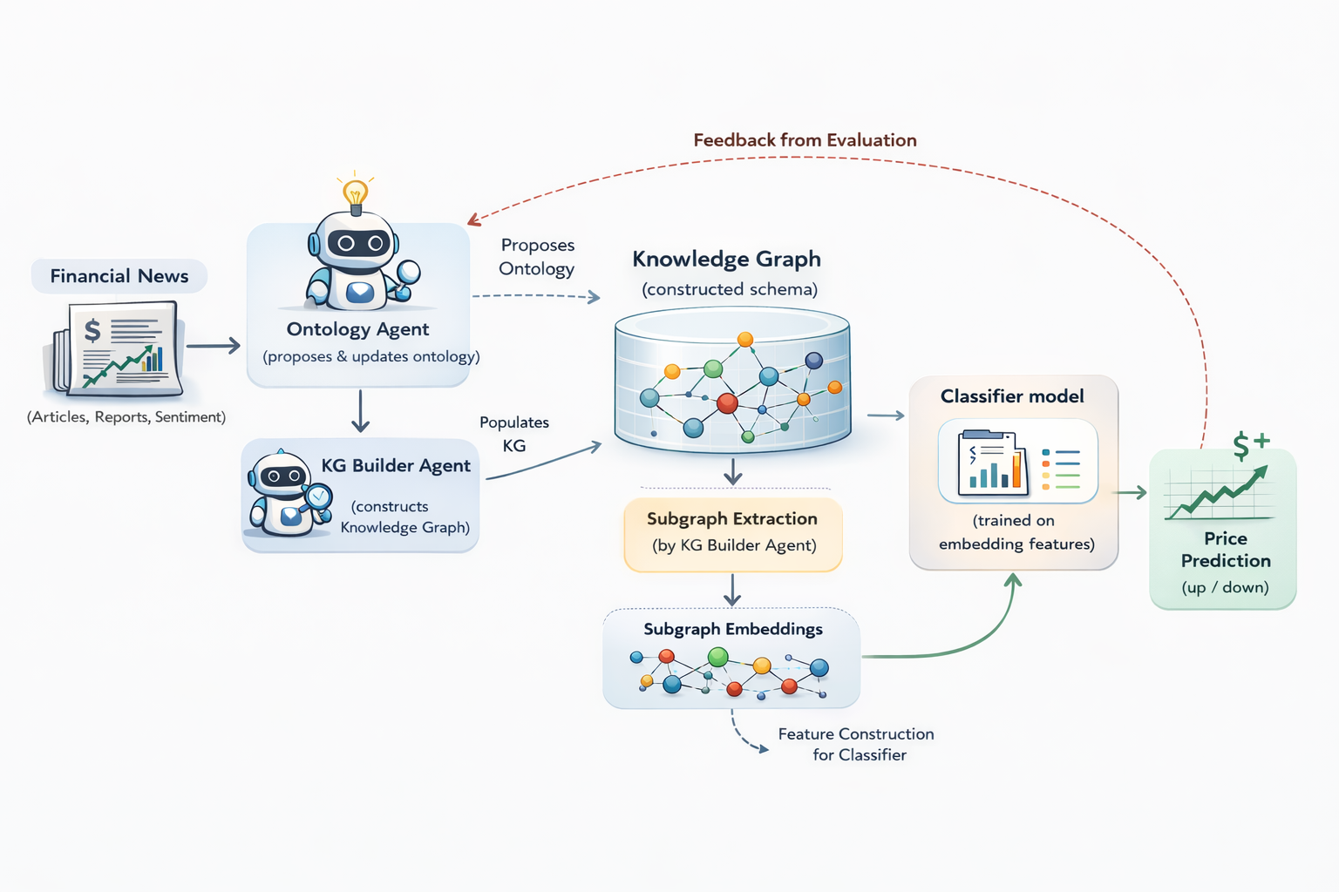

Application: Task-aware KG based on Financial News
Monthly joint seminar of QFRG and DSLab, University of Warsaw, Faculty of Economic Sciences
Ontology as a hyperparameter: Task-aware knowledge graph construction using LLMs 13th April 2026
Notes:
Here we can see this idea applied in practice—this is my first use case, combining computer science with economics.
The goal is to represent a stream of financial news related to S&P 500 companies as a temporal knowledge graph, and use it to predict the direction of price movements.
The system has two main components: knowledge graph construction and evaluation.
The construction process is handled by two agents: an ontology agent, which proposes candidate ontologies, and a graph builder, which processes the text and constructs the graph.
The evaluation step is more involved. Each day of market activity is represented as a subgraph, which is then transformed into a numerical representation (embeddings) and fed into a classification model.
Finally, the evaluation results are fed back into the construction process—better-performing candidates are retained, while weaker ones are discarded.
This creates a closed loop of iterative improvement.

Slide 10
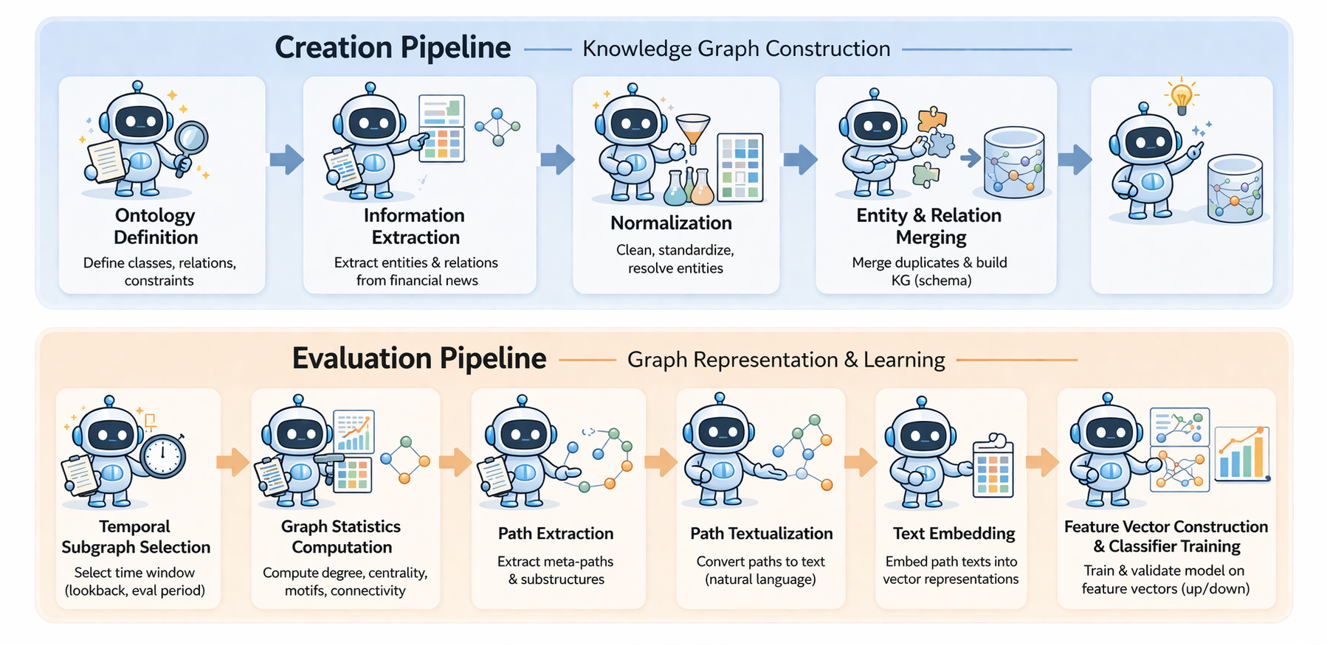
Detailed Processing Pipeline
Monthly joint seminar of QFRG and DSLab, University of Warsaw, Faculty of Economic Sciences
Ontology as a hyperparameter: Task-aware knowledge graph construction using LLMs 13th April 2026
Notes:
Here we can see this idea applied in practice—this is my first use case, combining computer science with economics.
The goal is to represent a stream of financial news related to S&P 500 companies as a temporal knowledge graph, and use it to predict the direction of price movements.
The system has two main components: knowledge graph construction and evaluation.
The construction process is handled by two agents: an ontology agent, which proposes candidate ontologies, and a graph builder, which processes the text and constructs the graph.
The evaluation step is more involved. Each day of market activity is represented as a subgraph, which is then transformed into a numerical representation (embeddings) and fed into a classification model.
Finally, the evaluation results are fed back into the construction process—better-performing candidates are retained, while weaker ones are discarded.
This creates a closed loop of iterative improvement.

Slide 11
Research Hypotheses
Monthly joint seminar of QFRG and DSLab, University of Warsaw, Faculty of Economic Sciences
Hypothesis 1: Task-aware knowledge graph construction improves prediction accuracy in node-level price movement classification.
Hypothesis 2: Task-aware optimization enables smaller knowledge graphs while maintaining or improving downstream task performance.
Hypothesis 3 : Iterative, task-driven construction produces more informative graph structures and facilitates the identification of effective ontologies.
Ontology as a hyperparameter: Task-aware knowledge graph construction using LLMs 13th April 2026
Notes:
Now that we now what we are talking about I can describe more to reaserch questions there are three most imporatant.

Slide 12
Monthly joint seminar of QFRG and DSLab, University of Warsaw, Faculty of Economic Sciences
Preliminary Results
Ontology as a hyperparameter: Task-aware knowledge graph construction using LLMs 13th April 2026
Notes:
I have already developed a working prototype and am now moving to a cloud environment to conduct larger-scale experiments.
The initial results are promising with respect to the stated hypotheses.

Slide 13
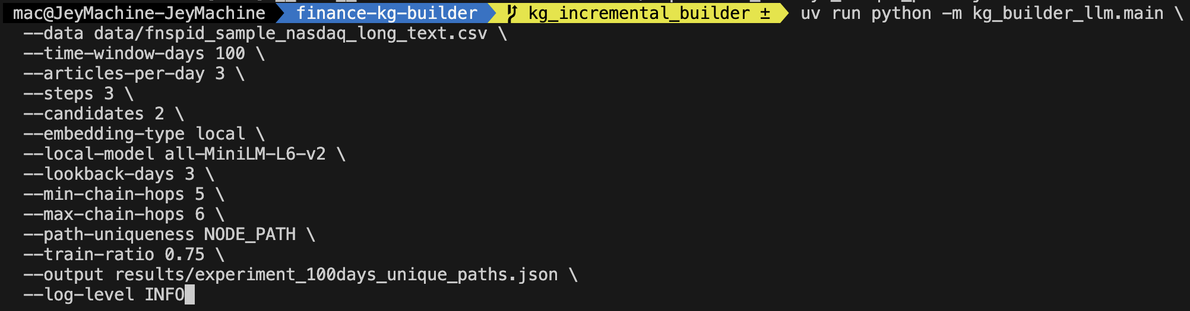
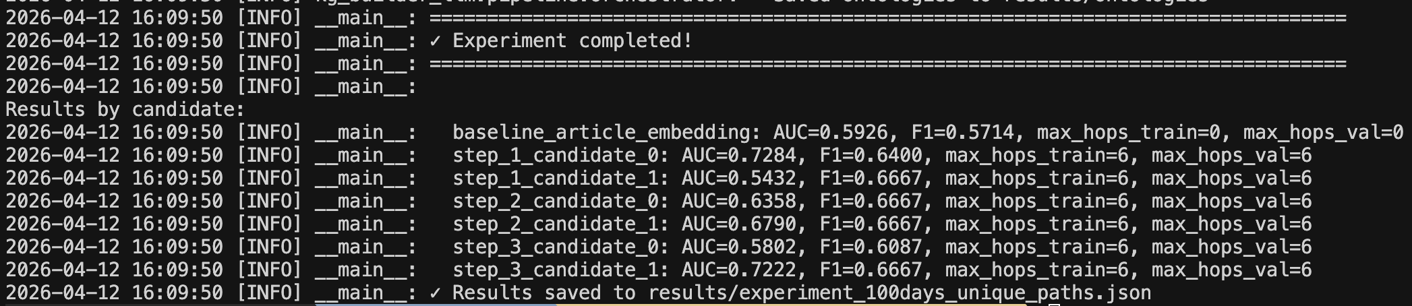
Example kg_builder run
Monthly joint seminar of QFRG and DSLab, University of Warsaw, Faculty of Economic Sciences
Ontology as a hyperparameter: Task-aware knowledge graph construction using LLMs 13th April 2026
Notes:
This is an example run of the system. There are several parameters, but I will briefly explain the most important ones.
We can specify the number of graph evolution steps, as well as how many candidate graphs are evaluated at each step. There are also constraints on the graph representation and the embeddings used during evaluation.
Below, you can see the results for this configuration.
The AUC score does not reach very high values, but what is important is the consistent improvement in predictive accuracy across iterations.
This gradual increase is exactly the behavior we are aiming for.
I am constrained to local machine today
I had the urge to misrepresent it and show a story of gradual increase but I think it is better to just show that…

Slide 14
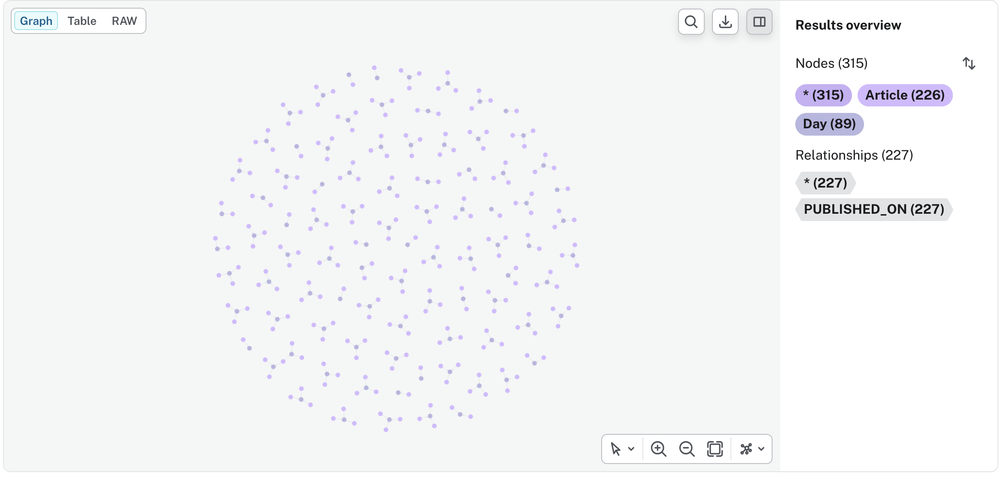
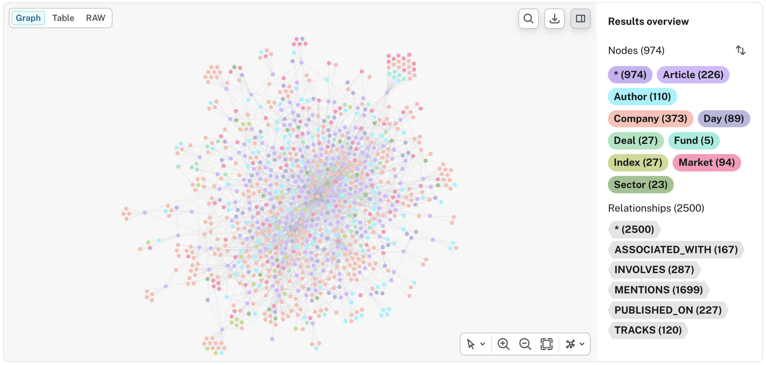
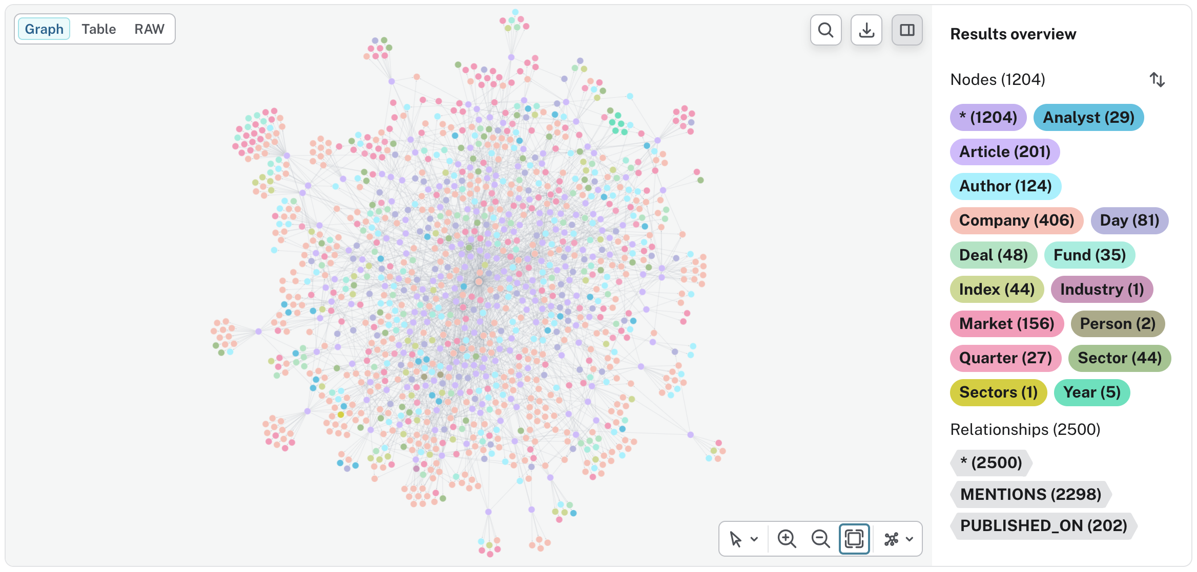
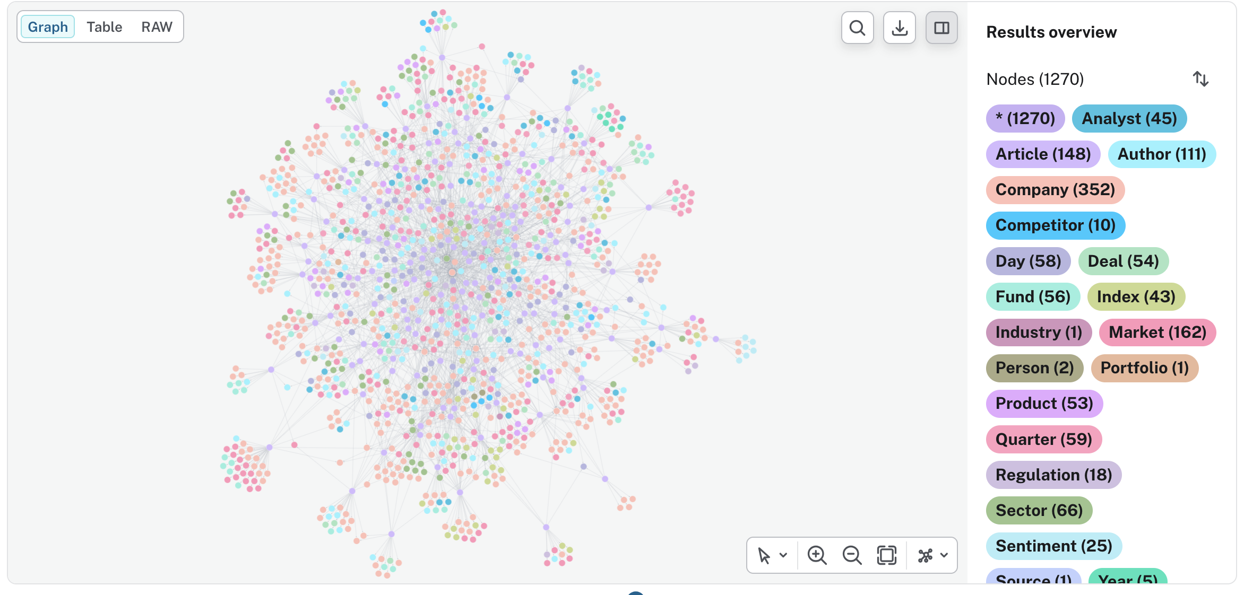
Knowledge Graph Growth
Monthly joint seminar of QFRG and DSLab, University of Warsaw, Faculty of Economic Sciences
0
1
2
3
Ontology as a hyperparameter: Task-aware knowledge graph construction using LLMs 13th April 2026
Notes:
Here we can see something visually intuitive.
This is the graph produced by the run I showed earlier.
As the process evolves, the number of nodes increases at each stage, indicating that the ontology itself is being expanded and refined.
WE can also see one imporatnat trait of this system: connections emerging inbetween entities mentioned in different articles.
(Wejść do interfejsu I tak pokazać to)

Slide 15
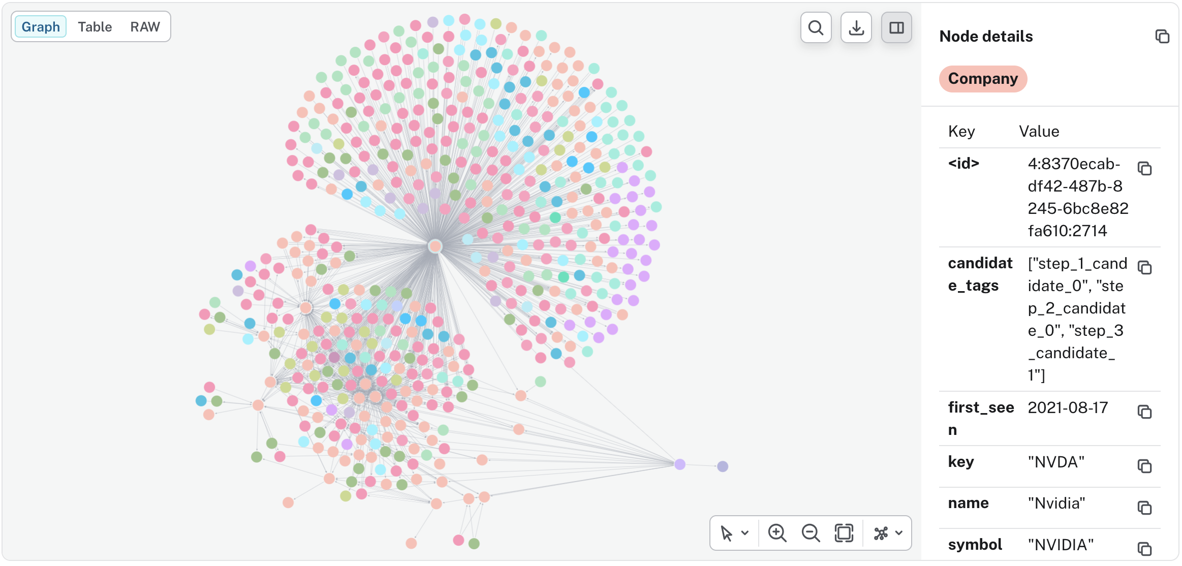
2 hops from example article…
Monthly joint seminar of QFRG and DSLab, University of Warsaw, Faculty of Economic Sciences
Ontology as a hyperparameter: Task-aware knowledge graph construction using LLMs 13th April 2026
Notes:
Here we can see the neighborhood of an example news article—everything within two hops.
This highly connected node represents a company.
Would you like to guess which one?

Slide 16
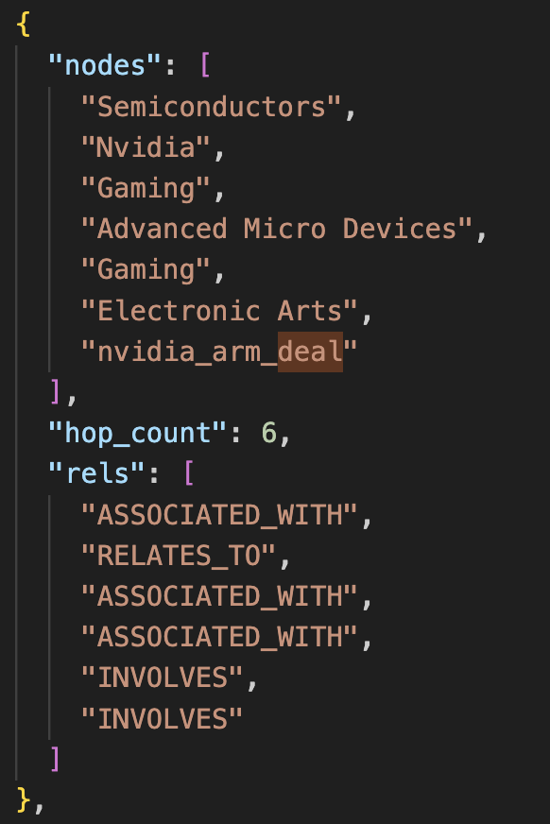
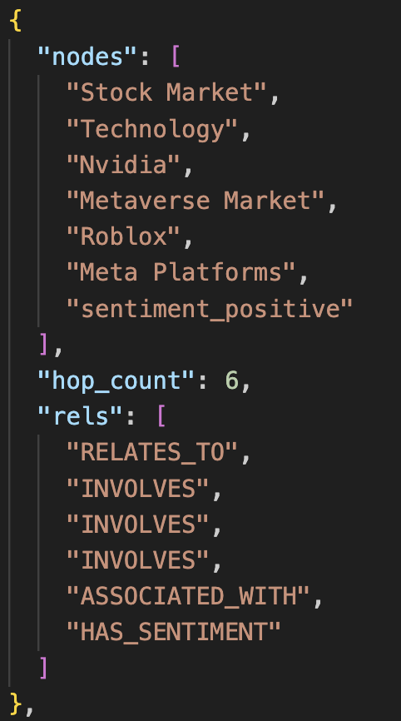
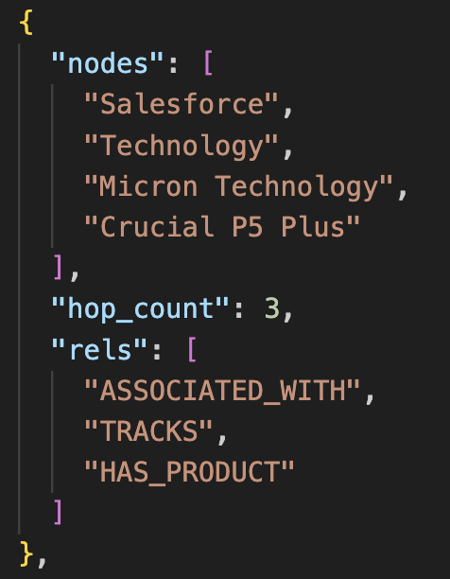
Article Neighbourhood Illustrated as Pathways
Monthly joint seminar of QFRG and DSLab, University of Warsaw, Faculty of Economic Sciences
Article
Ontology as a hyperparameter: Task-aware knowledge graph construction using LLMs 13th April 2026
Notes:
Here we see the same neighborhood, now represented as paths.
Path extraction is important for representing local graph structure and serves as a foundation for further processing.
It also enables the transformation of graph data into textual form.

Slide 17
Research Expansion
Monthly joint seminar of QFRG and DSLab, University of Warsaw, Faculty of Economic Sciences
Increasing diversity of paths
Explainability; how to track down the reason for performance improvement/degradation
Implementing test split (tricky in this scenario)
Scaling idea to cloud env with more data and more hparams
min_count
max_count
lookback_days
Connecting with KGrEaT
Ontology as a hyperparameter: Task-aware knowledge graph construction using LLMs 13th April 2026
Notes:
Increasing diversity of paths
Explainability; how to track down the reason for performance improvement/degradation (reducing feedback loop to 1 entity per iteration?)
Implementing test split? (tricky in this scenario)
Scaling idea to cloud env with more data and more hparams tested
min_count
max_count
lookback_days
Connecting with KGrEaT?

Slide 18

Expected Contributions
Monthly joint seminar of QFRG and DSLab, University of Warsaw, Faculty of Economic Sciences
Unified framework and library for adaptive LLM-based KG construction enabling:
Ontology optimization via supervision
Smaller, more informative graphs.
Direct applications in finance and more (link prediction, fraud detection, regression, classification)
Ontology as a hyperparameter: Task-aware knowledge graph construction using LLMs 13th April 2026
Notes:
To conclude, I expect several contributions from this project.
First, I am developing a unified library for adaptive, LLM-based knowledge graph construction, enabling ontology optimization.
I also plan to produce a couple research articles exploring applications of this framework not only in finance but also in drug discovery and pharmacovigilance (Adverse Drug Reaction severity (ADR) Classification).
Maybe connect with KGrEaT??

Slide 19
Monthly joint seminar of QFRG and DSLab, University of Warsaw, Faculty of Economic Sciences
Thank you!
Ontology as a hyperparameter: Task-aware knowledge graph construction using LLMs 13th April 2026

