Slide 1
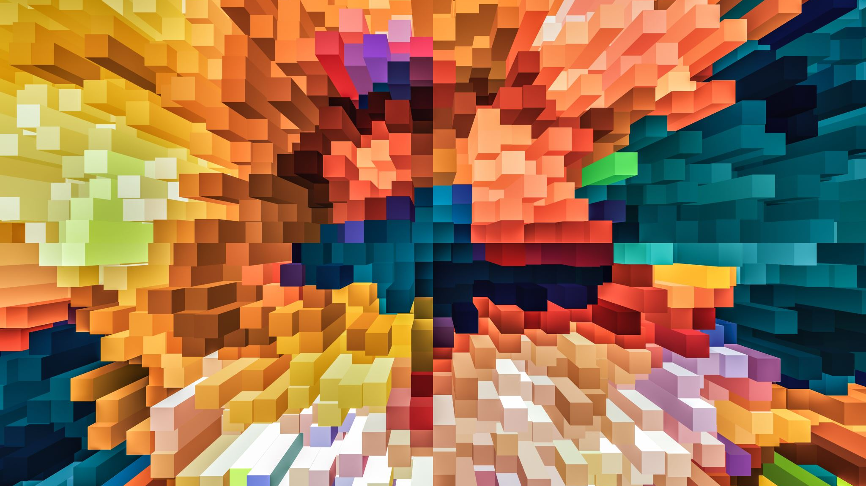
IMPROVED GRAPHIC RENDERING WITH PARALLELIZATION
By: Josh Gearhart and Shane Smith

Slide 2
Methods / Sub-Topics
NVIDIA Graphics Cards & CUDA Cores
Types of graphical rendering parallelization
Functional, Data, and Temporal Parallelism
Mixing parallel algorithms/architectures to create better performing hybrid methodologies.

Slide 3
Results
Researched into CUDA
How its increased performance in Computing
The functionality of CUDA and how it works
Parallel Sorting Algorithms
The types of Algorithms
New Algorithms
How these Algorithms can be improved.

Slide 4
Future of Parallel Graphic Rendering
How will CUDA cores increase performance to keep up with demanding graphical rendering such as raytracing?
What is the possibility of the standard sorting algorithms being replaced at some point?
How great is the effect of hard-wired graphical applications in hardware?

