Slide 1
Notes: 1. Correct fonts won’t load until you open this in PowerPoint (e.g., if you’re previewing this in your browser it’ll look uglier than it actually is). 2. Generate QR codes here: https://www.qrcode-monkey.com/

Slide 2

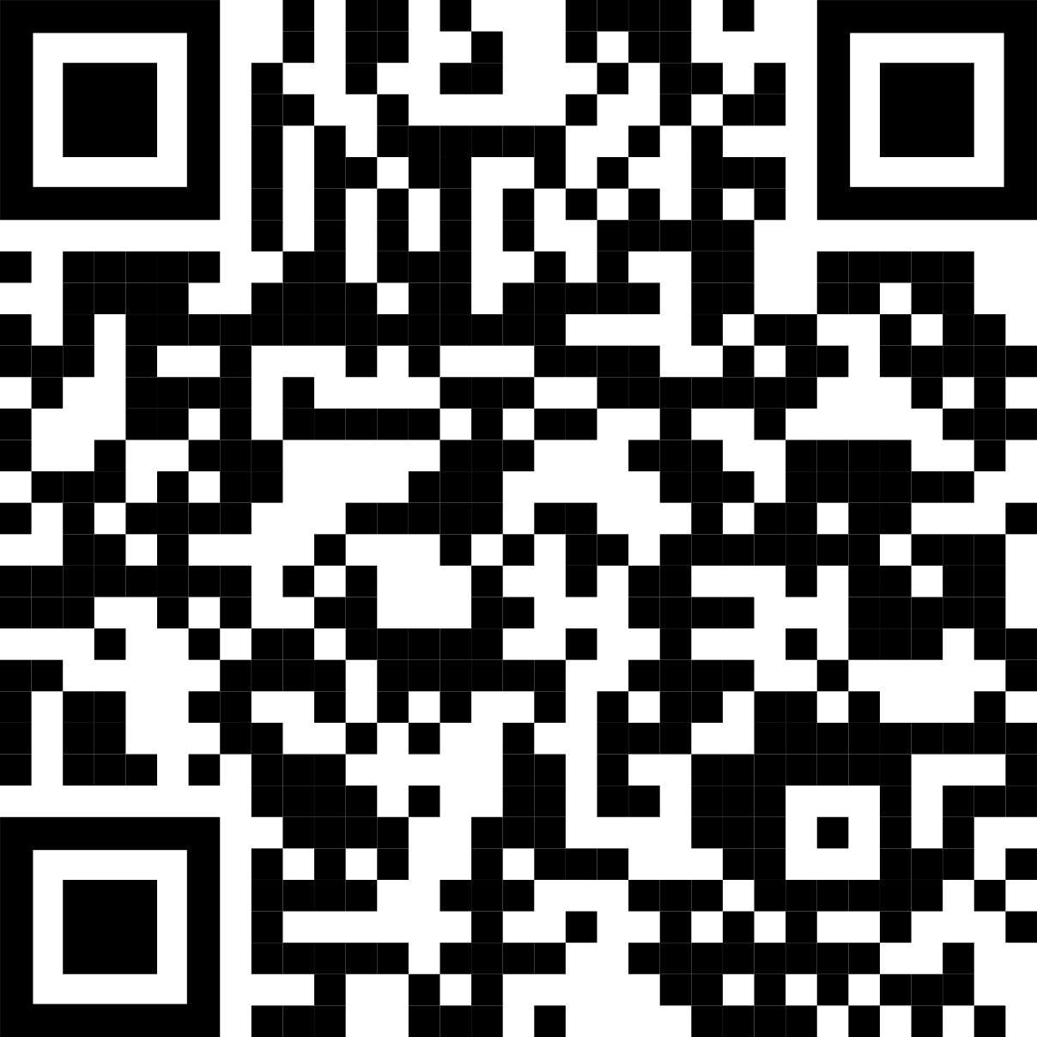
Main finding goes here, translated into plain English. Emphasize the important words.
Title: Subtitle
Leeroy Jenkins, author2, author3, author4
Title goes here; make it small if you need to free up space.
AMMO BAR
Delete this and replace it with your…
Extra Graphs
Extra Correlation tables
Extra Figures
Extra nuance that you’re worried about leaving out.
Keep it messy! This section is just for you.
INTRO
Just give context for the gap you’re filling
You’re not going to get yelled at if you don’t cite the 5 papers from 1937 that defined this construct. They’ll download your paper if they want that.
METHODS
N = ###,
Collected this
Tested with X statistical test
RESULTS
Graph or table with essential results only.
All the other correlations in the ammo bar.
DISCUSSION
“If this result actually generalized and I didn’t have to humbly disclaim the possibility of a thousand confounds and limitations, it would imply that….”
Keep font size as high above 28 as possible.
Leeroy Jenkins, author2, author3, author4
Take a picture to download the full paper

Slide 3
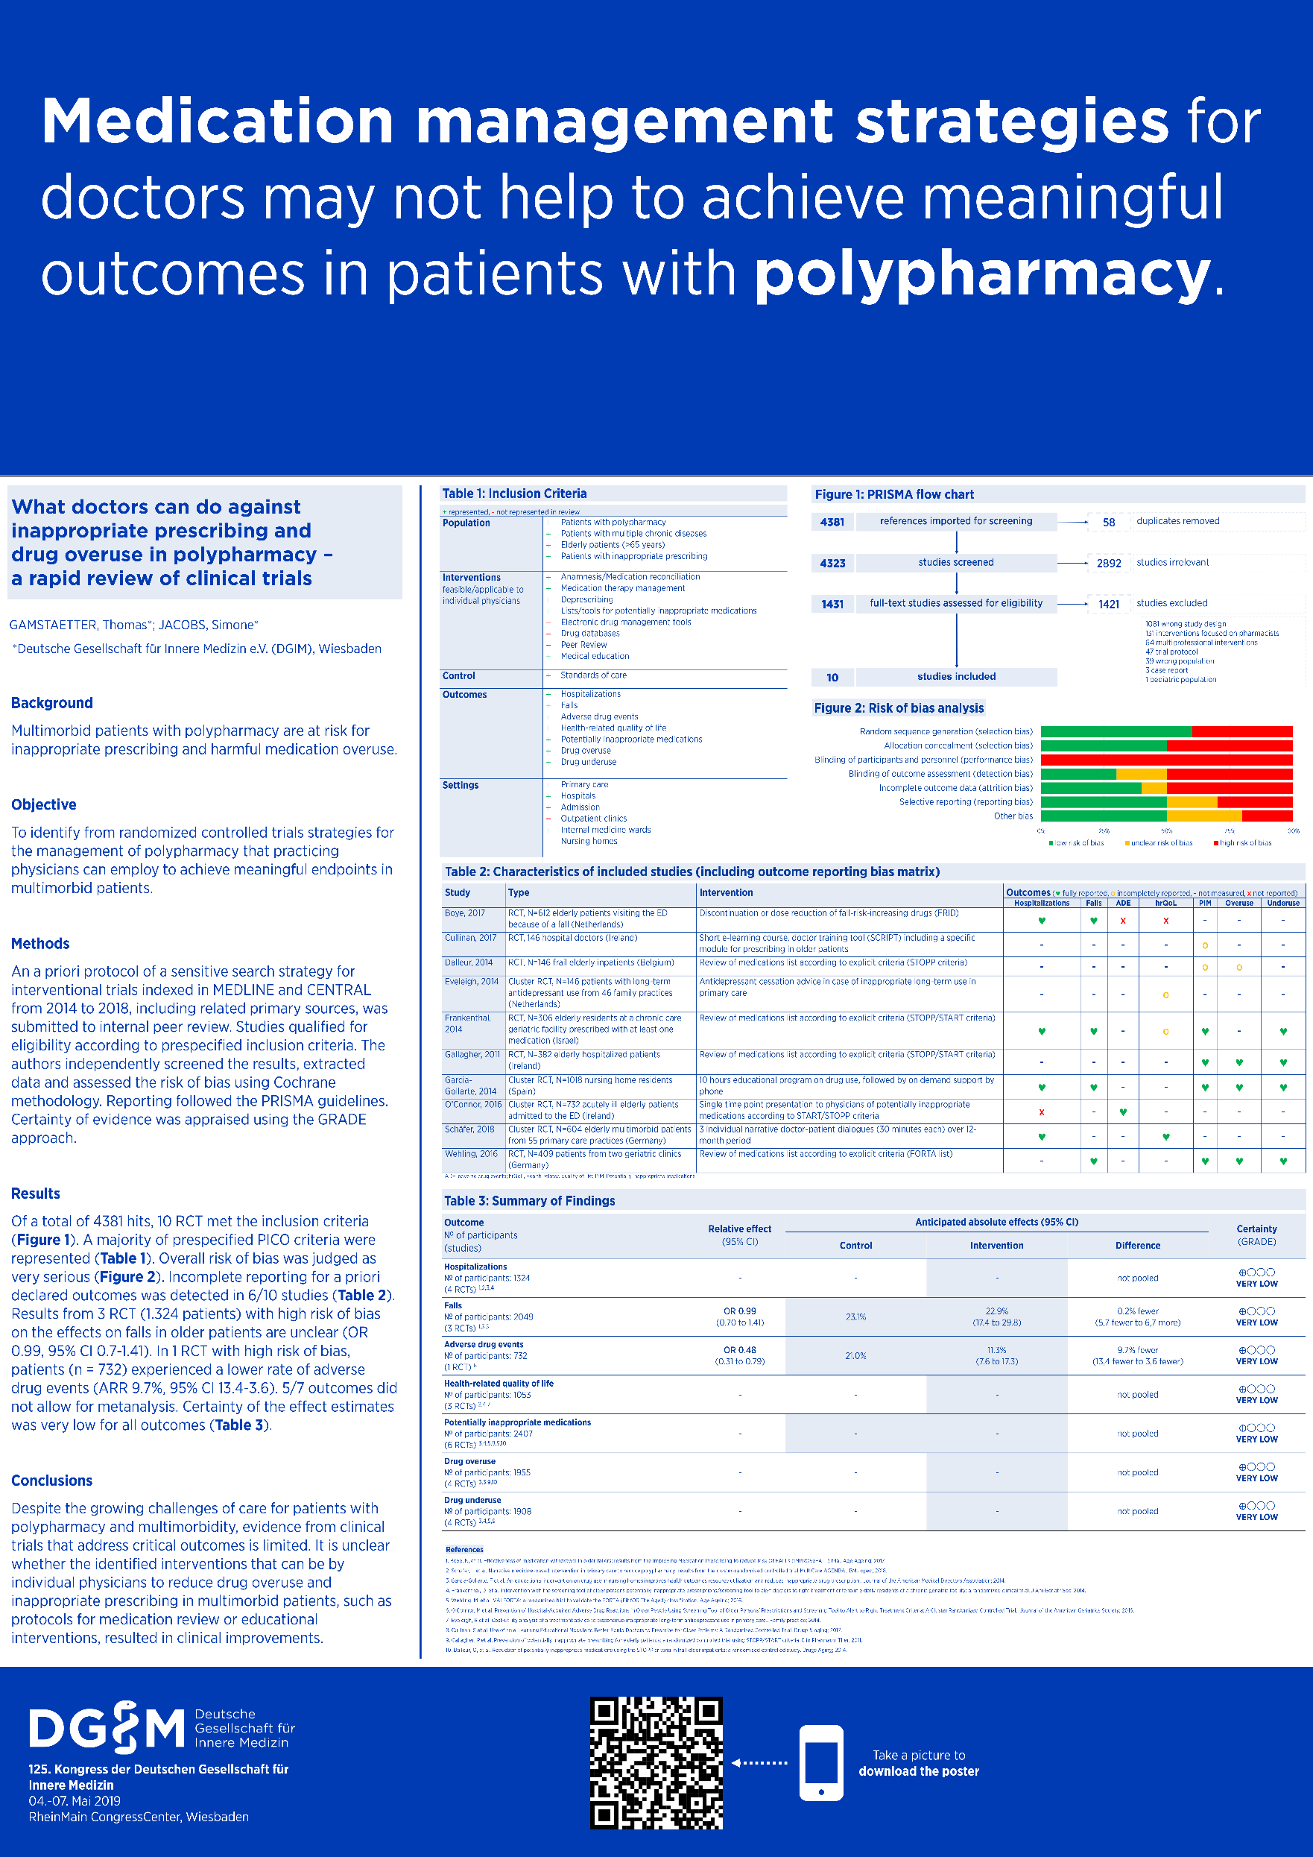
Example donated by Dr. Thomas Gamstätter

Slide 4

Example donated by Dr. David Ku

