Slide 1
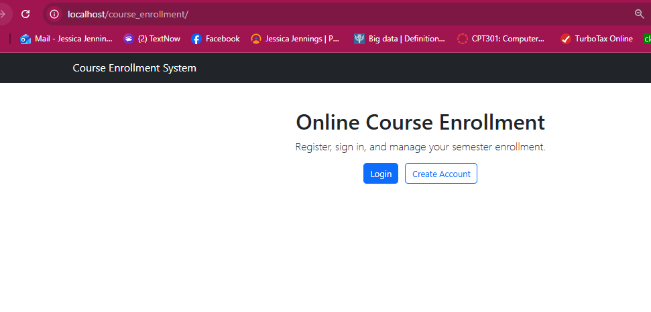
Online Course Enrollment System
CST499 Final Project Presentation
Jessica Jennings
CST499: Capstone for Computer Software Technology
Instructor: Charmelia Butler | October 7, 2026

Slide 2
1. Project Purpose and SRS Scope
The project is a browser-based Online Course Enrollment System that connects requirements, UML design, PHP implementation, MySQL data, and testing.
Core student functions include account registration, authentication, semester course viewing, enrollment, wait-list participation, and cancellation.
The SRS uses unique requirement identifiers so requirements can be traced into design and test activities.
Registration
Create an account and profile with a unique user ID, password, name, phone, and email.
Course Enrollment
View semester offerings, enroll when capacity is available, and prevent duplicate enrollment.
Wait List & Cancellation
Use FIFO waiting-list behavior and notify the first eligible student when a seat becomes available.
(Tsui et al., 2018; ISO/IEC/IEEE, 2018)
2

Slide 3
2. Requirements Made Testable
Final SRS revision incorporates instructor feedback on precision and verification.
REG / AUTH
Reject duplicate user IDs; store password hashes rather than plaintext; grant protected access only after valid authentication.
CRS / ENR
Display courses by semester; enforce maximum enrollment; prevent duplicate active enrollment.
WAIT / CAN
Assign FIFO wait-list positions; cancel active enrollments; identify the first eligible wait-listed student when a seat opens.
Performance Criterion
Login, course listing, enrollment confirmation, and cancellation confirmation are defined with a measurable response-time target.
Verification Strategy
Use valid, invalid, duplicate, capacity, cancellation, and wait-list scenarios to confirm observable system behavior.
(ISO/IEC/IEEE, 2018; Temoshok et al., 2025)
3

Slide 4
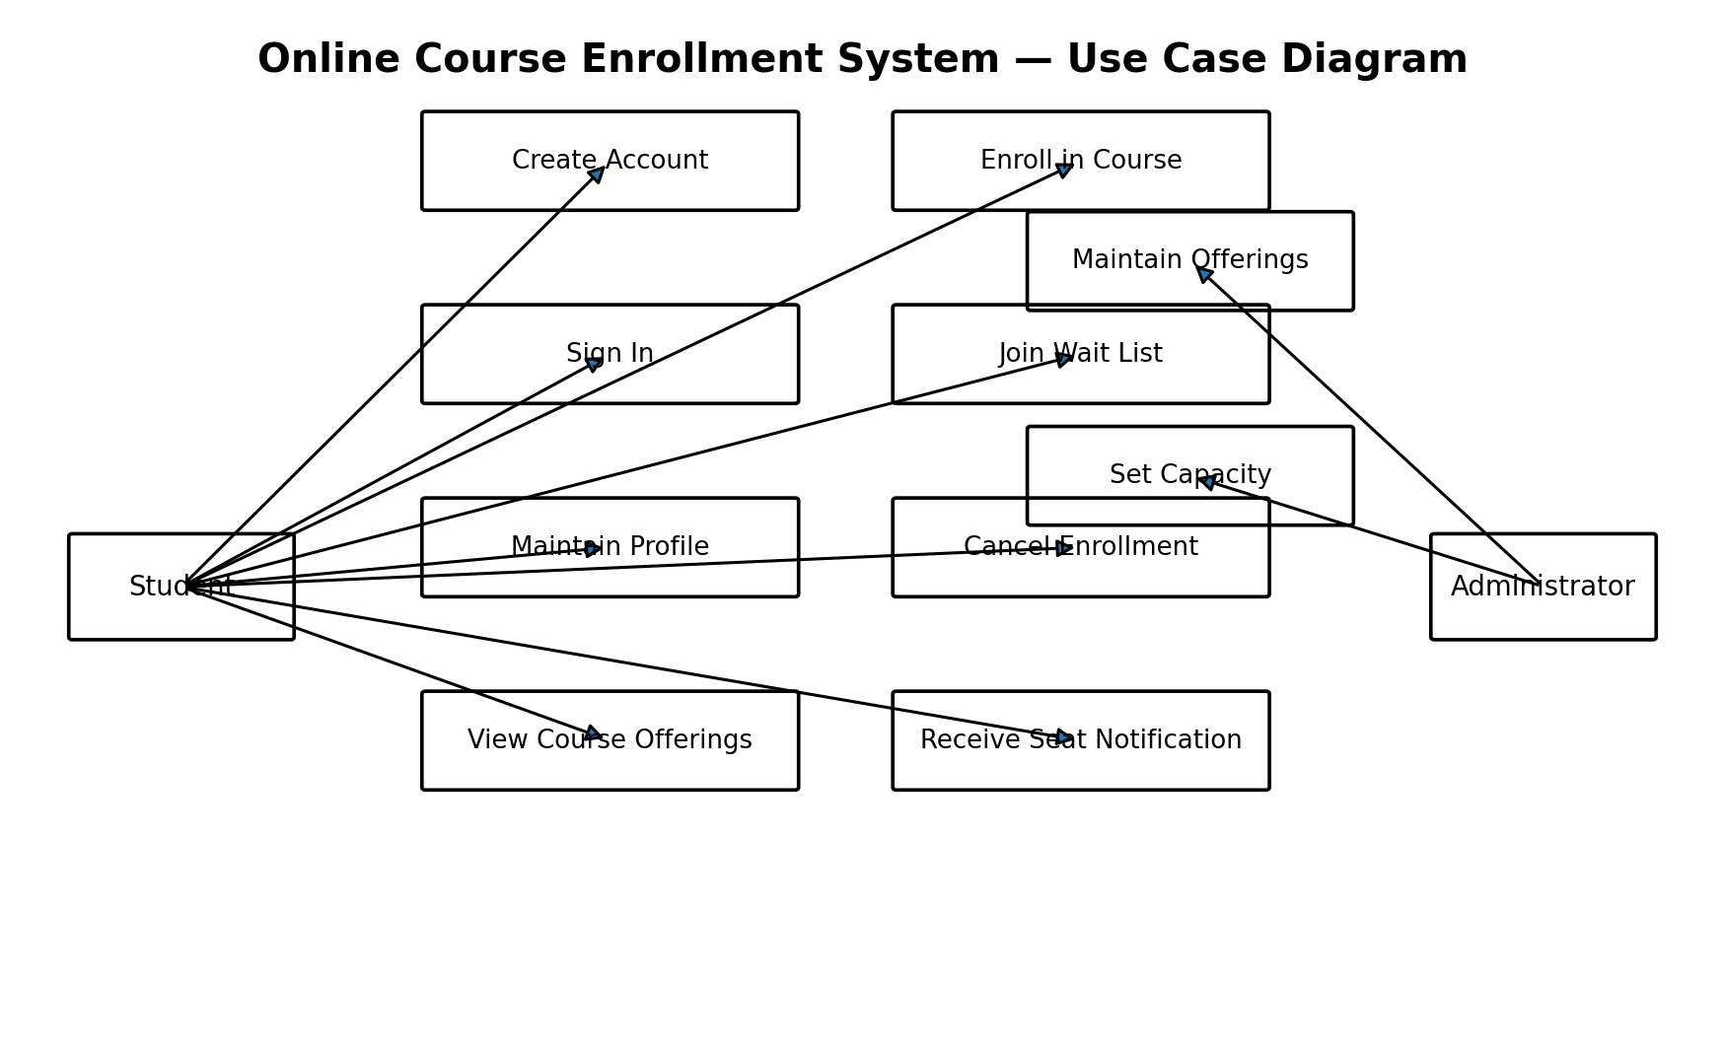
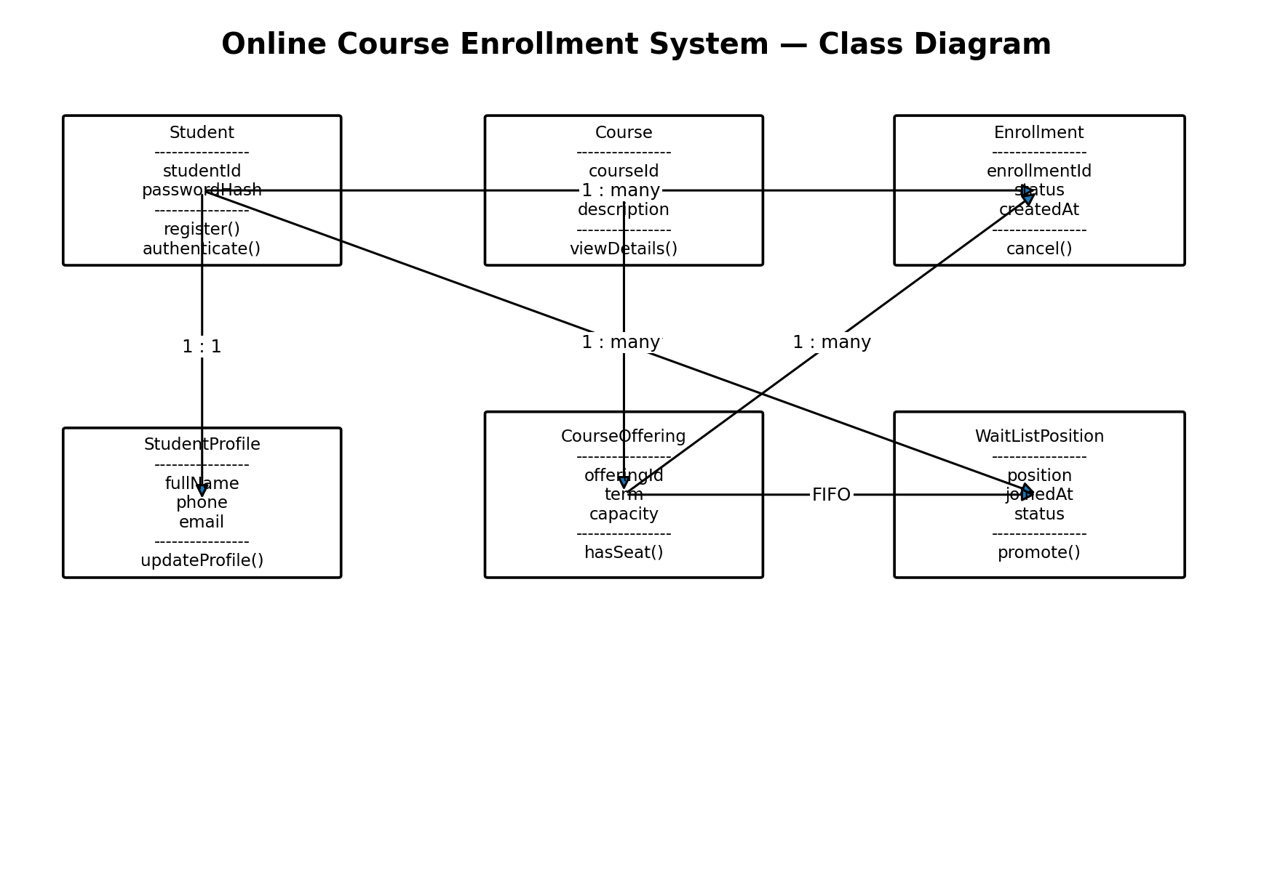
3. UML Design: Requirements to Structure
Use case diagram: actors and system functions
Class diagram: core domain objects and relationships
Use cases translate SRS functions into interactions for Student and Administrator actors.
Those responsibilities guide the class model: Student, StudentProfile, Course, CourseOffering, Enrollment, and WaitListPosition.
The models provide complementary views rather than separate, unrelated documents.
(Tsui et al., 2018; Object Management Group, 2017)
4

Slide 5
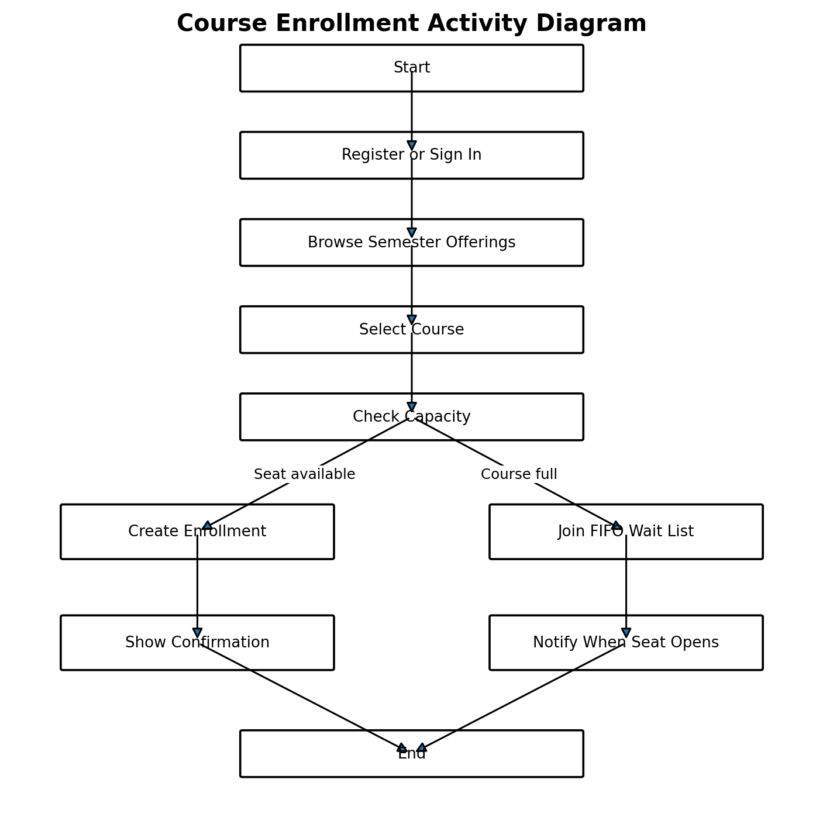
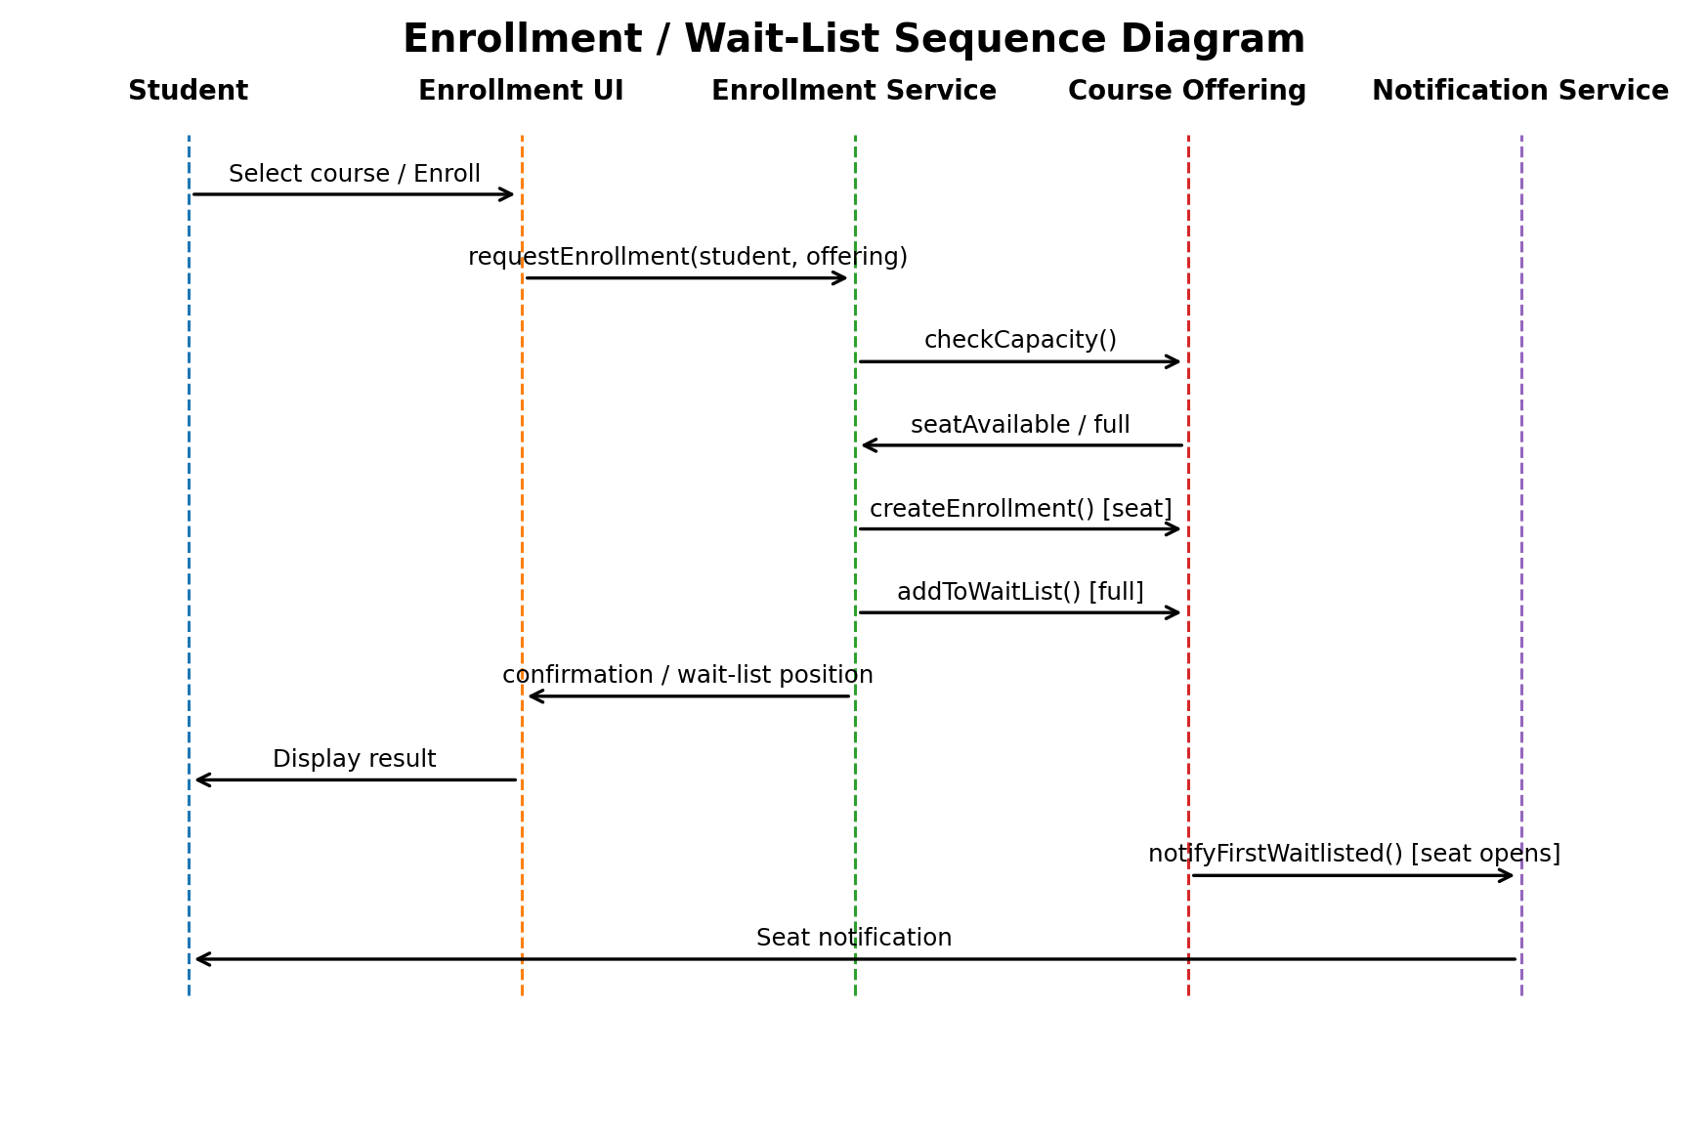
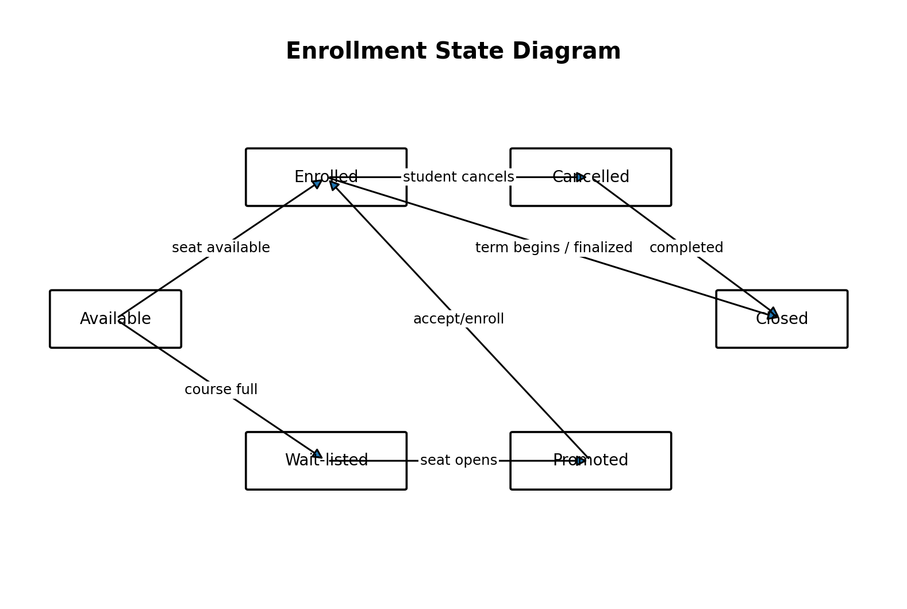
4. UML Design: Interactions, Workflow, and State
Sequence: messages during enrollment / wait-list processing
Activity: workflow branches on seat availability
State: enrollment lifecycle transitions
The sequence diagram shows who communicates and in what order; the activity diagram emphasizes decision flow; the state diagram shows how enrollment status changes over time.
Together, the five UML models trace requirements into structure, interactions, workflow, lifecycle behavior, and later testing.
(Object Management Group, 2017)
5

Slide 6
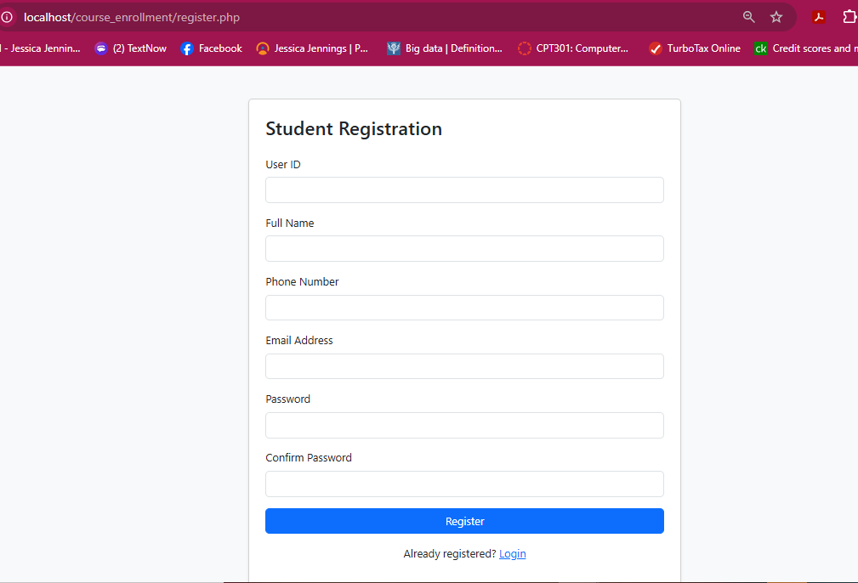
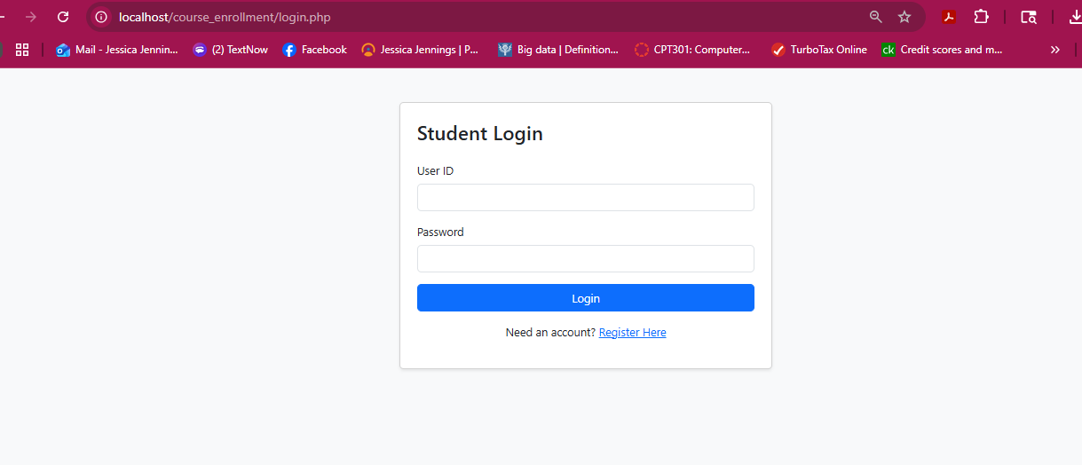
5. Landing, Login, and Registration Pages
Landing page
Student login
Student registration
XAMPP provides Apache, PHP, MySQL/MariaDB, and phpMyAdmin for local development.
Bootstrap-based forms provide consistent controls and responsive layout.
Registration validates required data and sends form values to PHP using POST.
(Tsui et al., 2018; Bootstrap, n.d.)
6

Slide 7
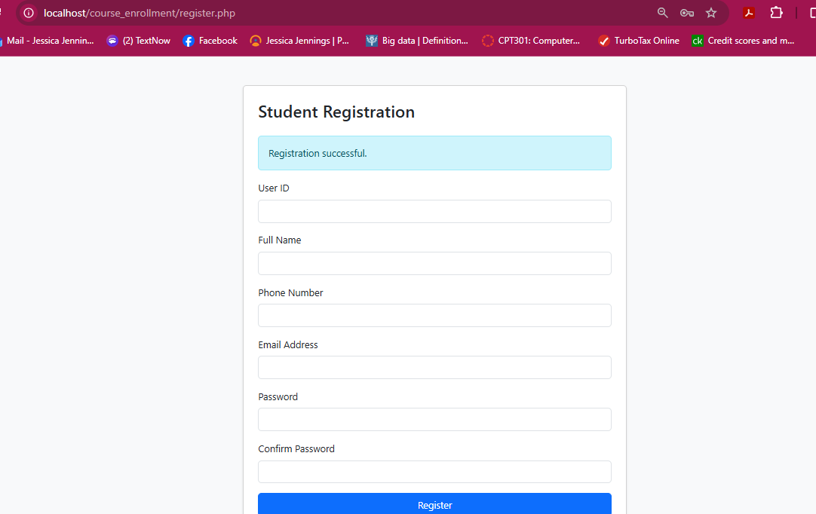
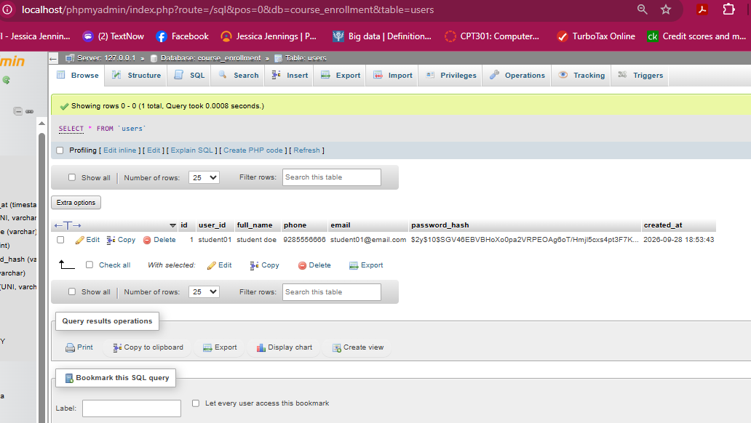
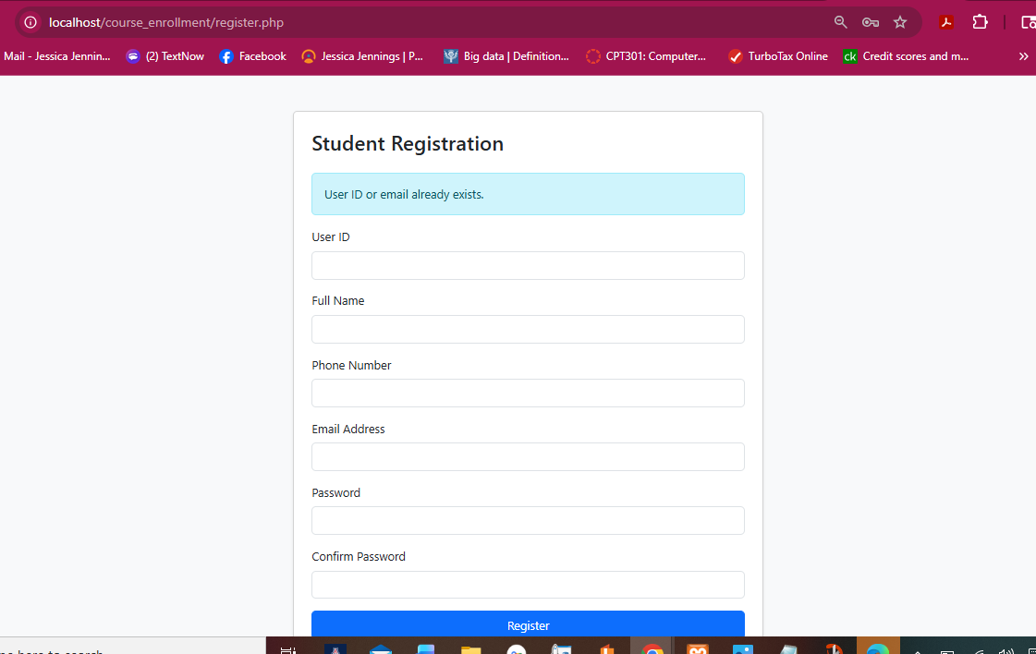
6. Registration Validation and Persistent User Data
Successful registration message
Registered user record in MySQL
Duplicate user/email protection
The users table stores user ID, profile information, a password hash, and creation time.
Prepared statements bind user-entered values separately from SQL, and password_hash() prevents plaintext password storage.
Duplicate user IDs or email addresses are rejected with user feedback.
(PHP Documentation Group, n.d.; Oracle, 2026)
7

Slide 8
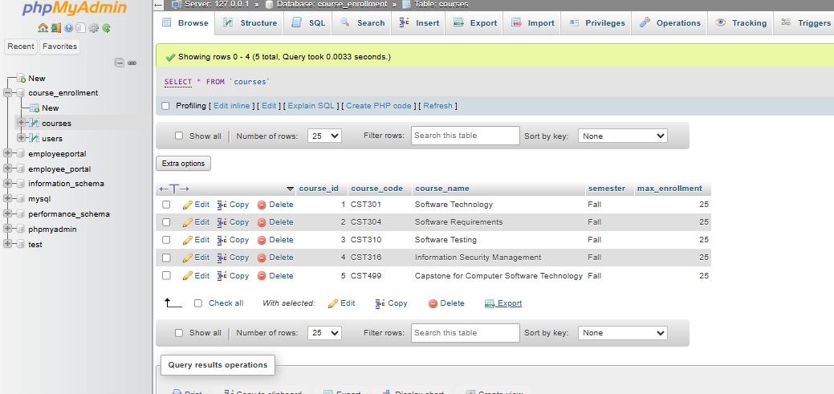
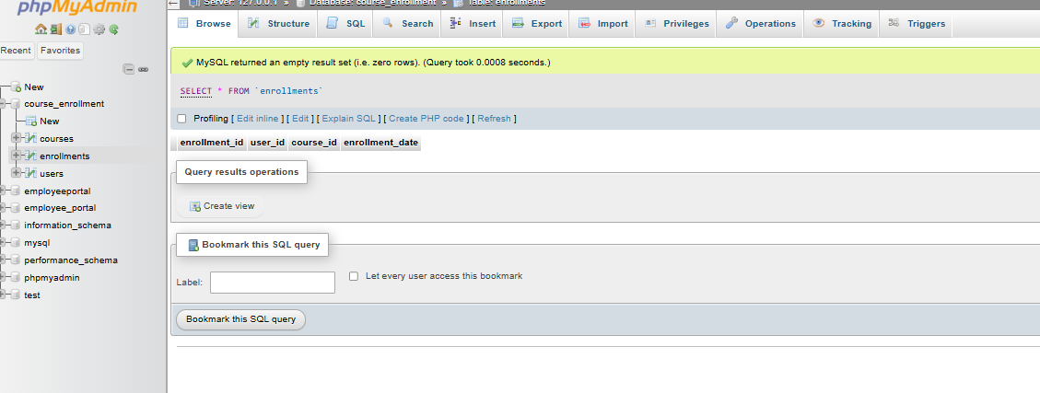
7. MySQL Database and Course Registration
Courses table: five Fall course offerings
Enrollments table before registration
The courses table stores course ID, code, name, semester, and maximum enrollment.
The enrollments table links the internal user ID to a selected course ID and records the enrollment time.
A unique user/course relationship supports data integrity by preventing duplicate enrollment records.
(Elmasri & Navathe, 2016; Tsui et al., 2018)
8

Slide 9
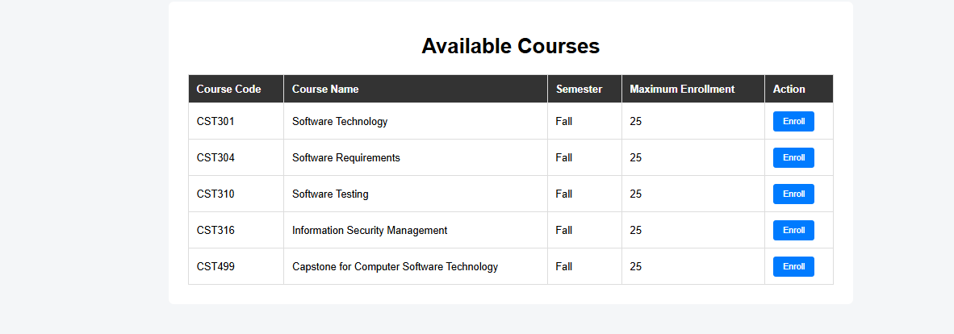
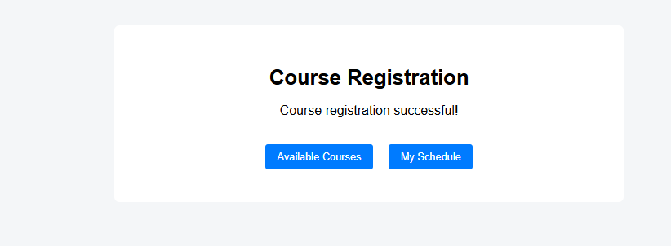
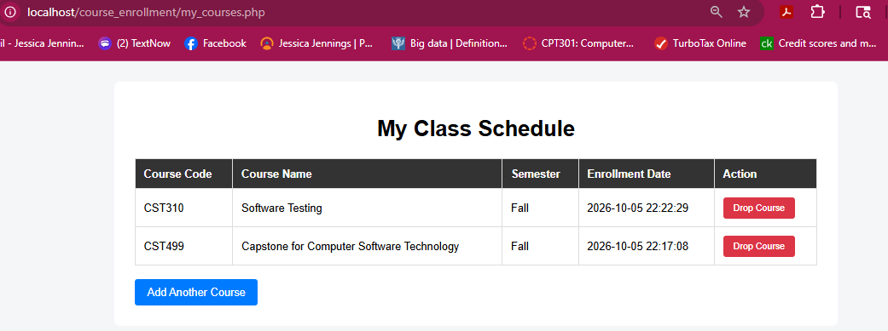
8. Enrollment and Student Schedule Workflow
Available courses retrieved from MySQL
Successful course registration
My Class Schedule after adding courses
Selecting Enroll submits the course ID to server-side PHP.
A successful INSERT creates a persistent enrollment record, and the schedule JOIN displays meaningful course information.
The implementation demonstrates the connection from front-end action → PHP processing → MySQL state → updated interface.
(Sommerville, 2016; Tsui et al., 2018)
9

Slide 10
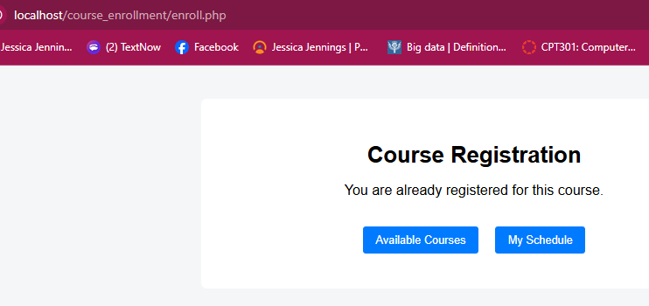
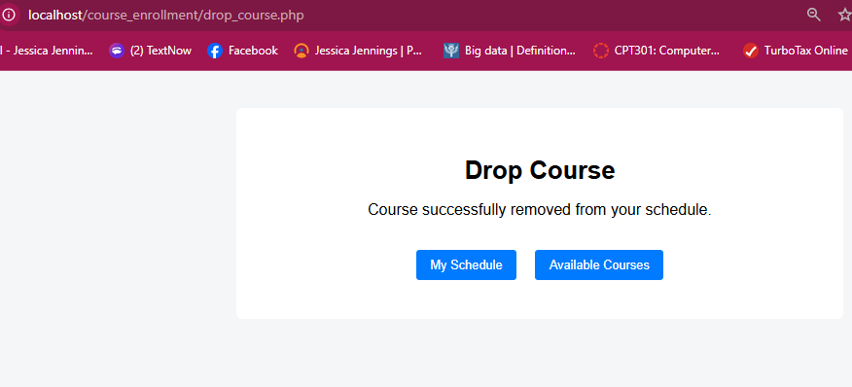
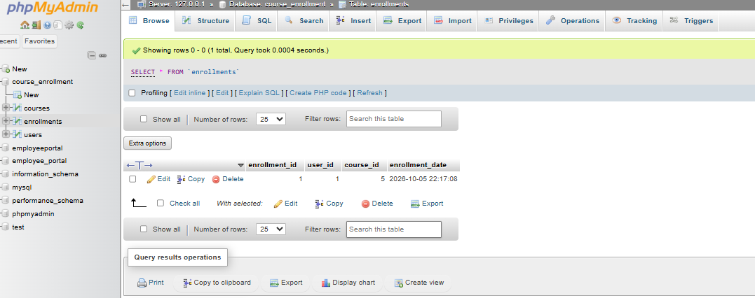
9. Validation and CRUD Operations
Duplicate enrollment prevented
Drop Course confirmation
Database state after course deletion
Create: register a student and add an enrollment.
Read: retrieve available courses and the student's schedule.
Delete: remove the selected enrollment while preserving other records.
Validation protects the database from duplicate enrollment and confirms the resulting persistent state.
(Elmasri & Navathe, 2016; Sommerville, 2016)
10

Slide 11
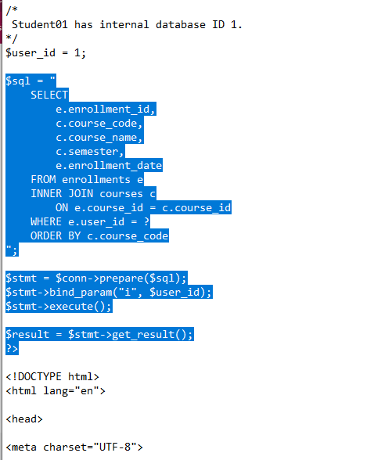
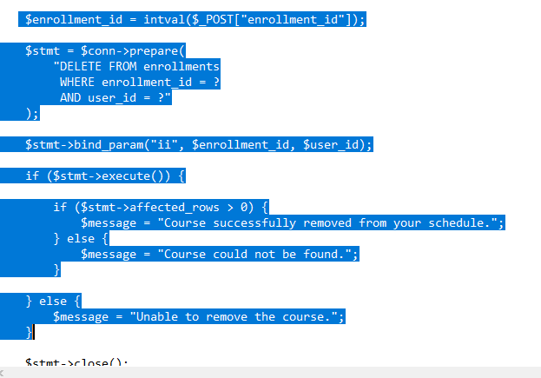
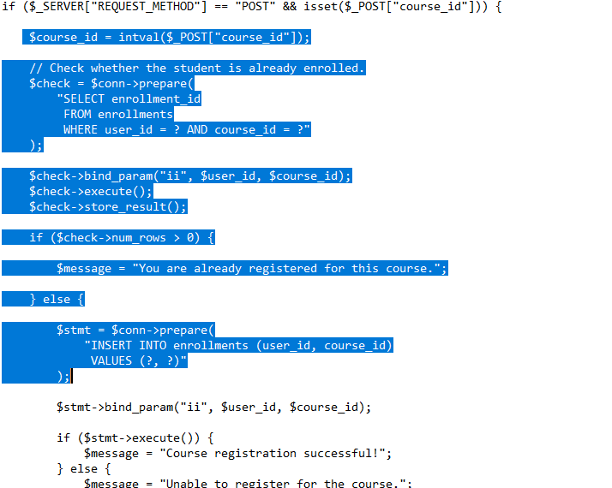
10. PHP Implementation and Project Integration
Duplicate check + INSERT
JOIN for registered-course schedule
Parameterized DELETE for course removal
Prepared statements and parameter binding are used for enrollment and deletion operations.
The final implementation demonstrates traceability across SRS requirements, UML design, PHP logic, MySQL data, and observable test evidence.
Testing each operation at both the interface and database levels helped verify that browser actions and stored data remained synchronized.
(PHP Documentation Group, n.d.; Tsui et al., 2018)
11

Slide 12
References
Bootstrap. (n.d.). Forms. https://getbootstrap.com/docs/5.3/forms/overview/
Elmasri, R., & Navathe, S. B. (2016). Fundamentals of database systems (7th ed.). Pearson.
ISO/IEC/IEEE. (2018). ISO/IEC/IEEE 29148:2018 systems and software engineering—Life cycle processes—Requirements engineering. IEEE.
Object Management Group. (2017). OMG Unified Modeling Language (OMG UML), version 2.5.1.
Oracle. (2026). CREATE TABLE statement. In MySQL 8.4 reference manual.
PHP Documentation Group. (n.d.). mysqli::prepare. PHP manual.
Sommerville, I. (2016). Software engineering (10th ed.). Pearson.
Temoshok, D., et al. (2025). Digital identity guidelines: Authentication and authenticator management (NIST SP 800-63B-4). NIST.
Tsui, F., Karam, O., & Bernal, B. (2018). Essentials of software engineering (4th ed.). Jones & Bartlett Learning.
12

