Slide 1
Preliminary COVID-19 Analysis
Jeremy Guinta
April 10, 2020

Slide 2
Data
John Hopkins via https://raw.githubusercontent.com/CSSEGISandData/COVID-19/
Daily Counts of Confirmed COVID-19 cases
Organized by Region
It is a HUGE mess (They changed format at the end of March)

Slide 3
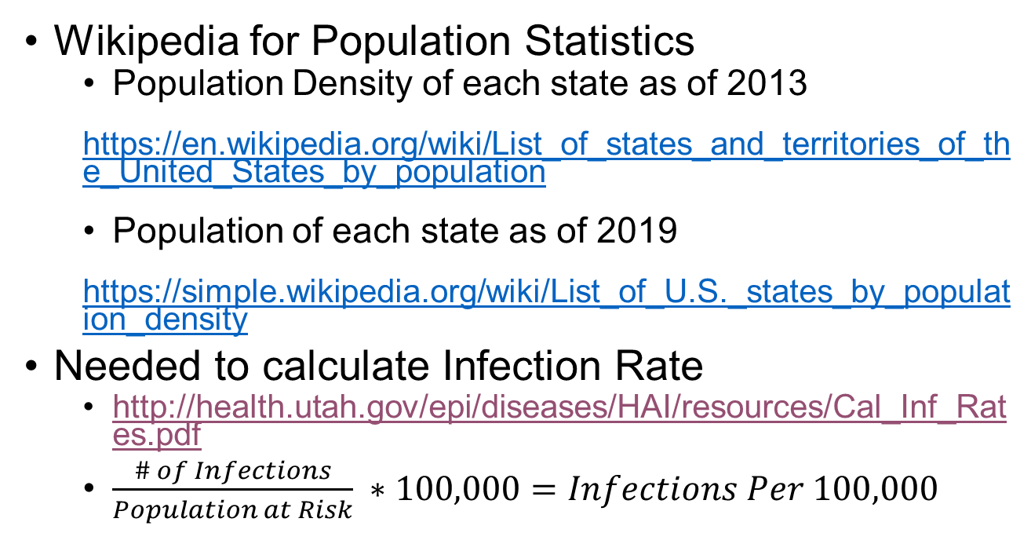
Data (Cont.)
Wikipedia for Population Statistics
Population Density of each state as of 2013
https://en.wikipedia.org/wiki/List_of_states_and_territories_of_the_United_States_by_population
Population of each state as of 2019
https://simple.wikipedia.org/wiki/List_of_U.S._states_by_population_density
Needed to calculate Infection Rate
http://health.utah.gov/epi/diseases/HAI/resources/Cal_Inf_Rates.pdf
$\frac{\# of Infections}{Population at Risk} ∗100,000=Infections Per 100,000$

Slide 4
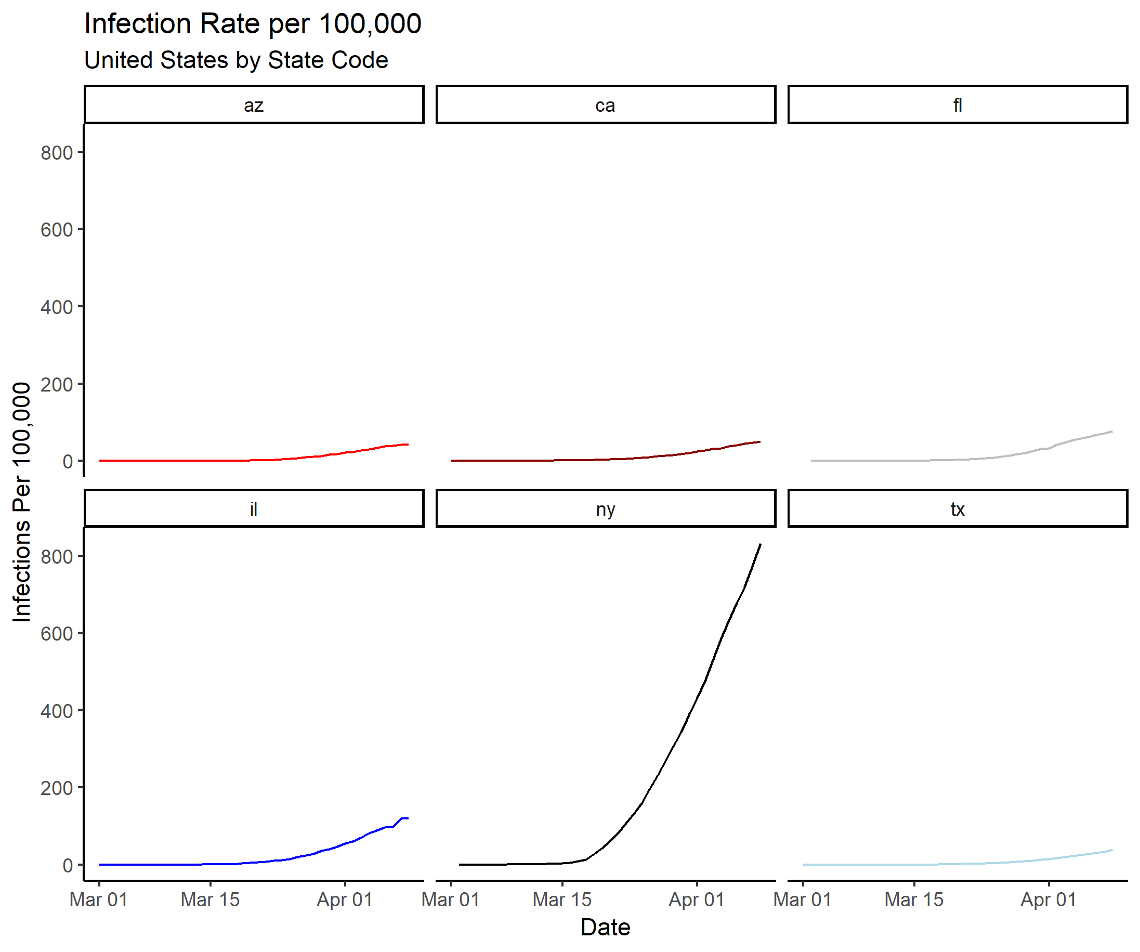
Initial State-by-State Curves

Slide 5
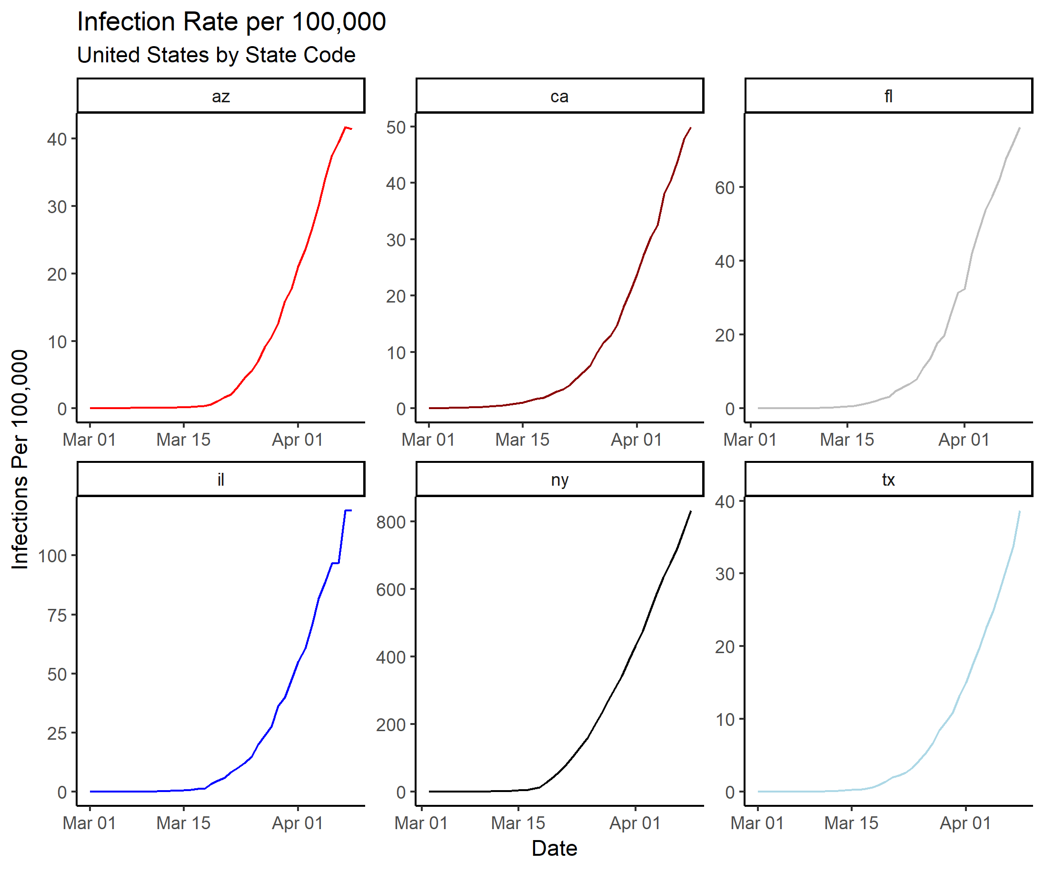
Initial State-by-State Curves

Slide 6
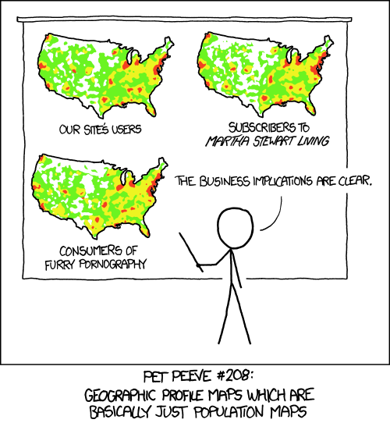
Pitfalls of this Data #1
Count data by Region
Tends to mirror the population.
Is not a great indicator of infection rates.
Not Surprisingly, high density locations (e.g., NY) have higher infection rates.

Slide 7
Pitfalls of This Data #2
Count data
It is dependent on how active states are in testing for the disease.
An increase in cases could be the disease spreading more virulently, or simply an increase in testing.
States with low infection rates may be due to a lack of testing, not a lack of infection.
States with high infection rates may be due to increased testing, not a prevalent rate of infection.

Slide 8
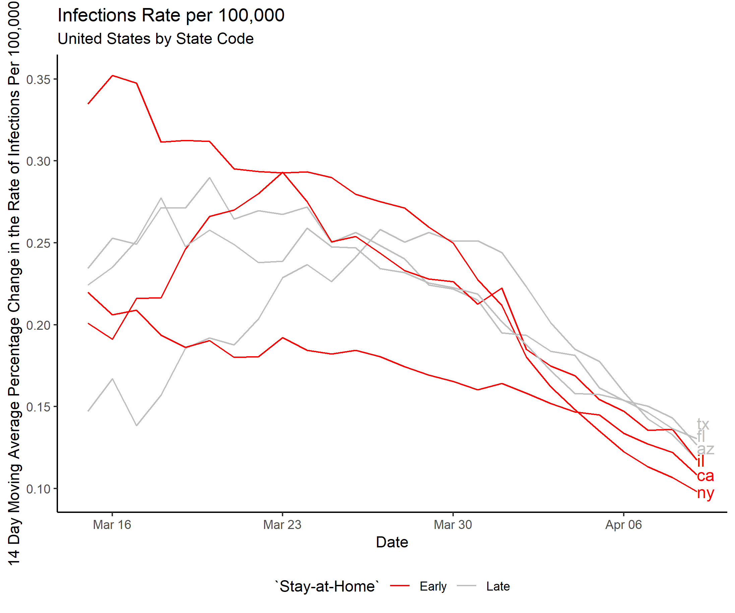
Flattening the Curve and Stay-at-Home Orders

