Slide 1
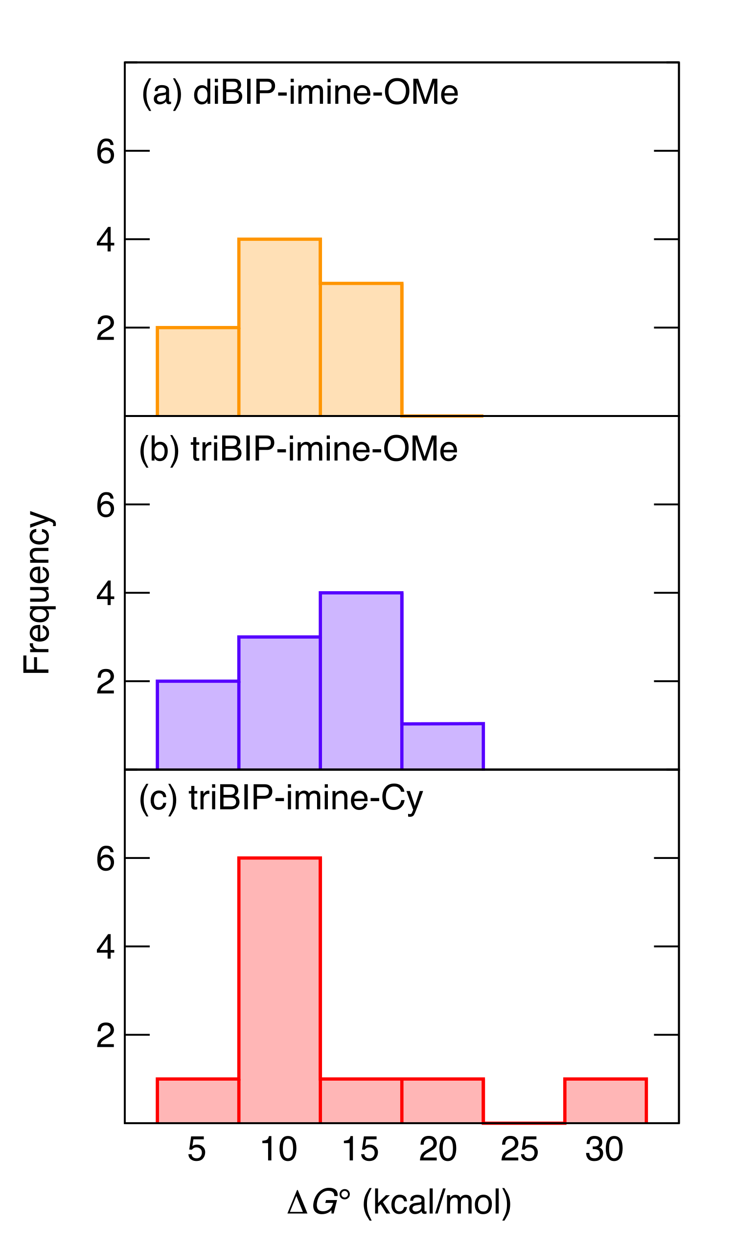
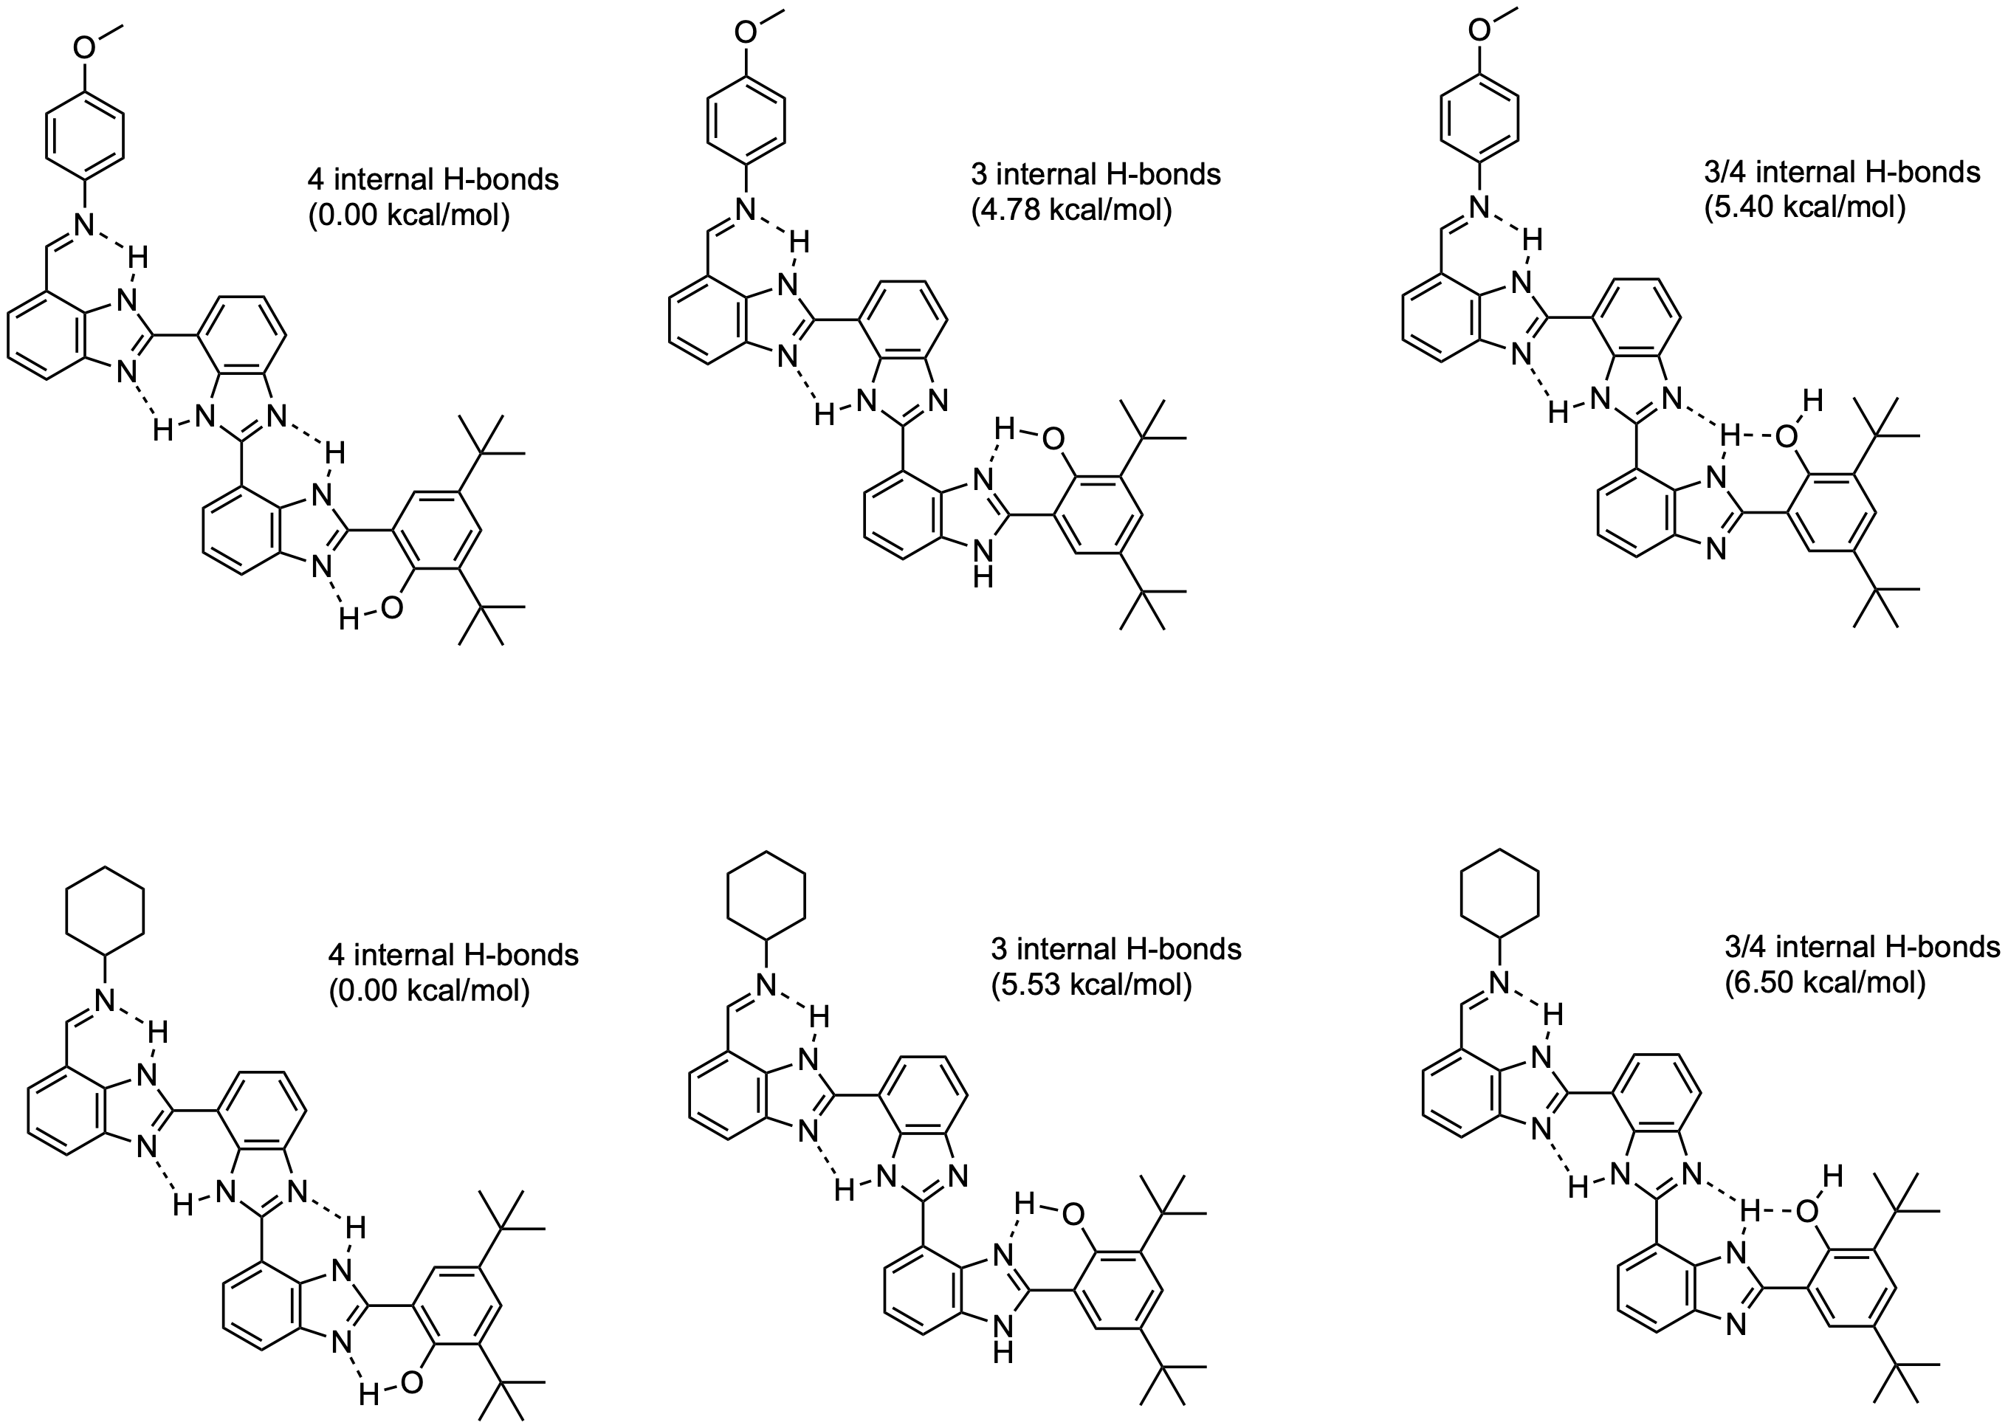
Histogram: Relative free energies (ΔG°) of different isomers relative to the global minimum of (a) diBIP-imine-Ph^{OMe}, (b) triBIP-imine-Ph^{OMe}, and (c) triBIP-imine-Cy. The bin heights indicate the number of isomers found within the ΔG° values.
Figure: The global minimum and the two lowest-energy isomers for (top) triBIP-imine-Ph^{OMe} and (bottom) triBIP-imine-Cy.
B3LYP-D3/6-31G** in DCM (C-PCM)

