Slide 1
Stock Insights

Slide 2
Who:
Kevin Flynn Jason Hill Andrew Callahan Soham Shah

Slide 3
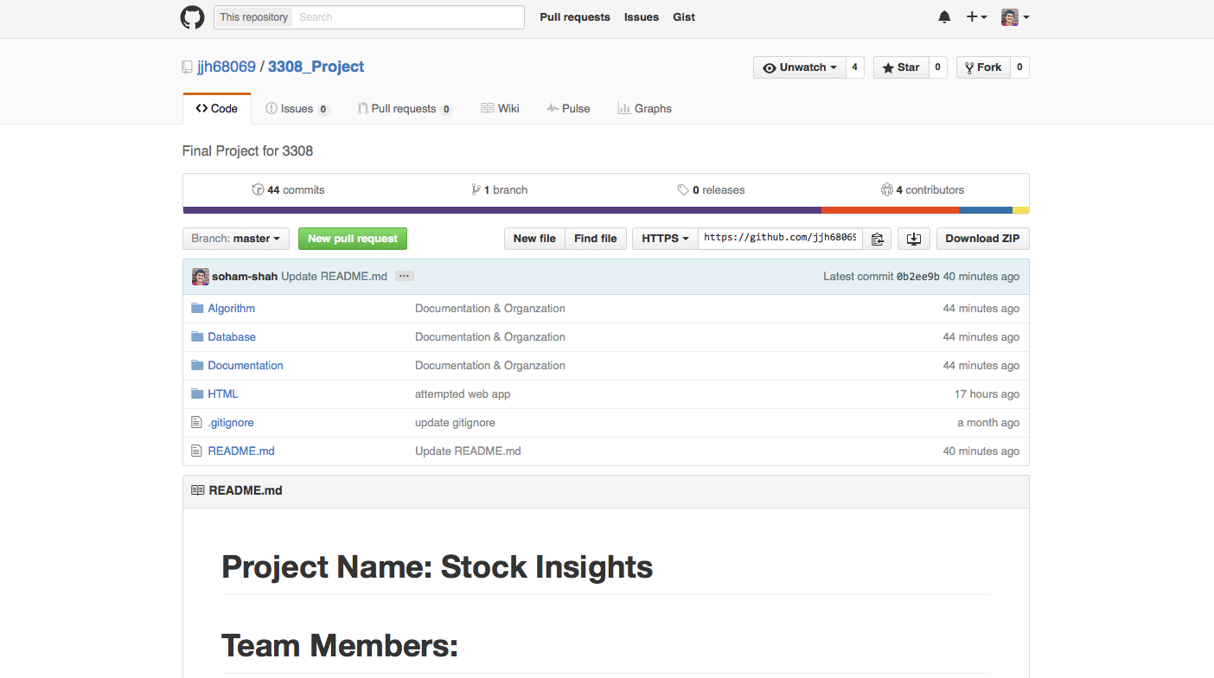
VCS Repo
Github
⭑⭑⭑⭑⭑

Slide 4

Database
SQL Lite 3
It’s a built in library for python
It creates a database on the local file system easily queried with standard SQL syntax through python
⭑⭑⭑⭑⭑

Slide 5
Testing
Python Unit testing
⭑⭑⭑⭑⭑

Slide 6
Auto Documenter
Pydoc

Slide 7
Deployment Environment
Github

Slide 8
Development

Slide 9
Development
Sublime
Geany
PyCharm
Vim

Slide 10
Testing
Pydoc

