Slide 1
Stock Insights
Kevin Flynn Jason Hill Andrew Callahan Soham Shah

Slide 2
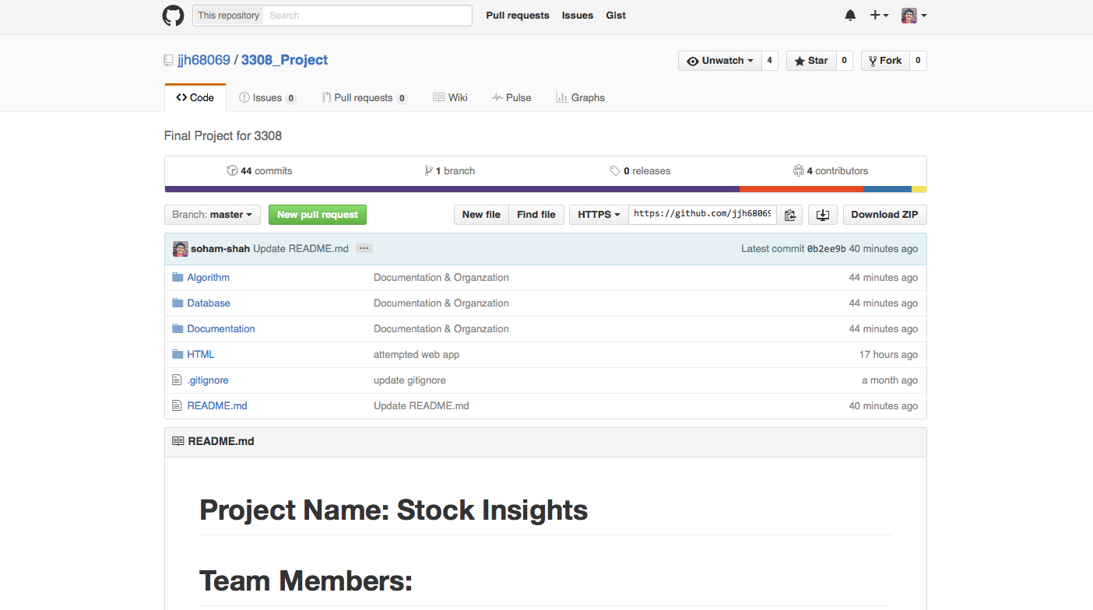
VCS Repo: Github Desktop Client
Simple to use
⭑⭑⭑⭑⭑

Slide 3

Project Tracking: Trello
Simple
Not very useful for small teams
Much more convenient to just message someone directly
⭑⭑⭑⭑⭑

Slide 4
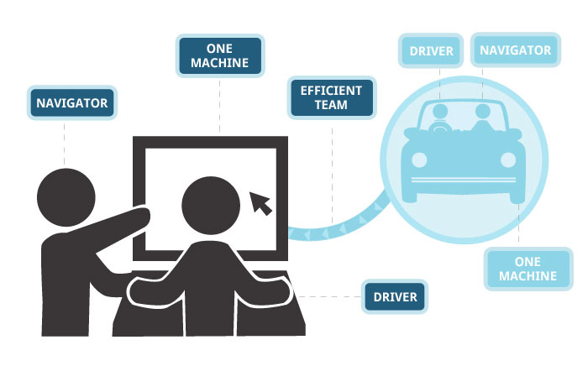
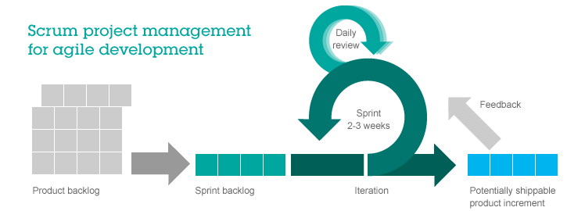
Development Style: Agile
Weekly meetings
Meet on Monday and Wednesday
Standups
Pair programming
Code Reviews before committing
Retrospective to change
methodology

Slide 5

Database: SQL Lite 3
It’s a built in library for python
It creates a database on the local file system easily queried with standard SQL syntax through python
⭑⭑⭑⭑⭑

Slide 6
Testing: Python Unit Testing
Not as useful for such a small codebase
Agile Manifesto: Code over documentation & testing
⭑⭑⭑

Slide 7
Auto Documenter: Doxygen
Simple
⭑⭑⭑⭑⭑

Slide 8


Development
Sublime
Lightweight simple Text Editor
High level of customization
Lots of shortcuts to speed up workflow
⭑⭑⭑⭑⭑
PyCharm
Automatic code compilation
Inline code suggestions
⭑⭑⭑⭑

Slide 9
Deployment Environment
Github.io
You can push the website code and Github will display the website

Slide 10
Frameworks: Flask
Allows incorporation of Python and HTML
Run python code on a website with Flask as an intermediary
⭑⭑⭑⭑⭑

Slide 11
API
Quandl

Slide 12
Challenges
Data storage limitations
Couldn’t do an entire stock’s history because it is too many

