Slide 1
Stock Insights
Kevin Flynn Jason Hill Andrew Callahan Soham Shah

Slide 2
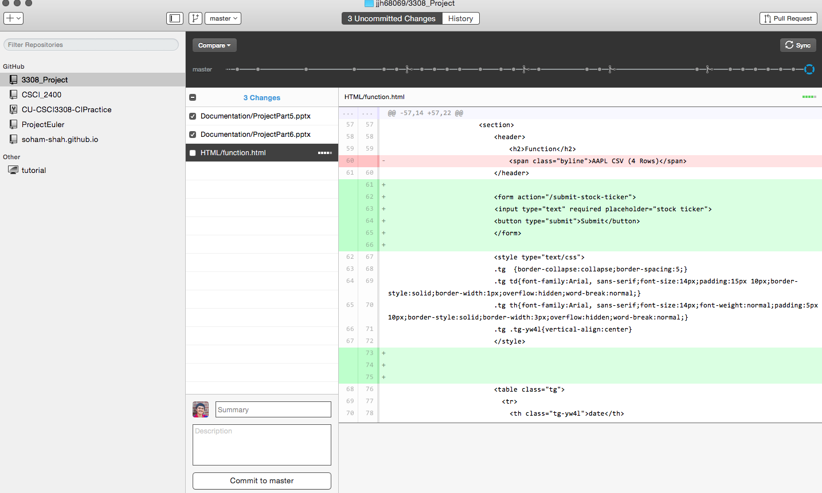
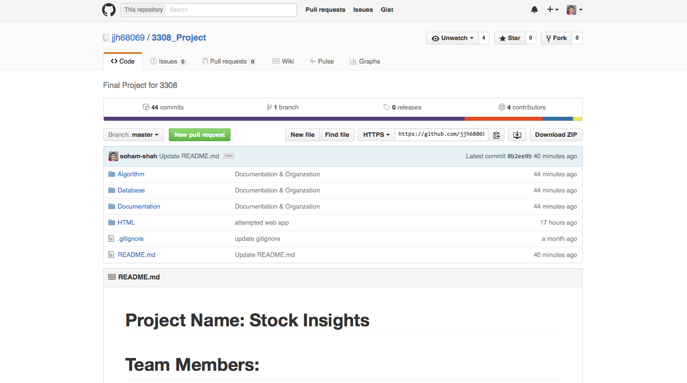
VCS Repo: Github Desktop Client
Simple to use
Keep track of contributions
⭑⭑⭑⭑⭑

Slide 3

Project Tracking: Trello
Simple
Not very useful for small teams
Much more convenient to just message someone directly
⭑⭑

Slide 4
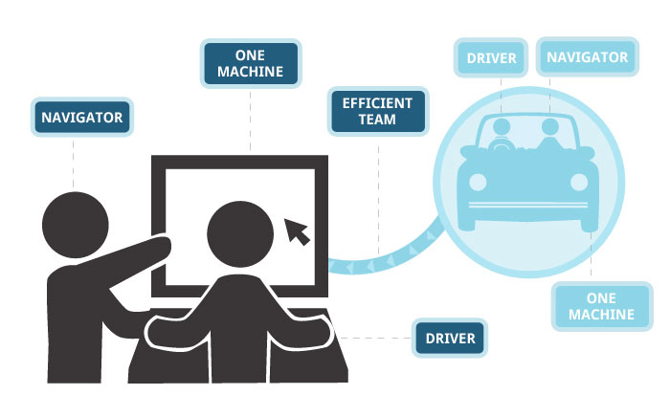
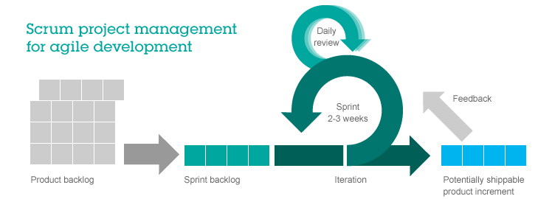
Development Style: Agile
Weekly meetings
Meet on Monday and Wednesday
Standups
Pair programming
Code Reviews before committing
⭑⭑⭑⭑⭑

Slide 5

Database: SQLite 3
It’s a built in database library for python
It creates a database on the local file system easily queried with standard SQL syntax through python
⭑⭑⭑⭑⭑

Slide 6
Testing: Python Unit Testing
Simple, easy to use syntax
Not as useful for such a small codebase
⭑⭑

Slide 7

Auto Documenter: Doxygen
Simple, elegant way to isolate documentation from code base in a very readable format
⭑⭑⭑⭑⭑

Slide 8


Development
Sublime Text 2
Lightweight Text Editor
High level of customization
Lots of shortcuts to speed up workflow
⭑⭑⭑⭑⭑
PyCharm
Automatic code compilation
Inline code suggestions
⭑⭑⭑⭑

Slide 9

Frameworks: Flask
Allows incorporation of Python and HTML
Run python code on a website with Flask as an intermediary
⭑⭑⭑⭑⭑

Slide 10

API
Quandl

Slide 11
Deployment Environment
[username].github.io
soham-shah.github.io
You can push the website code and Github will display the website for free

Slide 12
Challenges
Data storage limitations
Couldn’t do an entire stock’s history because it is too many
API call restrictions
Didn’t look at the bigger picture
Didn’t consider integration between subsystems

