Slide 1
NYC Crime
Harm Index
A Smarter Way to Measure Crime
John Hall | March 2026

Slide 2
The Problem
1 = 1 ?
This misleads decisions.
A neighborhood that loses 50 thefts but gains 5 homicides looks safer on paper—even as real harm to residents skyrockets.
Traditional crime statistics count
every crime equally—a shoplifting
and a murder both count as one.
Resources go to the wrong places.
The Crime Harm Index solves this by weighting each crime by its seriousness.

Slide 3
A Brief History
2007
The Power Few
Sherman shows a tiny share of places produce most serious harm.
Today
13+
2009
Canada CSI
First national harm-weighted crime measure, published annually.
countries use harm-weighted
crime measurement for
policing decisions.
2016
Cambridge CHI
Crime counts overstated safety gains by 76% vs. harm index.
Including Canada, UK, Denmark,
New Zealand, Australia, Sweden
2024
Equity Critique
Court-sentence weights can embed bias—statutory law avoids this.

Slide 4
How NYC’s Index Works
Each crime is weighted by the midpoint of the sentencing range in New York State law.
Grounded in Law
Avoids Sentencing Bias
Transparent
Weights come directly from
what legislators have decided
each crime deserves.
Uses statutory ranges, not
court sentences—sidestepping
disparities in actual sentencing.
Anyone can look up NYS
Penal Law and verify every
weight in the index.
1 murder (7,300 days) = 40 misdemeanor assaults (183 days each)

Slide 5
The Weight Scale
Harm weight = midpoint of NYS Penal Law sentencing range, in days.
Offense Class | Type | Range | CHI (Days)
A-I Felony | Murder 2nd | 15–25 yrs to life | 7,300
B Felony | Violent | 5–25 years | 5,475
C Felony | Violent | 3.5–15 years | 3,380
D Felony | Violent | 2–7 years | 1,643
E Felony | Violent | 1.5–4 years | 1,004
B Felony | Non-Violent | 1–9 years | 1,825
C Felony | Non-Violent | 1–5.5 years | 1,186
D Felony | Non-Violent | 0–2.5 years | 456
A Misdemeanor | — | Up to 1 year | 183
B Misdemeanor | — | Up to 3 months | 45
Source: NYS Penal Law §70.00, §70.02

Slide 6
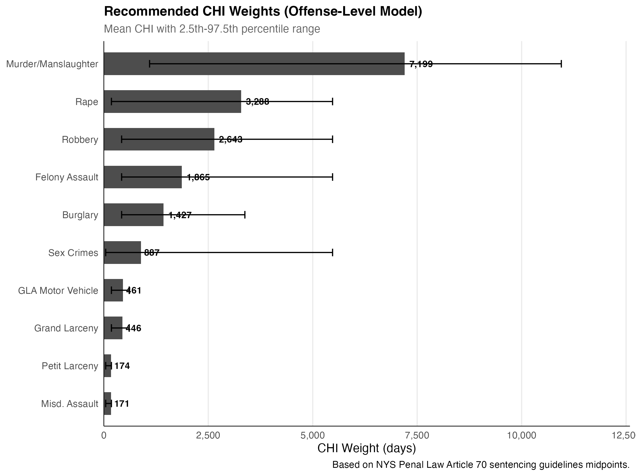
What We Measured
1M+ victim-reported crimes across 10 offense categories, 2018–2022.
Murder & Manslaughter
Rape
Robbery
Felony Assault
Burglary
Grand Larceny
Motor Vehicle Theft
Misdemeanor Assault
Petit Larceny
Sex Crimes
Recommended CHI weights by offense category (days)
7 FBI Part I + 3 additions

Slide 7
Not All Robberies Are Equal
151 distinct weights—the finest-grained crime harm index in the U.S.
Carjacking / hijacking
4,426 days
Street robbery, open area
2,771 days
Personal electronic device
2,459 days
Bank / commercial
1,534 days
Weights reflect the actual mix of criminal charges NYPD records for each specific type of incident.

Slide 8
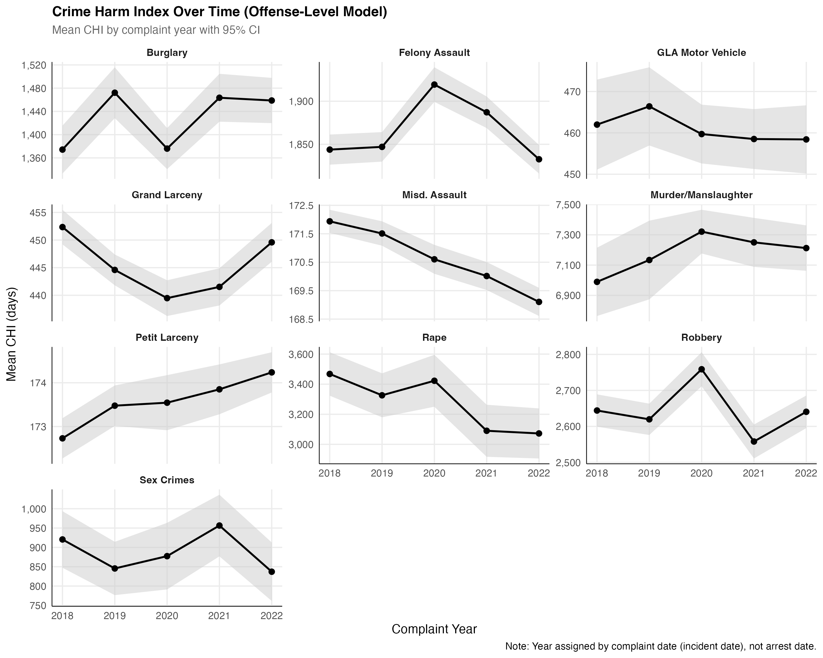
Stable Over Time
Weights computed separately for each year from 2018 to 2022 are highly consistent.
CHI weights by offense category, 2018–2022

Slide 9
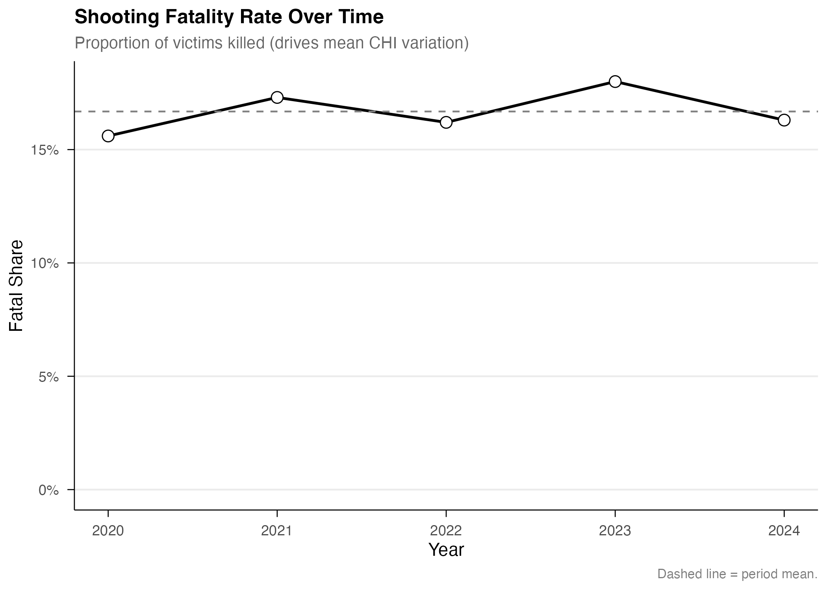
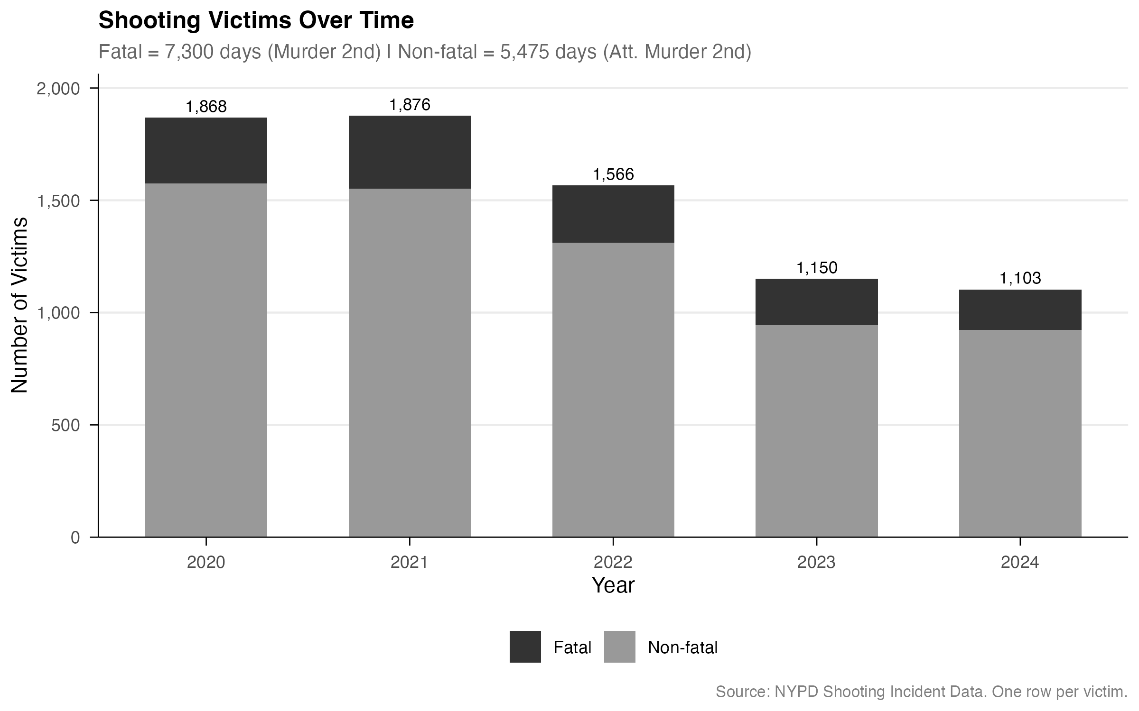
Accounting for Gun Violence
Shootings replace—not add to—matching crime complaints, preventing double-counting.
Fatal Shooting
Non-Fatal Shooting
Shots Fired
7,300
5,475
3,376
days
days
days
Murder 2nd Degree
Attempted Murder 2nd
CPW 2nd Degree floor

Slide 10
What This Means for Policy
A Targeting Tool
Not a Scorecard
Identifies where the most harm happens—not just the most crime.
Designed for block-level targeting: the smallest practical unit for place-based interventions.
Harm is far more concentrated than crime counts suggest.
The CHI informs decisions—it should not become a performance metric.
When indices become scorecards, the numbers themselves become the target.
This tool directs resources. It does not rank neighborhoods.
Built on NYS law · Transparent & reproducible · Portable to other jurisdictions

Slide 11
NYC Crime Harm Index
Measuring what matters to keep New Yorkers safe.
March 2026

