Slide 1
Every Block Counts
Targeting Analysis
Comparing block targeting algorithms for a
place-based violence intervention in NYC
John Hall | March 2026

Slide 2
The Question
Which algorithm best identifies the blocks where
intervention can prevent the most serious harm?
424K
20K
88K
violent crime
complaints
shooting
victims
eligible
city blocks
5-year baseline: October 2020 – September 2025

Slide 3
Nine Models, Three Families
Gun Violence
Count-Based
Crime Harm Index
Shootings + shots fired
only. Pure gun violence
signal.
Violent crime ranked by
raw volume. Includes
outdoor & felony variants.
Crimes weighted by
statutory seriousness.
151 distinct weights.
1 model
4 models
4 models
Blocks with precinct stations, hospitals, or large NYCHA developments are excluded from the eligible pool.

Slide 4
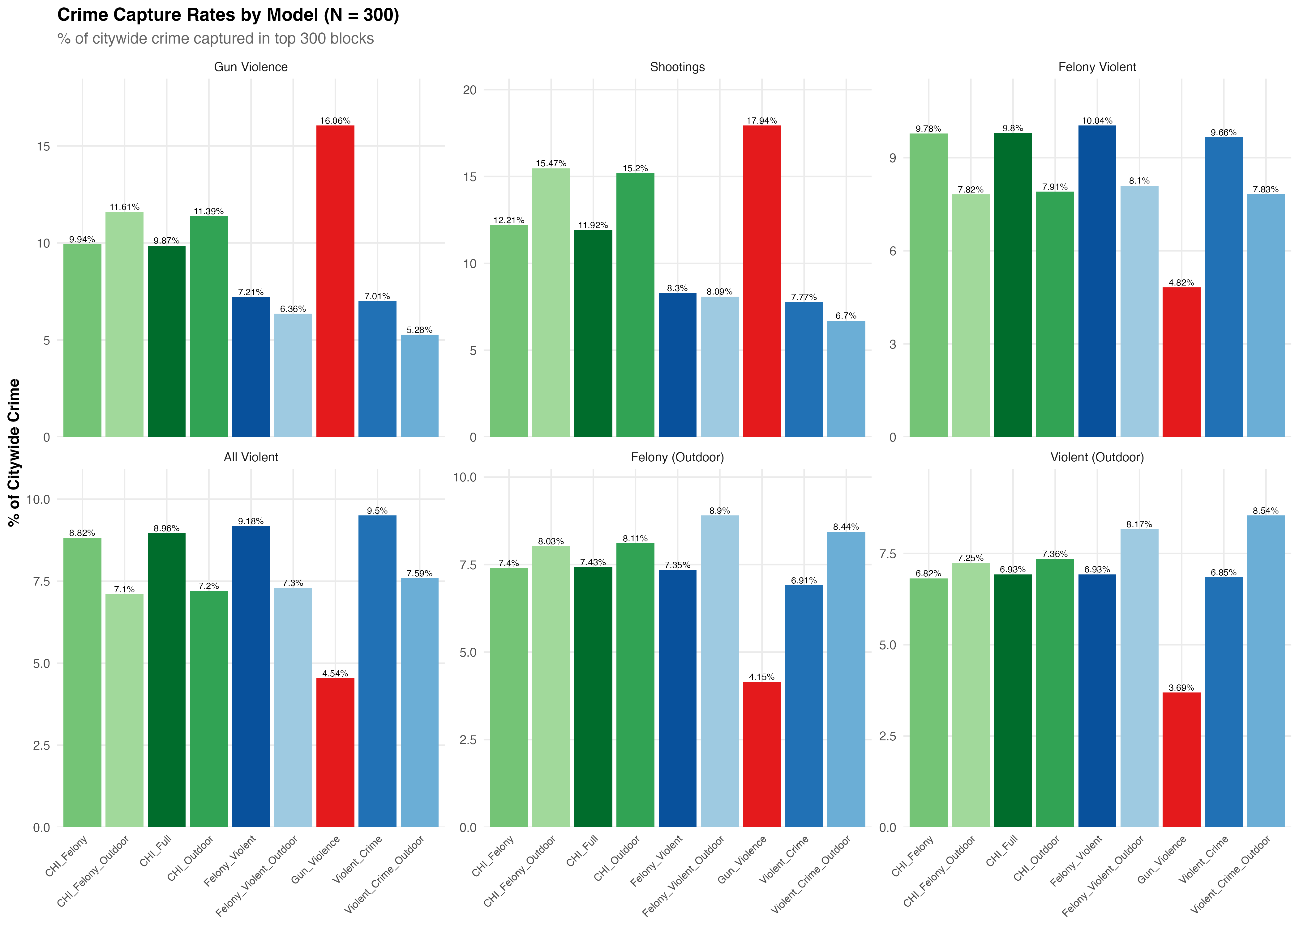
What Each Model Captures

Slide 5
The Core Trade-Off
No single model dominates every dimension.
 | Gun Violence | CHI Outdoor | Violent Crime
GV capture (N=200) | 12.1% | 8.4% | 4.9%
Top 20 GV coverage | 100% | 95% | 65%
Top 50 GV coverage | 100% | 90% | 38%
Felony violent capture | 3.6% | 6.1% | 7.5%
All violent capture | 3.3% | 5.5% | 7.3%
Shootings / block / yr | 0.95 | 0.79 | 0.37
Violent crimes / block / yr | 14.1 | 23.5 | 30.9
Gun violence focus
Balance both
Broad violence
Gun Violence model
CHI Outdoor model
Violent Crime model

Slide 6
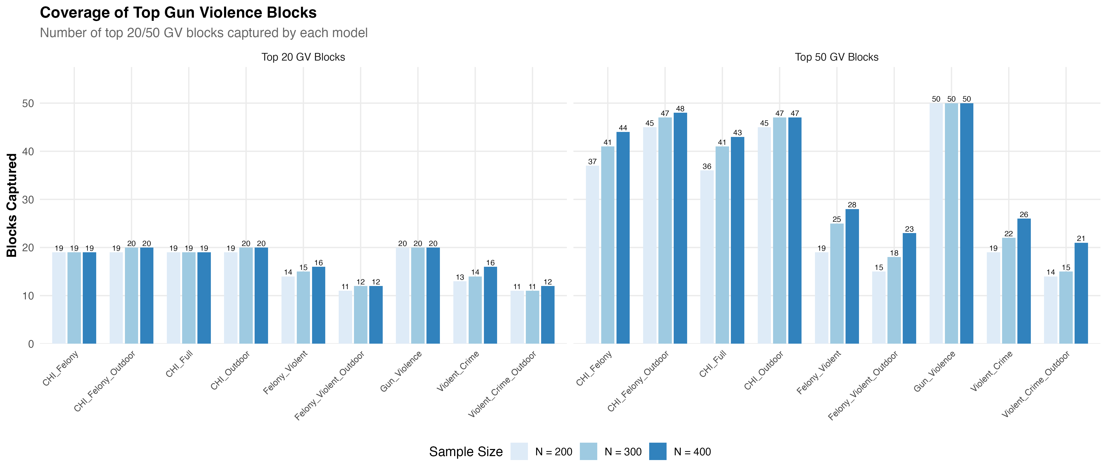
Covering the Hottest Blocks
Only the Gun Violence model guarantees 100% of the top 20 and top 50 most violent blocks.
CHI Outdoor captures 90–95%. Violent Crime models miss 35–62% of the top 50.

Slide 7
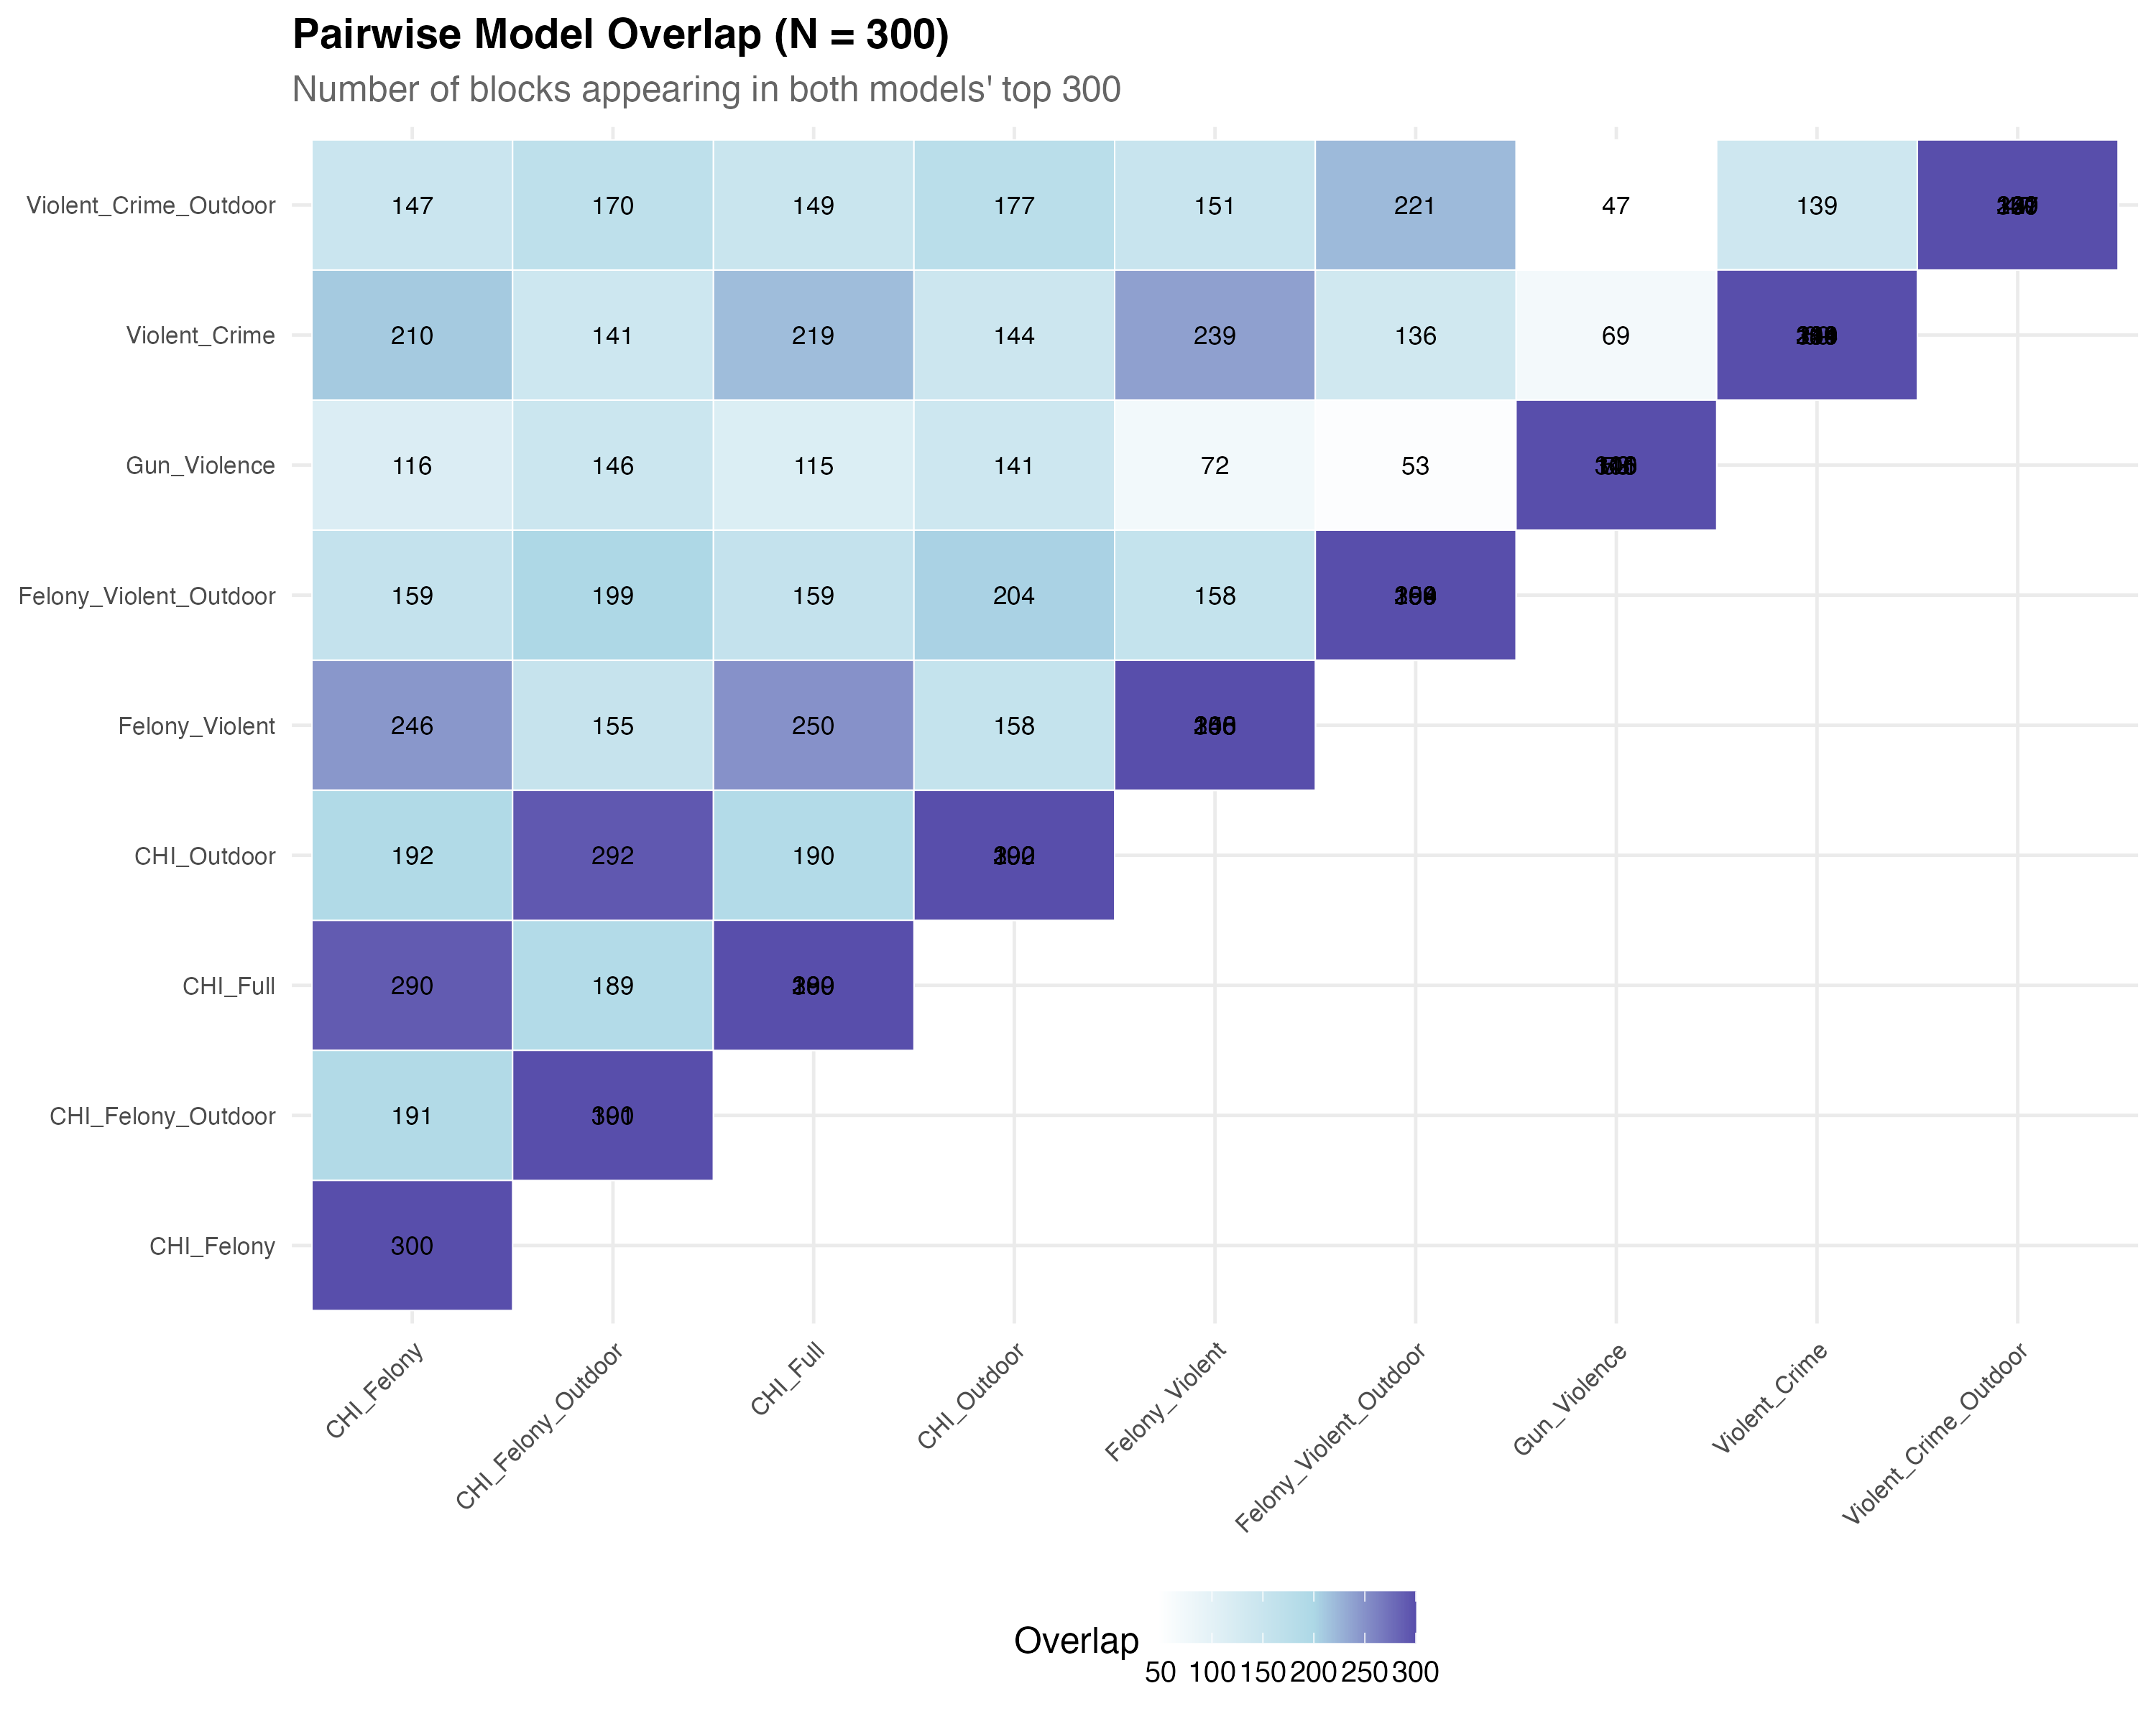
How Much Do Models Agree?
Key findings
CHI variants are near-identical
97% overlap between CHI Felony & CHI Full
Gun Violence stands apart
Only 18–44% overlap with other models
18 consensus blocks
Appear in all 9 models’ top 200

Slide 8
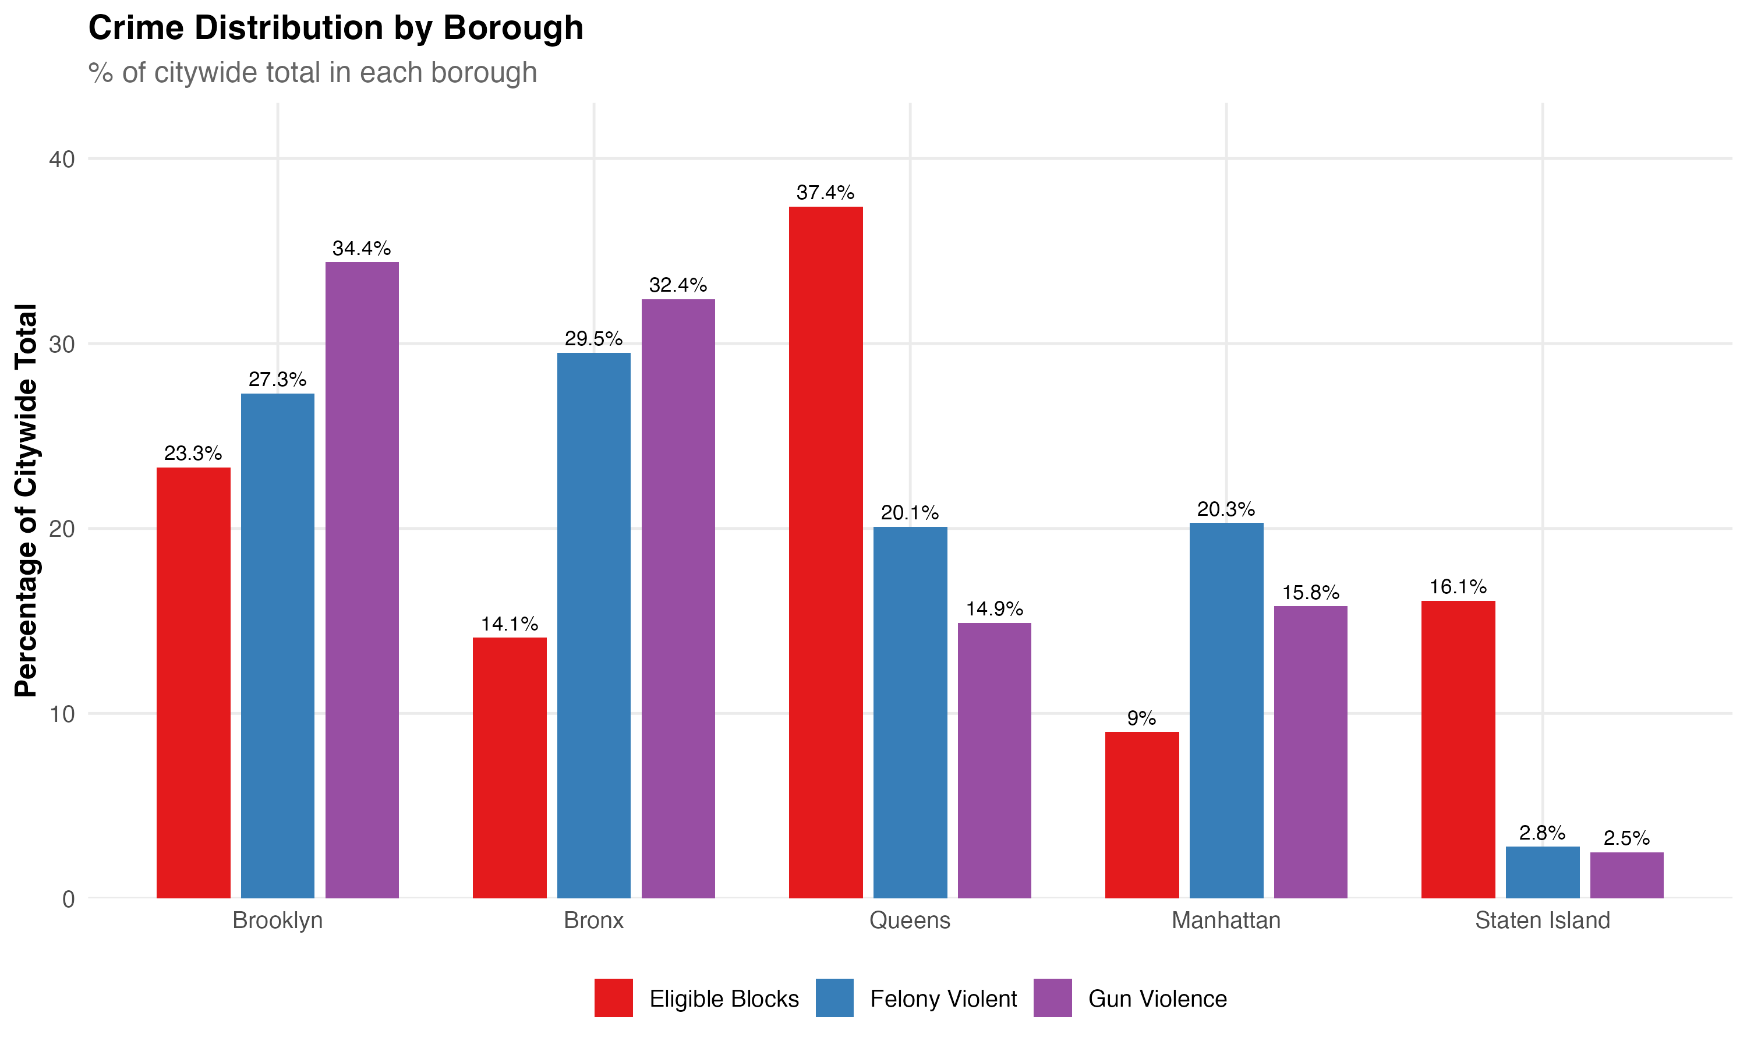
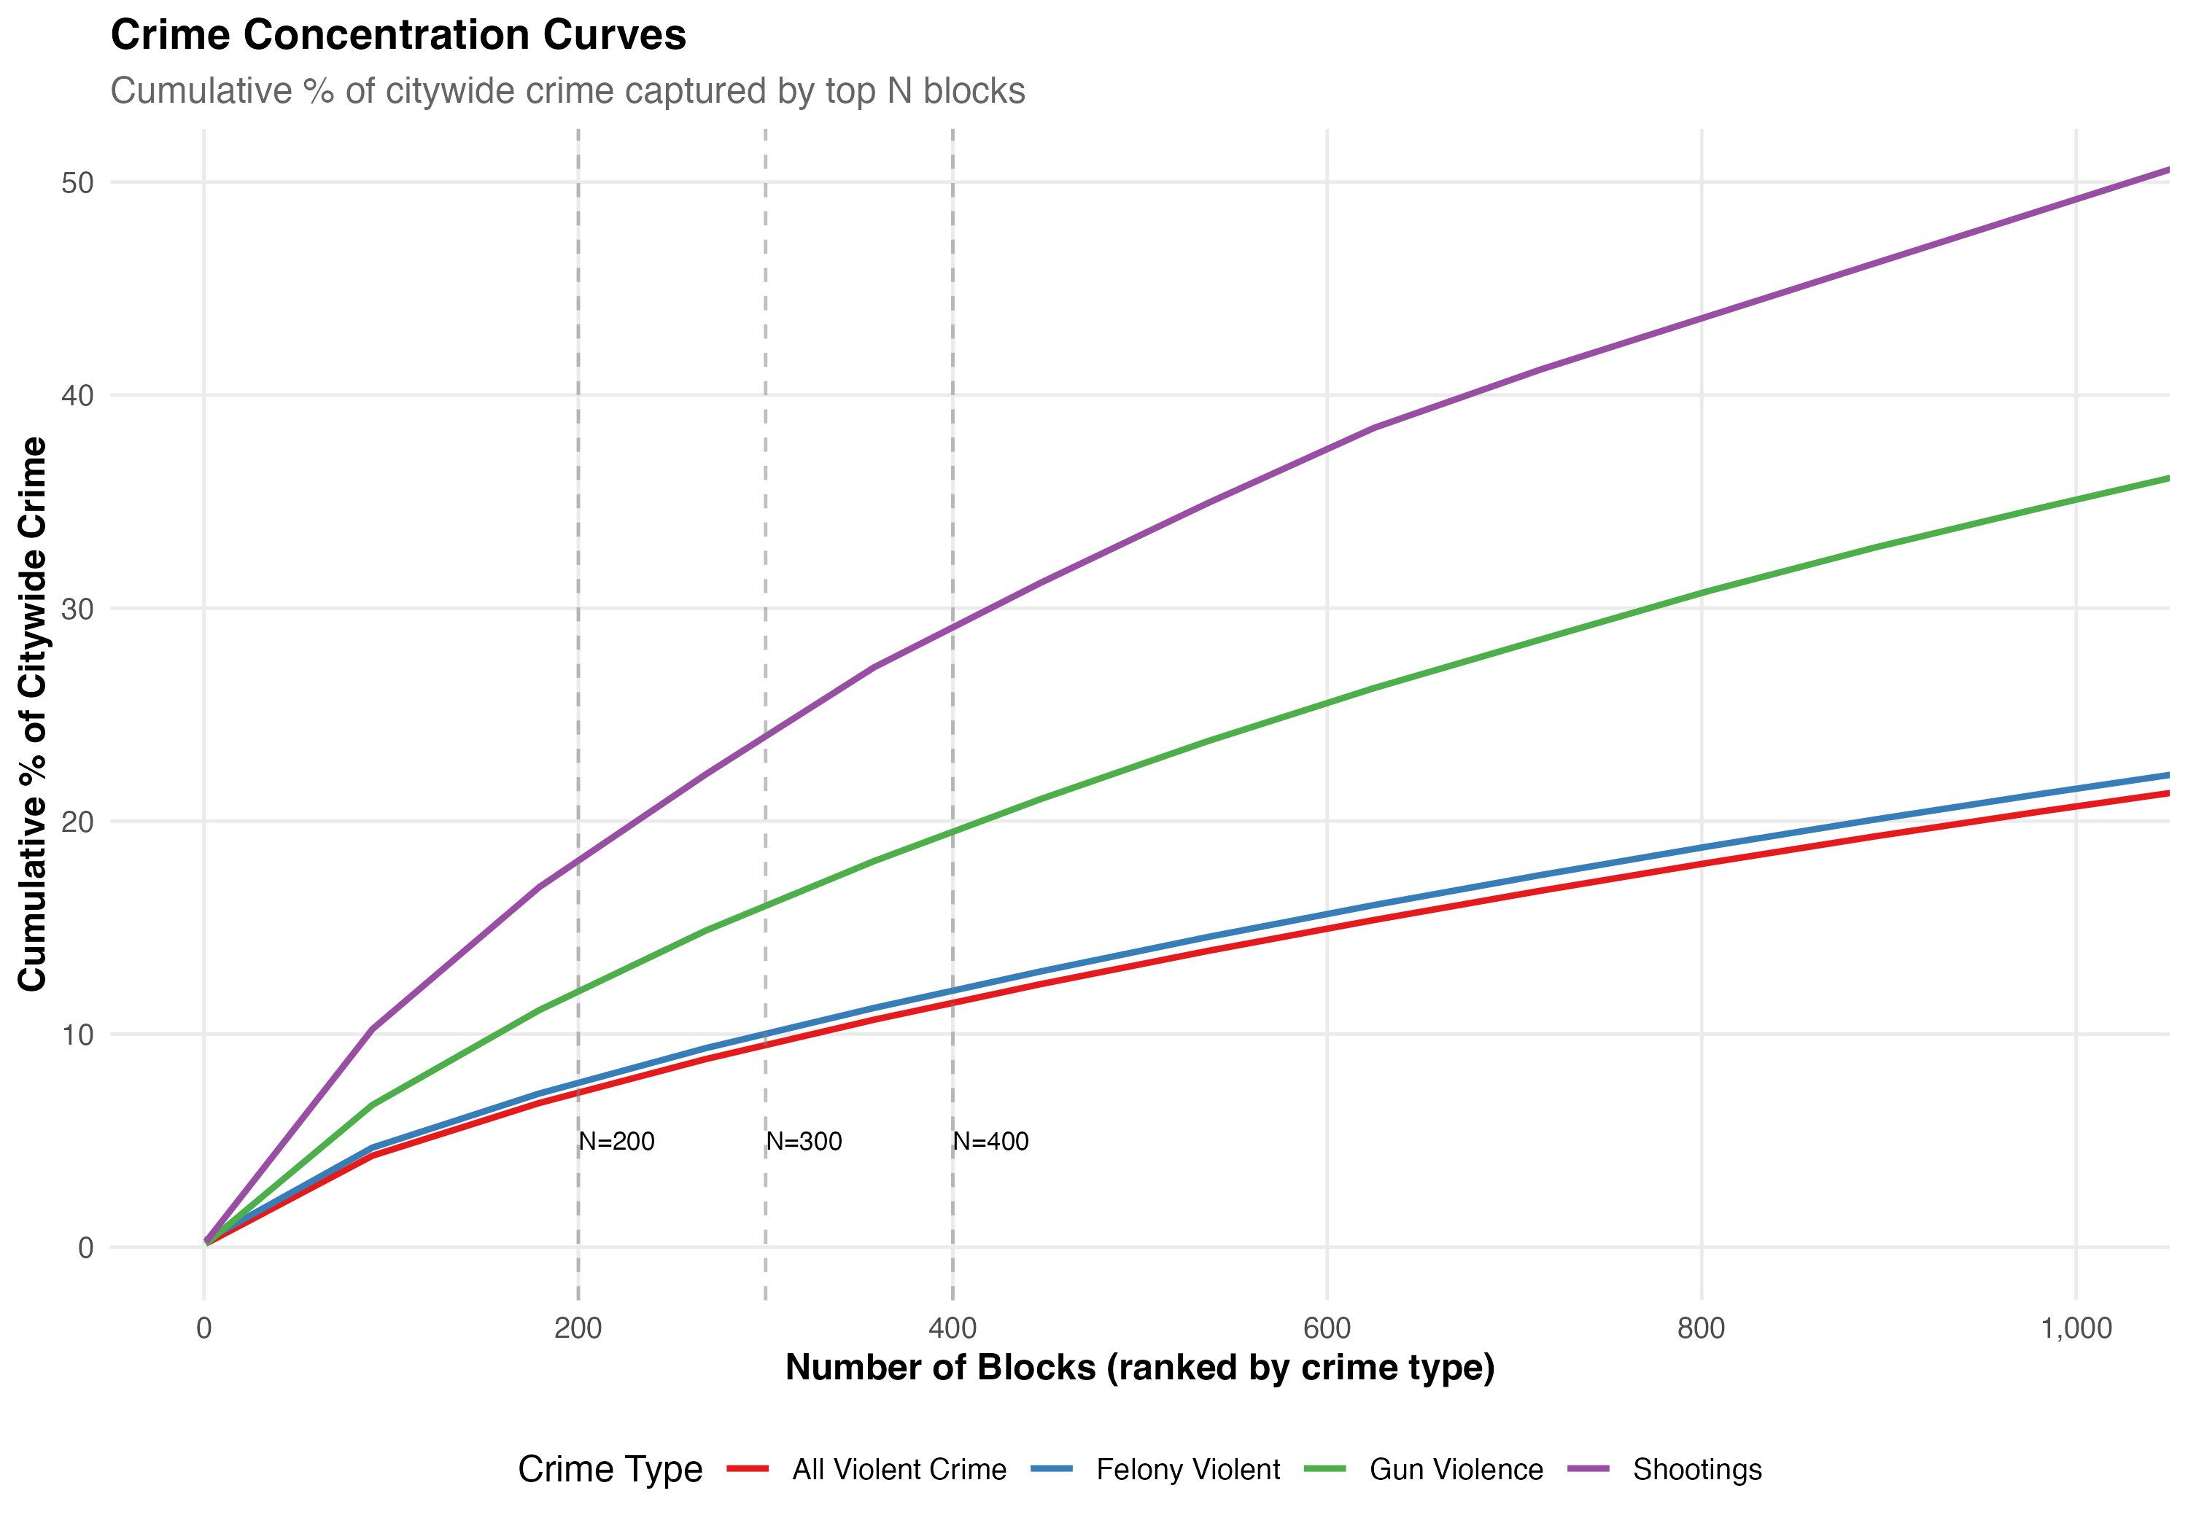
Where Harm Concentrates
Brooklyn + Bronx = two-thirds of citywide gun violence, despite 37% of blocks.
Top 200 blocks capture 12% of gun violence but only 3–7% of broader violent crime.

Slide 9
Every Block Counts
The targeting algorithm shapes which blocks
are eligible for randomization.
John Hall
March 2026

