Slide 1
Introduction to Operating Systems
CPSC/ECE 3220 Summer 2018
Lecture Notes
OSPP Chapter 4
(adapted by Mark Smotherman from Tom Anderson’s slides on OSPP web site)

Slide 2
Motivation for Threads
Operating systems (and application programs) often need to be able to handle multiple things happening at the same time
Process execution, interrupts, background tasks, system maintenance
Humans are not very good at keeping track of multiple things happening simultaneously
Threads are an abstraction to help bridge this gap

Slide 3
Examples of Concurrency
Servers
Multiple connections handled simultaneously
Parallel programs
To achieve better performance
Programs with user interfaces
To achieve user responsiveness while doing computation
Network and disk bound programs
To hide network/disk latency

Slide 4
Definitions
A thread is a single execution sequence that represents a separately schedulable task
Single execution sequence: familiar programming model
Separately schedulable: OS can run or suspend a thread at any time
Protection is an orthogonal concept
Can have one or many threads per protection domain

Slide 5
Threads vs. Processes
For parallel processing involving shared objects, threads are more efficient than processes
Cheaper to create and destroy
Faster to switch among
Communicate through shared memory in single process
But code is hard to get correct when multiple threads can update shared objects
“[N]on-trivial multi-threaded programs are incomprehensible to humans.” Edward Lee, UCB
“For most purposes proposed for threads, events are better. Threads should be used only when true CPU concurrency is needed.” John Ousterhout

Slide 6
Thread Abstraction
Infinite number of processors
Threads execute with variable speed
Programs must be designed to work with any schedule
Otherwise false assumptions can lead to incorrect results

Slide 7
Programmer vs. Processor View

Slide 8
Possible Executions

Slide 9
Thread Operations
thread_create(thread, func, args)
Create a new thread to run func(args)
thread_yield()
Relinquish processor voluntarily
thread_join(thread)
In parent, wait for forked thread to exit, then return
thread_exit(return_value)
Quit thread and clean up, wake up joiner if any

Slide 10
Thread Context Switch
Voluntary
Thread_yield()
Thread_join() – if child is not done yet
Involuntary (“preemption”)
Interrupt or exception
Some other thread is higher priority

Slide 11
Fork/Join Executes a Procedure Call in Parallel
Procedure Call/Return
call func()→ func()
execute
← return
execute
Single path of execution
Caller resumes execution on return
Thread Fork/Join
t_create()→ func()
execute execute
t_join() ← t_exit()
execute
Parallel execution
Exit is immediate
Join will wait for exit if necessary

Slide 12
Example: threadHello
#define NTHREADS 10
thread_t threads[NTHREADS];
main() {
for (i = 0; i < NTHREADS; i++) thread_create(&threads[i], &go, i);
for (i = 0; i < NTHREADS; i++) {
exitValue = thread_join(threads[i]);
printf("Thread %d returned with %ld\n", i, exitValue);
}
printf("Main thread done.\n");
}
void go (int n) {
printf("Hello from thread %d\n", n);
thread_exit(100 + n);
// REACHED?
}

Slide 13
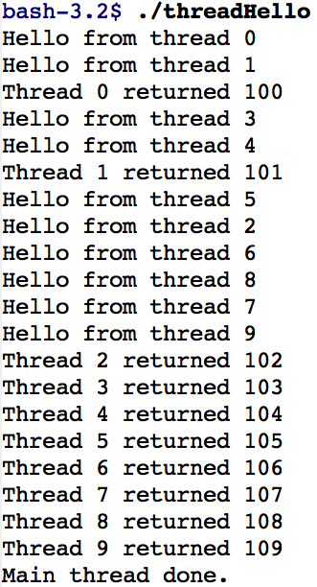
threadHello: Example Output
Why must “thread returned” print in order?
What is maximum # of threads running when thread 5 prints hello?
Minimum?

Slide 14
Fork/Join Concurrency
Threads can create children, and wait for their completion
Data can be shared before fork and after join
Otherwise extra code to coordinate access (Chapter 5)
Examples:
Web server: fork new thread for each new connection
As long as the threads are completely independent
Merge sort
Parallel memory copy

Slide 15
bzero with fork/join concurrency
void blockzero (unsigned char *p, int length) {
int i, j;
thread_t threads[NTHREADS];
struct bzeroparams params[NTHREADS];
// For simplicity, assumes length is divisible by NTHREADS.
for (i = 0, j = 0; i < NTHREADS; i++, j += length/NTHREADS) {
params[i].buffer = p + i * length/NTHREADS;
params[i].length = length/NTHREADS;
thread_create_p(&(threads[i]), &go, &params[i]);
}
for (i = 0; i < NTHREADS; i++) {
thread_join(threads[i]);
}
}

Slide 16
Thread Data Structures

Slide 17
Thread Metadata
Thread ID
Scheduling priority
Thread state (ready, running, waiting, …)
State of Thread | Location of TCB | Location of Registers
Init | being created | TCB or thread’s stack
Ready | Ready List | TCB/stack
Running | Running List | processor
Waiting | synch. variable’s Waiting List | TCB/stack
Finished | Finished List then deleted | TCB/stack or deleted

Slide 18
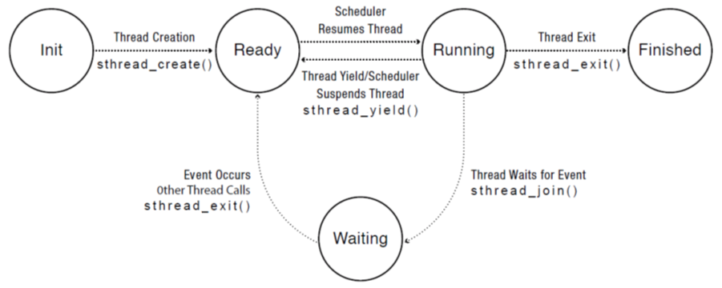
Thread Lifecycle

Slide 19
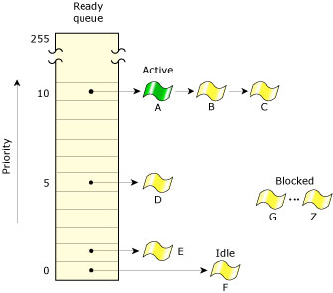
Ready Threads in QNX
Shows alternate design decisions with one list per priority level and with running thread (“active”) remaining linked
(Diagram from http://www.qnx.com/developers/docs/6.3.2/neutrino/sys_arch/kernel.html)

Slide 20
Threads at User and Kernel Level
Multiple single-threaded processes
System calls access shared kernel data structures
Multiple multi-threaded user processes
Each with multiple threads, sharing same data structures, isolated from other user processes
Kernel design
Kernel can have zero threads (e.g., IBM MVT)
Kernel can use internal threads
In general, interrupt handlers are not threads but can be used to wake or signal threads

Slide 21
Multithreaded OS Kernel

Slide 22
Multithreaded User Processes (Take 1)

Slide 23
Multithreaded User Processes (Take 2)
Green threads (early Java)
User-level library, within a single-threaded process
Library does thread context switch
Preemption via upcall/UNIX signal on timer interrupt
Use multiple processes for real concurrency
Shared memory region mapped into each process

Slide 24
Multithreaded User Processes (Take 3)
Scheduler activations (Windows 8)
Kernel allocates processors to user-level library
Thread library implements context switch
Thread library decides what thread to run next
Upcall whenever kernel needs a user-level scheduling decision
Process assigned a new processor
Processor removed from process
System call blocks in kernel

Slide 25
Asynchronous I/O as a Alternative to Threads

Slide 26
(if time permits)

Slide 27
Event-Driven Approach
Ousterhout description:
One execution sequence; no concurrency
Establish callbacks for events
Event loop waits for an event and invokes handlers
No preemption of event handlers
Event handlers are generally short-lived
But must add “continuation” data structures if event processing is complex and needs local state and tracking of next step

Slide 28
Question
When is event-driven programming better than multithreaded concurrency? Why?

