Slide 1
Introduction to Operating Systems
CPSC/ECE 3220 Summer 2018
Lecture Notes
OSPP Chapter 5 – Part A
(adapted by Mark Smotherman from Tom Anderson’s slides on OSPP web site)

Slide 2
Lost Update / Record Out Problem
Thread A with shared “x”
x = x + 1;
// at machine code level
load r1, x
add r1, r1, #1
// switch threads →
store r1, x ←
Thread B with shared “x”
x = x + 1;
// at machine code level
load r1, x
add r1, r1, #1
store r1, x
// switch threads

Slide 3
Question: Are All Pushes Successful?
Consider shared linked list accessed as a stack: (adapted from Michael Scott)
struct node{
...
struct node *next;
}
struct node *head;
void push( struct node *new ){
new->next = head;
// what if a second push starts at this point?
head = new;
}

Slide 4
Synchronization Motivation
When threads concurrently read/write shared memory, program behavior is undefined
Two threads write to the same variable; which one should win?
Thread schedule is non-deterministic
Behavior can change when you re-run program
Also:
Compiler/hardware instruction reordering
Multi-word operations are not atomic

Slide 5
Question: Can this panic?
Thread 1
p = someComputation();
pInitialized = true;
Thread 2
while ( !pInitialized )
/* empty loop body */ ;
q = someFunction(p);
if ( q != someFunction(p) )
panic();

Slide 6
Why Reordering?
Why do compilers reorder instructions?
Efficient code generation requires analyzing control/data dependency
If variables can spontaneously change, most compiler optimizations become impossible
Why do CPUs reorder instructions?
Write buffering: allow next instruction to execute while write is being completed
Fix: memory barrier
Instruction to compiler/CPU
All ops before barrier complete before barrier returns
No op after barrier starts until barrier returns

Slide 7
Too Much Milk Example
 | Person A | Person B
12:30 | Look in fridge. Out of milk.
12:35 | Leave for store.
12:40 | Arrive at store. | Look in fridge. Out of milk.
12:45 | Buy milk. | Leave for store.
12:50 | Arrive home, put milk away. | Arrive at store.
12:55 |  | Buy milk.
1:00 |  | Arrive home, put milk away. Oh no!

Slide 8
Definitions
Race condition: output of a concurrent program depends on the order of operations between threads
Mutual exclusion: only one thread does a particular thing at a time
Critical section: piece of code that only one thread can execute at once
Lock: prevent someone from doing something
Lock before entering critical section, before accessing shared data
Unlock when leaving, after done accessing shared data
Wait if locked (all synchronization involves waiting!)

Slide 9
Too Much Milk, Try #1
Correctness property
Someone buys if needed (liveness)
At most one person buys (safety)
Try #1: leave a note
if ( !milk )
if ( !note ) {
leave note
buy milk
remove note
}

Slide 10
Too Much Milk, Try #2
Thread A
leave note A
if ( !note B ) {
if ( !milk )
buy milk
}
remove note A
Thread B
leave note B
if ( !noteA ) {
if ( !milk )
buy milk
}
remove note B

Slide 11
Too Much Milk, Try #3
Thread A
leave note A
while ( note B ) // X
do nothing;
if ( !milk )
buy milk;
remove note A
Thread B
leave note B
if ( !noteA ) { // Y
if ( !milk )
buy milk
}
remove note B
Can guarantee at X and Y that either:
Safe for me to buy
Other will buy, ok to quit
Notes:
At Y: if noNote A, safe for B to buy (means A hasn't started yet)
if note A, A is either buying, or waiting for B to quit,
so ok for B to quit
At X: if nonote B, safe to buy
if note B, don't know. A hangs around. Either:
if B buys, done
if B doesn't buy, A will.

Slide 12
Lessons
Solution is complicated
“obvious” code often has bugs
Modern compilers/architectures reorder instructions
Making reasoning even more difficult
Generalizing to many threads/processors
Even more complex: see Peterson’s algorithm

Slide 13
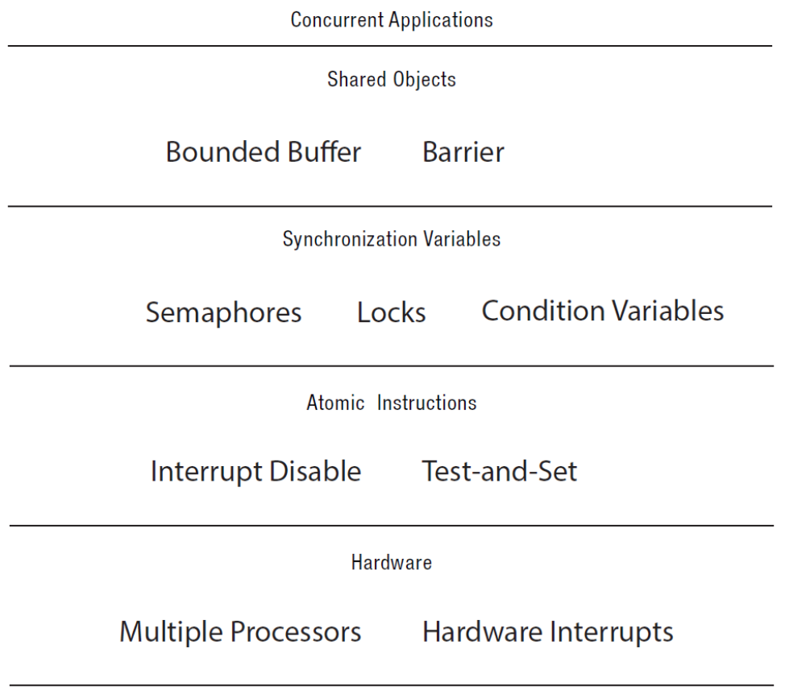
Roadmap

Slide 14
Locks
Lock::acquire()
wait until lock is free, then take it
Lock::release()
release lock, waking up anyone waiting for it
At most one lock holder at a time (safety)
If no one holding, acquire gets lock (progress)
If all lock holders finish and no higher priority waiters, waiter eventually gets lock (progress)

Slide 15
Question: Why only Acquire/Release
Suppose we add a method to ask if a lock is free. Suppose it returns true. Is the lock:
Free?
Busy?
Don’t know?

Slide 16
Too Much Milk, #4
Locks allow concurrent code to be much simpler:
lock.acquire();
if (!milk)
buy milk
lock.release();

Slide 17
Lock Example: Malloc/Free
char *malloc (n) {
heaplock.acquire();
p = allocate memory
heaplock.release();
return p;
}
void free(char *p) {
heaplock.acquire();
put p back on free list
heaplock.release();
}

Slide 18
Rules for Using Locks
Lock is initially free
Always acquire before accessing shared data structure
Beginning of procedure!
Always release after finishing with shared data
End of procedure!
Only the lock holder can release
DO NOT throw lock for someone else to release
Never access shared data without lock
Danger!

Slide 19
Example: Bounded Buffer
tryget() {
item = NULL;
lock.acquire();
if ( front < tail ) {
item = buf[front % MAX];
front++; // ignoring ovf
}
lock.release();
return item;
}
tryput(item) {
lock.acquire();
if ( (tail – front) < size ) {
buf[tail % MAX] = item;
tail++; // ignoring ovf
}
lock.release();
}
Initially: front = tail = 0; lock = FREE; MAX is buffer capacity

Slide 20
Example: Bounded Buffer
For simplicity, assume no wraparound on the integers front and tail; I’ll assume you can fix that if you want
front = total number of items that have ever been removed
tail = total number of items ever inserted
Lock at beginning of procedure; unlock at end; no access outside of locks
Note that we don’t know whether the buffer is still empty once we release the lock– we only know the state of the buffer while holding the lock!

Slide 21
Question
If tryget() returns NULL, do we know the buffer is empty?
If we poll tryget() in a loop, what happens to a thread calling tryput()?

Slide 22
Condition Variables
Waiting inside a critical section
Called only when holding a lock
Wait: atomically release lock and relinquish processor
Reacquire the lock when wakened
Signal: wake up a waiter, if any
Broadcast: wake up all waiters, if any

Slide 23
Condition Variable Design Pattern
methodThatWaits() {
lock.acquire();
// Read/write shared state
while ( !testSharedState() ) {
cv.wait(&lock);
}
// Read/write shared state
lock.release();
}
methodThatSignals() {
lock.acquire();
// Read/write shared state
// If testSharedState is now true
cv.signal(&lock);
// Read/write shared state
lock.release();
}

Slide 24
Example: Bounded Buffer
get() {
lock.acquire();
while ( front == tail ) {
empty.wait(&lock);
}
item = buf[front % MAX];
front++; // ignoring ovf
full.signal(&lock);
lock.release();
return item;
}
put(item) {
lock.acquire();
while ( (tail – front) == MAX ) {
full.wait(&lock);
}
buf[tail % MAX] = item;
tail++; // ignoring ovf
empty.signal(&lock);
lock.release();
}
Initially: front = tail = 0; MAX is buffer capacity
empty/full are condition variables

Slide 25
Pre/Post Conditions
What is state of the bounded buffer at lock acquire?
front <= tail
front + MAX >= tail
These are also true on return from wait
And at lock release
Allows for proof of correctness

Slide 26
Pre/Post Conditions
methodThatWaits() {
lock.acquire();
// Pre-condition: State is consistent
// Read/write shared state
while ( !testSharedState() ) {
cv.wait(&lock);
}
// WARNING: shared state may
// have changed! But
// testSharedState is TRUE
// and pre-condition is true
// Read/write shared state
lock.release();
}
methodThatSignals() {
lock.acquire();
// Pre-condition: State is consistent
// Read/write shared state
// If testSharedState is now true
cv.signal(&lock);
// NO WARNING: signal keeps lock
// Read/write shared state
lock.release();
}

Slide 27
Condition Variables
ALWAYS hold lock when calling wait, signal, broadcast
Condition variable is sync FOR shared state
ALWAYS hold lock when accessing shared state
Condition variable is memoryless
If signal when no one is waiting, no op
If wait before signal, waiter wakes up
Wait atomically releases lock
What if wait, then release?
What if release, then wait?

Slide 28
Condition Variables, cont’d
When a thread is woken up from wait, it may not run immediately
Signal/broadcast puts thread on ready list
When lock is released, anyone might acquire it
Wait MUST be in a loop
while ( needToWait() ) {
condition.Wait(lock);
}
Simplifies implementation
Of condition variables and locks
Of code that uses condition variables and locks

Slide 29
Structured Synchronization
Identify objects or data structures that can be accessed by multiple threads concurrently
Add locks to object/module
Grab lock on start to every method/procedure
Release lock on finish
If need to wait
while( needToWait() ) { condition.Wait(&lock); }
Do not assume when you wake up that signaller just ran
If do something that might wake someone up
Signal or Broadcast
Always leave shared state variables in a consistent state
When lock is released, or when waiting

Slide 30
Remember the rules
Use consistent structure
Always use locks and condition variables
Always acquire lock at beginning of procedure, release at end
Always hold lock when using a condition variable
Always wait in while loop
Never spin in sleep()

Slide 31
(if time permits)

Slide 32
Pthread Syntax
Thread A
pthread_mutex_lock( &my_lock );
while( /* test of shared state fails */ ){
pthread_cond_wait( &my_cond_var,
&my_lock );
}
/* read/write shared state */
pthread_mutex_unlock( &my_lock );
Thread B
pthread_mutex_lock( &my_lock );
/* read/write shared state */
/* if state has changed in a way that
allows other threads to make
progress, then signal or broadcast */
pthread_cond_signal( &my_cond_var );
pthread_mutex_unlock( &my_lock );

Slide 33
Blocking Bounded Buffer in Java
class BoundedBuffer {
Lock lock = new ReentrantLock();
Condition notFull = lock.newCondition();
Condition notEmpty = lock.newCondition();
Object[] items = new Object[100];
int putptr, takeptr, count;
public void put(Object x)throws IE {
lock.lock(); try {
while ( count == items.length )
notFull.await();
items[putptr] = x;
if ( ++putptr == items.length )
putptr = 0;
++count;
notEmpty.signal();
} finally { lock.unlock(); }
}
public Object take() throws IE {
lock.lock(); try {
while ( count == 0 )
notEmpty.await();
Object x = items[takeptr];
if ( ++takeptr == items.length )
takeptr = 0;
--count;
notFull.signal();
return x;
} finally { lock.unlock(); }
}
}
(code example from gee.cs.oswego.edu/dl/concurrency-interest/jsr166-slides.pdf)

Slide 34
Pthreads and Java 5 (and later)
When waiting upon a Condition Variable, a “spurious wakeup” is permitted to occur, in general, as a concession to the underlying platform semantics. This has little practical impact on most application programs as a Condition Variable should always be waited upon in a loop, testing the state predicate that is being waited for.

Slide 35
Mesa vs. Hoare semantics
Mesa
Signal puts waiter on ready list
Signaller keeps lock and processor
Hoare
Signal gives processor and lock to waiter
When waiter finishes, processor/lock given back to signaller
Nested signals possible!

Slide 36
FIFO Bounded Buffer (Hoare semantics)
get() {
lock.acquire();
if ( front == tail ) {
empty.wait(&lock);
}
item = buf[front % MAX];
front++; // ignoring ovf
full.signal(&lock);
lock.release();
return item;
}
put(item) {
lock.acquire();
if ( (tail – front) == MAX ) {
full.wait(&lock);
}
buf[last % MAX] = item;
last++; // ignoring ovf
empty.signal(&lock);
// CAREFUL: someone else ran
lock.release();
}
Initially: front = tail = 0; MAX is buffer capacity
empty/full are condition variables

Slide 37
FIFO Bounded Buffer (Mesa semantics)
Create a condition variable for every waiter
Queue condition variables (in FIFO order)
Signal picks the front of the queue to wake up
CAREFUL if spurious wakeups!
Easily extends to case where queue is LIFO, priority, priority donation, …
With Hoare semantics, not as easy

Slide 38
FIFO Bounded Buffer (Mesa semantics, put() is similar)
get() {
lock.acquire();
myPosition = numGets++;
// ignoring ovf
self = new Condition;
nextGet.append(self);
while ( front < myPosition
|| front == tail ) {
self.wait(&lock);
}
delete self;
item = buf[front % MAX];
front++; // ignoring ovf
if (next = nextPut.remove()) {
next->signal(&lock);
}
lock.release();
return item;
}
Initially: front = tail = numGets = 0; MAX is buffer capacity
nextGet, nextPut are queues of Condition Variables

