Slide 1
Introduction to Operating Systems
CPSC/ECE 3220 Summer 2018
Lecture Notes
OSPP Chapters 11 and 12
(adapted by Mark Smotherman from Tom Anderson’s slides on OSPP web site)

Slide 2
Main Points
File systems
Useful abstractions on top of physical devices
Files
Metadata, data, file types, open/close
Storage hardware characteristics
Disks and flash memory
File system usage patterns
Naming

Slide 3
I/O System Layers

Slide 4
File Systems
Abstraction on top of persistent storage
Magnetic disk
Flash memory (e.g., USB thumb drive)
Devices provide
Storage that (usually) survives across machine crashes
Block level (random) access
Large capacity at low cost
Relatively slow performance
Magnetic disk read takes 10-20M processor instructions

Slide 5
Logical Record Blocking
Application
Reads/writes of
logical records
(can be 1 byte at a time)
Physical record buffer
Buffer in memory to reduce the number of physical I/O ops
Reads/writes of
physical records (blocks)
(1000s of bytes at a time)
Device
Note: double-buffering allows processing to overlap transfer of next physical record

Slide 6
File System as Illusionist: Hide Limitations of Physical Storage
Persistence of data stored in file system:
Even if crash happens during an update
Even if disk block becomes corrupted
Even if flash memory wears out
Controlled access to shared data
Naming:
Named data instead of disk block numbers
Byte addressable data even though devices are block-oriented
Directories instead of flat storage
Performance:
Data placement and data structure organization
Cached data

Slide 7
File System Abstraction
File system
Persistent, named data
Operating system crashes (and disk errors) leave file system in a valid state
Access control on data
File: named collection of data
Linear sequence of bytes (or a set of sequences or records)
Read/write or memory mapped
Hierarchical organization (directories, subdirectories)
Performance
Achieve close to the hardware limit in the average case

Slide 8
Files
Metadata
owner, access permissions, timestamps (creation, last written), size, reference count, lock, etc.
Data
May be unstructured or structured:
Stream of bytes (even if stored as blocks)
Records are collections of related fields, often with a key field used for searching and sorting
Alternate data streams (resource forks in Mac OS)

Slide 9
Connection-Oriented Interface
Explicit open and close operations for files
OS creates an internal data structure on open
Read and write ops use descriptor (a.k.a. handle or stream) to identify the internal data structure
No need to reparse file name
Per-open data structure contains:
Access permission under which file was opened
Location of file (e.g., inode number)
Pointer to current byte or record for sequential access

Slide 10
UNIX Data Structures for Open Files
per-process
system-wide
on disk
Diagram from K. Thompson, “UNIX Implementation,” Bell System Tech. Jrnl., 1978

Slide 11
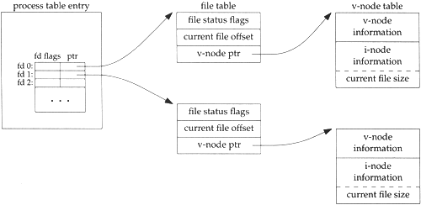
UNIX Data Structures for Open Files (2)
copy inode info
into kernel memory
per-process
system-wide
Diagram from W. Richard Stevens, Chapter 3, “UNIX File I/O,” Advanced Programming in the UNIX® Environment, 2003

Slide 12
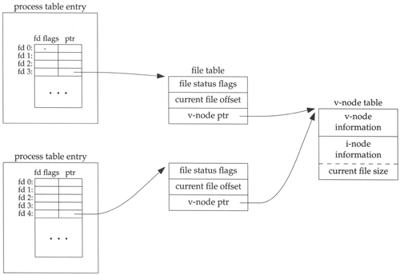
UNIX Data Structures for Open Files (3)
Two processes open the same file – each
has its own current file pointer (“offset”)
Diagram from W. Richard Stevens, Chapter 3, “UNIX File I/O,” Advanced Programming in the UNIX® Environment, 2003

Slide 13
UNIX File System API
create, link, unlink, createdir, rmdir
Create file, link to file, remove link
Create directory, remove directory
open, close, read, write, seek
Open/close a file for reading/writing
Seek resets current position
fsync
File modifications can be cached
fsync forces modifications to disk (like a memory barrier)

Slide 14
Storage Devices
Magnetic disks
Storage that rarely becomes corrupted
Large capacity at low cost
Block level random access
Slow performance for random access
Better performance for streaming access
Flash memory
Storage that rarely becomes corrupted
Capacity at intermediate cost (50x disk)
Block level random access
Good performance for reads; worse for random writes

Slide 15
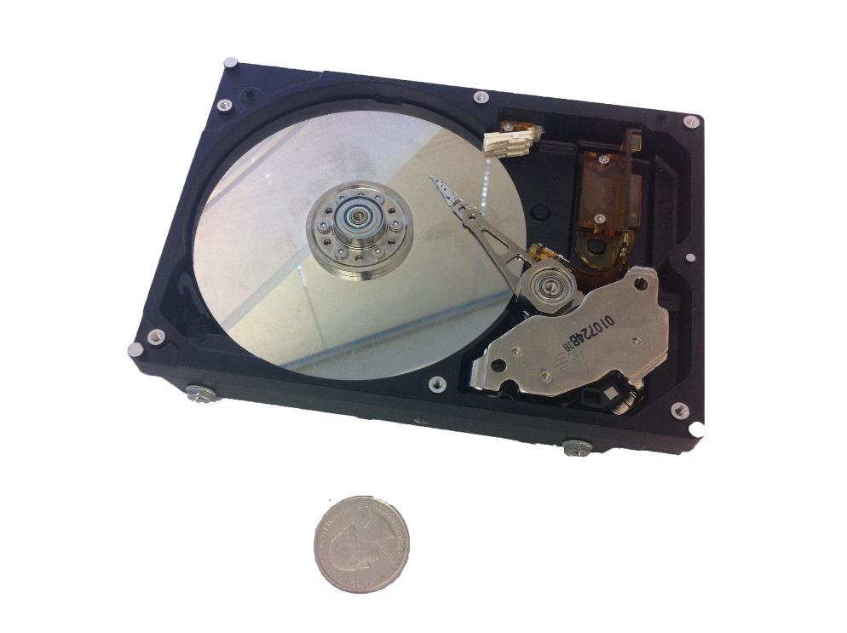
Magnetic Disk

Slide 16
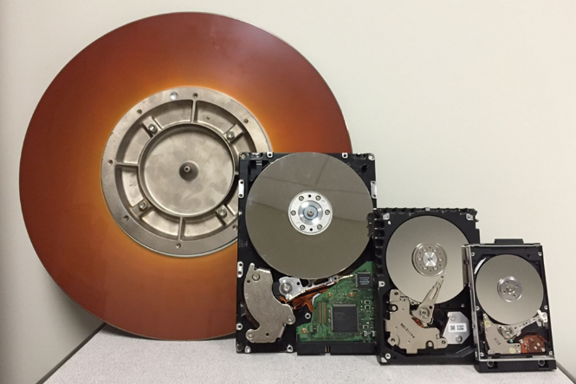

Left-to-right:
Single 14-inch disk platter, 16 MB removable cartridge disk for 1980s rack-mount Ampex DFR-900 series HDD, 3600 rpm, 30 ms avg. seek time
Three 5.12-inch (5.25-inch FF) platters, 19.2 GB internal drive, Quantum Bigfoot TS19A011, 4000 rpm, 10.5 ms seek
Four 3.74-inch (3.5-inch FF) platters, likely 80 GB internal drive, Seagate Barracuda, 7200 rpm, 8 ms seek
Single 2.56-inch (2.5-inch FF) platter, 10.06 GB internal drive, IBM Travelstar 07N5138, 4200 rpm, 12 ms seek

Slide 17
Notes:
Head and track are not to scale – head is actually much much bigger than a track.
Track ~ 1 micron wide
Wavelength of light is ~ 0.5 micron
Resolution of human eye: 50 microns
Outer edge of disk is travelling at 30 mph, with the head riding on top of the disk surface with a cushion of a few atoms

Slide 18
Disk Tracks
~ 1 micron wide
Wavelength of light is ~ 0.5 micron
Resolution of human eye: 50 microns
100K tracks on a typical 2.5” disk
Separated by unused guard regions
Reduces likelihood neighboring tracks are corrupted during writes (still a small non-zero chance)
Track length varies across disk
Outside: More sectors per track, higher bandwidth
Disk is organized into regions of tracks with same # of sectors/track
Only outer half of radius is used
Most of the disk area in the outer regions of the disk

Slide 19
Sectors
Sectors contain sophisticated error correcting codes
Disk head magnet has a field wider than track
Hide corruptions due to neighboring track writes
Sector sparing
Remap bad sectors transparently to spare sectors on the same surface
Slip sparing
Remap all sectors (when there is a bad sector) to preserve sequential behavior
Track skewing
Sector numbers offset from one track to the next, to allow for disk head movement for sequential ops
Notes:
Error correcting code: ex: parity. But you can get more sophisticated.

Slide 20
Disk Performance
Disk Latency =
Seek Time + Rotation Time + Transfer Time
Seek Time: time to move disk arm over track (1-20ms)
Fine-grained position adjustment necessary for head to “settle”
Head switch time ~ track switch time (on modern disks)
Rotation Time: time to wait for disk to rotate under disk head
Disk rotation: 4 – 15ms (depending on price of disk)
On average, only need to wait half a rotation
Transfer Time: time to transfer data onto/off of disk
Disk head transfer rate: 50-100MB/s (5-10 usec/sector)
Host transfer rate dependent on I/O connector (USB, SATA, …)

Slide 21
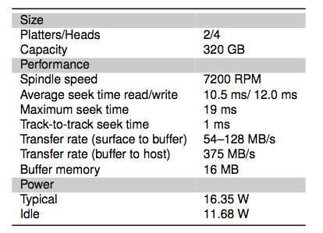
Toshiba Disk (2008)

Slide 22
Question
How long to complete 500 random disk reads, in FIFO order?

Slide 23
Question
How long to complete 500 random disk reads, in FIFO order?
Seek: average 10.5 msec
Rotation: average 4.15 msec
Transfer: 5-10 usec
500 * (10.5 + 4.15 + 0.01)/1000 = 7.3 seconds

Slide 24
Question
How long to complete 500 sequential disk reads?

Slide 25
Question
How long to complete 500 sequential disk reads?
Seek Time: 10.5 ms (to reach first sector)
Rotation Time: 4.15 ms (to reach first sector)
Transfer Time: (outer track)
500 sectors * 512 bytes / 128MB/sec = 2ms
Total: 10.5 + 4.15 + 2 = 16.7 ms
Might need an extra head or track switch (+1ms)
Track buffer may allow some sectors to be read off disk out of order (-2ms)

Slide 26
Question
How large a transfer is needed to achieve 80% of the max disk transfer rate?

Slide 27
Question
How large a transfer is needed to achieve 80% of the max disk transfer rate?
Assume x rotations are needed, then solve for x:
0.8 (10.5 ms + (1ms + 8.5ms) x) = 8.5ms x
Total: x = 9.1 rotations, 9.8MB

Slide 28
Question
How long to complete 500 random disk reads, in any order?

Slide 29
Question
How long to complete 500 random disk reads, in any order?
Disk seek: 1ms (most will be short)
Rotation: 4.15ms
Transfer: 5-10usec
Total: 500 * (1 + 4.15 + 0.01) = 2.2 seconds
Would be a bit shorter with R-CSCAN
vs. 7.3 seconds if FIFO order

Slide 30
Question
How long to read all of the bytes off of a disk?

Slide 31
Question
How long to read all of the bytes off of a disk?
Disk capacity: 320GB
Disk bandwidth: 54-128MB/s
Transfer time =
Disk capacity / average disk bandwidth
~ 3500 seconds (1 hour)

Slide 32
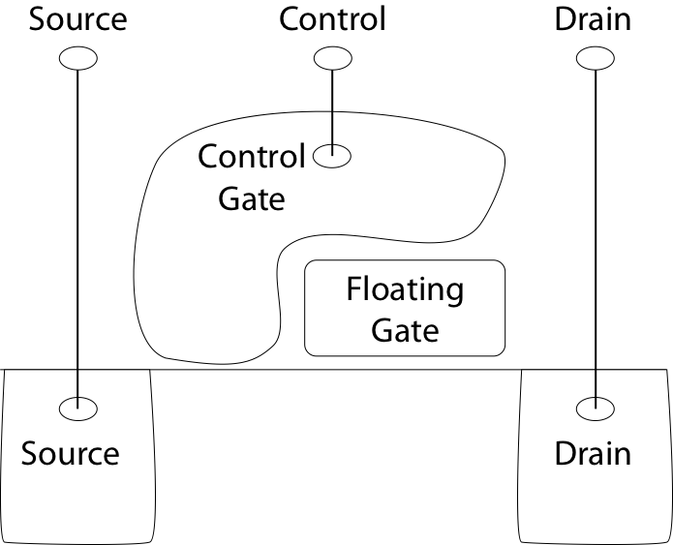
Flash Memory

Slide 33
Flash Memory
Writes must be to “clean” cells; no update in place
Large block erasure required before write
Erasure block: 128 – 512 KB
Erasure time: Several milliseconds
Write/read page (2-4KB)
50-100 usec

Slide 34
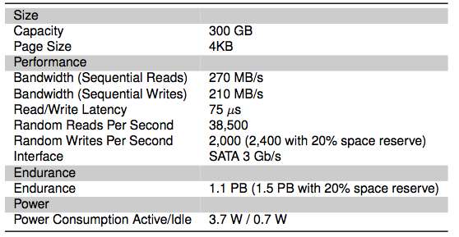
Flash Drive (2011)

Slide 35
Question
Why are random writes so slow?
Random write: 2000/sec
Random read: 38500/sec

Slide 36
Flash Translation Layer
Flash device firmware maps logical page # to a physical location
Garbage collect erasure block by copying live pages to new location, then erase
More efficient if blocks stored at same time are deleted at same time (e.g., keep blocks of a file together)
Wear-leveling: only write each physical page a limited number of times
Remap pages that no longer work (sector sparing)
Transparent to the device user

Slide 37
File System – Flash
How does Flash device know which blocks are live?
Live blocks must be remapped to a new location during erasure
TRIM command
File system tells device when blocks are no longer in use

Slide 38
Device Intelligence
Disk and flash devices now have simple CPUs
Disk head scheduling, remapping, SSD write leveling
Historical trends based on technological ratios
I/O channels and disk controllers in 1960s had a fair amount of processing power since the main CPU was expensive
E.g., to reduce load on CPU, channel could independently search for a record within a file when given a search key
When CPU costs decreased, I/O devices became dumb so that you could build a cheaper overall system => OS file system did more work
Now, CPUs are very cheap so device manufacturers include more intelligence on devices

Slide 39
File System Workload
File sizes
Are most files small or large?
Which accounts for more total storage: small or large files?

Slide 40
File System Workload
File sizes
Are most files small or large?
SMALL
Which accounts for more total storage: small or large files?
LARGE

Slide 41
File System Workload
File access
Are most accesses to small or large files?
Which accounts for more total I/O bytes: small or large files?

Slide 42
File System Workload
File access
Are most accesses to small or large files?
SMALL
Which accounts for more total I/O bytes: small or large files?
LARGE

Slide 43
File System Workload
How are files used?
Most files are read/written sequentially
Some files are read/written randomly
Ex: database files, swap files
Some files have a pre-defined size at creation
Some files start small and grow over time
Ex: program stdout, system logs

Slide 44
File System Design
For small files:
Small blocks for storage efficiency
Concurrent ops more efficient than sequential
Files used together should be stored together
For large files:
Storage efficient (large blocks)
Contiguous allocation for sequential access
Efficient lookup for random access
May not know at file creation
Whether file will become small or large
Whether file is persistent or temporary
Whether file will be used sequentially or randomly

Slide 45
File System Abstraction
Directory
Group of named files or subdirectories
Mapping from file name to file metadata location
Path
String that uniquely identifies file or directory
Ex: /web/home/mark/public_html/3220.html
Links
Hard link: link from name to metadata location
Soft link: link from name to alternate name
Mount
Mapping from name in one file system to root of another

Slide 46
Directory Levels
 | System-wide | Per-device
Flat |  | CP/M
Two-level | OS/360 – top-level is user name
Tree-structured | UNIX | Windows

Slide 47
Path Names
Absolute path
Fully qualified
Starts at root (“/” in Unix systems)
Relative path
Partially qualified, ex: public_html/3220.html
Unqualified, ex: 3220.html
Starts at current working directory
. = this directory, .. = parent directory

Slide 48
File Types
Extension identifier (.c, .o)
Can be used to specify usage or structure
OS can associate a specific application with an extension
Magic number within file
Identify usage or structure
First four bytes for ELF file are: 177 E L F

Slide 49
File Types (2)
Regular file
Text (e.g., ASCII)
Binary
Directory
Writes must be restricted to preserve structure
Special file
Maps physical I/O device to the file system

Slide 50
File Types (3)
UNIX philosophy as stated by Ritchie and Thompson (inventors):
“the structure of files is controlled by the programs that use them, not by the system”
Alternate approach, e.g., IBM z/OS
“An access method defines the technique that is used to store and retrieve data. Access methods have their own data set structures to organize data, macros to define and process data sets, and utility programs to process data sets.”
Ex: Virtual Sequential Access Method (VSAM)
Ex: Queued Sequential Access Method (QSAM)

