Slide 1
Final Exam Review
CPSC 4620

Slide 2
Disclaimer
The final exam is cumulative
These review slides are not
They only cover the material after midterm 2
Add these slides to the review slides for midterm 1 and 2 to get the complete set
It is not guaranteed that every question on the exam will have it’s answer somewhere in these slides
These slides are a guide to help you recall the most important topics
I include the lecture title pages to help you trace back to the original slides

Slide 3
Exam format
Similar to midterms
True/False
Fill in the blank
Matching
Multiple Select
Short answer
Create ER diagram from prompt
Answer questions about ER diagrams
Convert diagram to schema using provided algorithm
Find results of queries
Write queries
Explain key concepts

Slide 4
Database Security
Chapter 30

Slide 5
Security issues
Legal issues
FERPA, HIPPA
Ethical issues
Responsibility with personal data
Policy issues
Government, institutional, or corporate level
Multiple Security levels
All complicated by different clearance levels

Slide 6
Loss of Integrity
Data integrity is key to a database
Use of a database with contaminated data can result in
Inaccuracy in reports
Fraud
Erroneous decision making
We’ve talked a lot about adding constraints to keep bad data out
Security threats can try to introduce bad data through modification of data

Slide 7
Loss of availability
A database isn’t useful to us if it isn’t available
Someone with malicious intent could try to eliminate availability to a database for a user or all users
Down time can result in inconveniences and huge financial losses
Critical databases could have higher impact from down time
Unavailability of medical records could lead to mistaken diagnoses or treatments

Slide 8
Loss of confidentiality
We need to protect against unauthorized disclosure of data
Private data disclosed could be use for fraud or blackmail
If users don’t feel safe using your system, they won’t use it
Many privacy laws exist to protect private data
Legal action could be taken after data is disclosed

Slide 9
Control measures for security
Four kinds of control measures
Access Control
Who can access the database
Inference Control
Even with identifying information hidden, could identities be inferred in anonymous data?
Flow Control
Can secure information be moved into a less secure object?
Data Encryption
Encode the data

Slide 10
The Database Administrator
The Database Administrator (DBA) is the central authority on our database
DBA can
Create Accounts
Grant access privileges
Revoke access privileges
Assign security levels
These tasks are crucial for Access control
DBA is responsible for the overall security of the database

Slide 11
User Accounts
The DBA can add user accounts to the database
Allows multiple users to log in with their own name and password
Applications can also be given an account that they use to login to the database
Or the application can prompt the user for their log in information
Most DBMS’s provide some method of logging user activity
Users added using the CREATE USER statement
CREATE USER ‘<username>’@’<host>’ IDENTIFIED BY ‘<password>’
User accounts stored in an encrypted table
Use ‘localhost’ to only allow direct access
Use ‘%’ for any remote access

Slide 12
Grant privileges
Now that accounts have been created, we can use them to control access to the database
We can specify the type of privilege
We can specify where the privilege applies to
<SCHEMA>.* for all tables
<SCHEMA>.<Table> for a specific table or view
<Schema>.<Table>(field) for only a specific field on a table
GRANT <Privilege1>, <Privilege2>, … <PrivilegeN>
ON <Schema>.<Table>(<field>)
TO ‘<user>’@’<host>’;

Slide 13
Privileges
The Privileges we can grant correspond to the SQL commands we have learned
SELECT
INSERT
UPDATE
DELETE
CREATE
Applies to just a schema, not a table
DROP

Slide 14
Revoke privileges
We can revoke privileges from users as well
REVOKE <privilege1>, <privilege2>, …
ON <schema>.<table>(field)
FROM ‘<user>’@’<host>’;

Slide 15
Views for Security
Remember, we can use views to enforce security restrictions as well
A user can only see certain rows or fields of a table
Create a view defined by a query that limits the rows/fields
Grant the user the SELECT privilege on the field

Slide 16
Discretionary vs Mandatory
Discretionary Security mechanisms
Used to grant security to specific users
Privileges decided on a user by user basis
We can enforce through SQL statements
Mandatory Security mechanisms
Enforces multi-level security
Divide users and data into different security classes
Security determined by the specific class
Privileges decided on a level by level basis
Provided by some DBMSs

Slide 17
Discretionary vs Mandatory
Discretionary is far more flexible
Application accounts are a weak point
Discretionary does not have control of the data after it has been accessed by an authorized user
Mandatory
Controls the flow of information better
More rigid
Not applicable to as many situations
Do users fit into a classification well?

Slide 18
Role Based Access
Role Based Access provides a good balance
Roles are created with different privileges
Like Mandatory Access Control
Roles are then assigned to users
Users can have more than one role
More flexible
Security is tied to the type of actions the user would take in the system

Slide 19
Role Based Access
Create a role in SQL
CREATE ROLE ‘<roleName1>’, …. , <roleNameN>;
Grant privileges to the Role
Same syntax as the previous GRANT syntax, but use the role name instead of the user name.
Add the role to the user(s)
GRANT <RoleName1>, … <RoleNameN>
TO ‘<user1>’@’<host1>’, ‘<user2>’@’<host2>’ … ;

Slide 20
SQL injection
SQL injection attacks are a common security threat that need to be handled
The hacker attempts to inject another SQL statement into a normal parameter
This happens because of our dynamically created queries
Recall: We get input from the user and store it in some variables
Those variables then appended to a string with our SQL query to create the whole query
A hacker can use the input field to put a different SQL statement into the system

Slide 21
Guard against SQL injection
Validate user input
Check for unexpected characters
‘ ; # etc are reserved characters in SQL and can be used for SQl injection
Ensure numeric values are numbers
Use escape characters or replace characters
Write a function that places a \ to escape any special characters
Parameter Binding
Using PreparedStatements also helps guard against this
Processes the query and the parameters separately
ParameterBinding requires a type match
Binding to a SQL datatype
Not using quotes, which can be cancelled out to add in more conditions

Slide 22
Statistical DB security
Often times we may have a database that only allows statistical queries
Can’t select fields directly, can only use aggregate data (COUNT, SUM, AVG, MIN, MAX)
This keeps every individual record protected and anonymous
Every query returns aggregate information for a population not an individual
Commonly used in datamining to find trends but protect privacy
However, we can still infer private information
Pick our conditions to eliminate as many people as we can
Do we know the person’s gender, area where they live, age range, education level, etc? All of these can be used to isolate specific individuals.
Even if can’t get the count down to 1, with a small enough count we can glean meaningfull information (min and max provide a range

Slide 23
Guard Statistical DBs
Don’t allow queries to run if the count falls below a certain threshold
Can use the HAVING clause to eliminate small Groups
Partition the database
Separate the population out into groups of a minimum size
Only allow queries to refer to a group or a set of groups, not a subset of records in a group

Slide 24
Encryption
Convert the data into some encoded form for transmission
Symmetric Key Algorithms
The same key is used for both encryption and decryption
Need to share the secret encryption key
Often times a user password
Public (Asymmetric) Key Encryption
The public key is used for encryption
The private key is used for decryption
The keys are linked, but it’s difficult to derive the private key from the public key
You give the public key away so people can encrypt a message, then only you can decrypt it

Slide 25
Chapter 12 – Object Oriented Databases

Slide 26
Pros and Cons
Pros
Use of objects in the database allows for more advanced data storage
Less of an Impedance mismatch
Cons
More difficult design
Switching over takes a lot of work

Slide 27
Overview of Object Database Concepts
Introduction to object-oriented concepts and features
Origins in OO programming languages
Object has two components:
State (value) and behavior (operations)
Instance variables (attributes)
Hold values that define internal state of object
Operation is defined in two parts:
Signature (interface) and implementation (method)

Slide 28
Overview of Object Database Concepts (cont’d.)
Inheritance
Permits specification of new types or classes that inherit much of their structure and/or operations from previously defined types or classes
Operator overloading
Operation’s ability to be applied to different types of objects
Operation name may refer to several distinct implementations

Slide 29
Object Identity, and Objects versus Literals
Object has Unique identity
Implemented via a unique, system-generated object identifier (OID)
Immutable
Similar to Primary Key
Most OO database systems allow for the representation of both objects and literals (simple or complex values)

Slide 30
Complex Type Structures for Objects and Literals
Structure of arbitrary complexity
Contain all necessary information that describes object or literal
Nesting type constructors
Generate complex type from other types
Type constructors (type generators):
Atom (basic data type – int, string, etc.)
Struct (or tuple)
Collection

Slide 31
Encapsulation of Operations
Encapsulation
Related to abstract data types
Define behavior of a class of object based on operations that can be externally applied
External users only aware of interface of the operations
Can divide structure of object into visible and hidden attributes

Slide 32
Type (Class) Hierarchies and Inheritance
Inheritance
Definition of new types based on other predefined types
Leads to type (or class) hierarchy
Type: type name and list of visible (public) functions (attributes or operations)
Format:
TYPE_NAME: function, function, ..., function

Slide 33
Type (Class) Hierarchies and Inheritance (cont’d.)
Subtype
Useful when creating a new type that is similar but not identical to an already defined type
Subtype inherits functions
Additional (local or specific) functions in subtype
Example:
EMPLOYEE subtype-of PERSON: Salary, Hire_date, Seniority
STUDENT subtype-of PERSON: Major, Gpa

Slide 34
Other Object-Oriented Concepts
Polymorphism of operations
Also known as operator overloading
Allows same operator name or symbol to be bound to two or more different implementations
Type of objects determines which operator is applied
Multiple inheritance
Subtype inherits functions (attributes and operations) of more than one supertype

Slide 35
Object-Relational Features: Object DB Extensions to SQL
Type constructors (generators)
Specify complex types using UDT
Mechanism for specifying object identity
Encapsulation of operations
Provided through user-defined types (UDTs)
Inheritance mechanisms
Provided using keyword UNDER

Slide 36
User-Defined Types (UDTs) and Complex Structures for Objects
UDT syntax:
CREATE TYPE <type name> AS (<component declarations>);
Can be used to create a complex type for an attribute (similar to struct – no operations)
Or: can be used to create a type as a basis for a table of objects (similar to class – can have operations)

Slide 37
Creating Tables Based on the UDTs
INSTANTIABLE
Specify that UDT is instantiable
The user can then create one or more tables based on the UDT
If keyword INSTANTIABLE is left out, can use UDT only as attribute data type – not as a basis for a table of objects

Slide 38
Specifying Type Inheritance
NOT FINAL:
The keyword NOT FINAL indicates that subtypes can be created for that type
UNDER
The keyword UNDER is used to create a subtype

Slide 39
Creating Tables based on UDT
UDT must be INSTANTIABLE
One or more tables can be created
Table inheritance:
UNDER keyword can also be used to specify supertable/subtable inheritance
Objects in subtable must be a subset of the objects in the supertable

Slide 40
Specifying Relationships via Reference
Component attribute of one tuple may be a reference to a tuple of another table
Specified using keyword REF
Keyword SCOPE
Specify name of table whose tuples referenced
Dot notation
Build path expressions
–>
Used for dereferencing

Slide 41
The Object Query Language OQL
Query language proposed for ODMG object model
Simple OQL queries, database entry points, and iterator variables
Syntax: select ... from ... where ... Structure
Select D.Dname
From D in DEPARTMENTS
Where D.College = ‘Engineering’;

Slide 42
Chapter 13 – XML and JSON
CPSC 4620

Slide 43
XML
XML – eXtensible Markup Language
A markup language to describe the structure of data
As opposed to a document
Provides a description of the data using tags
Self-Describing document
Can be used for storage and retrieval
Mainly used for transferring data from one system to another
Remember, any collection of related data is a database

Slide 44
Structured, Semi-Structured, Unstructured
Structured Data – strict format
Relational DB – Every record in a table follows the same format
DBMS enforces the structure of a table
Semi-Structured Data – no pre-defined schema
Entities of the same type may have different attributes
New attributes can be introduced at any time
Structure is similar to a graph or tree
Schema is mixed with data
Unstructured data – no or limited indication of the type of data
Html pages have data in them, but they just all appear in between tags that specify formatting

Slide 45
Hierarchical Model
The basic object in XML is the XML document
Constructed with elements and attributes
Elements
Identified with a start and end tag
<Project> … </Project>
Complex Elements are composed of other elements that appear between the tags
Simple Elements just have data values between their tags
Attributes
Not the same concept as a normal database or ER attribute
Used to help describe elements
Appear in the tag itself
Similar to attributes in html
Useful for metadata

Slide 46
Parsing
Often we will define our own xml document structure to use with our applications
Use xml documents to transmit data
Can parse in our application
Example:
Client server calls function on application server to get data
Happens over a network, so not a direct function call
Application server sends query to data server through JDBC and gets data
Application server parses the ResultSet, but needs to send back across the network to client
Stores data in an xml document and transmits that
Client server parses xml document into local objects to use
Easy string parsing since the tags provide structure

Slide 47
Hierarchical model
Document is well formed if:
It starts with an XML declaration
It follows the tree data model
Has one single root/parent element
Every element has a pair of matching start and end tags
Every element appears within the start and end tags of the root element
A document is valid if:
It is well formed
It follows a particular schema

Slide 48
XML DTD
Document Type Definition
Don’t need to know syntax, just that it’s a way to specify a schema

Slide 49
Enforcing XML DTD
If we want to require our XML document to follow a defined DTD
At the top of the document have:
<?xml version = “1.0”standalone = “no”?>
Standalone = no means it needs to be checked against a DTD or a schema
<!DOCTYPE Projects SYSTEM “proj.dtd”>
Says which DTD to use
Must be stored in the same directory or provide the path
Alternatively can put the DTD at the top of the document
Need an XML parser to check it
Built into IE, Dreamweaver and many others

Slide 50
Drawbacks of DTD
Has it’s own specialized syntax
Requires specialized parsers
Could we specify the syntax using xml syntax?
DTD requires a certain ordering of elements
Unordered elements not permitted

Slide 51
XML Schema
Uses XML syntax to specify the structure of XML documents
More general
Also more complex
Opens up to creating a whole Database Structure
Has keys, references and identifiers
We won’t go into the details

Slide 52
XPath
A way of querying an XML document
Allows you to pull data out on the fly as opposed to parsing it yourself
Specify a path using element names
Can add qualifier conditions as well
Will return the XML elements that meet the path and conditions
/ is a direct path, // is any path
Drawback
The path that specifies the pattern also specifies the data to retrieve
Makes more complicated queries difficult

Slide 53
XQuery
More robust querying
FOR – variable bindings to individual elements/nodes
LET – variable binding for a collection of elements
WHERE – qualifier conditions
ORDER BY – order condition
RETURN – what data to include in the results

Slide 54
SQL and XML
SQL standards include syntax to have the results returned as XML instead of as a tabl
Some DBMSs allow this syntax
Use functions in the SELECT clause to specify the data should be returned as an XML ELEMENT

Slide 55
JSON
JavaScript Object Notation
Another syntax for storing and exchanging information
Like XML, self describing semi-structured data
Stored as text, so easy to transmit
Easy to convert back and forth between text and JavaScript Objects
You aren’t required to use JavaScript to use JSON, it just uses JavaScript Format
It has a lot of built in parsing functionality

Slide 56
Objects in JavaScript
JavaScript is much less structured that other C++ or Java
We don’t define classes, objects are self-describing
A collection of attributes
Syntax: Var <variable name> = {“<attribute name>”:<value>, “<attribute name>”:<value> …}
Get data back out:
<variable name>.<attribute name>
Set Data
<variable name>.<attribute name> = <new value>;
var myObj = { “name”:”John”, “age”:31, “city”:”New York”};

Slide 57
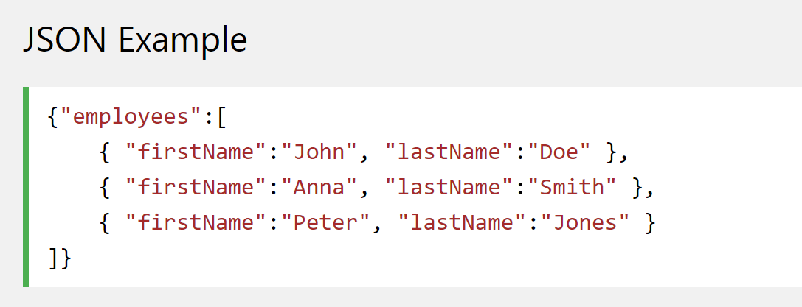
JSON
JSON borrows this notation to store data in text
Can also add collections of objects

Slide 58
JSON vs XML
Similarities
Self Describing
Hierarchical
Able to be parsed
Easily transmitted
Differences
No End tag in JSON
JSON is shorter
Quicker to read and write
JSON can use arrays
JSON is easier to parse in JavaScript

Slide 59
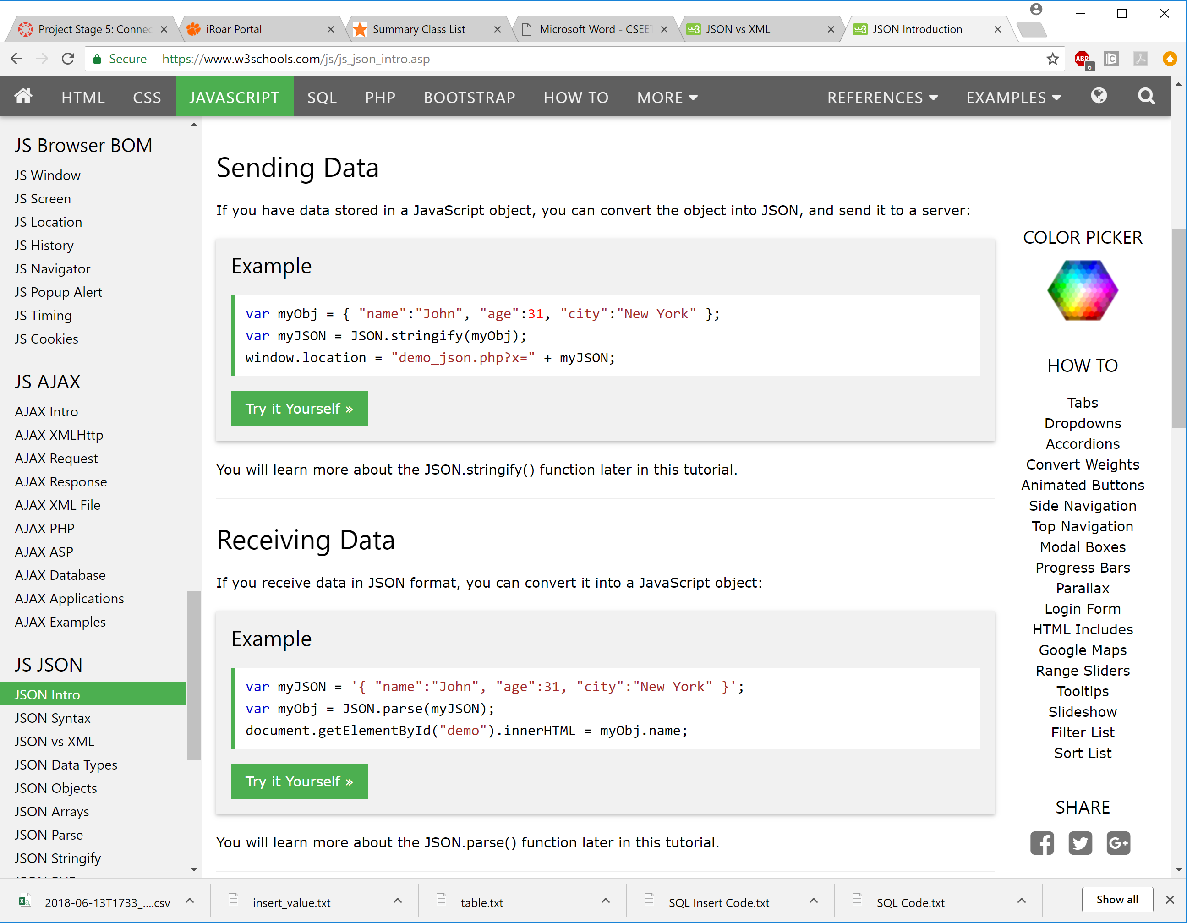
Parsing in JavaScript
Go from JavaScript Object to JSON text
Go from text to JavaScript Object

Slide 60
Chapter 24 – NOSQL Systems
CPSC 4620

Slide 61
Introduction
Developed to handle large amounts of data and more complicated data
Google, Amazon, Facebook, Twitter
Not Only SQL, not NO SQL
Need more than just Standard relational databases
Need to be able to handle more complex data, or less structured data
Sometimes SQL provides too many services
We don’t need the advanced querying and triggers
Existing DBMSs are designed to have them, and optimized for them
Adds in unnecessary overhead

Slide 62
NOSQL data model characteristics
No required schema
Self describing data
Semi-structured data
User can add a schema for efficiency
Less powerful query languages
CRUD
Create
Read
Update
Delete
Joins, advanced searching happens at application level
Versioning
Multiple version of the same data with timestamps

Slide 63
Categories of NOSQL Systems
Document Based
Key-Value Based
Column Based (Wide Column)
Graph Based
Hybrid
Object databases and XML are sometimes considered NOSQL, although they existed before the term NOSQL was widely used

Slide 64
CAP Theorem
Describes competing requirements of a distributed database
Consistency
Is data consistent among replicated copies?
Availability
Is data available all the time?
Partition Tolerance
Can the database handle partitioning of nodes?
Nodes can’t communicate due to network issues
Impossible to guarantee all three
In order to keep data available even when partitioning occurs, we need redundant copies, which leads to consistency issues
NOSQL systems allow for reduced consistency
Called eventual consistency
The system is working on restoring consistency, delays are acceptable

Slide 65
Document Based NOSQL
Store data as collections of similar documents
Documents could be object based, or XML
JSON (JavaScript Object Notation) is commonly used
Documents in a collection should be similar, but do not need to follow any schema
Variations are allowed
Documents have a unique ObjectID called _id
Documents describe some object or entity
Objects in a document can have other object types in them using:
Nesting/Embedding (like XML)
An array
References (like foreign keys)
MongoDB
CouchDB

Slide 66
Key-Value NOSQL
Key is a unique identifier of some data
Value is the data itself (can be a collection)
Value must have a unique key
Retrieving a value by the key is very fast
No query language
A set of operations that can be used by application programmers
Basically a giant Map
DynamoDB
Voldemort Key-Value
Oracle key-value

Slide 67
Column Based Systems
Also known as Wide Column Systems
Examples:
BigTable
Developed and used by Google
Used to store large amounts of data, like in GMail
Hbase
Open Source is called Apache Hbase
Very similar to BigTable, just uses another storage system

Slide 68
Hbase Columns
A Column consists of a Column Family and a Column Qualifier
Written as ColumnFamily:ColumnQualifier
For instance the Column Family name could have many qualifiers first_name, middle_name, last_name
EX. Sterling Mallory Archer
Name:first_name = “Sterling”
Name:middle_name = “Mallory”
Name:last_name = “Archer”
A succinct way to handle composite attributes

Slide 69
So... What’s the difference?
With Column-Based Systems, you only need to have the column families when you create the tables, not the column qualifiers.
A new column qualifier can be added at any time.
This allows flexibility

Slide 70
Rows vs. Columns
Rows are better when...
Many columns of a single row are required at one time
All the data for a row is given at once
Columns are better when...
Aggregates are computed over many rows for a small number of columns
New values of a column are supplied at the same time

Slide 71
Graph Based NOSQL Systems
Neo4j is an open source example
Data is represented as a graph with vertices and edges
In the Neo4j model
Vertices are called Nodes which correspond to entities
Edges are relationships, which correspond to relationship instances
Relationships are directed
Nodes have a Label, which correspond to entity-types
Relationships have a Label, which corresponds to relationship types
Nodes and Relationships have Properties, which correspond to attributes
Properties can be grouped in a Map Pattern
{Fname:’Sterling’, Mname:’Mallory’, Lname:’Archer’}
Graph (Math) Term
Entity-Relationship Model Term
Graph Based NOSQL Term

Slide 72
Graph Based NOSQL Systems
Schemas are optional
Allow for adding property constraints based on their label
Cypher
High Level Query Language
Uses MATCH along with a relationship template to find matching nodes and relationships (Select)
Uses WHERE to specify which matches to consider
Uses RETURN to specify which properties to return (Project)
DELETE deletes a node or relationship
SET updates a node or relationship
REMOVE removes a property or label from a relationship

Slide 73
Summary
These may seem like limited versions of a relational database
Because they are
Less functionality means more optimization
Can handle big data
Less functionality means more flexibility
Can add attributes on the fly
Semi-Structured data
Handle multimedia data

