Slide 1


Slide 2
CHAPTER 7
More SQL: Complex Queries, Triggers, Views, and Schema Modification
Slide 7- <number>

Slide 3
Chapter 7 Outline
More Complex SQL Retrieval Queries
Specifying Semantic Constraints as Assertions and Actions as Triggers
Views (Virtual Tables) in SQL
Schema Modification in SQL
Slide 7- 3

Slide 4
More Complex SQL Retrieval Queries
Additional features allow users to specify more complex retrievals from database:
  Nested queries, joined tables, and outer joins (in the FROM clause), aggregate functions, and grouping
Slide 7- 4

Slide 5
Nested Queries, Tuples, and Set/Multiset Comparisons
Nested queries
  Complete select-from-where blocks within WHERE clause of another query
  Outer query and nested subqueries
Comparison operator IN
  Compares value v with a set (or multiset) of values V
  Evaluates to TRUE if v is one of the elements in V
Slide 7- 8

Slide 6
EXPLICIT SETS
It is also possible to use an explicit (enumerated) set of values in the WHERE-clause rather than a nested query
Example: Retrieve the social security numbers of all employees who work on project number 1, 2, or 3.
  SELECT DISTINCT ESSN
  FROM WORKS_ON
  WHERE PNO IN (1, 2, 3);
Slide 7- <number>

Slide 7
NESTING OF QUERIES
Many of the previous queries can be specified in an alternative form using nesting
Example: Retrieve the name and address of all employees who work for the 'Research' department.
SELECT FNAME, LNAME, ADDRESS
FROM EMPLOYEE
WHERE DNO IN (SELECT DNUMBER
FROM DEPARTMENT
WHERE DNAME='Research' );
Slide 7- <number>

Slide 8

Nested Queries (cont’d.)
Slide 7- 9

Slide 9

Nested Queries (cont’d.)
Use tuples of values in comparisons
  Place them within parentheses
Slide 7- 10

Slide 10

Nested Queries (cont’d.)
Use other comparison operators to compare a single value v
  = ANY (or = SOME) operator
    Returns TRUE if the value v is equal to some value in the set V and is hence equivalent to IN
  Other operators that can be combined with ANY (or SOME): >, >=, <, <=, and <>
  ALL: value must exceed all values from nested query
Slide 7- 11

Slide 11
Using ANY and ALL
There’s an alternate way of seeing if a value is IN some table
IN is equivalent to = ANY
Since we often want to known if a value is equal to any other, IN is a nice shortcut
Other uses of ANY are <> ANY, > ANY, < ANY, >= ANY, <= ANY
The evaluation of ANY expressions is not always intuitive
Examples:
4 = ANY (1,2,3,4)
Yes, because it’s equal to the 4.
4 <> ANY (1,2,3,4)
Yes, because it’s not equal to the 1.
Slide 7- <number>

Slide 12
Using ANY and ALL (continued)
Similarly, we can use ALL to see how a value compares to all values in a table
We can use = ALL, <> ALL, > ALL, < ALL, >= ALL, <= ALL
Again, the evaluation of ALL expressions is not always intuitive
Examples:
4 = ALL (1,2,3,4)
No, because it’s not equal to the 1.
4 <> ALL (1,2,3,4)
No, because it’s equal to the 4.
4 = ALL (4,4,4,4)
Yes, because all of the values are equal to 4
Slide 7- <number>

Slide 13
CORRELATED NESTED QUERIES
If a condition in the WHERE-clause of a nested query references an attribute of a relation declared in the outer query, the two queries are said to be correlated
The result of a correlated nested query is different for each tuple (or combination of tuples) of the relation(s) in the outer query
Example: Retrieve the name of each employee who has a dependent with the same first name as the employee.
SELECT E.FNAME, E.LNAME
FROM EMPLOYEE AS E
WHERE E.SSN IN (SELECT ESSN
FROM DEPENDENT
WHERE ESSN=E.SSN AND E.FNAME=DEPENDENT_NAME);
Slide 7- <number>

Slide 14
CORRELATED NESTED QUERIES
In the last example, the nested query has a different result for each tuple in the outer query
A query written with nested SELECT... FROM... WHERE... blocks and using the = or IN comparison operators can always be expressed as a single block query. For example, the last query may be written:
SELECT E.FNAME, E.LNAME
FROM EMPLOYEE E, DEPENDENT D
WHERE E.SSN=D.ESSN AND E.FNAME=D.DEPENDENT_NAME;
Slide 7- <number>

Slide 15
You try it
Write the SQL statements to find the following values. Use nested queries
  1. What is the name of the employee with the highest salary?
  2. What are the names of the employees who work on a project located in Sugarland? Do not provide duplicate names
  3. What are the names of employees who have a son?
  4. What are the names of the employees who make more money than Jennifer Wallace?
Slide 7- <number>

Slide 16
The EXISTS and UNIQUE Functions in SQL for correlating queries
EXISTS function
  Check whether the result of a correlated nested query is empty or not. They are Boolean functions that return a TRUE or FALSE result.
EXISTS and NOT EXISTS
  Typically used in conjunction with a correlated nested query
SQL function UNIQUE(Q)
  Returns TRUE if there are no duplicate tuples in the result of query Q
Slide 7- 14

Slide 17
USE of EXISTS
Q7:
SELECT Fname, Lname
FROM Employee
WHERE EXISTS (SELECT *
FROM DEPENDENT
WHERE Ssn= Essn)
AND EXISTS (SELECT *
FROM Department
WHERE Ssn= Mgr_Ssn)
Slide 7- 15

Slide 18
USE OF NOT EXISTS
To achieve the “for all” (universal quantifier- see Ch.8) effect, we use double negation this way in SQL:
Query: List first and last name of employees who work on ALL projects controlled by Dno=5.
SELECT Fname, Lname
FROM Employee
WHERE NOT EXISTS ( (SELECT Pnumber
FROM PROJECT
WHERE Dno=5)
EXCEPT (SELECT Pno
FROM WORKS_ON
WHERE Ssn= ESsn)
The above is equivalent to double negation: List names of those employees for whom there does NOT exist a project managed by department no. 5 that they do NOT work on.
Slide 7- 16

Slide 19
Joining Tables
We can have queries with multiple tables
This leads to the product of all the tables being joined
Then need to use our where clause to eliminate junk data
This is memory intensive
  What if we were pulling from tables with thousands of entries?
Slide 7- <number>

Slide 20
Joining Tables
We can join our tables together in our from statement, which prevents our meaningless combinations from being in our table to begin with
Joined tables have to be joined “on” something
  Our foreign keys
Slide 7- <number>

Slide 21

Specifying Joined Tables in the FROM Clause of SQL
Joined table
  Permits users to specify a table resulting from a join operation in the FROM clause of a query
The FROM clause in Q1A
  Contains a single joined table. JOIN may also be called INNER JOIN
Slide 7- 19

Slide 22
Different Types of JOINed Tables in SQL
Specify different types of join
  NATURAL JOIN
  Various types of OUTER JOIN (LEFT, RIGHT, FULL )
NATURAL JOIN on two relations R and S
  No join condition specified
  Is equivalent to an implicit EQUIJOIN condition for each pair of attributes with same name from R and S
    Must have the same name to work
Slide 7- 20

Slide 23
NATURAL JOIN
Rename attributes of one relation so it can be joined with another using NATURAL JOIN:
Q1B: SELECT Fname, Lname, Address
FROM (EMPLOYEE NATURAL JOIN
(DEPARTMENT AS DEPT (Dname, Dno, Mssn,
Msdate)))
WHERE Dname=‘Research’;
The above works with EMPLOYEE.Dno = DEPT.Dno as an implicit join condition
Slide 7- <number>

Slide 24
INNER and OUTER Joins
INNER JOIN (versus OUTER JOIN)
  Default type of join in a joined table
  Tuple is included in the result only if a matching tuple exists in the other relation
LEFT OUTER JOIN
  Every tuple in left table must appear in result
  If no matching tuple
    Padded with NULL values for attributes of right table
RIGHT OUTER JOIN
  Every tuple in right table must appear in result
  If no matching tuple
    Padded with NULL values for attributes of left table
Slide 7- 22

Slide 25

Example: LEFT OUTER JOIN
SELECT E.Lname AS Employee_Name
S.Lname AS Supervisor_Name
FROM Employee AS E LEFT OUTER JOIN EMPLOYEE AS S
ON E.Super_ssn = S.Ssn)
Slide 7- <number>

Slide 26
Multiway JOIN in the FROM clause
FULL OUTER JOIN – combines result if LEFT and RIGHT OUTER JOIN
Can nest JOIN specifications for a multiway join:
Q2A: SELECT Pnumber, Dnum, Lname, Address, Bdate
FROM ((PROJECT JOIN DEPARTMENT ON Dnum=Dnumber) JOIN EMPLOYEE ON Mgr_ssn=Ssn)
WHERE Plocation=‘Stafford’;
Slide 7- <number>

Slide 27
Consider:
What would be the result of:
  Select * From A, B;
 | A
A-ID | A-Val | B-FK
1 | Hello | 1
2 | What | 2
3 | Noise | 1
4 | toy | NULL
B
B-ID | B-Val
1 | Wallet
2 | Map
3 | Lamp
Slide 7- <number>

Slide 28
Consider:
What would be the result of:
  Select * From A Inner Join B on B-FK = B-ID;
 | A
A-ID | A-Val | B-FK
1 | Hello | 1
2 | What | 2
3 | Noise | 1
4 | toy | NULL
B
B-ID | B-Val
1 | Wallet
2 | Map
3 | Lamp
Slide 7- <number>

Slide 29
Consider:
What would be the result of:
  Select * From A Left Outer Join B on B-FK = B-ID;
 | A
A-ID | A-Val | B-FK
1 | Hello | 1
2 | What | 2
3 | Noise | 1
4 | toy | NULL
B
B-ID | B-Val
1 | Wallet
2 | Map
3 | Lamp
Slide 7- <number>

Slide 30
Consider:
What would be the result of:
  Select * From A Right Outer Join B on B-FK = B-ID;
 | A
A-ID | A-Val | B-FK
1 | Hello | 1
2 | What | 2
3 | Noise | 1
4 | toy | NULL
B
B-ID | B-Val
1 | Wallet
2 | Map
3 | Lamp
Slide 7- <number>

Slide 31
Consider:
What would be the result of:
  Select * From A Full Outer Join B on B-FK = B-ID;
 | A
A-ID | A-Val | B-FK
1 | Hello | 1
2 | What | 2
3 | Noise | 1
4 | toy | NULL
B
B-ID | B-Val
1 | Wallet
2 | Map
3 | Lamp
Slide 7- <number>

Slide 32
You Try It
Write the SQL queries for the following problems using joins
  1. The names of all employees who work on the Computerization project, and the number of hours they work on it
  2. The name and location of each project, the name of the controlling department, and the name of the manager of that department
  3. Every Dependent name, and the name of the employee who they are dependent on
  4. The name of every employee who worked on any project for more than 20 hours a week, and the name of that project
Slide 7- <number>

Slide 33
Aggregate Functions in SQL
Used to summarize information from multiple tuples into a single-tuple summary
Built-in aggregate functions
  COUNT, SUM, MAX, MIN, and AVG
Grouping
  Create subgroups of tuples before summarizing
To select entire groups, HAVING clause is used
Aggregate functions can be used in the SELECT clause or in a HAVING clause
Slide 7- <number>

Slide 34
Renaming Results of Aggregation
Following query returns a single row of computed values from EMPLOYEE table:
Q19: SELECT SUM (Salary), MAX (Salary), MIN (Salary), AVG (Salary)
FROM EMPLOYEE;
The result can be presented with new names:
Q19A: SELECT SUM (Salary) AS Total_Sal, MAX (Salary) AS Highest_Sal, MIN (Salary) AS Lowest_Sal, AVG (Salary) AS Average_Sal
FROM EMPLOYEE;
Slide 7- <number>

Slide 35

Aggregate Functions in SQL (cont’d.)
NULL values are discarded when aggregate functions are applied to a particular column
Slide 7- <number>

Slide 36
Aggregate Functions on Booleans
SOME and ALL may be applied as functions on Boolean Values.
SOME returns true if at least one element in the collection is TRUE (similar to OR)
ALL returns true if all of the elements in the collection are TRUE (similar to AND)
Slide 7- <number>

Slide 37
Grouping: The GROUP BY Clause
Partition relation into subsets of tuples
  Based on grouping attribute(s)
  Apply function to each such group independently
GROUP BY clause
  Specifies grouping attributes
COUNT (*) counts the number of rows in the group
Slide 7- <number>

Slide 38
Examples of GROUP BY
The grouping attribute must appear in the SELECT clause:
Q24: SELECT Dno, COUNT (*), AVG (Salary)
FROM EMPLOYEE
GROUP BY Dno;
If the grouping attribute has NULL as a possible value, then a separate group is created for the null value (e.g., null Dno in the above query)
GROUP BY may be applied to the result of a JOIN:
Q25: SELECT Pnumber, Pname, COUNT (*)
FROM PROJECT, WORKS_ON
WHERE Pnumber=Pno
GROUP BY Pnumber, Pname;
Slide 7- <number>

Slide 39
Group By Multiple columns
You can specify multiple attributes in the Group By clause
  This will group the results based on the unique combination of those attributes.
Example: Count the number of projects in each location for each department
  SELECT Dname, Plocation, Count(*)
  FROM Project Inner Join Department on Dno = Dnumber
  Group By Dname, Plocation;
Slide 7- <number>

Slide 40
Group By
For a field to be listed in the Group By clause, it must be in the select clause
  Different from the Where clause
  Results need to have labels for each group.
Slide 7- <number>

Slide 41
Group By
If you are using aggregate functions, everything in the select statement needs to be either in an aggregate function or in the group by, unless the group by is a field marked as the primary key or unique
Select Fname, Lname, Salary, Count(Pno)
From Employee Join Works_On on essn = ssn
Group By Fname;
Slide 7- <number>

Slide 42
Group By
“unless the group by is a field marked as the primary key or unique”
  Why group by the primary key?
  Won’t that result in one entry per group?
This can be helpful for joined tables where you will only find aggregate values on one of the tables
Select Ssn, Fname, Lname, Salary, Count(Pno)
From Employee Join Works_On on essn = ssn
Group By Ssn;
Slide 7- <number>

Slide 43
Count(*)
Be cautious with Count(*) with outer joins
  Count(field) ignores NULL values in field
  For Count(*) to ignore NULLs, all the fields would have to be NULL
  This query will return a count of one even if no one works for the project
Select Pname, count(*) As Num_Employees
From Project Left Outer Join Works_On on Pnumber = Pno
Group By Pname;
Slide 7- <number>

Slide 44
Grouping: The GROUP BY and HAVING Clauses (cont’d.)
HAVING clause
  Provides a condition to select or reject an entire group:
Query 26. For each project on which more than two employees work, retrieve the project number, the project name, and the number of employees who work on the project.
Q26: SELECT Pnumber, Pname, COUNT (*)
FROM PROJECT, WORKS_ON
WHERE Pnumber=Pno
GROUP BY Pnumber, Pname
HAVING COUNT (*) > 2;
Slide 7- 31

Slide 45
Combining the WHERE and the HAVING Clause
Consider the query: we want to count the total number of employees whose salaries exceed $40,000 in each department, but only for departments where more than five employees work.
INCORRECT QUERY:
    SELECT Dno, COUNT (*)
    FROM EMPLOYEE
    WHERE Salary>40000
    GROUP BY Dno
    HAVING COUNT (*) > 5;
Slide 7- <number>

Slide 46

Combining the WHERE and the HAVING Clause (continued)
Correct Specification of the Query:
Note: the WHERE clause applies tuple by tuple whereas HAVING applies to entire group of tuples
Dnumber IN
Slide 7- <number>

Slide 47

EXPANDED Block Structure of SQL Queries
Slide 7- 40

Slide 48
You Try It
Write the following SQL statements and show the values they will return.
  How many Projects are located in Stafford?
  How many hours did employees work on each project? Show the hours and Project name. Order Project Name
  For each employee, show their name and the number of dependents they have (Even if the number is 0)
Slide 7- <number>

Slide 49
Use of CASE
SQL also has a CASE construct
Used when a value can be different based on certain conditions.
Can be used in any part of an SQL query where a value is expected
Applicable when querying, inserting or updating tuples
Slide 7- <number>

Slide 50
EXAMPLE of use of CASE
The following example shows that employees are receiving different raises in different departments (A variation of the update U6)
U6’: UPDATE EMPLOYEE
SET Salary =
CASE WHEN Dno = 5 THEN Salary + 2000
WHEN Dno = 4 THEN Salary + 1500
WHEN Dno = 1 THEN Salary + 3000
Slide 7- <number>

Slide 51
Specifying Constraints as Assertions and Actions as Triggers
Semantic Constraints: The following are beyond the scope of the EER and relational model
CREATE ASSERTION
  Specify additional types of constraints outside scope of built-in relational model constraints
CREATE TRIGGER
  Specify automatic actions that database system will perform when certain events and conditions occur
Slide 7- 41

Slide 52

Specifying General Constraints as Assertions in SQL
CREATE ASSERTION
  Specify a query that selects any tuples that violate the desired condition
  Use only in cases where it goes beyond a simple CHECK which applies to individual attributes and domains
Slide 7- <number>

Slide 53
Introduction to Triggers in SQL
CREATE TRIGGER statement
  Used to monitor the database
Typical trigger has three components which make it a rule for an “active database “ (more on active databases in section 26.1) :
  Event(s)
  Condition
  Action
Slide 7- 43

Slide 54
USE OF TRIGGERS
AN EXAMPLE with standard Syntax.(Note : other SQL implementations like PostgreSQL use a different syntax.)
R5:
CREATE TRIGGER SALARY_VIOLATION
BEFORE INSERT OR UPDATE OF Salary, Supervisor_ssn ON EMPLOYEE
FOR EACH ROW
WHEN (NEW.SALARY > ( SELECT Salary FROM EMPLOYEE
WHERE Ssn = NEW. Supervisor_Ssn)) INFORM_SUPERVISOR (NEW.Supervisor.Ssn, New.Ssn)
Slide 7- 44

Slide 55
Views (Virtual Tables) in SQL
Concept of a view in SQL
  Single table derived from other tables called the defining tables
  Considered to be a virtual table that is not necessarily populated
A view is a “virtual” table that is derived from other tables
Allows for limited update operations
Allows full query operations
A convenience for expressing certain operations
Slide 7- 45

Slide 56

Specification of Views in SQL
CREATE VIEW command
  Give table name, list of attribute names, and a query to specify the contents of the view
  In V1, attributes retain the names from base tables. In V2, attributes are assigned names
Slide 7- 46

Slide 57
Specification of Views in SQL (cont’d.)
Once a View is defined, SQL queries can use the View relation in the FROM clause
View is always up-to-date
  Responsibility of the DBMS and not the user
DROP VIEW command
  Dispose of a view
Slide 7- 47

Slide 58
Views as authorization mechanism
SQL query authorization statements (GRANT and REVOKE) are described in detail in Chapter 30
Views can be used to hide certain attributes or tuples from unauthorized users
E.g., For a user who is only allowed to see employee information for those who work for department 5, he may only access the view DEPT5EMP:
  CREATE VIEW DEPT5EMP AS
  SELECT *
  FROM EMPLOYEE
  WHERE Dno = 5;
Slide 7- <number>

Slide 59
Comparisons Involving NULL and Three-Valued Logic
Meanings of NULL
  Unknown value
  Unavailable or withheld value
  Not applicable attribute
Each individual NULL value considered to be different from every other NULL value
SQL uses a three-valued logic:
  TRUE, FALSE, and UNKNOWN (like Maybe)
NULL = NULL comparison is avoided
Slide 7- 5

Slide 60
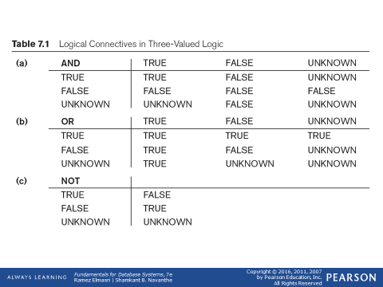
Comparisons Involving NULL and Three-Valued Logic (cont’d.)
Slide 7- 6

Slide 61

Comparisons Involving NULL and Three-Valued Logic (cont’d.)
SQL allows queries that check whether an attribute value is NULL
  IS or IS NOT NULL
Slide 7- 7

Slide 62
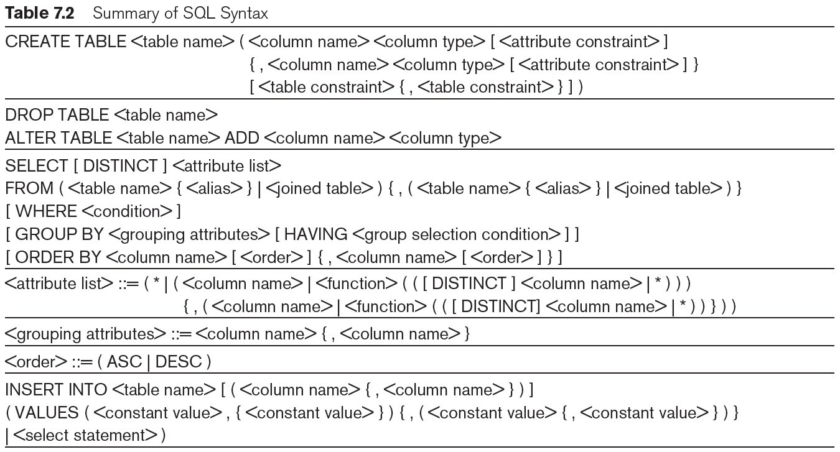
Table 7.2 Summary of SQL Syntax
continued on next slide
Slide 7- 59

Slide 63
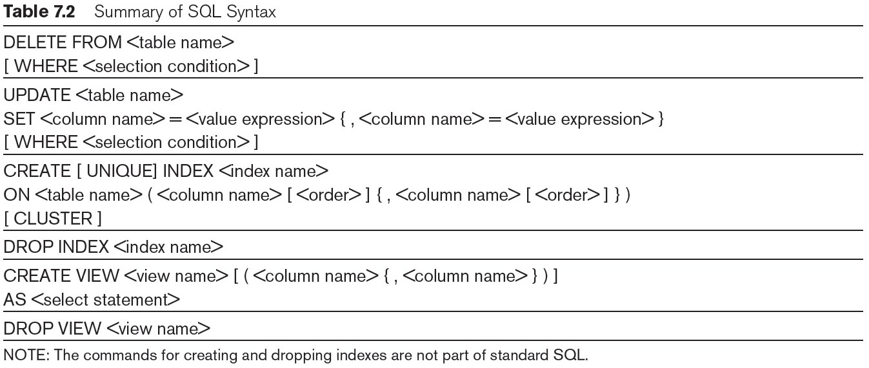
Table 7.2 (continued) Summary of SQL Syntax
Slide 7- 60

Slide 64
Summary
Complex SQL:
  Nested queries, joined tables (in the FROM clause), outer joins, aggregate functions, grouping
Handling semantic constraints with CREATE ASSERTION and CREATE TRIGGER
CREATE VIEW statement and materialization strategies
Schema Modification for the DBAs using ALTER TABLE , ADD and DROP COLUMN, ALTER CONSTRAINT etc.
Slide 7- 61

