Slide 1
Introduction to Operating Systems
CPSC/ECE 3220 Summer 2018
Lecture Notes
OSPP Chapter 13
(adapted by Mark Smotherman from Tom Anderson’s slides on OSPP web site)

Slide 2
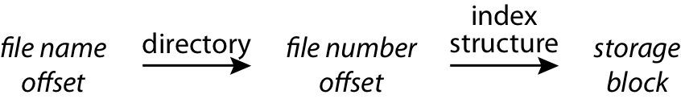
Named Data in a File System
Directory – typically tree-structured
Index structure – typically tree-structured
Free space map – often a bitmap
Locality heuristics
Policy in finding free space (first-fit, etc.)
Grouping of directories and files
Defragmentation
Optimization of writes over reads

Slide 3
Main Points
File layout
Directory layout
Access control

Slide 4
File Organization Design Constraints
For small files:
Small blocks for storage efficiency
Files used together should be stored together
For large files:
Contiguous allocation for sequential access
Efficient lookup for random access
May not know at file creation
Whether file will become small or large

Slide 5
File System Design
Data structures
Directories: file name -> file metadata
Store directories as files
File metadata: how to find file data blocks
Free map: list of free disk blocks
How do we organize these data structures?
Device has non-uniform performance

Slide 6
Design Challenges
Index structure
How do we locate the blocks of a file?
Index granularity
What block size do we use?
Free space
How do we find unused blocks on disk?
Locality
How do we preserve spatial locality?
Reliability
What if machine crashes in middle of a file system op?

Slide 7
File Organization
Want sequential data placement that provides efficient sequential access
Also want placement that provides efficient random access
But…
Reject contiguous storage of disk blocks – why?
Reject linked-list storage with links located in the disk blocks – why?

Slide 8
File Organization (2)
Typically tree-structured indexing of data
Want to limit overheads to be efficient for small files
Provide scalability for large files
Provide a place for per-file metadata

Slide 9
File Organization Design Options
 | FAT | FFS | NTFS | ZFS
Index structure | linked list | tree (fixed, asymmetric) | tree (dynamic) | tree (COW, dynamic)
Granularity | block | block | extent | block
Free space allocation | FAT array | bitmap (fixed location) | bitmap (file) | space map (log-structured)
Locality | defrag | block groups, first fit, reserve space | extents, best fit, defrag | write-anywhere block groups

Slide 10
Microsoft File Allocation Table (FAT)
Linked list index structure
Links are collected together in a table, not placed out in data blocks
Simple, easy to implement
Still widely used (e.g., thumb drives)
File table
Linear map of all blocks on disk
Each file a linked list of blocks

Slide 11
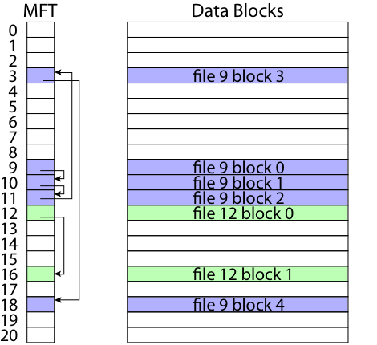
FAT Organization

Slide 12
FAT Evaluation
Pros:
Easy to find free block
Easy to append to a file
Easy to delete a file
Cons:
Small file access is slow
Random access is very slow
Fragmentation
File blocks for a given file may be scattered
Files in the same directory may be scattered
Problem becomes worse as disk fills

Slide 13
Berkeley UNIX FFS (Fast File System)
inode table
Analogous to FAT table
inode
Metadata
File owner, access permissions, access times, …
Set of 12 data pointers
With 4KB blocks => max size of 48KB files

Slide 14
Additional FFS inode Block Pointers
Indirect block pointer (13th pointer in inode)
pointer to disk block of data pointers
4KB block size => 1K data blocks => 4MB
Doubly indirect block pointer (14th in inode)
Doubly indirect block => 1K indirect blocks
4GB (+ 4MB + 48KB)
Triply indirect block pointer (15th in inode)
Triply indirect block => 1K doubly indirect blocks
4TB (+ 4GB + 4MB + 48KB)

Slide 15
FFS inode

Slide 16
FFS Asymmetric Tree
Small files: shallow tree
Efficient storage for small files
Large files: deep tree
Efficient lookup for random access in large files
Sparse files: only fill pointers if needed

Slide 17
FFS Small File

Slide 18
FFS Large File

Slide 19
FFS Locality
Block group allocation
Block group is a set of nearby cylinders
Files in same directory located in same group
Subdirectories located in different block groups
inode table spread throughout disk
inodes, bitmap near file blocks
First fit allocation
Small files fragmented, large files contiguous

Slide 20
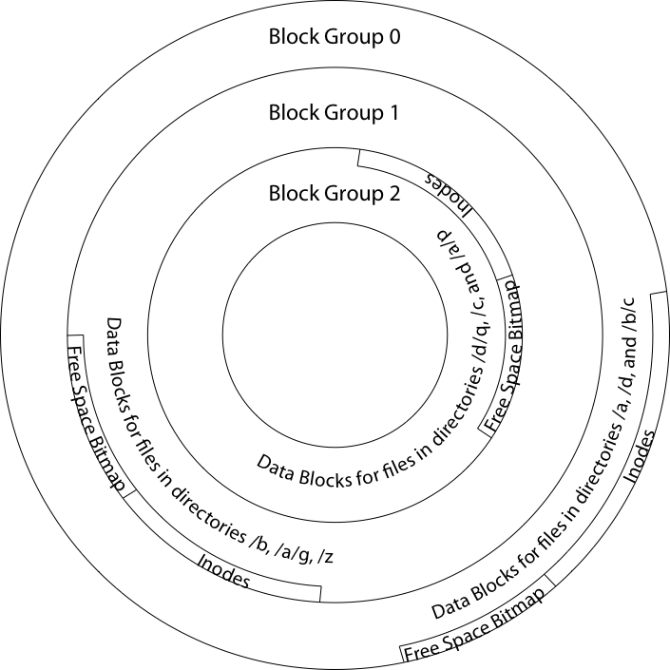

Slide 21
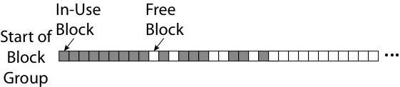
FFS First Fit Block Allocation

Slide 22

FFS First Fit Block Allocation

Slide 23

FFS First Fit Block Allocation

Slide 24
FFS Evaluation
Pros
Efficient storage for both small and large files
Locality for both small and large files
Locality for metadata and data
Cons
Inefficient for tiny files (a 1 byte file requires both an inode and a data block)
Inefficient encoding when file is mostly contiguous on disk (no equivalent to superpages)
Need to reserve 10-20% of free space to prevent fragmentation

Slide 25
NTFS
Master File Table
Flexible 1KB storage for metadata and data
Extents
Block pointers cover runs of blocks
Similar approach in linux (ext4)
File create can provide hint as to size of file
Journalling for reliability
Next chapter

Slide 26
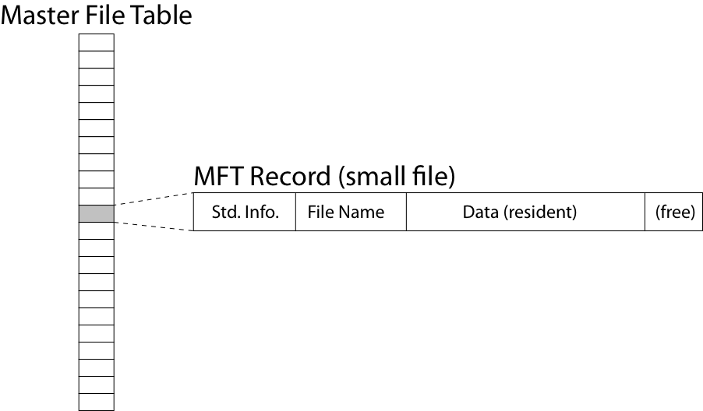
NTFS Small File

Slide 27
NTFS Medium-Sized File

Slide 28
NTFS Indirect Block

Slide 30
Directories Are Files

Slide 31
Recursive Filename Lookup

Slide 32
Directory Layout
Directory stored as a file
Linear search to find filename (small directories)

Slide 33
Large Directories: B Trees

Slide 34
Large Directories: Layout

Slide 35
Access Control
Access control matrix
Row for each user (or application)
Column for every protected resource
Sparse
Row-oriented approach
Capability list
Keep with user
Column-oriented approach
Access control list (ACL)
Keep with resource

Slide 36
Capability List
Example: process keeps a table of open files with allowed type of access
Example: smartphone app keeps a list of resources with allowed type of access

Slide 37
Access Control List
For every protected resource, list of who is permitted to do what
Example: Windows ACL
List of access control entries (ACEs)
Each ACE contains a 32-bit access rights mask and a security identifier (SID)
Example: compressed ACL for UNIX files
Owner, group, world: read, write, execute
Setuid: program will run using the permissions of user who installed it
File type to indicate if file is a directory

