Slide 1
Introduction to Operating Systems
CPSC/ECE 3220 Summer 2018
Lecture Notes
OSPP Chapter 14
(adapted by Mark Smotherman from Tom Anderson’s slides on OSPP web site)

Slide 2
Main Points
Problem posed by machine/disk failures
Transaction concept
Reliability
Careful sequencing of file system operations
Copy-on-write (WAFL, ZFS)
Journalling (NTFS, linux ext4)
Log structure (flash storage)
Availability
RAID

Slide 3
File System Reliability
What can happen if disk loses power or machine software crashes?
Some operations in progress may complete
Some operations in progress may be lost
Overwrite of a block may only partially complete
File system wants durability (as a minimum!)
Data previously stored can be retrieved (maybe after some recovery step), regardless of failure

Slide 4
Storage Reliability Problem
Single logical file operation can involve updates to multiple physical disk blocks
inode, indirect block, data block, bitmap, …
With remapping, single update to physical disk block can require multiple (even lower level) updates
At a physical level, operations complete one at a time
Want concurrent operations for performance
How do we guarantee consistency regardless of when crash occurs?

Slide 5
Transaction Concept
Transaction is a group of operations
Atomic: operations appear to happen as a group, or not at all (at logical level)
At physical level, only single disk/flash write is atomic
Durable: operations that complete stay completed
Future failures do not corrupt previously stored data
Isolation: other transactions do not see results of earlier transactions until they are committed
Consistency: sequential memory model

Slide 6
Reliability Approach #1: Careful Ordering
Sequence operations in a specific order
Careful design to allow sequence to be interrupted safely
Post-crash recovery
Read data structures to see if there were any operations in progress
Clean up/finish as needed
Approach taken in FAT, FFS (fsck), and many app-level recovery schemes (e.g., Word)

Slide 7
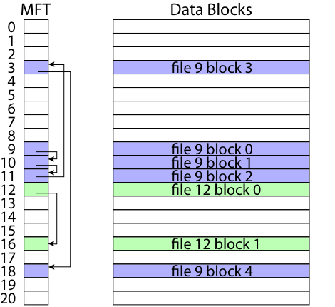
FAT: Append Data to File
Add data block
Add pointer to data block
Update file tail to point to new MFT entry
Update access time at head of file

Slide 8
FAT: Append Data to File
Normal operation:
Add data block
Add pointer to data block
Update file tail to point to new MFT entry
Update access time at head of file
Recovery:
Scan MFT
If entry is unlinked, delete data block
If access time is incorrect, update

Slide 9
FAT: Create New File
Normal operation:
Allocate data block
Update MFT entry to point to data block
Update directory with file name -> file number
What if directory spans multiple disk blocks?
Update modify time for directory
Recovery:
Scan MFT
If any unlinked files (not in any directory), delete
Scan directories for missing update times

Slide 10
FFS: Create a File
Normal operation:
Allocate data block
Write data block
Allocate inode
Write inode block
Update bitmap of free blocks
Update directory with file name -> file number
Update modify time for directory
Recovery:
Scan inode table
If any unlinked files (not in any directory), delete
Compare free block bitmap against inode trees
Scan directories for missing update/access times
Time proportional to size of disk

Slide 11
FFS: Move a File
Normal operation:
Remove filename from old directory
Add filename to new directory
Recovery:
Scan all directories to determine set of live files
Consider files with valid inodes and not in any directory
New file being created?
File move?
File deletion?

Slide 12
FFS: Move and Grep
Process A
move file from x to y
mv x/file y/
Process B
grep across x and y
grep x/* y/*
Will grep always see contents of file?

Slide 13
Application Level
Normal operation:
Write name of each open file to app folder
Write changes to backup file
Rename backup file to be file (atomic operation provided by file system)
Delete list in app folder on clean shutdown
Recovery:
On startup, see if any files were left open
If so, look for backup file
If so, ask user to compare versions

Slide 14
Careful Ordering
Pros
Works with minimal support in the disk drive
Works for most multi-step operations
Cons
Can require time-consuming recovery after a failure
Difficult to reduce every operation to a safely interruptible sequence of writes
Difficult to achieve consistency when multiple operations occur concurrently

Slide 15
Reliability Approach #2: Copy on Write File Layout
To update file system, write a new version of the file system containing the update
Never update in place
Reuse existing unchanged disk blocks
Seems expensive! But
Updates can be batched
Almost all disk writes can occur in parallel
Approach taken in network file server appliances (WAFL, ZFS)

Slide 16
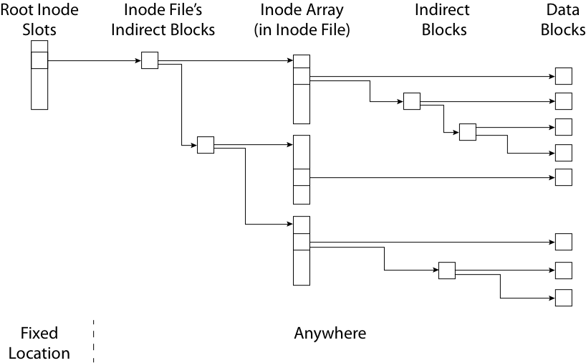
Copy on Write/Write Anywhere

Slide 17
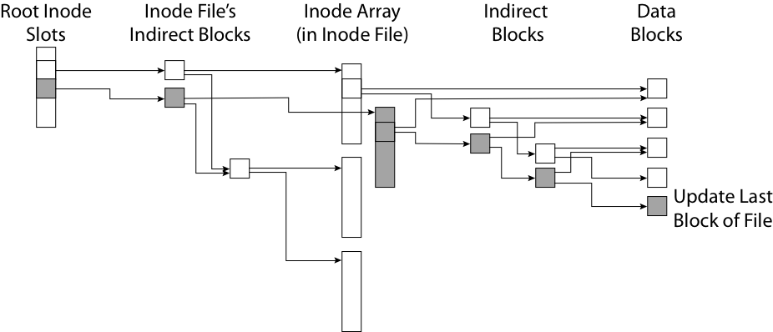
Copy on Write/Write Anywhere

Slide 18
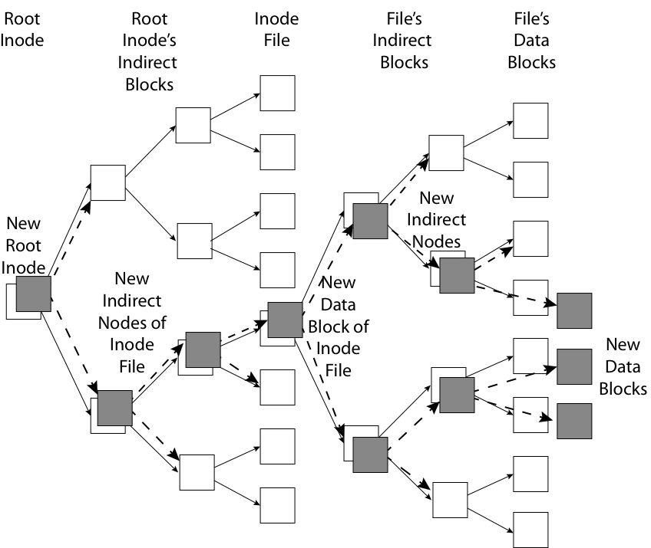
Copy on Write Batch Update

Slide 19
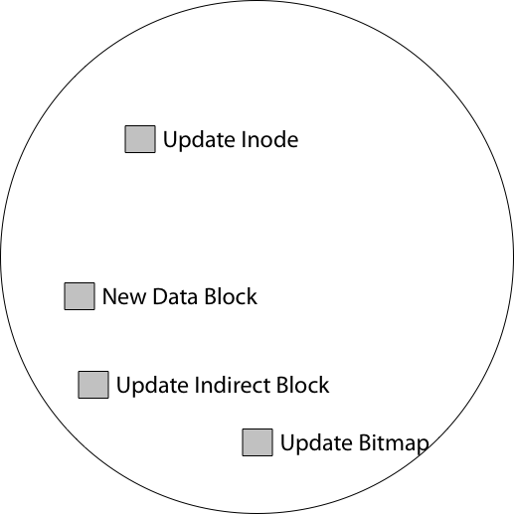
FFS Update in Place

Slide 20
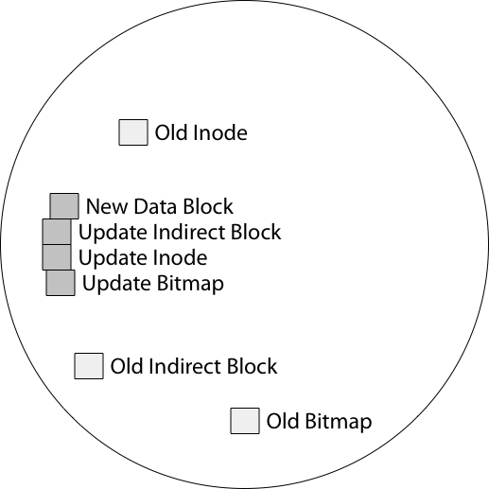
WAFL Write Location

Slide 21
Copy on Write Garbage Collection
For write efficiency, want contiguous sequences of free blocks
Spread across all block groups
Updates leave dead blocks scattered
For read efficiency, want data read together to be in the same block group
Write anywhere leaves related data scattered
=> Background coalescing of live/dead blocks

Slide 22
Copy On Write
Pros
Correct behavior regardless of failures
Fast recovery (root block array)
High throughput (best if updates are batched)
Cons
Potential for high latency
Small changes require many writes
Garbage collection essential for performance

Slide 23
Logging File Systems
Instead of modifying data structures on disk directly, write changes to a journal/log
Intention list: set of changes we intend to make
Log/Journal is append-only
Once changes are on log, safe to apply changes to data structures on disk
Recovery can read log to see what changes were intended
Once changes are copied, safe to remove log

Slide 24
Redo Logging
Prepare
Write all changes (in transaction) to log
Commit
Single disk write to make transaction durable
Redo
Copy changes to disk
Garbage collection
Reclaim space in log
Recovery
Read log
Redo any operations for committed transactions
Garbage collect log

Slide 25
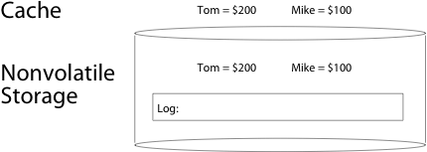
Before Transaction Start

Slide 26
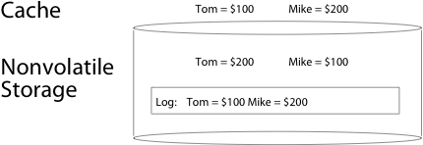
After Updates Are Logged

Slide 27
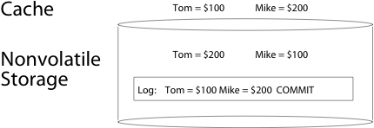
After Commit Logged

Slide 28
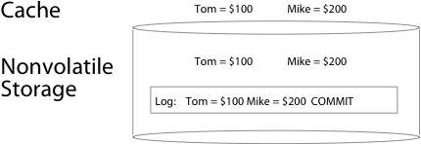
After Copy Back

Slide 29
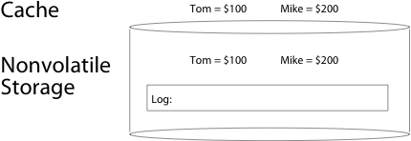
After Garbage Collection

Slide 30
Redo Logging
Prepare
Write all changes (in transaction) to log
Commit
Single disk write to make transaction durable
Redo
Copy changes to disk
Garbage collection
Reclaim space in log
Recovery
Read log
Redo any operations for committed transactions
Garbage collect log

Slide 31
Questions
What happens if machine crashes?
Before transaction start
After transaction start, before operations are logged
After operations are logged, before commit
After commit, before write back
After write back before garbage collection
What happens if machine crashes during recovery?

Slide 32
Performance
Log written sequentially
Often kept in flash storage
Asynchronous write back
Any order as long as all changes are logged before commit, and all write backs occur after commit
Can process multiple transactions
Transaction ID in each log entry
Transaction completed iff its commit record is in log

Slide 33
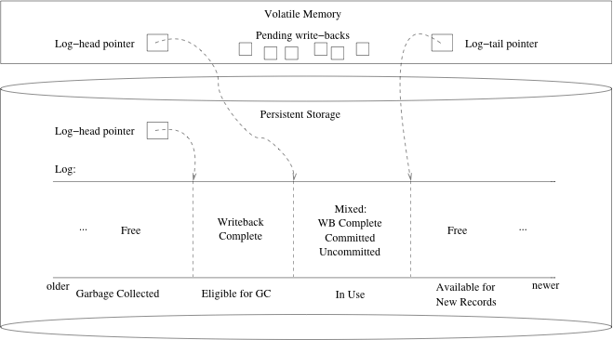
Redo Log Implementation

Slide 34
Transaction Isolation
Process A
move file from x to y
mv x/file y/
Process B
grep across x and y
grep x/* y/* > log
What if grep starts after changes are logged, but before commit?

Slide 35
Two Phase Locking
Two phase locking: release locks only AFTER transaction commit
Prevents a process from seeing results of another transaction that might not commit

Slide 36
Transaction Isolation
Process A
Lock x, y
move file from x to y
mv x/file y/
Commit and release x,y
Process B
Lock x, y, log
grep across x and y
grep x/* y/* > log
Commit and release x, y, log
Grep occurs either before or after move

Slide 37
Serializability
With two phase locking and redo logging, transactions appear to occur in a sequential order (serializability)
Either: grep then move or move then grep
Other implementations can also provide serializability
Optimistic concurrency control: abort any transaction that would conflict with serializability

Slide 38
Caveat
Most file systems implement a transactional model internally
Copy on write
Redo logging
Most file systems provide a transactional model for individual system calls
File rename, move, …
Most file systems do NOT provide a transactional model for user data
Historical artifact (imo)

Slide 39
Question
Do we need the copy back?
What if update in place is very expensive?
Ex: flash storage, RAID

Slide 40
Log Structure
Log is the data storage; no copy back
Storage split into contiguous fixed size segments
Flash: size of erasure block
Disk: efficient transfer size (e.g., 1MB)
Log new blocks into empty segment
Garbage collect dead blocks to create empty segments
Each segment contains extra level of indirection
Which blocks are stored in that segment
Recovery
Find last successfully written segment

Slide 41
Storage Availability
Storage reliability: data fetched is what you stored
Transactions, redo logging, etc.
Storage availability: data is there when you want it
More disks => higher probability of some disk failing
Data available ~ Prob(disk working)^k
If failures are independent and data is spread across k disks
For large k, probability system works -> 0

Slide 42
RAID
Replicate data for availability
RAID 0: no replication
RAID 1: mirror data across two or more disks
Google File System replicated its data on three disks, spread across multiple racks
RAID 5: split data across disks, with redundancy to recover from a single disk failure
RAID 6: RAID 5, with extra redundancy to recover from two disk failures

Slide 43
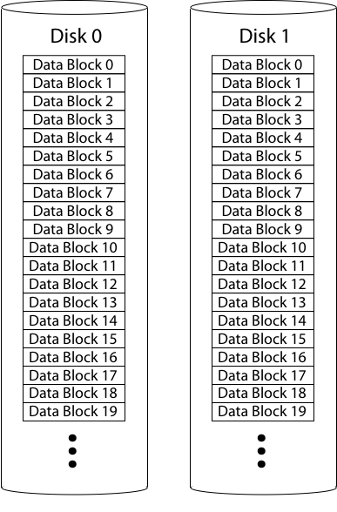
RAID 1: Mirroring
Replicate writes to both disks
Reads can go to either disk

Slide 44
Parity
Parity block: Block1 xor block2 xor block3 …
10001101 block1
01101100 block2
11000110 block3
--------------
00100111 parity block
Can reconstruct any missing block from the others

Slide 45
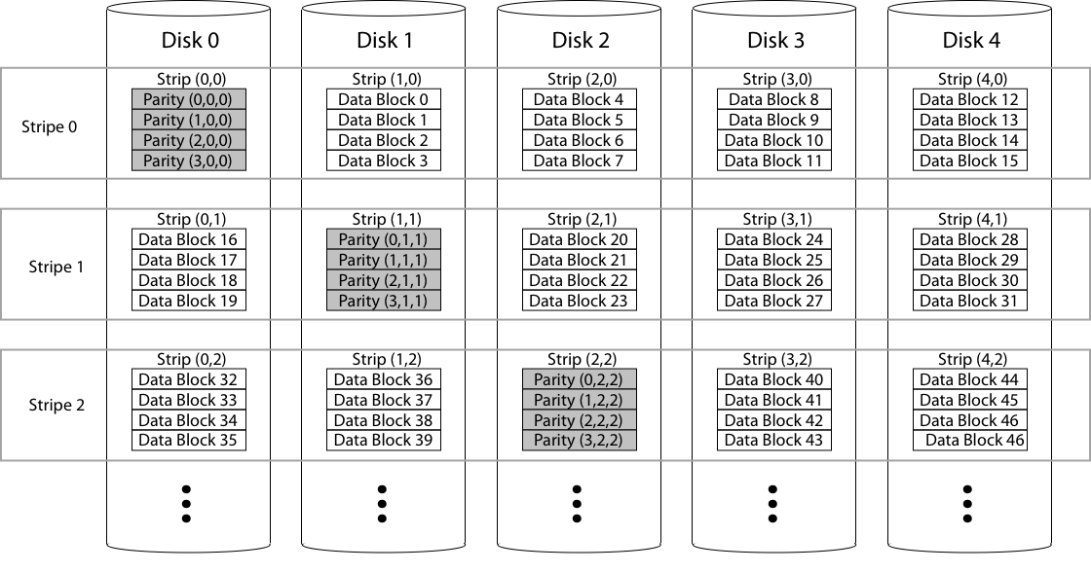
RAID 5: Rotating Parity

Slide 46
RAID Update
Mirroring
Write every mirror
RAID-5: to write one block
Read old data block
Read old parity block
Write new data block
Write new parity block
Old data xor old parity xor new data
RAID-5: to write entire stripe
Write data blocks and parity

Slide 47
Non-Recoverable Read Errors
Disk devices can lose data
One sector per 10^15 bits read
Causes:
Physical wear
Repeated writes to nearby tracks
What impact does this have on RAID recovery?

Slide 48
Read Errors and RAID recovery
Example
10 1 TB disks, and 1 fails
Read remaining disks to reconstruct missing data
Probability of recovery =
(1 – 10^15)^(9 disks * 8 bits * 10^12 bytes/disk)
= 93%
Solutions:
RAID-6: two redundant disk blocks
parity, linear feedback shift
Scrubbing: read disk sectors in background to find and fix latent errors

