Slide 1
Introduction to Operating Systems
CPSC/ECE 3220 Summer 2018
Lecture Notes
OSPP Chapter 2 – Part B
(adapted by Mark Smotherman from Tom Anderson’s slides on OSPP web site)

Slide 2
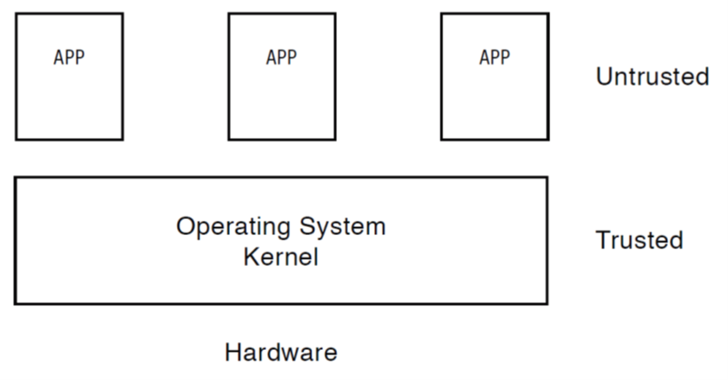
Types of Alerts to Kernel
j
k
l
m
Exceptions, e.g., divide by zero
Intentionally invoke kernel for system calls
Timer interrupts
I/O interrupts, e.g., completion or error

Slide 3
Aside – Interrupt Terminology
Asynchronous –> unrelated to current instruction
“Interrupt”
Synchronous –> related to instruction being executed
“Exception”
“Fault”
“Trap”
For some processor manufacturers, these terms are synonyms; for others, there are subtle differences (e.g., in the way the stack is handled and whether the faulting instruction can be resumed or restarted)

Slide 4
Hardware Timer
Hardware device that periodically interrupts the processor
Transfers control to the kernel timer interrupt handler
Interrupt frequency set by the kernel
Not by user code!
Interrupts can be temporarily deferred
Not by user code!
Interrupt deferral crucial for implementing mutual exclusion

Slide 5
Mode Switch
From user mode to kernel mode
Interrupts
Triggered by timer and I/O devices
Exceptions
Triggered by unexpected program behavior
Or malicious behavior!
System calls (a.k.a. protected procedure calls)
Request by program for kernel to do some operation on its behalf
Only limited # of very carefully coded entry points

Slide 6
Mode Switch
From kernel mode to user mode
New process/new thread start
Jump to first instruction in program/thread
Return from interrupt, exception, system call
Resume suspended execution
Process/thread context switch
Resume some other process
User-level upcall (UNIX signal)
Asynchronous notification to user program

Slide 7
How do we take interrupts safely?
Interrupt vector
Limited number of entry points into kernel
Atomic transfer of control with changes to:
Execution mode (kernel/user)
Permission for additional interrupts to occur
Program counter
Transparent restartable execution
User program does not know interrupt occurred

Slide 8
Mode Bit And Permission Bits
Typically held in Processor Status Register (PSR)
E.g., MC68000
Note that x86 stores two execution mode bits (CPL) in low bits of the code segment register

Slide 9
Interrupt Vector Table
Table is set up by kernel
At a fixed location in kernel memory or located using a privileged register
Contains pointers to code to run in response to different events
Code segments are called “interrupt handlers” or “interrupt service routines”

Slide 10
Interrupt Vector Table

Slide 11
Generic Interrupt Response
Save PC and PSR
Change execution mode to kernel
Disable or restrict further interrupts
Load new PC from interrupt vector table
=> Transfers control into the kernel at a kernel-defined entry point!

Slide 12
Question
Can an application invoke the kernel via a subroutine call that specifies the subroutine address?

Slide 13
Kernel is Interrupt-Driven
Interrupt handlers are the entry points into the kernel
Interrupt handlers are software!
Interrupt Return instruction (IRET) restores PC and PSR

Slide 14
IBM OS/360 MVT kernel (ca. 1967)
Diagram from H. Katzan, Jr., Operating Systems: A pragmatic Approach, 1973.

Slide 15
Interrupt Masking
Interrupt handler runs with interrupts off or restricted
Re-enabled when interrupt completes
OS kernel can also turn interrupts off
Eg., when determining the next process/thread to run
On x86
CLI: disable interrrupts
STI: enable interrupts
Only applies to the current CPU (on a multicore)
We’ll need this to implement synchronization in chapter 5

Slide 16
Interrupt Handlers
Non-blocking, runs to completion
Minimum necessary to allow device to take next interrupt
Any waiting must be limited duration
Sometimes handlers are divided into a top-half and a bottom-half to allow waiting
Wake up other threads to do any real work
E.g., device driver runs as a kernel thread

Slide 17
Interrupt Stack
Per-processor, located in kernel (not user) memory
Interrupt response will save PC, PSR, and user SP on the interrupt stack and then set the new SP to the top of the interrupt stack
Why can’t the interrupt handler run on the user stack of the interrupted user process?

Slide 18
Kernel Stacks
Per-process, located in kernel memory
There may still be a per-processor interrupt stack
Fixed size and locked in memory
Only trusted components such as interrupt handlers and kernel routines use them =>
Kernel stack and SP are always in valid states
Access by kernel cannot cause a page fault
No accesses allowed from user code

Slide 19
Kernel Stacks

Slide 20
System Call
Request kernel to perform a privileged action
Library routine acts as wrapper function (stub) around a trap into the kernel
Sets registers to pass the appropriate system call identification code and any parameters (e.g., size, address)
Trap is intentional interrupt

Slide 22
Kernel System Call Handler
Locate arguments
In registers or on user stack
Translate user addresses into kernel addresses
Copy arguments
From user memory into kernel memory
Protect kernel from TOCTOU attack
Validate arguments
Protect kernel from errors in user code
Copy results back into user memory
Translate kernel addresses into user addresses

Slide 23
Starting a New Process
Kernel builds user and kernel stacks for a new process to look like the process was interrupted before even the first instruction was executed
Avoids special case checking in the dispatcher, so dispatching is slightly faster

Slide 24
Booting the OS

Slide 25
Virtual Machine Monitor / Hypervisor
Protection – failure isolated to a single VM instance
Replication – run different types or versions of OS
Developing software for multiple platforms
Testing of OS modifications
Running legacy applications with an older version of OS
Running an “appliance” = application and tuned OS instance distributed as a VM
Hardware consolidation – one physical machine appears as multiple virtual servers
Live migration – load balancing and repair

Slide 26
Types of VMMs / Hypervisors

Slide 27
(if time permits)

Slide 28
Case Study: MIPS Interrupt/Trap
Two entry points: TLB miss handler, everything else
Save type: syscall, exception, interrupt
And which type of interrupt/exception
Save program counter: where to resume
Save old mode, interrupt permission bits to status register
Set mode bit to kernel
Set interrupts disabled
For memory faults
Save virtual address and virtual page
Jump to general exception handler

Slide 29
Case Study: x86 Interrupt
Save current stack pointer (SS:ESP)
Save current program counter (CS:EIP)
Save current processor status (EFLAGS)
Switch to interrupt stack; push saved values onto that stack
Switch to kernel mode
Get handler address from interrupt vector table
Interrupt handler saves registers it might clobber

Slide 30
Before Interrupt Accepted

Slide 31
When Interrupt Accepted

Slide 32
At End of Interrupt Handler

Slide 33
Upcall: User-level event delivery
Notify user process of some event that needs to be handled right away
Time expiration
Real-time user interface
Time-slice for user-level thread manager
Interrupt delivery for VM player
Asynchronous I/O completion (async/await)
Signal in UNIX; asynchronous event in Windows

Slide 34
Upcalls vs. Interrupts
Signal handlers = interrupt handlers
Signal stack = interrupt stack
Automatic save/restore registers = transparent resume
Signal masking: signals disabled while in signal handler

Slide 35
Upcall: Before

Slide 36
Upcall: During

