Slide 1
Introduction to Operating Systems
CPSC/ECE 3220 Summer 2018
Lecture Notes
OSPP Chapter 3
(adapted by Mark Smotherman from Tom Anderson’s slides on OSPP web site)

Slide 2
OS Design Questions
What functions should OS provide?
Where should this functionality be located?
In library routines that run in user mode?
In the kernel?
In OS server processes that run in kernel mode?
In OS server processes that run in user mode?
(Note that clients and servers will need to make kernel calls to communicate)

Slide 3
Each system call can be limited in functionality. Provides primitives that you can “mix and match”.
“thin waist”

Slide 4
UNIX Case Study
Creating and managing processes
fork(), exec(), wait()
Performing I/O
open(), read(), write(), close()
Communicating between processes
pipe(), dup2(), select(), connect()

Slide 5
UNIX Process Management
UNIX fork() – system call to create a copy of the current process, and start it running
No arguments!
UNIX exec() – system call to change the program being run by the current process
UNIX wait() – system call to wait for a process to finish
UNIX signal() – system call to send a notification to another process
Notes:
UNIX splits creating a process into two steps, each of them a lot simpler.

Slide 6
UNIX Process Management
Notes:
How is this used – typically, fork a process, child and parent are now both running the same program. One sets up the child program, and runs exec – becoming the new program
The parent, usually, waits for the child to finish

Slide 7
Question: What does this code print?
int child_pid = fork();
if (child_pid == 0) { // I'm the child process
printf("I am process #%d\n", getpid());
return 0;
} else { // I'm the parent process
printf("I am parent of process #%d\n", child_pid);
return 0;
}
Notes:
Parent could print first, or child could print first – you don’t know!

Slide 8
Questions
Can UNIX fork() return an error? Why?
Can UNIX exec() return an error? Why?
Can UNIX wait() ever return immediately? Why?

Slide 9
Implementing UNIX fork()
Create and initialize the process control block (PCB) in the kernel
Create a new address space
Initialize the address space with a copy of the entire contents of the address space of the parent
Inherit the execution context of the parent (e.g., any open files)
Inform the scheduler that the new process is ready to run

Slide 10
Implementing UNIX exec()
Load the program into current address space
Copy arguments into memory in address space
Initialize the hardware context to start execution at ``start'‘
(note that exec() does not create a new process)

Slide 11
Windows CreateProcess()
Create and initialize the process control block (PCB) in the kernel
Create and initialize a new address space
Load the program into address space
Copy arguments into memory in address space
Initialize the hardware context to start execution at ``start'’
Inform the scheduler that the new process is ready to run

Slide 12
Windows CreateProcess() API (simplified)
CreateProcess(
NULL, // No module name (use command line)
argv[1], // Command line
NULL, // Process handle not inheritable
NULL, // Thread handle not inheritable
FALSE, // Set handle inheritance to FALSE
0, // No creation flags
NULL, // Use parent's environment block
NULL, // Use parent's starting directory
&si, // Pointer to STARTUPINFO structure
&pi // Pointer to PROCESS_INFORMATION structure
)
Notes:
Ok, pretty complex! But its because there are a lot of aspects to a process

Slide 13
UNIX I/O
Uniformity
All operations on files, I/O devices, and pipes use the same set of system calls: open(), close(), read(), write()
Open before use
Check permissions and set up internal housekeeping
open() returns a handle (file descriptor) for use in later calls on the file
Byte-oriented interface
Kernel-buffered read() and write()
Explicit close()

Slide 14
UNIX File System Interface
UNIX file open() is a Swiss Army knife:
Open the file, return file descriptor
Options:
if file doesn’t exist, return an error
If file doesn’t exist, create file and open it
If file does exist, return an error
If file does exist, open file
If file exists but isn’t empty, nix it then open
If file exists but isn’t empty, return an error
…

Slide 15
Interface Design Question
Why not separate system calls for open()/create()/exists()?
if (!exists(name))
create(name); // can create() fail?
fd = open(name); // does the file exist?

Slide 16
Command Interpreter (“Shell”)
Interactive interface to OS system calls
Finds executable file associated with a command and creates a process (passing any parameters)
Typically extended as a mini-language (e.g., control structures, macros)
Shell scripts (“batch files” on Windows)
Start-up files (e.g., .cshrc) and environment variables (predefined macros)
Handles I/O redirection

Slide 17
Implementing a Shell
char *prog, **args;
int child_pid;
// Read and parse the input a line at a time
while (readAndParseCmdLine(&prog, &args)) {
child_pid = fork(); // create a child process
if (child_pid == 0) {
exec(prog, args); // I'm the child process. Run program
// NOT REACHED
} else {
wait(child_pid); // I'm the parent, wait for child
return 0;
}
}

Slide 18
Interprocess Communication (IPC) Using Pipes
Connect the I/O of two programs on the command line using a pipe (“|”)
Combine applications into complex structures

Slide 19
Client-Server IPC Using Pipes
Server process can wait on input from multiple client processes using select()

Slide 20
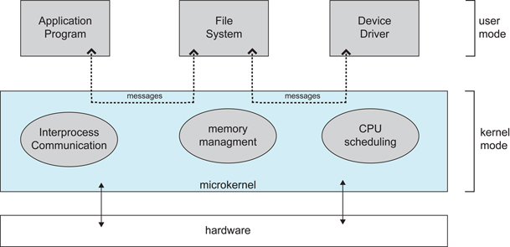
OS Structure Design Choice
Large kernel provides all or most system services
Sometimes called a “bloated kernel”
Microkernel provides minimal services
Other services provided by user-mode servers
Diagram 2.14 from Silberschatz, Galvin, and Gagne, OS concepts, 9th ed.

Slide 21
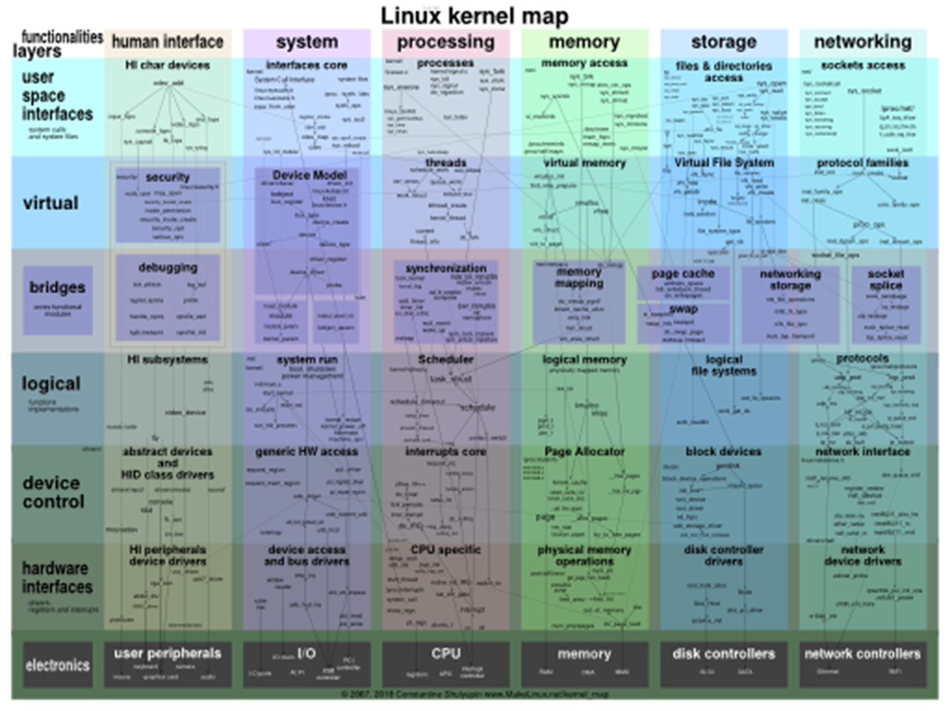
Diagram from http://www.makelinux.net/kernel_map/

Slide 22
Diagram courtesy of Gernot Heiser, UNSW

Slide 23
Message Passing in Microkernels
Typically define a message object for IPC
Use send() and receive() operations
instead of file-like read() and write()
Messages may be typed
For checking at compile time or run time
Messages may be buffered in a queue
Also called a channel, endpoint, mailbox, port
Zero-buffer approach is called rendezvous

Slide 24
// seL4 microkernel example from GitHub - seL4/libsel4/sel4_arch_include/aarch32/sel4/sel4_arch/syscalls.h
LIBSEL4_INLINE_FUNC void
seL4_Send(seL4_CPtr dest, seL4_MessageInfo_t msgInfo)
{
arm_sys_send(seL4_SysSend, dest, msgInfo.words[0], seL4_GetMR(0), seL4_GetMR(1), seL4_GetMR(2), seL4_GetMR(3));
}
…
static inline void
arm_sys_send(seL4_Word sys, seL4_Word dest, seL4_Word info_arg, seL4_Word mr0,
seL4_Word mr1, seL4_Word mr2, seL4_Word mr3)
{
register seL4_Word destptr asm("r0") = dest;
register seL4_Word info asm("r1") = info_arg;
/* Load beginning of the message into registers. */
register seL4_Word msg0 asm("r2") = mr0;
register seL4_Word msg1 asm("r3") = mr1;
register seL4_Word msg2 asm("r4") = mr2;
register seL4_Word msg3 asm("r5") = mr3;
/* Perform the system call. */
register seL4_Word scno asm("r7") = sys;
asm volatile (
"swi $0"
: "+r" (destptr), "+r" (msg0), "+r" (msg1), "+r" (msg2),
"+r" (msg3), "+r" (info)
: "r"(scno)
);
}
swi is ARM “software interrupt” instruction to trap into the kernel

Slide 25
Design Tradeoffs
Performance concerns
Procedure call to library routine is fastest
Kernel call is slower
Passing messages to a server process is slowest
Reliability concerns
Linux 4.11 has over 18M lines of code
half of which is reported to be device driver code
seL4 microkernel is 9,700 lines of C and 500 lines of assembler
but only implements interrupt handling, message passing, and scheduling; furthermore, it only runs on a limited number of platforms

Slide 26
Linus Shares His Opinion
I think microkernels are stupid. They push the problem space into *communication*, which is actually a much bigger and fundamental problem than the small problem they are purporting to fix. They also lead to horrible extra complexity as you then have to fight the microkernel model, and make up new ways to avoid the extra communication latencies etc.
from http://meta.slashdot.org/story/12/10/11/0030249/linus-torvalds-answers-your-questions

Slide 27
Typical OS Design Approaches
Hardware abstraction layer (HAL)
Portability across processors
Allows rest of OS to be written in a machine-independent manner
Loadable device drivers
“Plug and Play”
The kernel does not need to be recompiled to work with new I/O devices
Trend to make device drivers run in user mode

