Slide 1


Slide 2
CHAPTER 9
Relational Database Design by ER- and EERR-to-Relational Mapping
Slide 9- <number>

Slide 3
Chapter Outline
ER-to-Relational Mapping Algorithm
  Step 1: Mapping of Regular Entity Types
  Step 2: Mapping of Weak Entity Types
  Step 3: Mapping Specialization or Generalization
  Step 4: Mapping of Union Types (Categories).
  Step 5: Mapping of Binary 1:1 Relation Types
  Step 6: Mapping of Binary 1:N Relationship Types.
  Step 7: Mapping of Binary M:N Relationship Types.
  Step 8: Mapping of Multivalued attributes.
  Step 9: Mapping of N-ary Relationship Types.
A retrospective on ER diagrams
Slide 9- <number>

Slide 4
GOALS during Mapping
Preserve all information (that includes all attributes)
Maintain the constraints to the extent possible (Relational Model cannot preserve all contstraints- e.g., max cardinality ratio such as 1:10 in ER; disjoint/overlapping specialization)
Minimize null values
The mapping procedure described has been implemented in many commercial tools.
Slide 9- <number>

Slide 5
Note
This mapping is an algorithm
If you follow the steps exactly on the same input diagram, you should get the same output schema
I will not ask you to memorize this algorithm, but I will ask you to understand it
  A simplified version will be provided on the exams for you to use
Slide 5- <number>

Slide 6
ER-to-Relational Mapping Algorithm
Step 1: Mapping of Regular Entity Types.
  For each regular (strong) entity type E in the ER schema, create a relation R that includes all the simple attributes of E.
    For composite attributes, only add the simple attributes that create the composite attribute
      Add Fname, Mname, Lname, not Name
  Choose one of the key attributes of E as the primary key for R.
  If the chosen key of E is composite, the set of simple attributes that form it will together form the primary key of R.
Example: We create the relations EMPLOYEE, DEPARTMENT, and PROJECT in the relational schema corresponding to the regular entities in the ER diagram.
  SSN, DNUMBER, and PNUMBER are the primary keys for the relations EMPLOYEE, DEPARTMENT, and PROJECT as shown.
Slide 9- <number>

Slide 7
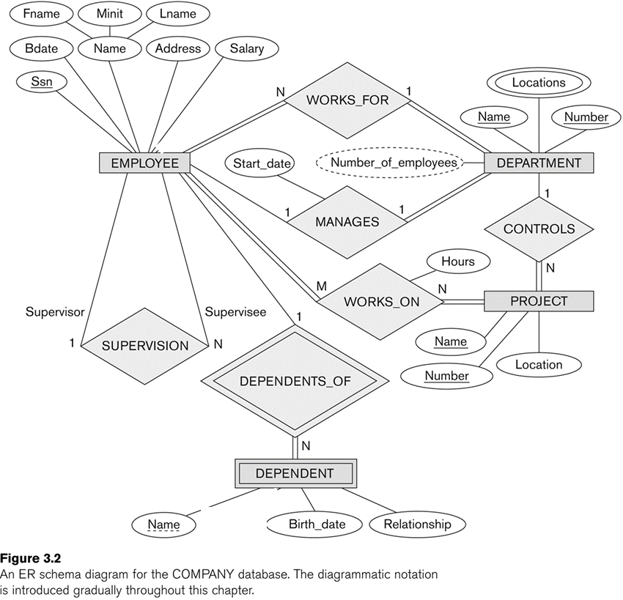
Figure 9.1 The ER conceptual schema diagram for the COMPANY database.
Slide 9- 6

Slide 8
ER-to-Relational Mapping Algorithm (contd.)
Step 2: Mapping of Weak Entity Types
  For each weak entity type W in the ER schema with owner entity type E, create a relation R & include all simple attributes (or simple components of composite attributes) of W as attributes of R.
  Also, include as foreign key attributes of R the primary key attribute(s) of the relation(s) that correspond to the owner entity type(s).
  The primary key of R is the combination of the primary key(s) of the owner(s) and the partial key of the weak entity type W, if any.
Example: Create the relation DEPENDENT in this step to correspond to the weak entity type DEPENDENT.
  Include the primary key SSN of the EMPLOYEE relation as a foreign key attribute of DEPENDENT (renamed to ESSN).
  The primary key of the DEPENDENT relation is the combination {ESSN, DEPENDENT_NAME} because DEPENDENT_NAME is the partial key of DEPENDENT.
Slide 9- <number>

Slide 9
Mapping EER Model Constructs to Relations
Step3: for Mapping Specialization or Generalization.
  Convert each specialization with m subclasses {S1, S2,….,Sm} and generalized superclass C, where the attributes of C are {k,a1,…an} and k is the (primary) key, into relational schemas
3A: Multiple relations-Superclass and subclasses
  Create a relation L for C with attributes Attrs(L) = {k,a1,…an} and PK(L) = k. Create a relation Li for each subclass Si, 1 < i < m, with the attributes Attrs(Li) = {k} U {attributes of Si} and PK(Li)=k. This works for any specialization (total or partial, disjoint of over-lapping).
Slide 9- <number>

Slide 10
Step 3 Whaaaa?
Add a relation for the super class with all it’s attributes and it’s primary key
Then add a relation for each subclass with it’s subclass specific attributes
  Then add the primary key of the superclass as the primary key of the subclass
Then add an arrow from the primary key of the subclass to the primary key of the superclass
  The primary key of the subclass is itself a foreign key
Slide 5- <number>

Slide 11
Step 3
A quick note:
The full algorithm actually gives options for how you can handle these
For simplicity sake, I am only providing you with one option
  The other options either aren’t very different, or are objectively worse options
Also note: We lose our disjoint/overlapping and total/partial constraints in the relational model
  We will have to enforce these ourselves
Slide 5- <number>

Slide 12

FIGURE 4.4
EER diagram notation for an attribute-defined specialization on JobType.
Slide 9- <number>

Slide 13
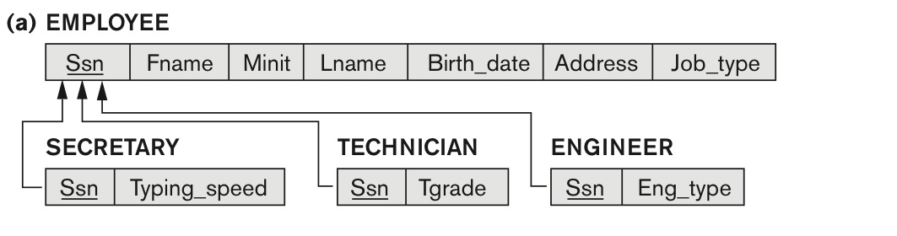
Fig. 9.5: Different Options for Mapping Generalization Hierarchies - summary
Slide 9- 29

Slide 14
Step 3 Continued
Mapping of Shared Subclasses (Multiple Inheritance)
  A shared subclass, such as STUDENT_ASSISTANT, is a subclass of several classes, indicating multiple inheritance.
  The shared subclass will work the same way as a normal subclass, but…
    It must have the primary key of each superclass as an attribute/foreign key
    It’s primary key will be a combination of all the primary keys of it’s super classes
      Note, the super classes could have the same attribute as the primary key
      Student_Assistant is a sub class of student and employee, which both have SSN as their primary key
Slide 9- <number>

Slide 15
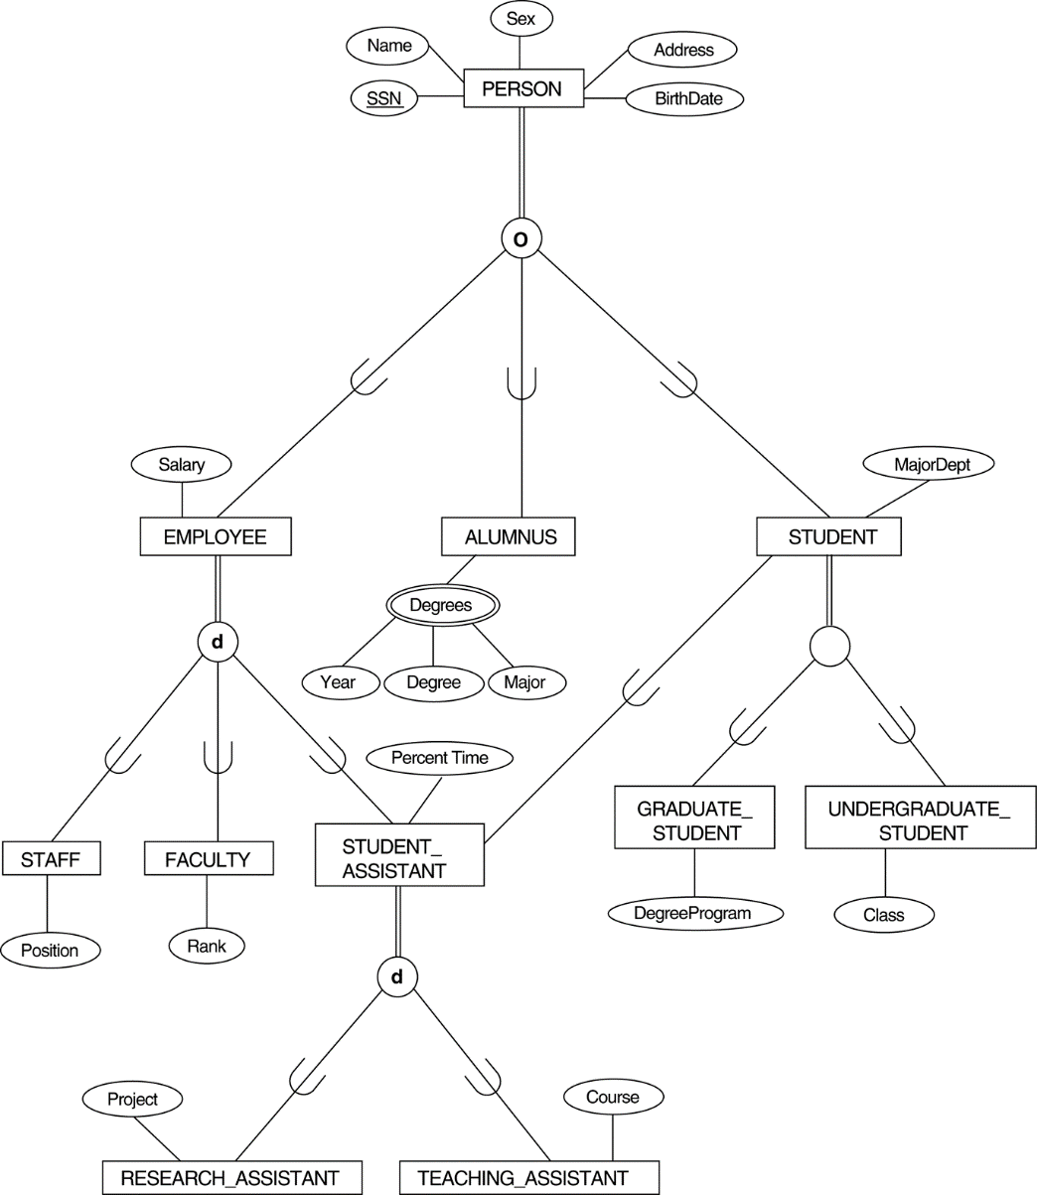
FIGURE 4.7
A specialization lattice with multiple inheritance for a UNIVERSITY database.
Slide 9- <number>

Slide 16
Mapping EER Model Constructs to Relations (contd.)
Step 4: Mapping of Union Types (Categories).
  Add each Superclass following the normal rules for adding an entity (dependent on the type of entity)
  For mapping a category/union type, create a new key attribute, called a surrogate key
  Add a relation for the category/union type, with the new surrogate as the primary key. Add any other attributes of the union type as attributes to the relation.
  In each superclass’s relation, add the primary key of the category/union type as a foreign key, and add an arc connecting the foreign key back to the primary key of the category
Slide 9- <number>

Slide 17
Step 4 Continued
In the example below we can create a relation OWNER to correspond to the OWNER category and include any attributes of the category in this relation. The primary key of the OWNER relation is the surrogate key, which we called OwnerId.
Slide 5- <number>

Slide 18

FIGURE 4.8
Two categories (union types): OWNER and REGISTERED_VEHICLE.
Slide 9- <number>

Slide 19
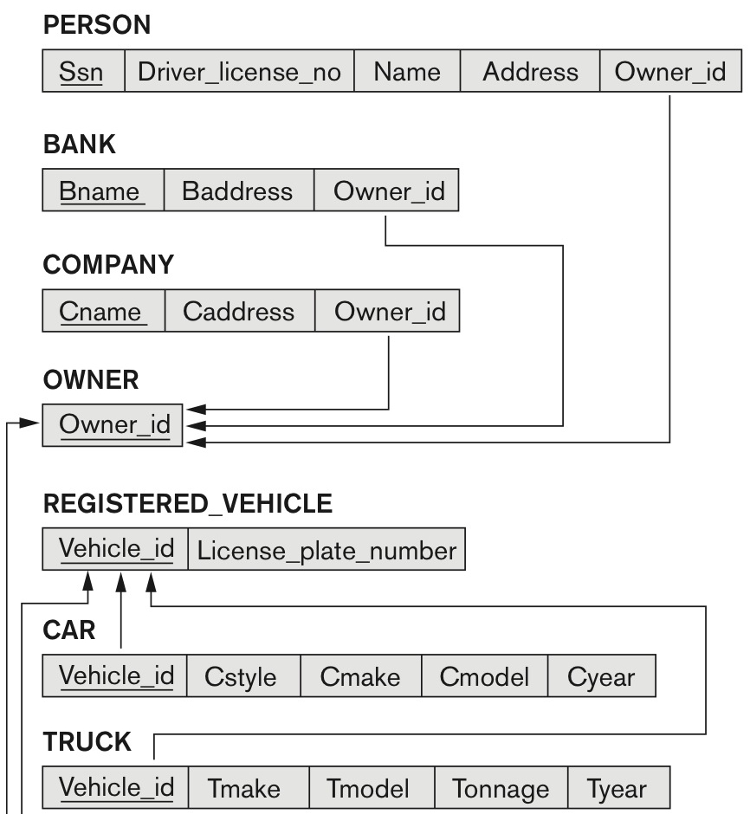
FIGURE 9.7
Mapping the EER categories (union types) in Figure 4.8 to relations.
Slide 9- <number>

Slide 20
ER-to-Relational Mapping Algorithm (contd.)
Step 5: Mapping of Binary 1:1 Relation Types
  For each binary 1:1 relationship type R in the ER schema, identify the relations S and T that correspond to the entity types participating in R.
Choose one of the relations-say S-and include a foreign key in S the primary key of T. It is better to choose an entity type with total participation in R in the role of S.
  Example: 1:1 relation MANAGES is mapped by choosing the participating entity type DEPARTMENT to serve in the role of S, because its participation in the MANAGES relationship type is total.
Slide 9- <number>

Slide 21
ER-to-Relational Mapping Algorithm (contd.)
Step 6: Mapping of Binary 1:N Relationship Types.
  For each regular binary 1:N relationship type R, identify the relation S that represents the participating entity type at the N-side of the relationship type.
  Include as foreign key in S the primary key of the relation T that represents the other entity type participating in R.
    Add the directed arcs connecting the foreign key and primary key
  Include any simple attributes of the 1:N relation type as attributes of S.
Example: 1:N relationship types WORKS_FOR, CONTROLS, and SUPERVISION in the figure.
  For WORKS_FOR we include the primary key DNUMBER of the DEPARTMENT relation as foreign key in the EMPLOYEE relation and call it DNO.
Slide 9- <number>

Slide 22
ER-to-Relational Mapping Algorithm (contd.)
Step 7: Mapping of Binary M:N Relationship Types.
  For each regular binary M:N relationship type R, create a new relation S to represent R. This is a relationship relation.
    Also called a join table
  Include as foreign key attributes in S the primary keys of the relations that represent the participating entity types; their combination will form the primary key of S.
    Add the directed arcs connecting the foreign key and primary key
  Also include any simple attributes of the M:N relationship type (or simple components of composite attributes) as attributes of S.
Example: The M:N relationship type WORKS_ON from the ER diagram is mapped by creating a relation WORKS_ON in the relational database schema.
  The primary keys of the PROJECT and EMPLOYEE relations are included as foreign keys in WORKS_ON and renamed PNO and ESSN, respectively.
  Attribute HOURS in WORKS_ON represents the HOURS attribute of the relation type. The primary key of the WORKS_ON relation is the combination of the foreign key attributes {ESSN, PNO}.
Slide 9- <number>

Slide 23
ER-to-Relational Mapping Algorithm (contd.)
Step 8: Mapping of Multivalued attributes.
  For each multivalued attribute A, create a new relation R.
  This relation R will include an attribute corresponding to A, plus the primary key attribute K-as a foreign key in R-of the relation that represents the entity type of relationship type that has A as an attribute.
    Add the directed arcs connecting the foreign key and primary key
  The primary key of R is the combination of A and K. If the multivalued attribute is composite, we include its simple components.
Example: The relation DEPT_LOCATIONS is created.
  The attribute DLOCATION represents the multivalued attribute LOCATIONS of DEPARTMENT, while DNUMBER-as foreign key-represents the primary key of the DEPARTMENT relation.
  The primary key of R is the combination of {DNUMBER, DLOCATION}.
Slide 9- <number>

Slide 24
ER-to-Relational Mapping Algorithm (contd.)
Step 9: Mapping of N-ary Relationship Types.
  For each n-ary relationship type R, where n>2, create a new relationship S to represent R.
  Include as foreign key attributes in S the primary keys of the relations that represent the participating entity types.
    Add the directed arcs connecting the foreign key and primary key
  Also include any simple attributes of the n-ary relationship type (or simple components of composite attributes) as attributes of S.
Example: The relationship type SUPPLY in the ER on the next slide.
  This can be mapped to the relation SUPPLY shown in the relational schema, whose primary key is the combination of the three foreign keys {SNAME, PARTNO, PROJNAME}
Slide 9- <number>

Slide 25

FIGURE 3.17
TERNARY RELATIONSHIP: SUPPLY
Slide 9- <number>

Slide 26
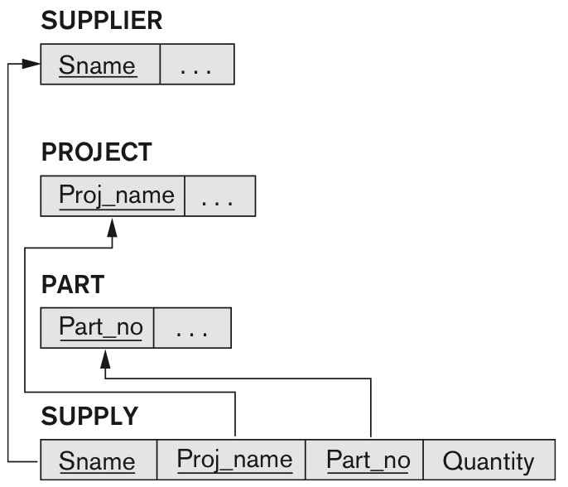
Mapping the n-ary relationship type SUPPLY
Slide 9- <number>

Slide 27
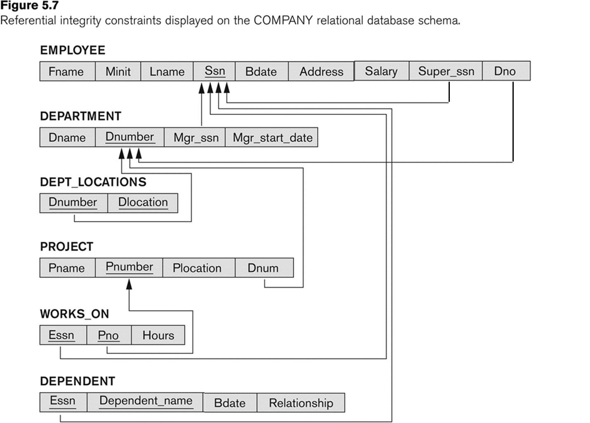
Figure 9.2 Result of mapping the COMPANY ER schema into a relational database schema.
Slide 9- 13

Slide 28
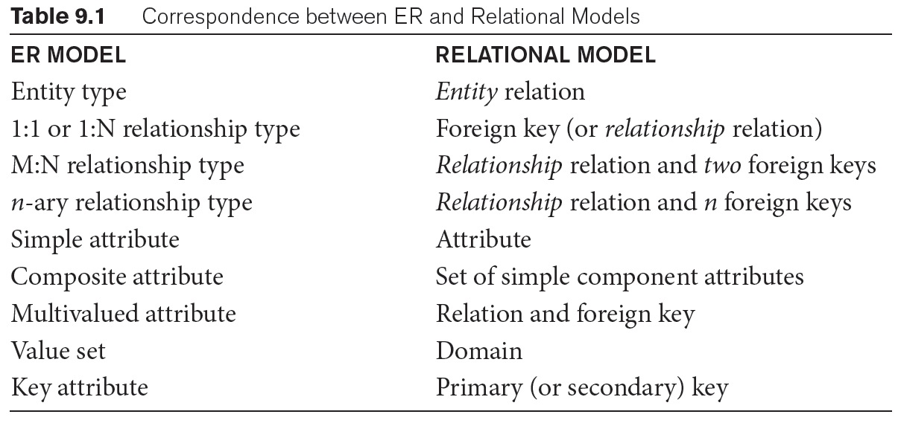
Summary of Mapping constructs and constraints
Slide 9- <number>

Slide 29
ER diagrams – A retrospective
1:N relationships
  Why does it matter which relation has the foreign key?
  We say to add the foreign key to the relation on the “many” side of the relationship
Consider the relationship between an insurance policy and an agent
  An Agent can sell many policies, but a policy is only sold by one agent
  If Policy has a FK called AgentID, there is only one agent that can sell that policy, so there is only one value for that FK for each policy
  If Agent has a FK called PolicyID, how do you show that the Agent has sold many policies?
    Add PolicyID1, PolicyID2, PolicyID3….
      What’s the Max number? Lost of NULLS
    Add multiple tuples in the Agent relation
      Would repeat the primary key!
Slide 5- <number>

Slide 30
ER Diagrams – A retrospective
Why do we handle multi-valued attributes that way?
Same reasons as 1:N
A car with many colors
  Color1, Color2, Color3
  Want to know if a car has red for one of it’s colors?
  Is Color1 red? Is Color2 red?....
  Now it’s does <CarID, “Red”> exist in the table?
Slide 5- <number>

Slide 31
ER Diagrams – A retrospective
1:N relationships
Why not create a relationship relation (join table) for our 1:N relationships?
  This would eliminate a step in our algorithm and combine it with the N:M step
  This will work, we can still represent that relationship
    And some people do
  BUT it will allow for M:N relationships to exist in our database
  So it better fits our constraints to use our foreign key method
Slide 5- <number>

Slide 32
ER Diagrams – A Retrospective
Many – to – Many relationships.
Why Create a new relation?
Consider how the data is stored in a relation
  We have two Relations in a many to many relationship
  A(pk, val) and B(pk, val2)
  A has tuples <1, 7> <2, 5> and B has tuples <x, 8> and <y, 42>
  <1,7> is in a relationship with both tuples of B, and <x,8> is in a relationship with both tuples of A
  AtoB<fkA, fkB> has tuples <1, x> <1,y> <2,x>
Slide 5- <number>

Slide 33
ER Diagrams – A Retrospective
N-ary relationships
We mentioned when drawing the diagrams that it’s difficult to show the cardinality constraints with non-binary relationships
In our algorithm, we end up creating a new table
  Which allows many to many relationships
  Which means we would lose those constraints anyways
  We have to enforce those constraints in our application
Slide 5- <number>

Slide 34
ER Diagrams – A Retorspective
Union types versus Super/Sub classes
  A Union type had multiple super classes, but it only belonged to one of them
  When we make the relations we add a relation for the union type with a key and it’s attributes
  Then we add the primary key of the union type as a foreign key to the relations for the super classes
    This could be the primary key of the subclasses as well
If we have A superclass with multiple subclasses
  We add a relation for the superclass with it’s key and attributes
  We add a relation for each subclass
  We add the PK of the superclass as a FK/PK to each subclass
They end up essentially the same in our relational model if they Union type’s super classes all use the same attribute as the primary key
  Otherwise, union type is more meaningful if the super classes don’t have the same primary key
Slide 5- <number>

Slide 35
ER Diagrams – A Retrospective
Why not have 1:1 relationships be one table?
Right now, it allows for 1:N relationships
We would end up with a ton of nulls if it’s not a total participation relationship
  A and B are in a 1:1 relationship, A has total participation but B does not.
  They are stored in one relation with all the attributes of A and B combined
  B can exist without being in a relationship with A
    Those tuples would have a null value for every attribute of A
Slide 5- <number>

Slide 36
ER Diagrams – a retrospective
Weak Entities
  When we transform our weak entity we end up with a relation with all the weak entities attributes, plus a foreign key for the identifying relationship. The foreign key and the partial key combine to make the primary key
  If we add an artificial key and void the weak entity type we end up with the same relation, plus one additional ID attribute, which is the primary key
The differences are minimal
  One extra attribute – memory usage
  It is possible for a weak entity to exist without the identifying relationship by having the foreign key be null. This could be enforced with SQL constraints or in our application.
Slide 5- <number>

Slide 37
ER Diagrams – A Retrospective
What if instead of using the EER notation we had created each subclass as an entity, and connected it to the superclass with a 1:N relationship called “Is A”?
  We would have added a relation for the super class and all subclasses
  We would have added a foreign key in each subclass connecting to the primary key of the superclass
The relational model would be the same
The EER notation is used to help us conceptually understand the miniworld, and use the super/subclass notation is similar to our OOP concepts we are familiar with
This is also why its referred to as the Superclass/Subclass Relationship
Slide 5- <number>

Slide 38
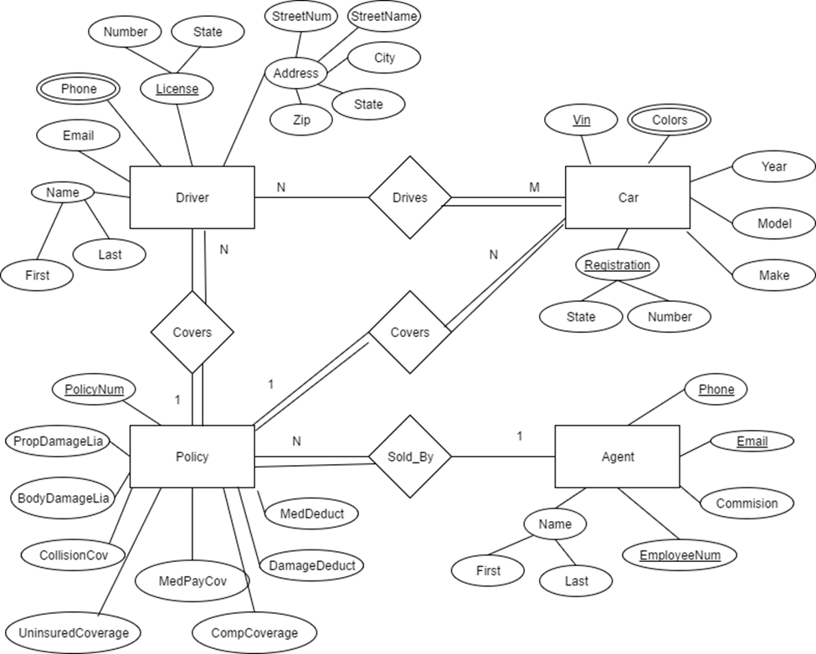
Mapping Exercise-2
Exercise 9.9 : Map this schema into a set of relations
Slide 9- <number>

Slide 39
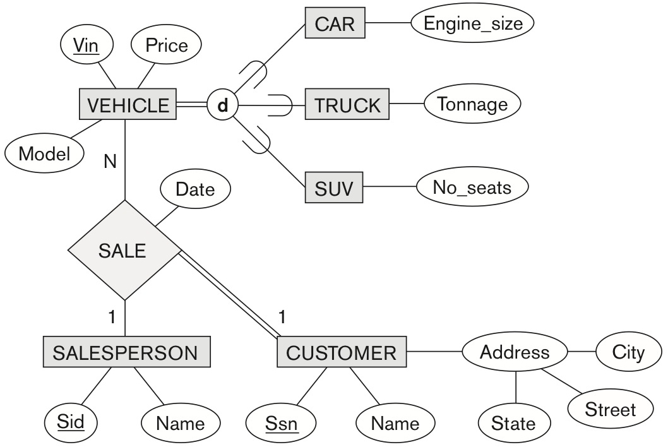
Mapping Exercise-2
Exercise 9.9 : Map this schema into a set of relations
FIGURE 9.9
EER diagram for a car dealer
Slide 9- <number>

Slide 40

Mapping Exercise-1
Exercise 9.4 : Map this schema into a set of relations.
FIGURE 9.8
An ER schema for a SHIP_TRACKING database.
Slide 9- <number>

