Slide 1
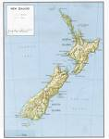
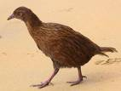
유용한 기계학습 실험 툴 Weka
The weka, or woodhen, is a bird
native to New Zealand. Weka is
also the name of a suite of machine
learning software tools, written in
Java, and developed at the University
of Wiakato in New Zealand.

Slide 2
Weka Can Be A Useful Tool
Weka has the potential to be a useful tool to support local air quality forecasting efforts – particularly those operating on a limited budget.
Weka is open source (free) software - although the purchase of the associated text book is strongly recommended.
Weka is easily installed on standard PC's but can also run on Linux and other platforms.
Only minimal modifications are necessary to prepare data files for use in Weka.
The user interface is simple and intuitive.

Slide 3
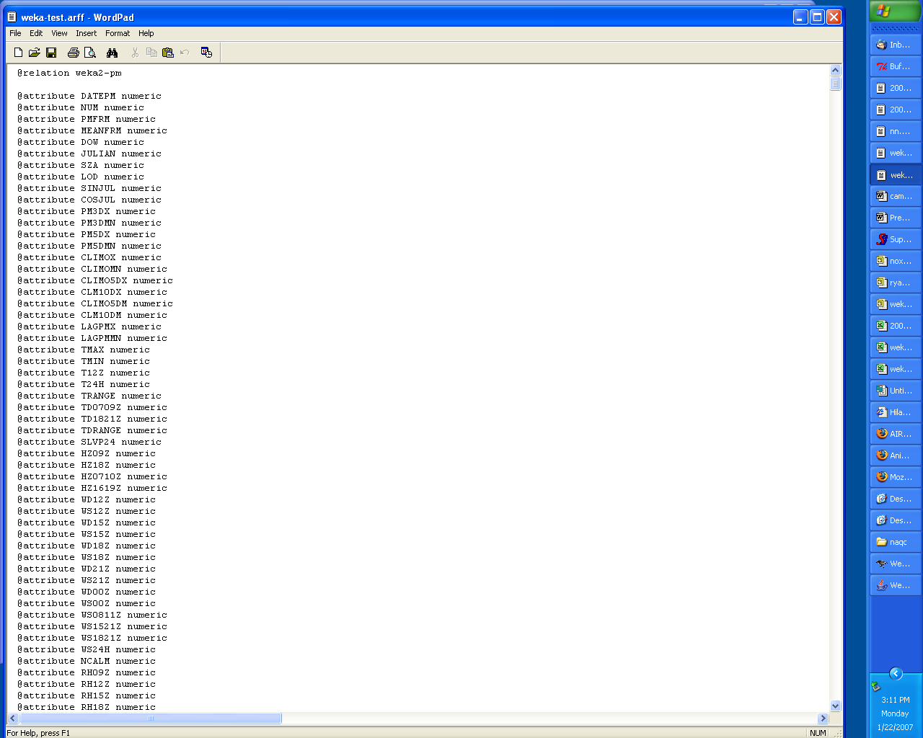
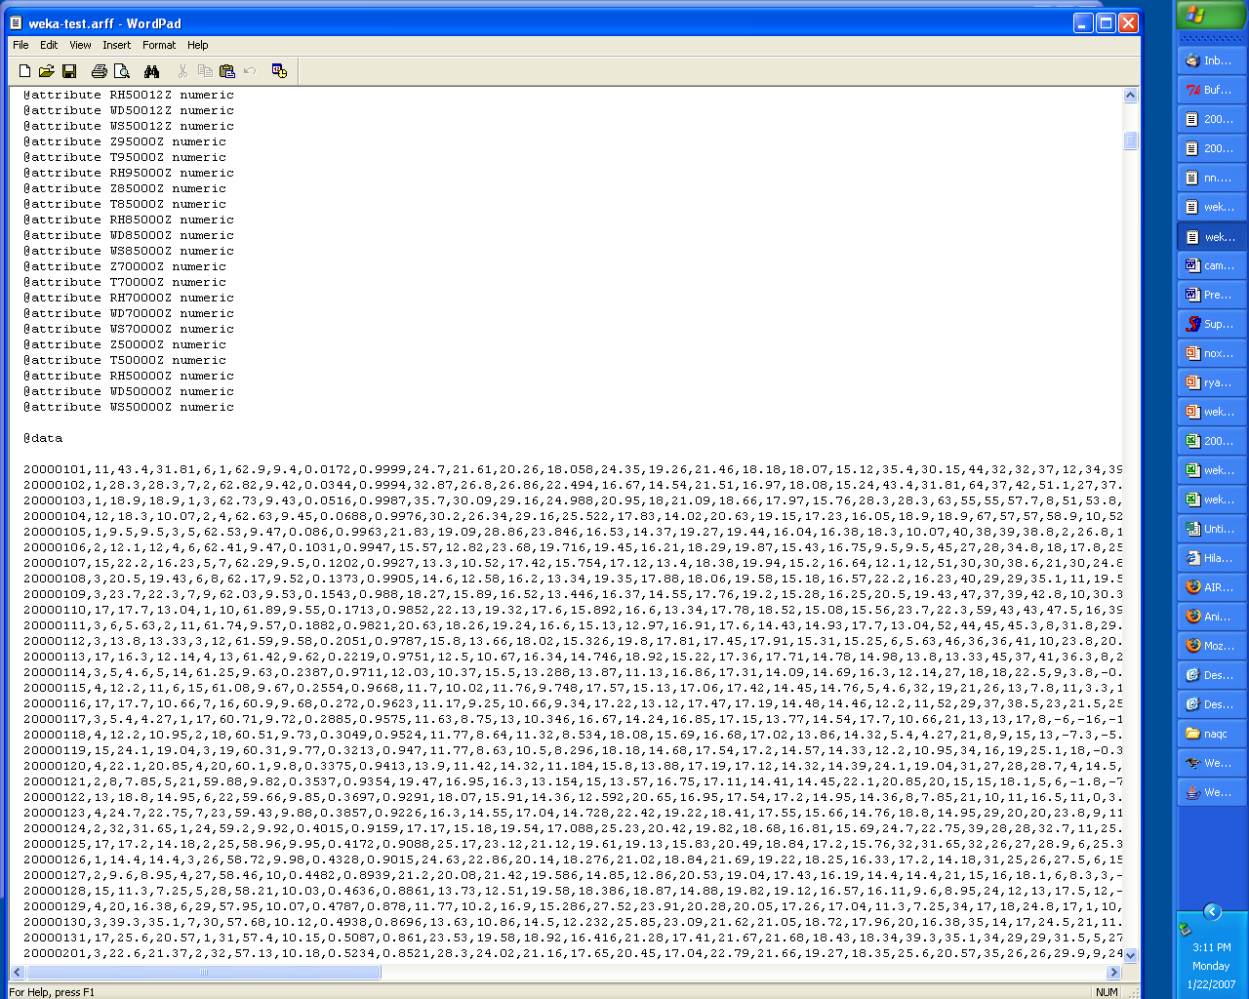
arff Format
arff format is simple anyway:
ASCII file
List of variable and type
Then data follows,
comma separated
Missing data marked as “?”

Slide 4
- Classification
Naive Bayesian Classifier, Decision Tree(ID3, C4.5, CART)
Multilayer Perceptron (Neural Networks), RBFNN, Linear/Nonlinear SVM,
HMM, Genetic Programming
- Regression
Linear Regression
Multilayer Perceptron (Neural Networks), RBFNN, Linear/Nonlinear SVM,
Genetic Programming
- Clustering
K-means, Hierarchical, Gaussian mixture, Spectral

Slide 5
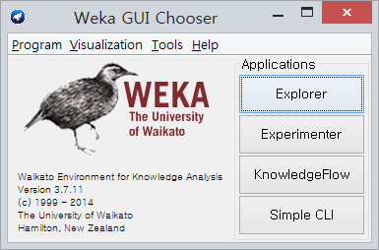
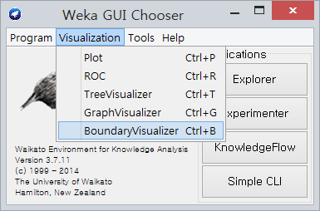
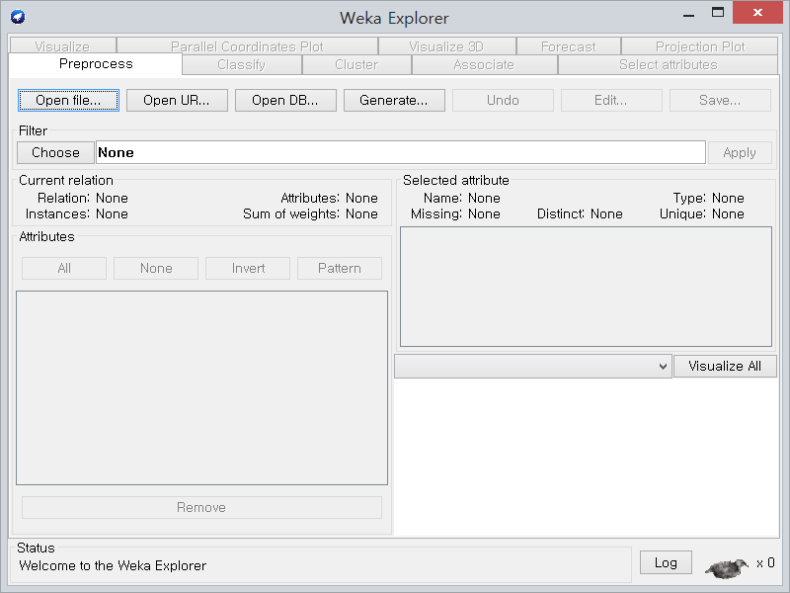
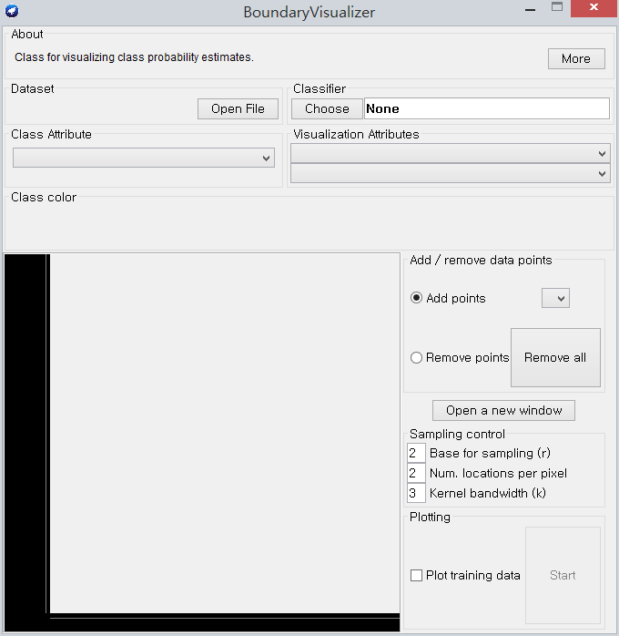
- Classification Interface
Explorer Boundary Visualizer

Slide 6
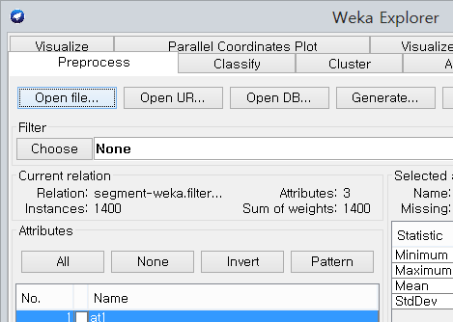
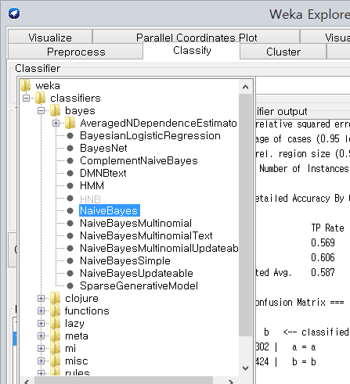
- Classification and Regression Interface
open file select classifier

Slide 7
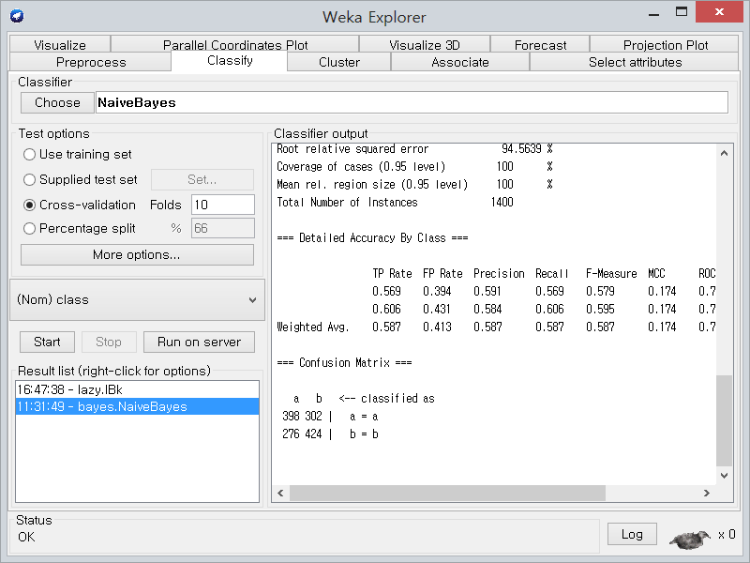
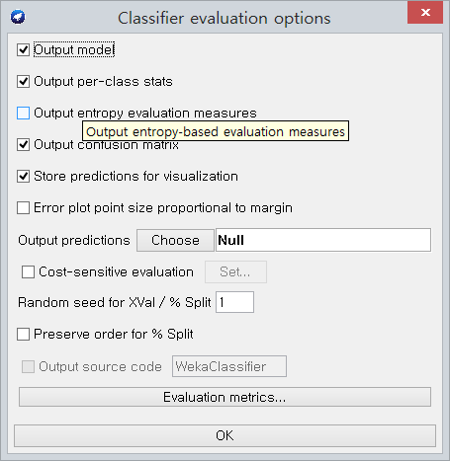
- Classification Interface
Test options and setting

Slide 8
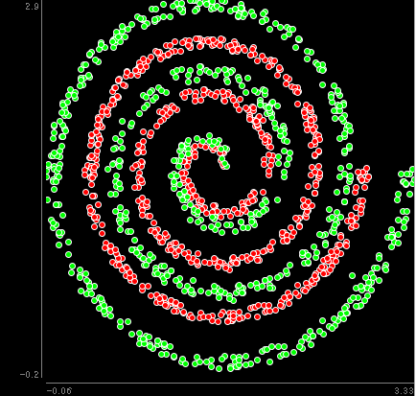
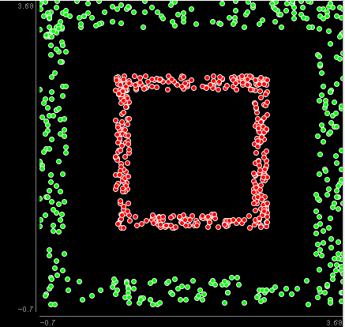
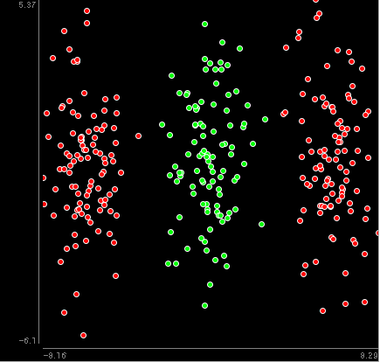
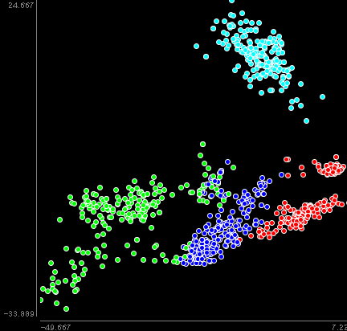
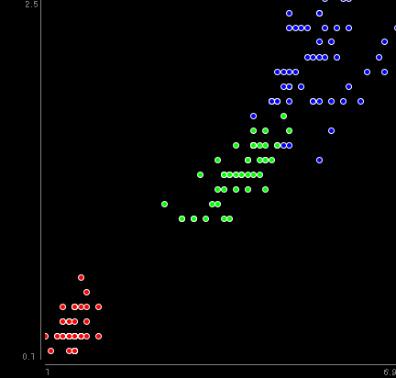
- Classification (1)
Naive Bayesian Classifier, Decision Tree(ID3, C4.5, CART)
Multilayer Perceptron (Neural Networks), RBFNN, Linear/Nonlinear SVM,
HMM, Genetic Programming
[classification(spiral,square,xor, segment, iris.2D).arff]

Slide 9
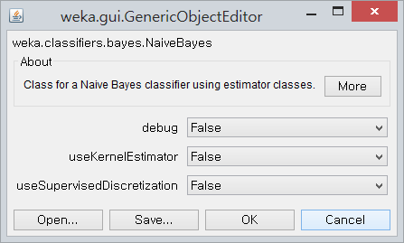
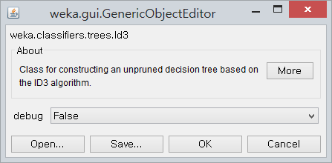
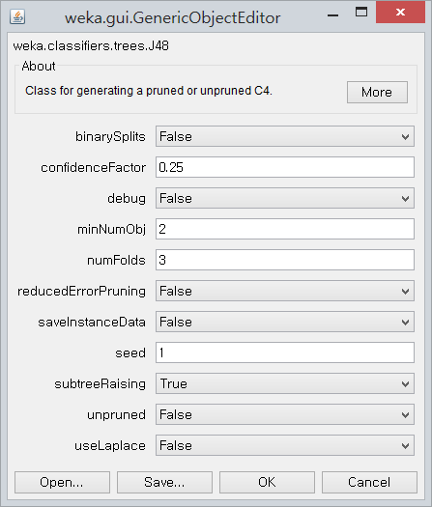
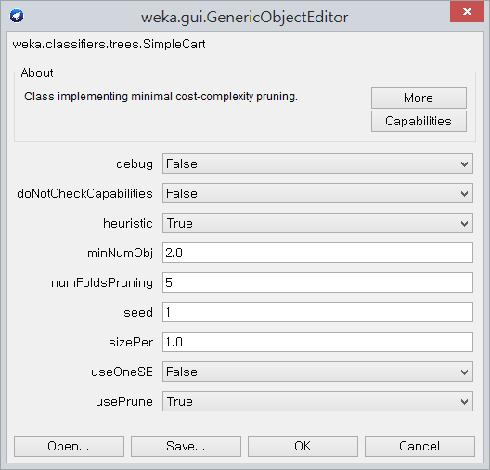
- Classification (2)
Naive Bayesian Classifier
[weka.classifiers.bayes.NaiveBayes]
Decision Tree(ID3, C4.5, CART)
[weka.classifiers.trees.Id3, J48, SimpleCart]

Slide 10
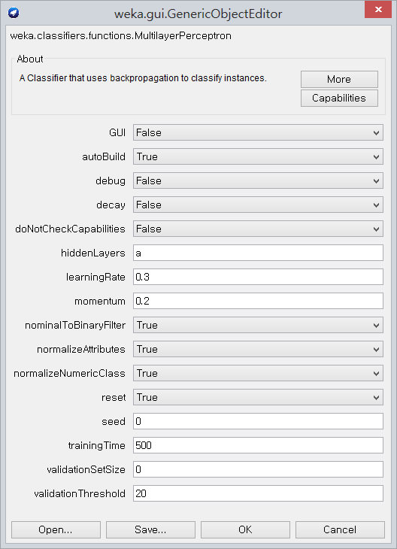
- Classification (3)
Multilayer Perceptrons (Neural Networks)
[weka.classifiers.functions.MultilayerPerceptron]
hiddenLayers –
This is a list of positive whole numbers.
1 for each hidden layer.
Comma seperated.
To have no hidden layers put a single 0 here.
This will only be used if autobuild is set.
There are also wildcard values
'a' = (attribs + classes) / 2,
'i' = attribs,
'o' = classes ,
't' = attribs + classes.

Slide 11
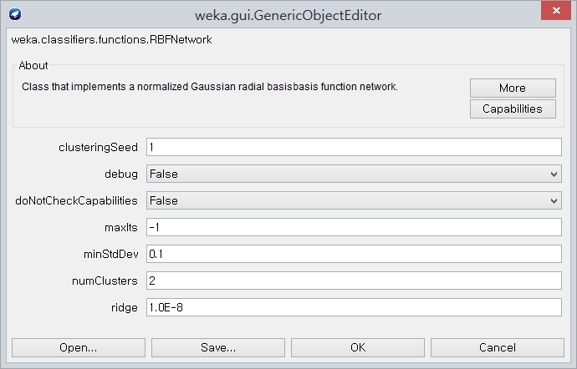
- Classification (4)
Radial Basis Function Network
[weka.classifiers.functions.RBFNetwork]

Slide 12
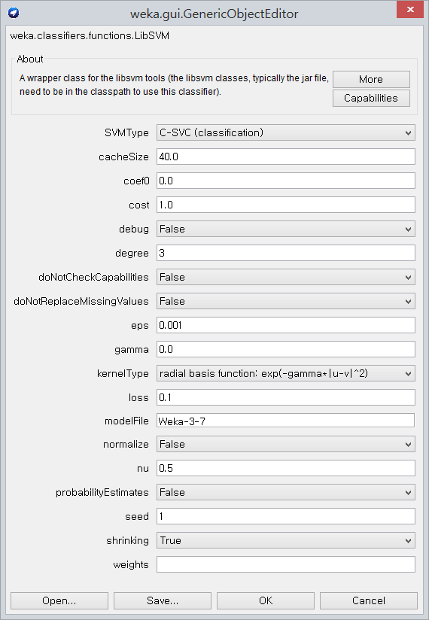
- Classification (5)
Linear/Nonlinear SVM
[weka.classifiers.functions.libSVM]
kernalType-
Linear
Polynomial
Radial Basis Function
Sigmoid
Important factor-
Cost(C value)
Gamma

Slide 13
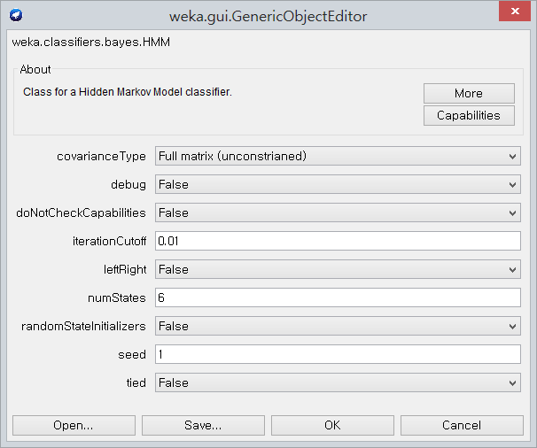
- Classification (6)
HMM
[weka.classifiers.bayes.HMM]

Slide 14
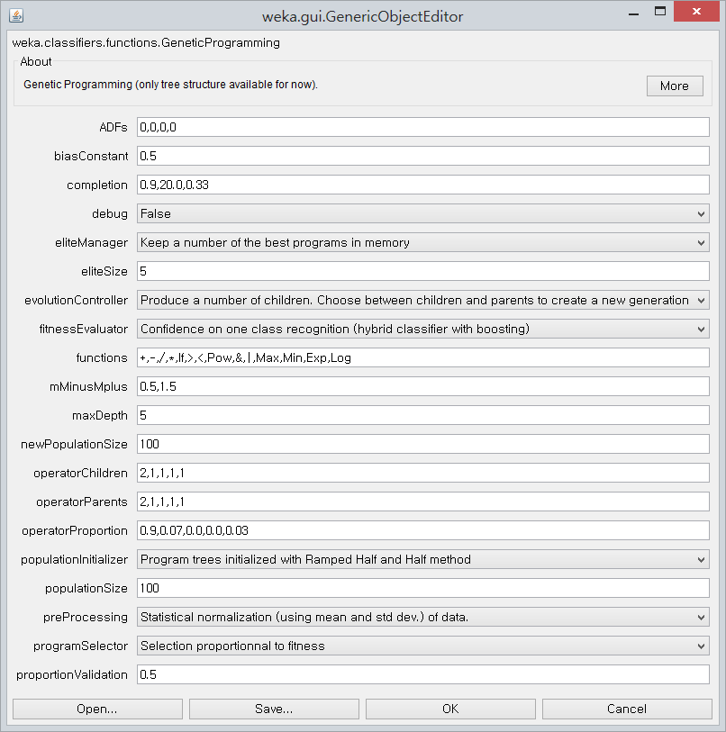
- Classification (7)
Genetic Programming
[weka.classifiers.functions.geneticprogramming]

Slide 15
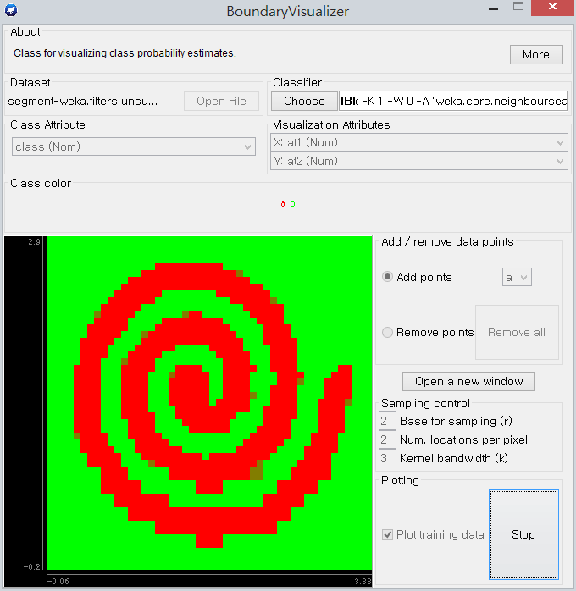
- Classification (8)
Boundary Visualizer Example

Slide 16
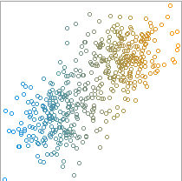
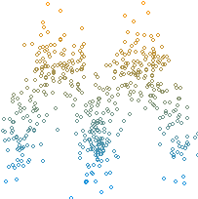
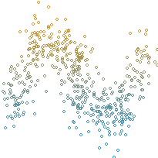
- Regression (1)
Linear Regression
Multilayer Perceptron (Neural Networks), RBFNN, Linear/Nonlinear SVM,
Genetic Programming
[regression-concentrated, M, sine.arff]

Slide 17
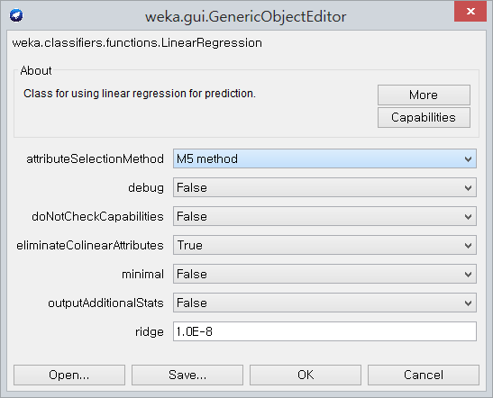
- Regression (2)
Linear Regression
[weka.classifiers.functions.LinearRegression]

Slide 18
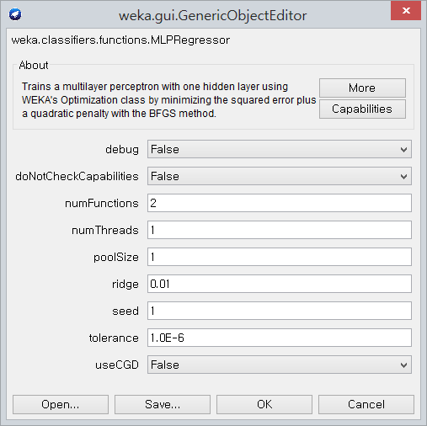
- Regression (3)
Multilayer Perceptron (Neural Networks)
[weka.classifiers.functions.MLPRegressor]

Slide 19
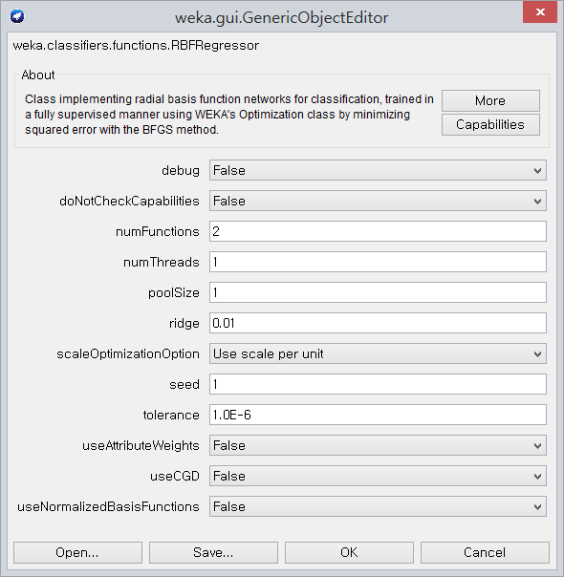
- Regression (4)
RBFNN
[weka.classifiers.functions.RBFRegressor]

Slide 20
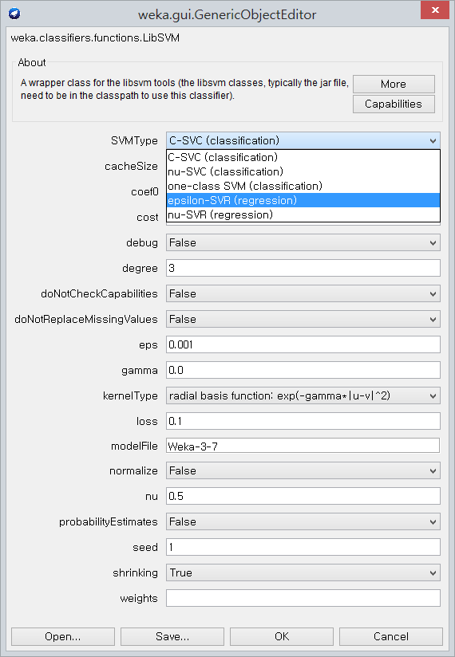
- Regression (5)
Linear/Nonlinear SVM
[weka.classifiers.functions.libSVM]
SVMType
epsilon-SVR(regression)
Important factor-
Cost(C value)
Gamma

Slide 21
- Regression (6)
Genetic Programming
[weka.classifiers.functions.geneticprogramming]

Slide 22
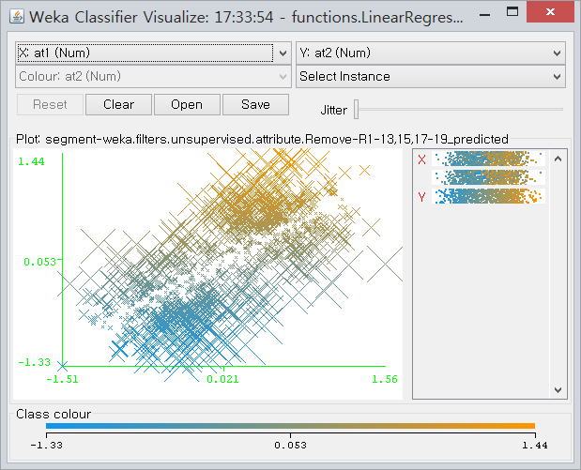
- Regression Visualize

Slide 23
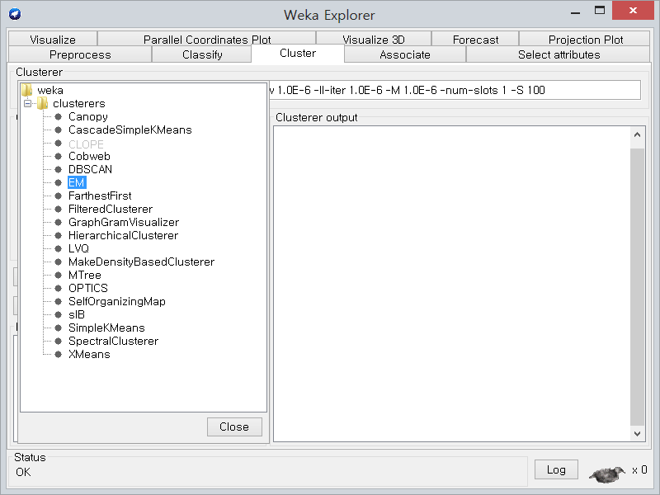
- Clustering Interface
k-means, hierarchical, gaussian mixture, spectral

Slide 24
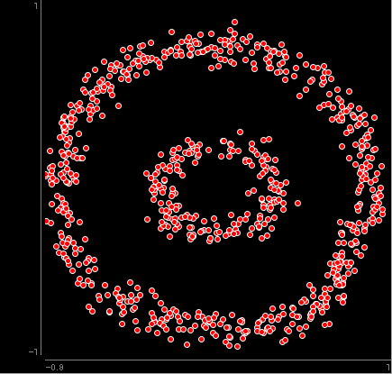
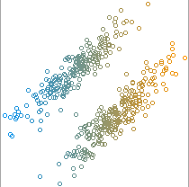
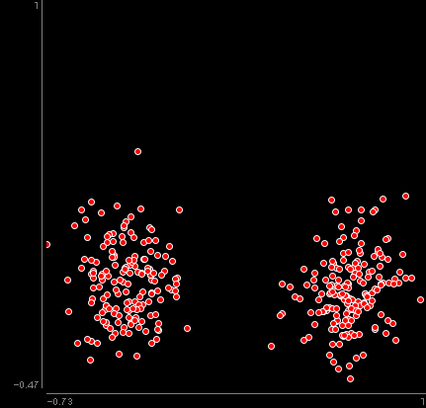
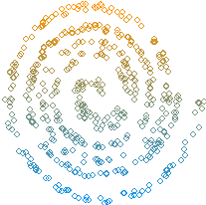
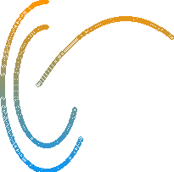
- Clustering (1)
k-means, hierarchical, gaussian mixture, spectral
[clustering-circle, concentrated, separated, separated(vertically), spiral, sepctral.arff]

Slide 25
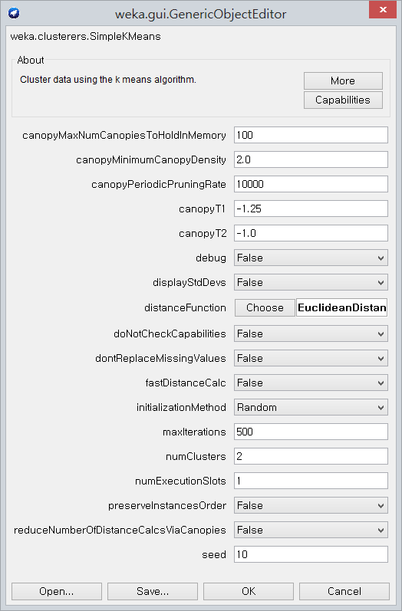
- Clustering (2)
K-means
[weka.clusterers.SimpleKmeans]

Slide 26
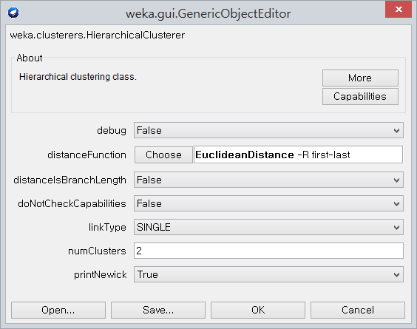
- Clustering (3)
Hierarchical
[weka.clusterers. HierarchicalClusterer]
linkType -- Sets the method used to measure the distance between two clusters.
SINGLE:
find single link distance aka minimum link, which is the closest distance between any item in cluster1 and any item in cluster2
COMPLETE:
find complete link distance aka maximum link, which is the largest distance between any item in cluster1 and any item in cluster2
ADJCOMPLETE:
as COMPLETE, but with adjustment, which is the largest within cluster distance
AVERAGE:
finds average distance between the elements of the two clusters
MEAN:
calculates the mean distance of a merged cluster (akak Group-average agglomerative clustering)
CENTROID:
finds the distance of the centroids of the clusters
WARD:
finds the distance of the change in caused by merging the cluster. The information of a cluster is calculated as the error sum of squares of the centroids of the cluster and its members.
NEIGHBOR_JOINING
use neighbor joining algorithm.

Slide 27
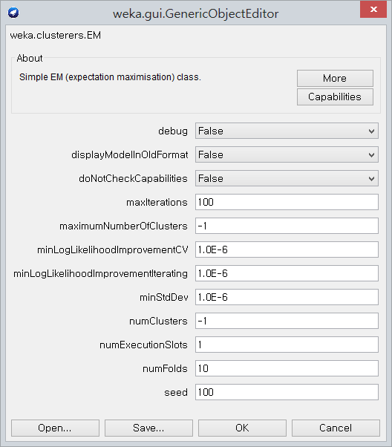
- Clustering (4)
Gaussian mixture
[weka.clusterers. EM]
minLogLikelihoodImprovementCV –
The minimum improvement in cross-validated log likelihood required in order to consider increasing the number of clusters when cross-validiting to find the best number of clusters
minLogLikelihoodImprovementIterating -- The minimum improvement in log likelihood required to perform another iteration of the E and M steps
minStdDev –
set minimum allowable standard deviation

Slide 28
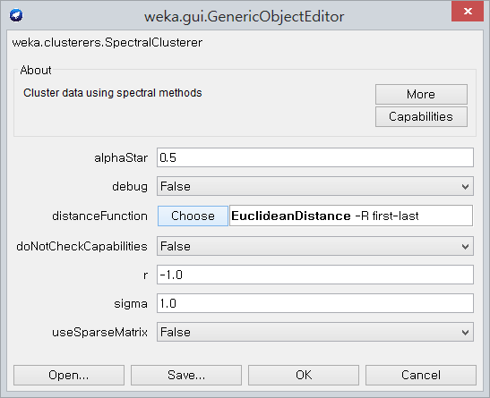
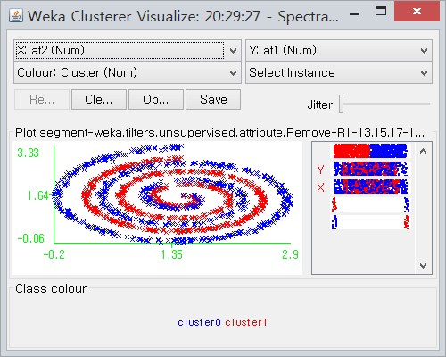
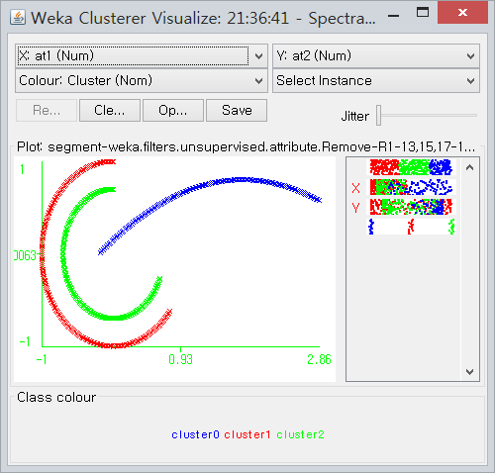
- Clustering (5)
Spectral
[weka.clusterers. SpectralClusterer]
http://www.ee.columbia.edu/ln/dvmm/researchProjects/BivariateGTI/demo_twomoon.htm
0.1, 1.0, 0.1
0.005, 0.5, 0.01

Slide 29
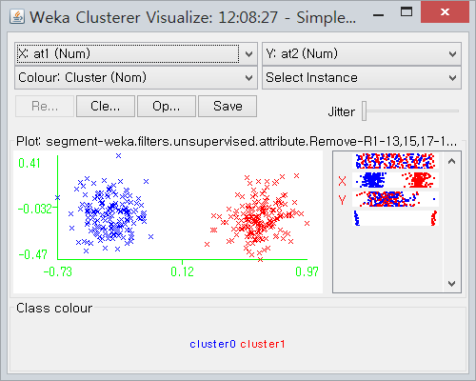
- Clusterer Visualize

