Slide 1
Case Study# 2
Julius Horvath, Michael Barker and Adam Scheerer

Slide 2
Case Study #2 outline
Business Objectives
Data Sourced
Methodology
Evaluation/Results
Summary

Slide 3
Business Objective
The business objective of this study is to show relationships of employee attrition with known data factors such as age, compensation, education, level of job satisfaction, tenure with the company, job level, and life satisfaction.

Slide 4
Data Source
The data used in this study was provided by DDSAnalytics. DDSAnalytics specializes in talent management solutions for Fortune 1000 companies.
For the exploratory data analysis (EDA) we cleaned the data to only leave what was relevant to employee attrition, and restructured by changing the column names to be removed of unnecessary visual data such as underscores, slashes, spaces, etc. We then recorded details such as job role, overtime, marital status, and if attrition occurred.

Slide 5
Methodology
In the process of this case study we:
Gathered data
Cleaned data
Structured Data
Wrote code for the data to output in user friendly visual format.
For our workflow, we started with fit the full model. Next we used the Stepwise regression model to find out what is indicative of attrition and what is not.
We specified the tuning parameter and the max to 3 to give us the most accurate 3 variable model. That model consists of life satisfaction, total work years, and overtime.
We trained the model using stepwise selection and this showed us our best model for predicting attrition had 4 variables, and the variables for the 4 are the same 3 as before plus the addition of stock option level.
That is the process we used to build the model we believe best predicts probability of attrition.

Slide 6
Top 3 factors that contribute to Attrition
As mentioned in the previous slide, our regression model for the top three factors from our dataset gave us Life Satisfaction, Total Work Years, and if someone works overtime.
The higher the Life Satisfaction and number of years worked, the less likely someone is to leave, but if they work Overtime, they are more likely to leave.
Attrition = 1.46+0.214*Overtime-0.033*LifeSatisfaction-0.008*Total Work Years

Slide 7
The Best Model
The previous model shows us the best 3 variable model, but according to R the most accurate model contains 4 variables.
It contains the same 3 variables as the previous model as well as the Stock Option Level variable.
Attrition = 0.512+0.214*Overtime-0.06*StockOptionLevel-0.008*TotalWorkYears -0.0333*LifeSatisfaction

Slide 8
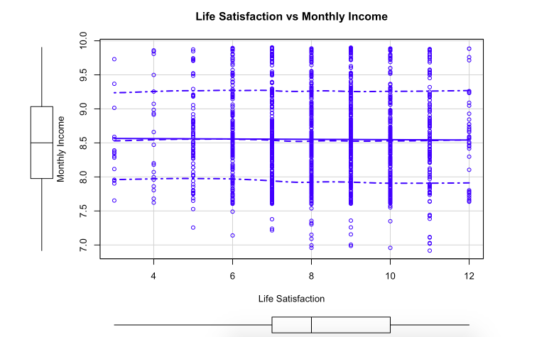
Life Satisfaction vs Monthly Income
As we saw, a higher Life Satisfaction keeps an employee at a company, but does Income factor into that Life Satisfaction?
Our graph of Life Satisfaction vs the log transformation of Monthly Income surprisingly shows that income does not seem to trend up as Life Satisfaction increases.

Slide 9
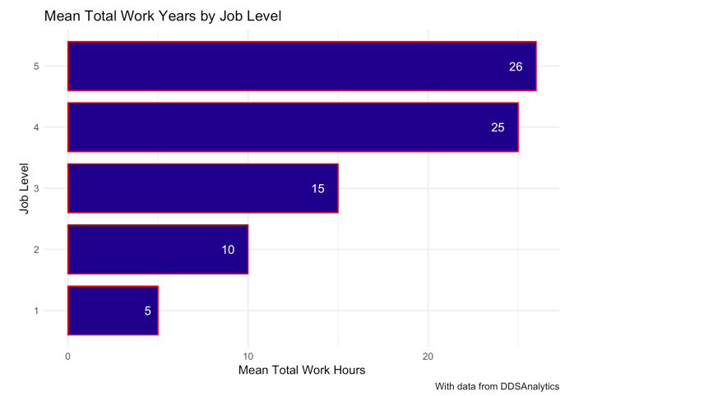
Observations
We see that Total Work Years decreases by Job Level, does Attrition also?
Attrition % for Job Level 5 is 7%,
for Job Level 3 it rises to 14.7%
for Job Level 1 it’s up to 26.3%.
So all of this follows as we would expect.

Slide 10
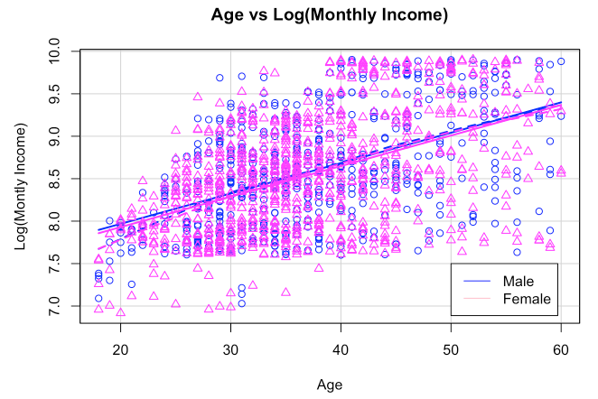
Interesting Trends
Did not find a difference in Monthly Income by age when
Accounting for different genders.

Slide 11
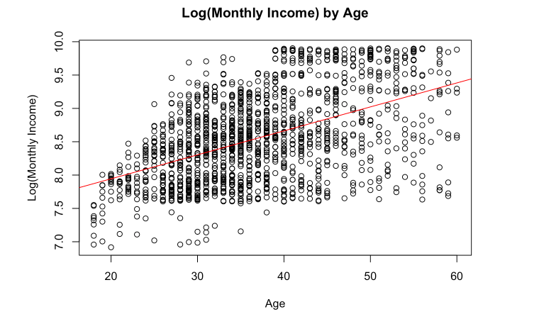
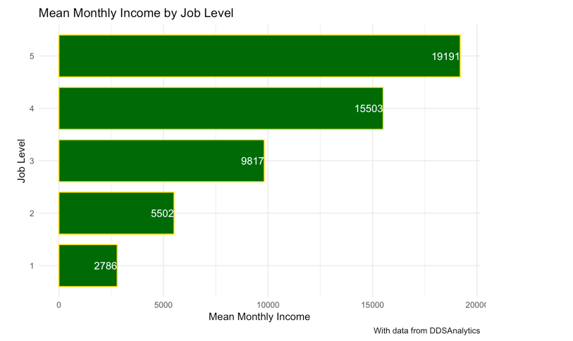
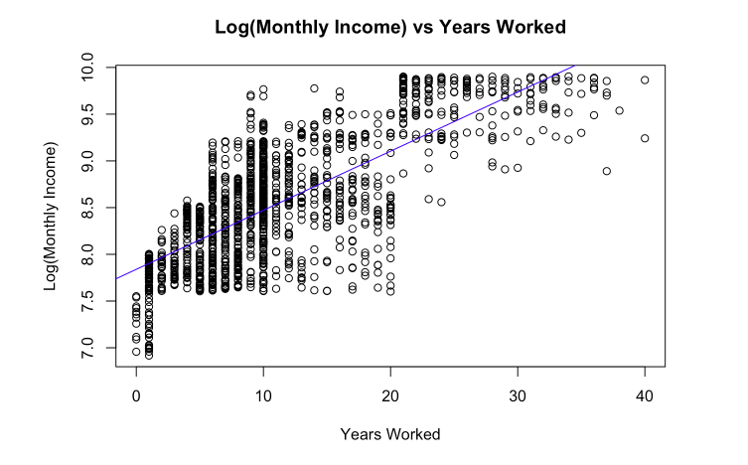
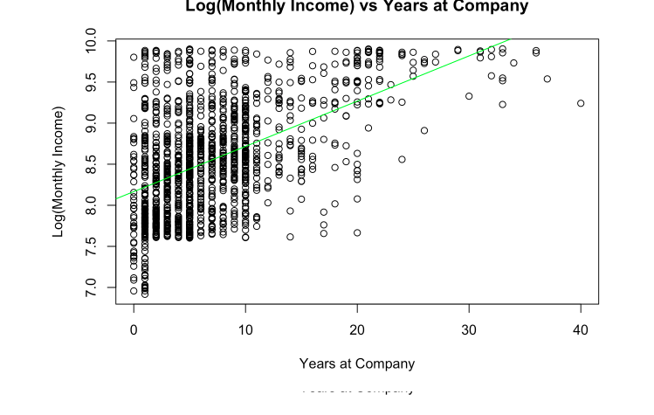
Interesting Trends
We see that as you get older, your monthly income seems to get higher, but we found that age is really just a proxy for things like experience or time at a certain workforce

Slide 12
Summary
In summary, to keep your employees happy and with the company, limit overtime hours, and make sure that workplace factors such as environment, offering counseling, and other benefits that can increase employee life satisfaction are available to your employees.
A happy employee is the best employee!

Slide 13
Questions?

