Slide 1

Representation of Breweries by State
H&S Data Analytics

Slide 2
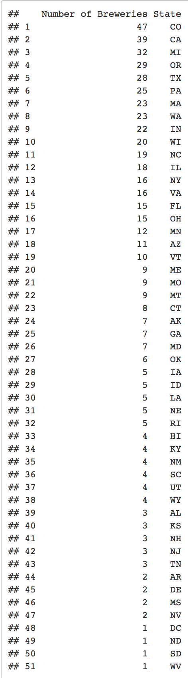
Number of Breweries in each state

Slide 3
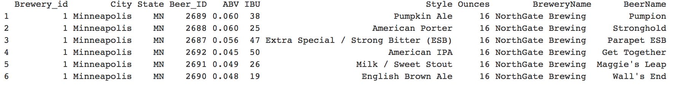
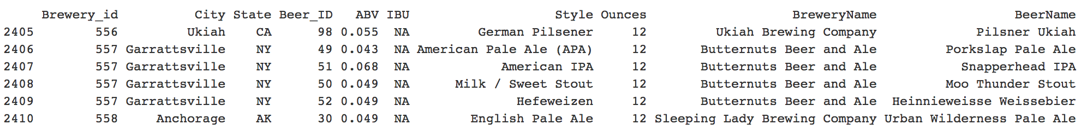
First and Last Observations from dataset

Slide 4
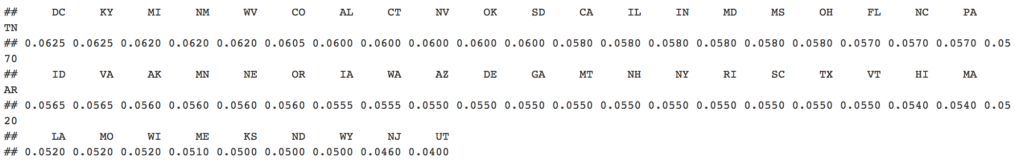
Median alcohol content for each state

Slide 5
Median alcohol international bitterness unit for each state

