Slide 1

Media Process Framework
Dec 22, 2004
Hui Shao

Slide 2
Goals and Considerations
Distributed architecture
  must support distributed network environments
Open and customization
  Atomic activity is done inside of a filter
  Task is a customized filter chain
  Support both task-oriented and centralized SRM
  Flex resource and session management
Automation and lower future development load
Minimizing network load and latency
Notes:
Dfasdfasdf
Asdfsadf
Sdfsdafas
Sad
Fas
Df
Das
F
Asd
F
Asd
F
Asdf

Slide 3
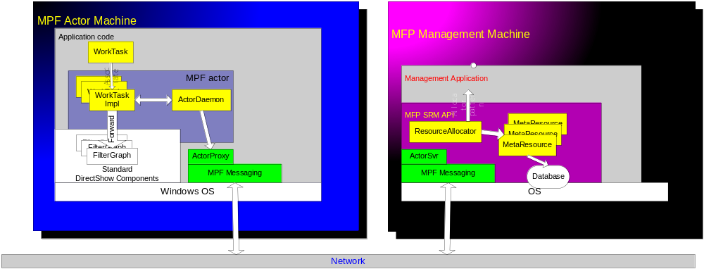
MPF overview

Slide 4
Machines involved in the framework
MPF Node = any machine invokes MPF SDK/components
Two type of MPF nodes
  MPF Actor node
    = any node with MPF ActorCtx COM control installed
  MPF Management node
    = has some applications invoking MPF SRM API

Slide 5
Filter Development
omitted

Slide 6
MPF actor node
Two stages of the MPF Actor implementation
  Application invoking MPF ActorCtx
  MPF service provider

Slide 7
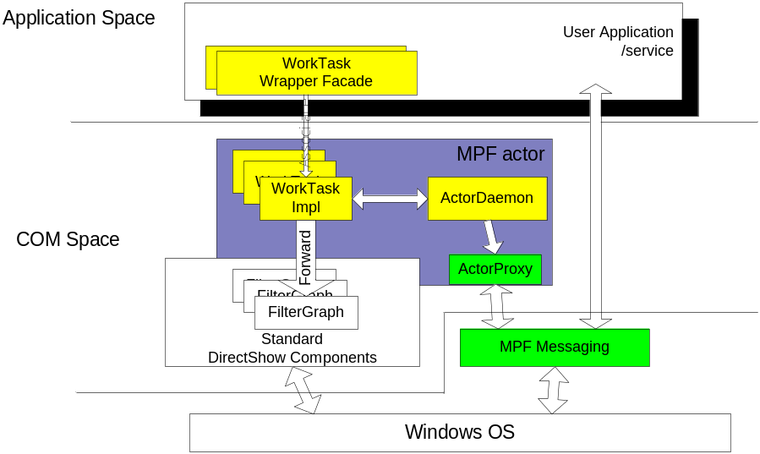
ActorCtx
COM control
WorkTaskImpl
  A redirector to FilterGraph
  Session Attacher
ActorDaemon
  The client-side of Actor resource
  The manager of WorkTaskImpls

Slide 8
Task
A complete filter chain in an MPF WorkTask(Impl)
Made up with DirectShow filters
  Support both DirectShow filters and MPF filters
A common container: WorkTaskImpl
  Belongs to one single MPF session
  Managed task
    Use the ActorDaemon to communicate with management node(s)
Standard DirectShow filter development

Slide 9
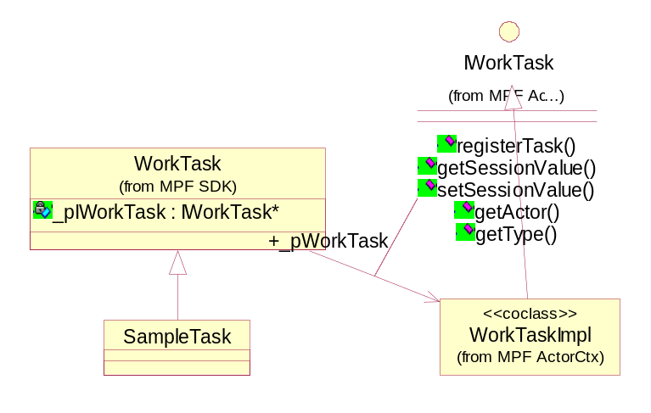
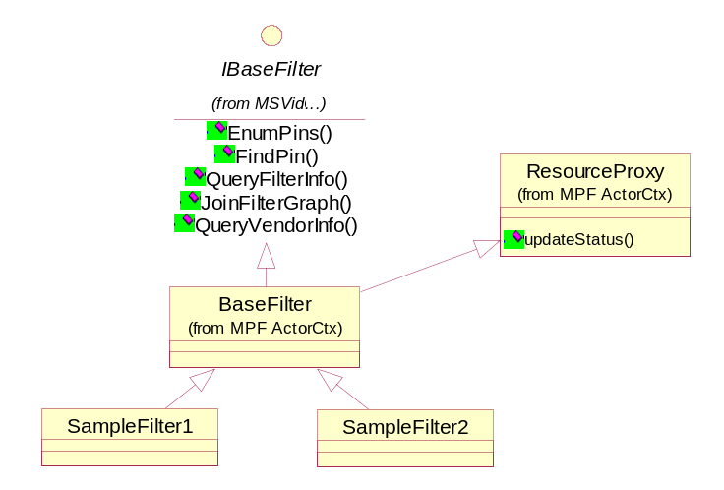
Actor Application
WorkTask Wrapper Façade
MPF Filter

Slide 10
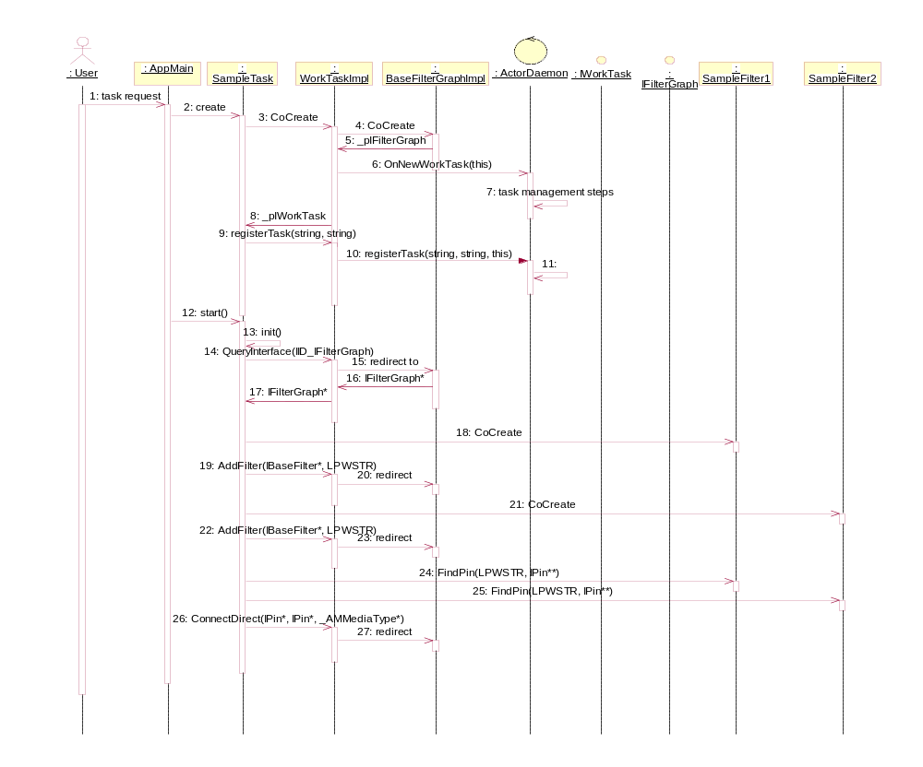
Actor Application Sequence
MDL

Slide 11
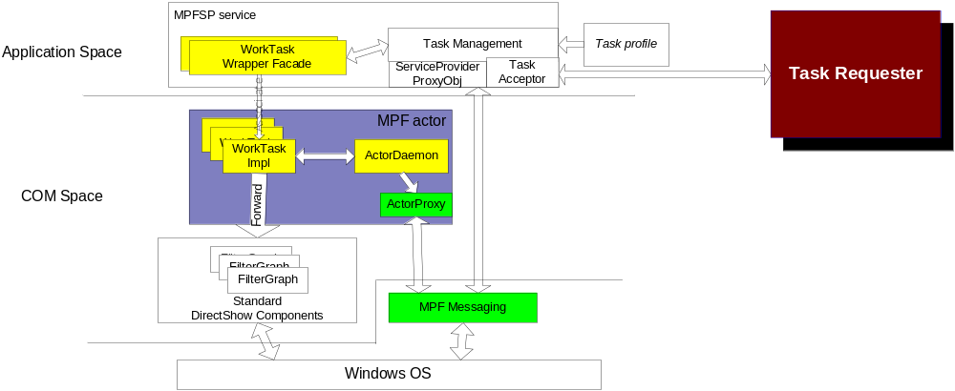
MPF Service Provider

Slide 12
MPF Service Provider
Still an Actor Application
SeaChange Service
  Load task profile
    Task naming
    Filter chain definition
    Pin connection definition
    Dependence validation
  Task Acceptor – Task Requester API
  Task Management
  Service Provide Proxy
    A resource proxy
    A service info publisher

Slide 13
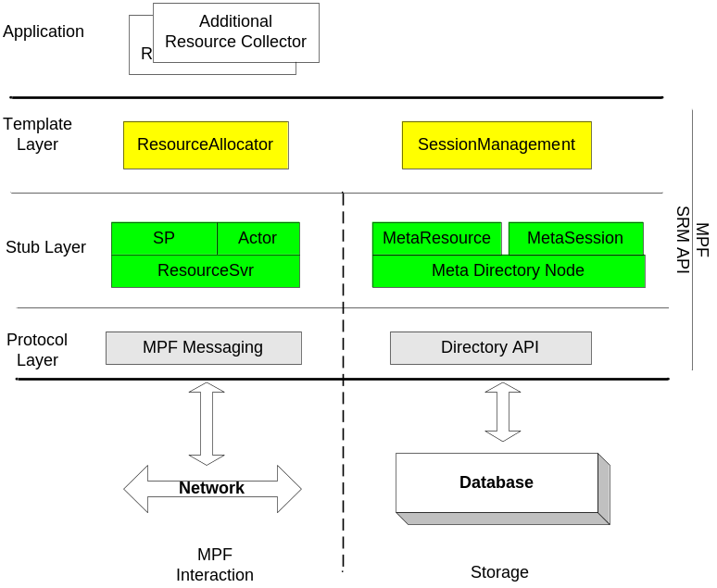
MPF Session & Resource Management API
Multiple Layers
  Protocol Layer
    Messaging: XMLRPC over persist connections
    Directory API: provide a directory storage access
  Stub Description Layer
    Resource Stub & MetaSession
    MetaRecord
  Template Layer
    ResourceAllocator
    SessionManagement

Slide 14
Resource Management
Resource Discovery
  Register
  Collecting or Polling
Resource Status Update
  Lease and heart-beat
  Polling (optional)
Resource Allocator Template
  Hotest allocation
  Coldest allocation
  Balanced allocation
  Resource booking and reservation ticket
Notes:
ActorProxy in ActorCtx register itself as a resource, it may also register the known resources on the same machine
ServiceProviderProxy inherits from ActorProxy by extending it with the operations as a service information publisher

Slide 15
Resource Management (continued)
Resource Stub Description
  Meta Resource Records
  Special Resources
    The actors
    The service providers
Resource Stub Storage
  Directory API
  Fail-over storage

Slide 16
Session Management
Session
  include all tasks performed by MPF for a single user
  Lifetime: from a client enters the MPF system to its leaving
  State attributes
Task
  Any work can be performed in a single actor node as a filter chain
  Belongs to a single session
Session Stub Storage
  MetaSession
    A entity class in SRM API to keep the session info
  Directory API and database
MPF WorkTaskImpl
  The client side of session

Slide 17
Management Node
Two Stage
  User’s application invoke MPF SRM API
    Integrated Actor management
    Customized session management
    Exclusive Resource Management / Allocator
    Customized resource discovery / collector
  MPF centralized SRM server
    All functionalities management application has
    Service provider resolving
    Pre-defined resource management for known resource
    User interface

Slide 18
Directory Storage Choices
LDAP
  Open interface, high performance, flex query
  Difficult to distribute
Windows Active Directory
  LDAP-compatible, comes with Windows
  Windows domain limitations
SQL-based server
  Commercial products
  high development load
Local database
  Berkley database, high development load
  MXF metadata partition
Local flat file
  Low performance

Slide 19
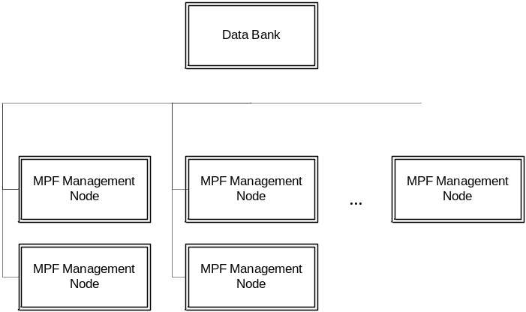
Fail-over considerations
External/remote database vs local database
Legato backup
  Easy, low development load
  Expensive for distribution
Data sync between primary SRM node and its backup
  M-to-N Actor and Manager relationship
  Difficult and high development load
Central data bank

