Slide 1
Media Cluster and RTSP Server for NGOD Scenario
Hui Shao
Apr 04, 2007

Slide 2
Contents
RTSP Server Framework
  RTSP Gateway
  Video Server Resource Management
  StreamSmith
  ContentStore
  Event Mechanism
NGOD Integration Scenario
  Media Cluster + RTSP Server
  Stream Setup and Control Sequence
  Highlights on the Integration with Axiom NGOD
Opening Issues and Gaps Summary

Slide 3
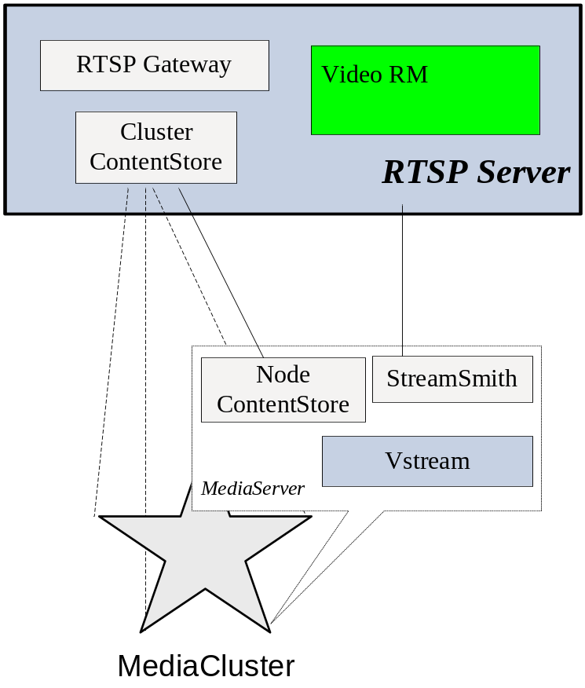
RTSP Server Framework
Major components
  RTSP Gateway
  Video Server Resource Management
  StreamSmith
  ContentStore
  Event Mechanism

Slide 4
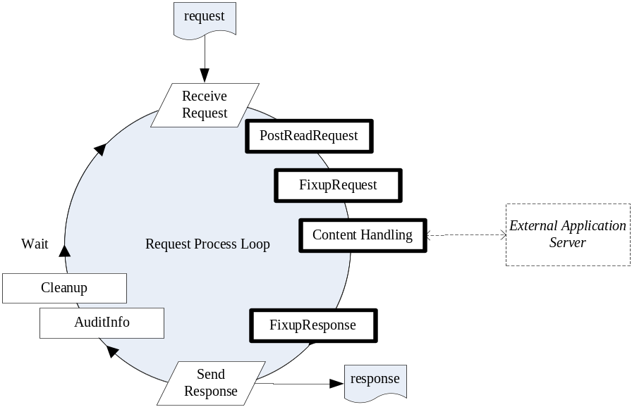
RTSP Server Framework – RTSP Gateway
RTSP server-side
  Sessions and connections management:
    Up to 10K concurrent connections
    m-n session to connection
  RTSP message parsing and generating
  Timeout control
Plugin framework – Customize the request handling
  Entry points that a plugin can hook and customize
    PostReadRequest, FixupRequest, ContentHandling, FixupResponse
  Links multiple plugin as process stacks for every entry point
  Plugin can implements protocol extensions
Dispatch load to multiple StreamSmith instances with the help of Video Resource Management

Slide 5
RTSP Server Framework – Video Server Resource Management
Complete Server Session Lifecycle Management
  State Machine: Init, Provisioned, InService, OutOfService, End
  Session timeout and control
  Safestore and restore
Video Transport Network Abstraction
  Manages the device information
  Evaluates the loads of any potential streaming resource allocation
  Selects the nearly best resource allocation
  Transparent to up layer
Remote Object-oriented API available

Slide 6
RTSP Server Framework - StreamSmith
VOD Stream Control
  Stream control
    create, delete, play, pause, change speed etc
Dynamic server-side playlist (DSPL) engine
  Playlist execution: item switching automation, support of splicing
  Playlist operations on fly: insert, remove, append, skip, seek etc
Content file based playout
  Supports flexible presentation of asset and OnDemand order
Built-in RTSP server-side (optional for NGOD)
Remote Object-oriented API available

Slide 7
RTSP Server Framework - ContentStore
File-system-like access to media contents
  Create, delete, get size etc
  Get volume capability
Extensions for media content
  Type, bitrate, resolution, playtime etc
Content state machine
  e.g. Init, Provisioned, OutOfService
Distributed Content Provision Engines
  E.g. RDS server w/ or w/o IngestCard
  ContentStore drives and monitors provisioning control
  Support of various protocols (FTP, PGM, Network Sharing), Pull and push mode
  Bandwidth and scheduling management
Remote Object-oriented API available

Slide 8
Node ContentStore vs. Cluster ContentStore
Node ContentStore
  Installed on each MediaCluster node
  As a slave ContentStore of the cluster ContentStore
  The worker that performs the actual tasks and queries
Cluster ContentStore
  Installed on an additional PC server other than MediaCluster nodes
  The only ContentStore interface exported from the MediaCluster
  The master ContentStore of the node ContentStores in the same cluster
  Dispatches tasks and queries to the node ContentStores

Slide 9
RTSP Server Framework – Event Mechanism
ContentStore Events
  Service status: Started,InService
  Content state changes: Created, Streamable, Provisioned, Destroyed
Provisioning Events
  Started, InProgress, Finished, ErrorOccurs
Stream Events
  StateChanged (init, streaming, paused), StreamExit, SpeedChanged, EndOfStreamReached, BeginningOfStreamReached, StreamProgress
Playlist Events
  ItemChanged
Conditional Stream Control (Callback)
  Authorization mask: pre-denied, pre-approved, need-authorization
  Remote authorization callback
SNMP support
  Query and modify-on-fly
  SNMP trap

Slide 10
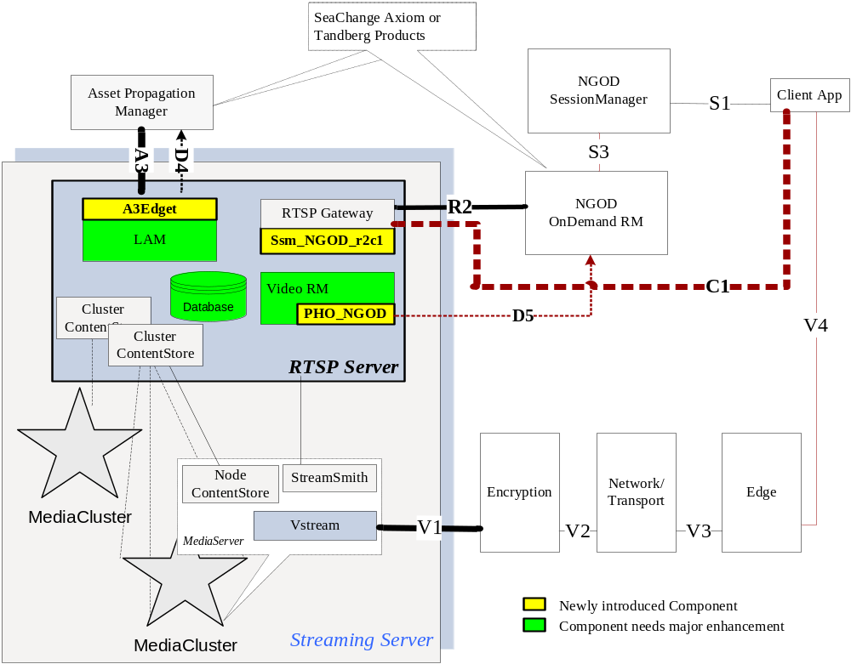
NGOD Integration Scenario – MediaCluster + RTSP Server

Slide 11
NGOD Integration Scenario – MediaCluster + RTSP Server
Deployment
  Node ContentStore and StreamSmith will be installed on the Media Server
  An 1U pair with Legato backup is introduced to host RTSP Server suite including RTSP gateway, Video Resource Manager, LAM, Cluster ContentStore and more
  Multiple Cluster ContentStore instances may be running on the RTSP Server pair for multiple MediaClusters
Interfaces to support
  A3 – LAM ContentStore with a wrapper – A3Edget
  R2 – RTSP Gateway with ssm_NGOD_r2c1 plugin
  C1 - RTSP Gateway with ssm_NGOD_r2c1 plugin
  V1 – Vstream/Edgecard
  D4 – Extension of LAM/ContentStore to advertising storage resources
  D5 – PHO_NGOD to advertising streaming resource

Slide 12
NGOD Integration Scenario – MediaCluster + RTSP Server (cont 1)
Ssm_NGOD_R2C1 - A new plugin of RTSP Gateay to support NGOD R2 and C1 RTSP specs
  R2 – SETUP, from ODRM to RTSP Gateway
    OnDemandSessionId will be the key to identify an order
    One SeaChange MediaServer has multiple EdgeCards available to stream but they may has different output connectivities to each other, how these cards are selected by ODRM, “source”?
  R2 – TEARDOWN, from ODRM to RTSP Gateway
  R2 – ANNOUNCE, from RTSP Gateway to ODRM
  R2 - GET_PARAMETERS, from ODRM to RTSP Gateway
  C1 - PLAY, from client application to RTSP Gateway, also covers speed changes
  C1 – PAUSE, from client application to RTSP Gateway
  C1 – ANNOUNCE, from RTSP Gateway to client application
  C1 - GET_PARAMETERS, from client application to RTSP Gateway
  OnDemand order presentation
    Translates ProviderId.AssetId based order into content or playlist
    Drives StreamSmith to present the session as a streaming
  Select proper edgecard and StreamSmith instance with the Video RM

Slide 13
NGOD Integration Scenario – MediaCluster + RTSP Server (cont 2)
A3Edget – A wrapper over LAM to support NGOD A3 spec
  Messaging to NGOD APM
  XML message over HTTP protocol
  Commands
    TransferContent, CancelTransfer, ExposeContent, GetContentCheckSum,GetContentInfo, DeleteContent, GetVolumeInfo
  Feedbacks
    TransferStatus, ContentCheckSum
LAM – Asset management shared by multiple Cluster ContentStore instances
  Enhanced asset state machine to meet NGOD spec on asset states
  Exclusive view of assets for each Cluster ContentStore
ContentStore
  Support of FTP and PGM transferring
    FTP server-side – the RDS server or Ingest card
    FTP client-side – support both push and pull mode
    PGM – modified MCPServer?
  Enhanced content state machine to meet NGOD spec on content states
  Extensions on provision control and monitoring
  RTLib provision engine
  D4 speaker to advertise volume, transfer protocols

Slide 14
NGOD Integration Scenario – MediaCluster + RTSP Server (cont 3)
Video Resource Management
  PHO - New network abstraction for NGOD video transport
  Collects streaming parameters from StreamSmith instances
  Configurations on NGOD transport such as next Hop
  D5 speaker to advertise streaming parameters such as bandwidth, output address/port and more
  Addresses the StreamStream via the given source address passed from R2 request
  Support of Vstream bandwidth management
V1 Support – Greenville
  Ommited

Slide 15
NGOD Integration Scenario – MediaCluster + RTSP Server (cont 4)
NGOD resource discovery and registering support
  Work as TREP spreaker
  ContentStore support D4
  PHO_NGOD support D5
Advertised attributes | Type Code | Streaming Service
 |  | ContentStore | PHO_NGOD
Withdrawn Route | 1 | Must | Must
Reachable Route | 2 | Must | Must
NextHopServer | 3 | n/a | Based on configuration
Total Bandwidth | 234 | n/a | Sum-up from StreamSmith queries
Available Bandwidth | 235 | n/a | Sum-up from StreamSmith queries
Cost | 236 | n/a | Evaluation algorithms
Volume | 240 | Sum up from ContentStore | n/a
Service Status | 241 | Should | Should
Max MPEG Flows | 242 | n/a | Based on configuration
NextHop Alternatives | 243 | n/a | May– Based on configuration
Output Port | 244 | n/a | From StreamSmith query results
Output Address | 245 | n/a | From StreamSmith query results
Transfer Protocol Capability | 246 | Based on configuration | n/a

Slide 16
NGOD Integration Scenarios – MediaCluster + Stream Setup and Control Sequence
Setup Session
  A client application setup an session on NGOD SM thru S1
  SM create a session and ask ODRM to select an appropriate on demand streaming resource thru S3
  The ODRM selects the resource and asks the RTSP gateway setup a stream session thru R2
  The RTSP gateway with ssm_NOG_r2c1 plugin creates an internal session and communicates with the video RM to address a proper StreamSmith instance
  ssm_NOG_r2c1 query LAM to convert the ProviderId.AssetId based OnDemand order to a playlist of content files
  ssm_NOG_r2c1 asks StreamSmith to create a stream instance, and present the playlist onto the stream instance
  RTSP gateway send setup response to ODRM. The response is also sent to the client application thru ODRM and SM
Stream Control
  The client application connects to RTSP gateway and request to perform a stream control operation on a given RTSP session
  The RTSP gateway accesses the stream instance associated with the RTSP session, and invokes StreamSmith remote API to control the stream

Slide 17
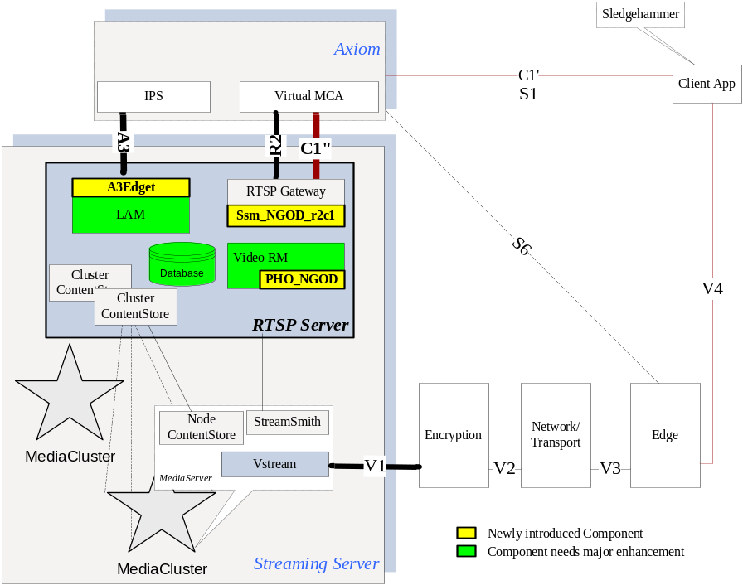
Highlights on the Integration Testing with Axiom NGOD
To an NGOD streaming server, Axiom opens
  A3 thru IPS, it will be connected to the A3Edget of RTSP server
  R2 thru VMCA, will be connected to the RTSP Gateway for session setup
  VMCA emulates as a C1 client to drive streaming service on stream control, it will be connected to the RTSP Gateway
Axiom may communicates 3rd party EdgeRM thru S6
Axiom manages the RTSP server by defining new DNP record(s) with NGOD extensions
Axiom still open SeaChange legacy RTSP/LSCP support to the client applications, which can be used in hammer testing

Slide 18
Opening Issues and Gaps Summary
Gaps to support such a scenario
  Support of FTP (server-side available) and PGM
  Engineering of Ssm_NGOD_R2C1
    Support of NGOD RTSP specs
    Possible announce posting thru multiple connections
    OnDemand order presentation
  VREP protocol support, any lib available?
  PHO_NGOD
    NGOD network abstraction. Axiom is based on DNP extension, and it is easy to enable integration, but how will Tandberg do to support NGOD?
    D5 advertising
  D4 advertising support, in ContentStore or A3Edget?
  Any other gaps to support V1

