Slide 1
21th Jan, 2008
Ken Qian
SE1 VOD Basic Training

Slide 2
Video On Demand
What is Video On Demand
  Watch Movies as Demand at Anytime
  More Application on TV Channel
Application in VOD
  MOD / SVOD / FVOD
  nPVR (Network Personal Video Recording)
  Start-Over
  PauseTV
  STV(Schedule TV)
Resolve two problems
  Content Ingestion (offline and real-time) and Propagation
  Streaming

Slide 3
Basic Components
Streaming Server
  Supported Video Format: MPEG2 (SD & HD), H264, etc
Storage
  NAS
  RAID5 Square
SRM (Session and Resource Management)
  Client Session(Connection)/Streaming Management
  Resource: content, edge, QAM, etc
  Service Proxy to take client request: RTSP, DSMCC
Asset Management
  Metadata and Lifecycle Management
  Asset Replica Management
  Asset Propagation and Distribution
Application (Business & Billing)
  MOD/SVOD/StartOver/PauseTV, etc
  Navigation, Purchase, etc
  SMS, Billing

Slide 4
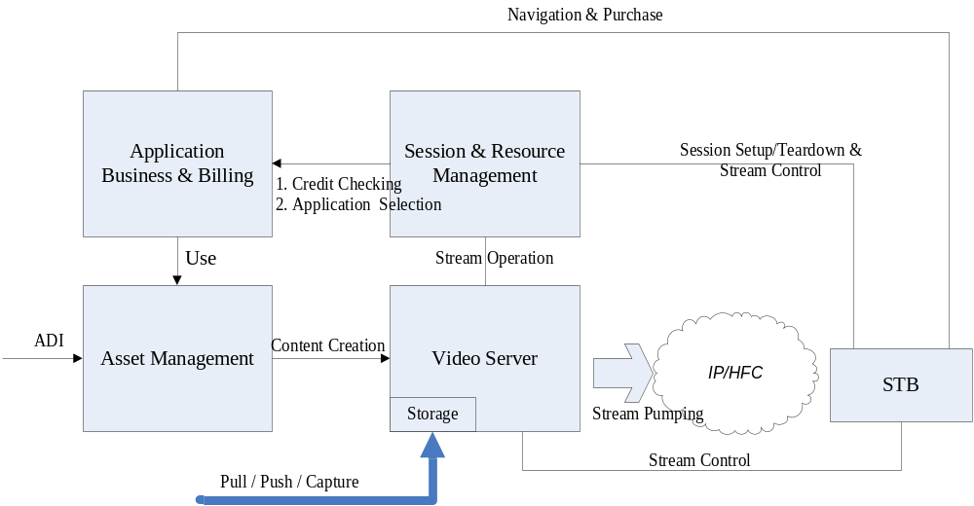
Basic Workflow

Slide 5
Content Ingestion with standard ADI interface
  ADI include asset metadata and operation, such as upload new asset, update metadata, delete asset
  Content ingestion by pull files by ftp or file share, files push by ftp client, sniff files from real time streaming
Navigate and Purchase program from SetBox
  Navigation data comes from business system
  Purchase created and saved in business system
Play and control ordered movies from SetBox
  SRM take client request
  Business system determine the application serve for the client
  Account the client request in billing system
  SRM drive streaming server pumping a stream from a device which could reach the SetBox

Slide 6
SeaChange Axiom
Streaming Server - MediaCluster
  RAID5 square Technology
  Infiniband Technology
  ENCL, MDS, HDS, FMS
  Output port: GigaE, DWDM
  MCAServer as content ingestion and streaming interface
SRM – ISRM + CM
  Take RTSP and DSMCC protocol message
  Manage client session/connection and stream session
  Manage Stream port and Network Resource
Aseet Management – IPS + IAM
  Entry of content ingestion
  Manage asset metadata and asset lifecycle
  Manage the asset propagation
Application – MOD (with MODPlugin) + MBS (MOD Billing system)
  Credit check and Billing
Notes:
MDS: Memory Server
HDS:
FMS: Flash Memory Server
IPS: Propagation Service
MOD: Movies On Demand

Slide 7
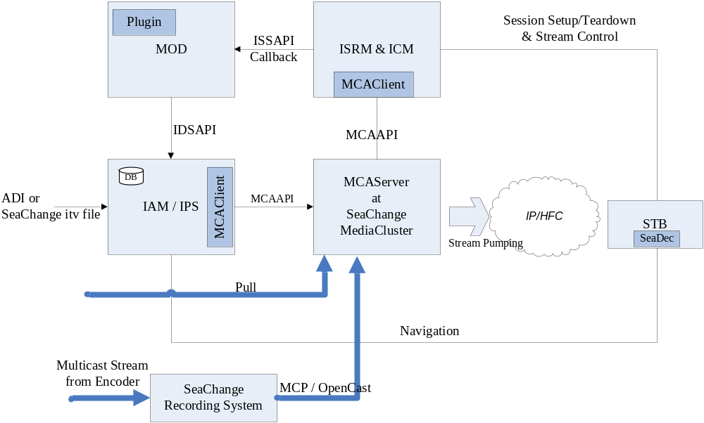
Axiom Workflow
Notes:
SeaChange itv file: SeaChange standard definition of asset and its metadata
ADI: Asset Distribution Interface, a industry standard interface
ISS:
IDS: Interactive Directory Service
MCA: MediaCluster Agent
SeaDec: SeaChange Middleware to navigate IAM asset hierarchy

Slide 8
TianShan
Streaming Server – StreamSmith
  Implementation of SeaChange MediaCluster for streaming
  Stream Interface for session setup/teardown and control
ClientGateway – RTSPProxy + Plugin
  As the service gateway to take client streaming request, and parse RTSP message
  Plugin request SRM to allocate streaming resource and determine the application
  Plugin setup/teardown and control streaming through StreamSmith interface
SRM – Weiwoo + SiteAdmin + PHO
  SiteAdmin manage the business route to determine Application
  PHO evaluate two linkages
    Link between ContentStore and Streamer
    Link between Streamer with Detination (service group)
  Weiwoo narrow and commit the resource to determine the streaming delivery path, and confirm to application
Storage Interface – ContentStore + ProvisionCluster/Engine
  An unified interface to wrapper a storage
  Unified provision resource management for one or multiple ContentStore
  Configurable provision engine workflow
Application – MOD / COD
  Application for different business to integrate with TVBS system
Notes:
PHO – path help object
COD – Channel On Demand

Slide 9
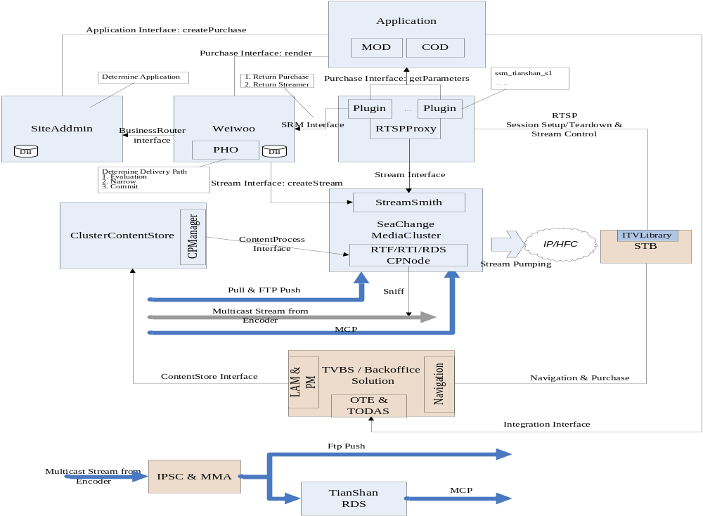
TianShan – Current Architecture
Notes:
ITVLibrary: STB middleware, wrap RTSP
IPSC: IP Stream Capture, capture the multicast stream to be file
MMA: Media XXX Agent, work as a ftp client to push a file to ftp server.
RDS: Reacording System
CODAS: Channel On Demand Application Server
OTE: Online Transaction Engine
MCP: a reliable multicast protocol

Slide 10
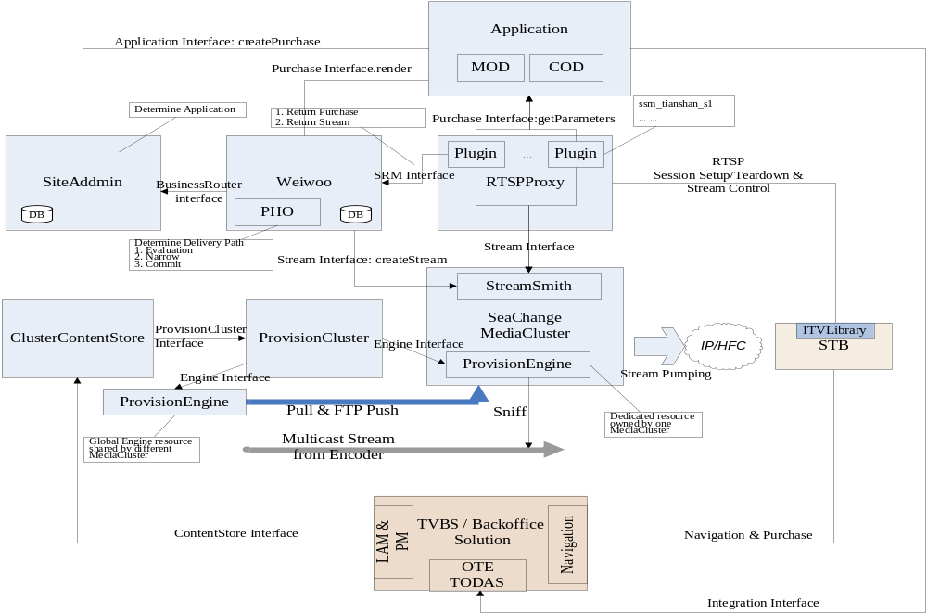
TianShan – Next Architecture

Slide 11
Content Ingestion
  LAM invoke ContentStore to initial an ingestion request for both offline and real-time ingestion
  ContentStore allocate resource and select a Provision Engine to take the real ingestion task.
  ContentStore update ingestion status and progress to LAM via JMS message
Order Movie
  Navigate and purchase a move from setbox
  Play an ordered movie, setbox send RTSP stream setup message to RTSPProxy
  RTSPProxy create a session in Weiwoo
  Weiwoo resolve the application through SiteAddmin module, and determine a stream instance, and then return a Purchase Proxy and Stream Proxy to RTSPProxy. While create purchase in the Application(MOD, COD, etc), the Application talk to TVBS to get the content information.
  RTSPProxy retrieve proper parameters from application via the Purchase Proxy and play a streaming via Stream interface
  StreamSmith pump the stream

Slide 12
ZQ Solution
TVBS + Axiom
TVBS + TianShan

Slide 13
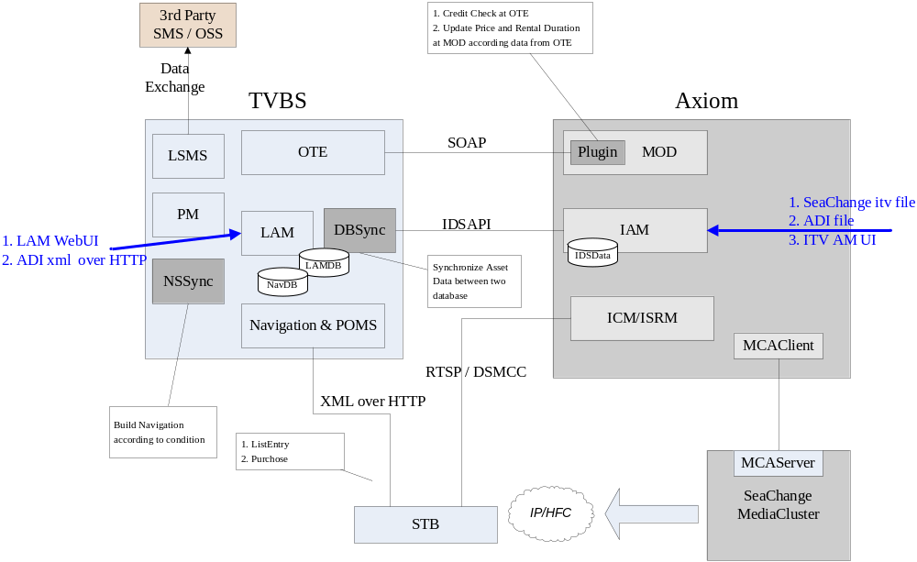
TVBS + Axiom

Slide 14
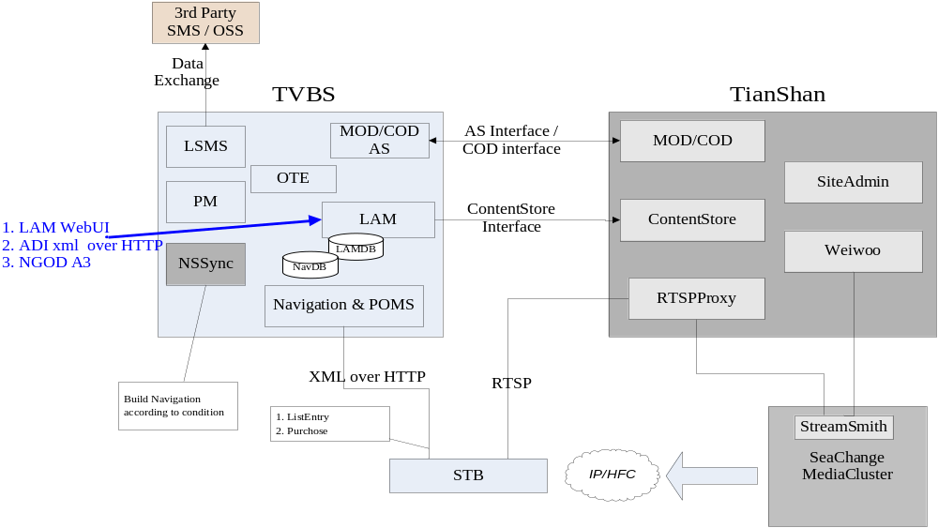
TVBS + TianShan

Slide 15
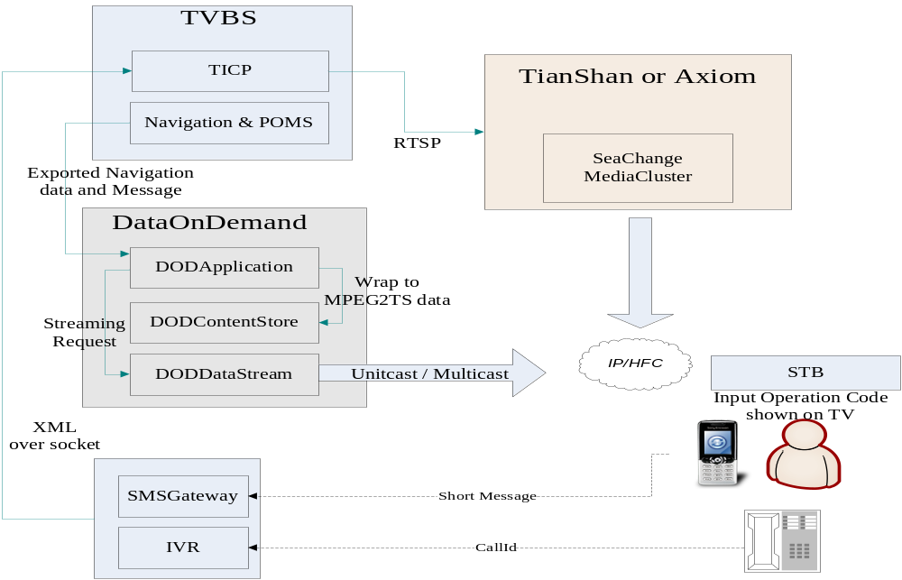
Oneway solution

