Slide 1
CME V2 简介
介绍*讨论*需求

Slide 2
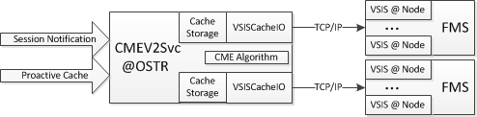
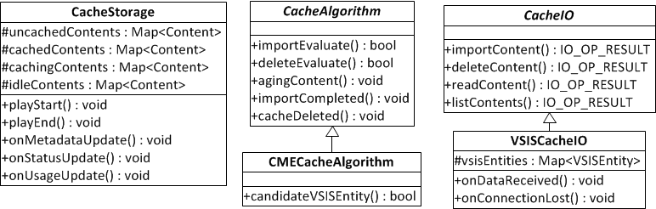
Framework

Slide 3
Instructions(1)
Input
  Session Notification: start/stop event
  PractiveCache (TBD)
    Used xml to define the proactive cache content pid, paid, cache time, lifetime, flag…
    To determine import the content to one or multiple FMS
CacheStorage manage the contents
  Two content lists: cachedContents, uncachedContents to manage all the contents
    Content will be moved between two lists
    Content will be kept in uncachedContents for 7 days (configurable)
  cachedContents had two sub lists
    cachingContents – contents are importing or deleting
    idleContents – content are not being caching or viewing (based on Session Notification)
  Content status
    CNT_UNCACHED CNT_CACHE_PENDING CNT_CACHING CNT_CACHED CNT_DELETING
    CNT_CACHE_FAIL CNT_DELETED CNT_DELETE_FAILED

Slide 4
Instructions(2)
  VSISCacheIO
  Manage the connection with VSIS
  Manage the FMS C2 import bandwidth
  Notes:
    Async communication between CME & VSIS
    CME does not know the real content importing bandwidth
    If need to cache multiple sub files in parallel, needs to send requests to multiple nodes, otherwise CME will import them in serial (import request only had PID & PAID, no sub file name)
    VSIS report C2 import bandwidth, storage usage every 60 seconds
    VSIS report C2 link status when status(up or down) is changed
  CME Algorithm
  Evaluate the if a content needs to be cached
    If storage usage < 70% & current C2 bandwidth usage < 50%, any played content will be cached . If not, go with logic of usage > 70%
    If storage usage > 70% & current C2 bandwidth usage < 75%, content playCount > 4 will be cached
    If storage usage > 70% & current C2 bandwidth usage > 75%, content playCount > 8 will be cached
    If storage usage > 95%, start to delete content.
    (50% is not configuration, 70%, 75%, 95%, 4, 8 are configurable)
  Evaluate which contents need to be deleted. Deletion condition:
    “Idle” content (contents in IdleList)
    Order by last second play time(LRU-2), the earlier one will be deleted
    Release space 2*(currentUsage – 95%), but maximum release 1% a time
    Maximum delete 20 content a time
  Aging content playCount
    The last play time is 22 hours ago, playCount = 1/3 * playCount - this is to avoid the long tail content been cached.
    The content is deleted, playCount = 0
    (1/3 is configurable)
  Evaluate which VSIS to do the importing
    Select the active VSIS (last Report time within 150 seconds) & maximum C2 free import bandwidth

Slide 5
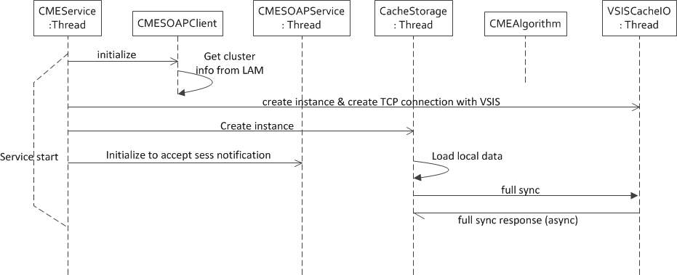
CME Service Start

Slide 6
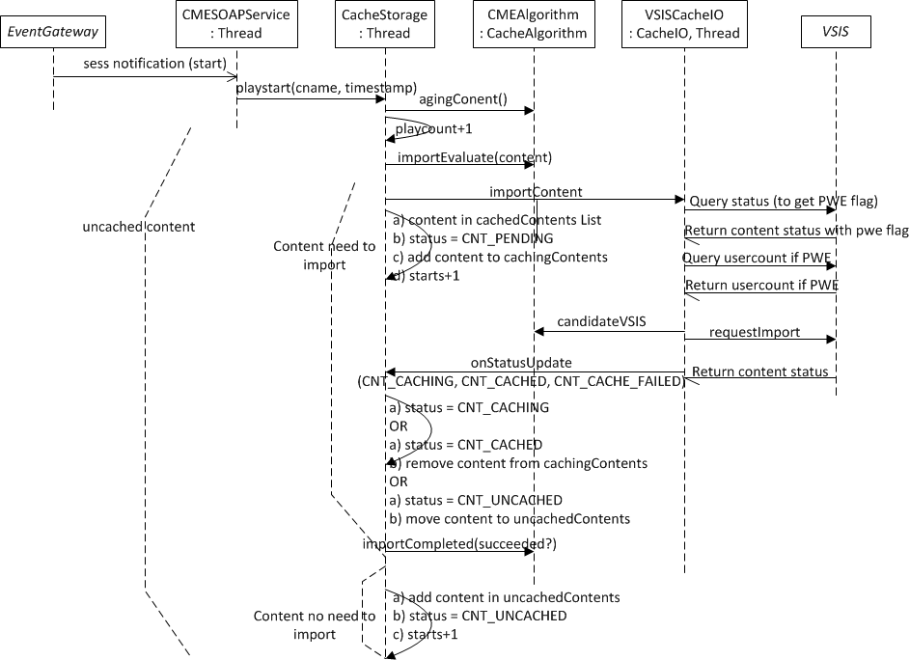
Session Start Notification

Slide 7
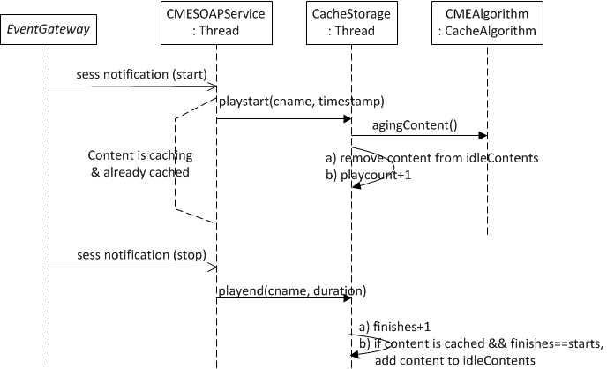
Session Start/Stop Notification

Slide 8
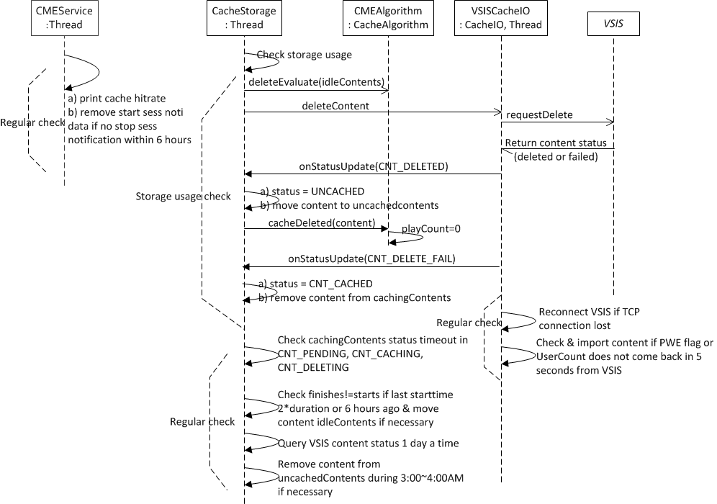
Deletion & Regular Check

