Slide 1
Virtual HPC with Virtualbox with Vagrant
CITS5507

Slide 2
Software requirements
You will need to install a few open source tools.
These are Virtualbox, Vagrant and Git.
https://www.virtualbox.org/
https://www.vagrantup.com/downloads.html
Macbooks typically have git installed.
Windows may or may not have git installed if not here is a link.
https://gitforwindows.org/

Slide 3
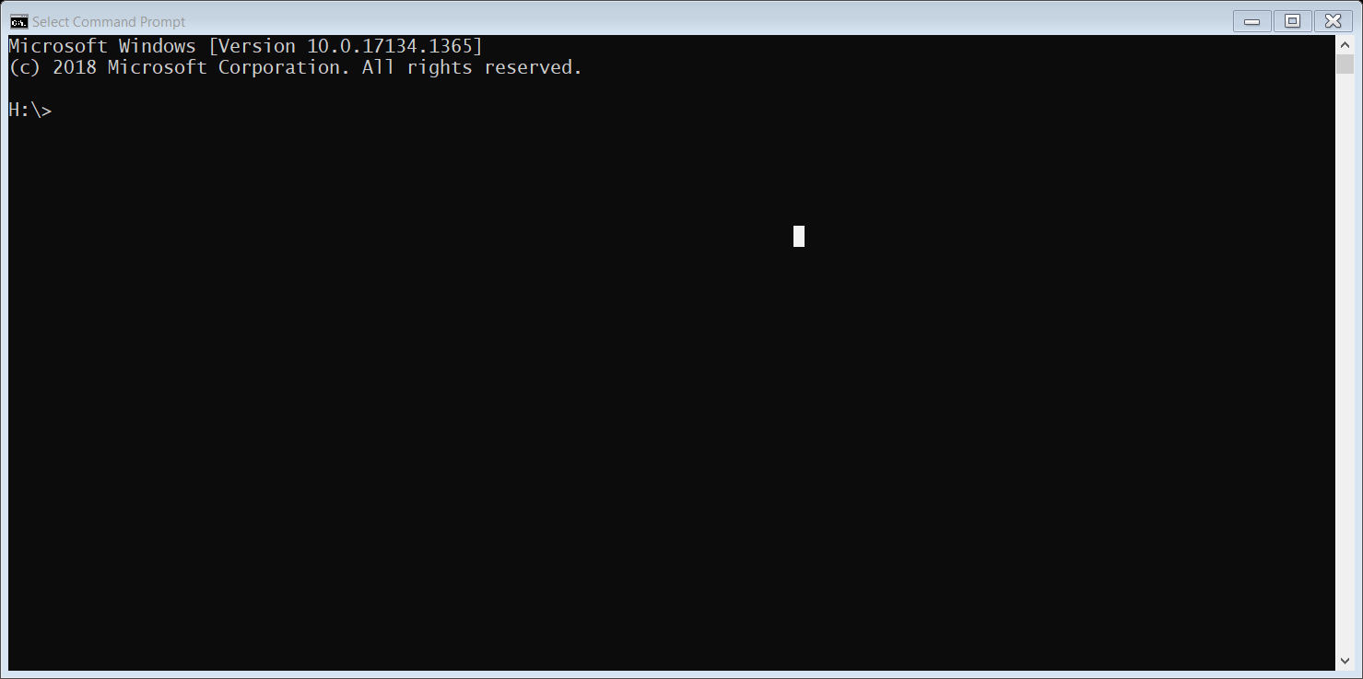
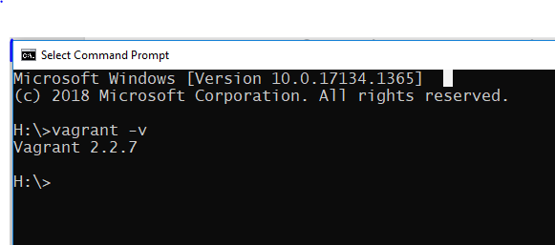
How to test if you have correctly installed virtualbox and vagrant.
On windows laptop open a “Command Prompt Terminal window”
On a macbook open the “terminal” window
Enter the command “vagrant –v”
If it returns the version number as shown above you are good to go!
NOTE 2.2.18 is the latest and everything will work with it as well.

Slide 4
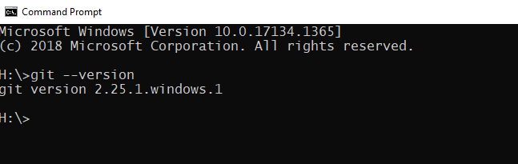
Test git on Windows
Windows may or may not have git installed if not here is a link.
https://gitforwindows.org/

Slide 5
Setup VM
Once Vagrant VirtualBox and Git are installed and working, you can then begin setting
up a Virtual Machine or VM that will run locally on your laptop.
Step 1 – create the directory structure for this project.
For Windows using the Command Prompt terminal the command is:
% mkdir cits5507
For MacOS and linux the command is:
% mkdir cits5507
To make cits5507 directory the working directory, use the command “cd”
it is the same for Windows and MacOS
% cd cits5507
NOTE the % is the prompt and not part of the command!!

Slide 6
Setup VM - continued
Step 2: clone the vagrant file repository from github
For Windows and Macs this step the command is identical.
% git clone https://github.com/jjiantong/HPC.git
Verify the command worked
On Windows:
dir --- this shows all the files and sub-directories in the current folder
On Macbooks/Linux
ls -- LIST so that is lower case L not capital I

Slide 7
Setup VM - continued
Step 3: change director into the cits5507/HPC directory
% cd HPC
You can check that it worked using the “ls” or “dir” command and you should see a file named
“Vagrantfile” it contains the instructions to setup the Virtual Machine. You don’t need to make
changes to it.
Launch the VM, you should still be in the HPC directory and you MUST be in the HPC directory as that is where the Vagrantfile is.
To start the VM the Vagrant command is
% vagrant up
Coffee Break:
This will take some time as it automatically downloading and configuring the base Ubuntu OS image that is used for your VM. It is dependent on your internet connection and laptop.

Slide 8
Install the HPC environment in the VM
Step 4: Log in to the VM using ssh once it finished the command prompt will return
% vagrant ssh
Step 4a: Run the command to install required packages.
% sudo apt-get update && sudo apt-get install g++ openmpi-bin openmpi-common openmpi-doc libopenmpi-dev
COFFEE BREAK:
This will take some time to complete! Depending on your laptop processor speed.
Go get a coffee! If you do work on your laptop or surf the net it will just take longer!
Good news is you only need to do this ONCE when you first create the VM.
Step 4b: To ensure that you correctly pickup all the changes to your environment the simplest thing todo is log out and log back in to the VM
% exit
Log back in to the VM.
% vagrant ssh

Slide 9
Summary of commands
Step 1 - Create the project directory
mkdir cits5507
cd cits5507
Step 2 - Clone the repository with Vagrantfile
git clone https://github.com/jjiantong/HPC.git
Step 3 - launch the Virtual machine
cd HPC
vagrant up
Step 4 - login to the virtual machine
vagrant ssh
Step 4a - run the installation command
sudo apt-get update && sudo apt-get install g++ openmpi-bin openmpi-common openmpi-doc libopenmpi-dev
Step 4b – initialize the environment permanently.
Exit (or ctrl-d)
vagrant ssh

Slide 10
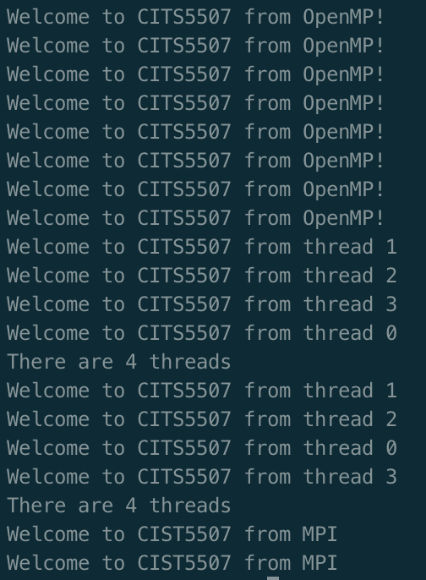
Run a test and shut down the VM
Login to your virtual machine
% vagrant ssh
Download test-omp-mpi.cpp from LMS
Copy test-omp-mpi.cpp to cits5507/HPC/data/
Go to the data folder in your virtual machine
% cd data
Compile and run the program
mpic++ -fopenmp test-omp-mpi.cpp
mpirun -n 2 a.out
You should see results similar to the screenshot to the left.
[Optional] Don’t worry if you see warnings. You can use the following command to make the warnings go away.
mpirun -n 2 --mca btl_base_warn_component_unused 0 a.out
[Optional] To shut down your virtual machine, you can use the follow command.
% vagrant halt

