Slide 1
Crime Analysis
Group Members:
Jaikit Jilka
Ashwajeet Gajre
Yu Fan
Hamad Almutairi

Slide 2
Index
High Level Description
Kick-off Meeting Agenda
Logical Database Design
ETL
Business Intelligence Report
Summary

Slide 3
High Level Description
High level description of the company.
We started our company in 2012
Started as a service provider to large scale Industries.
Started building data warehouse to various customer
Who are the customer?
Our customer for the present project are national security where we are providing them to analyze the crimes in different cities so that we can work accordingly.

Slide 4
Current State of DWM/BI
Describe the current purpose of the Data Warehouse/ Data Mart
The current purpose of building the Data warehouse is to analyze the crimes in different cities and fines according to it.
What is the current DBMS Technology
Excel – for source file.
MySQL is used for storing clean data.
What is the current BI Tool
Tableau is used for BI report

Slide 5
Kick-off Meeting Agenda
Introduction:
Our project name is crime analysis and it was created by ABC Analyst pvt. ltd. based on the statistically report and we also collect data to help analyze the number of crime committed in various cities and fines collected.

Slide 6
Kick-off Meeting Agenda
Goals and Objectives
Our business goals are to get the right output based on the Client demanded.
Which contained:
Total Crimes happened in Different Cities from 2012-2015.
What crimes more happens in specific cities.
Fine obtained according to the crime.
Is the crime reduced or increased.

Slide 7
Kick-off Meeting Agenda
Deliverables:
Team PowerPoint Presentation
Business Requirements Document (BRD)
Requirements questionnaire for business manager or analyst.
Technical Requirements Document (TRD)
Physical database design
Logical multidimensional design

Slide 8
Kick-off Meeting Agenda
Project Team Roles:
Yu Fan - Business Sponsor
Jaikit - ETL developer, Project Manager
Ashwajeet - BI Application developer
Hamad - CEO, System Architect
Administration Tools:
CloverETL
Tableau Software
MySQL
MS Word/ Visio / PowerPoint

Slide 9
Kick-off Meeting Agenda
Project Milestones:
Determine the company name and the project name
Download the raw data
Design the logical model based on the MS Visio
Transfer it into MySQL via CloverETL
Using Tableau Software to analyze the data and record the results.

Slide 10
Kick-off Meeting Agenda
Next Steps:
Finding some technical support to analyze the data.
Using the new ETL tools and BI tools to analyze the data.
Regular conversation based on the Facebook and Google Drive.

Slide 11
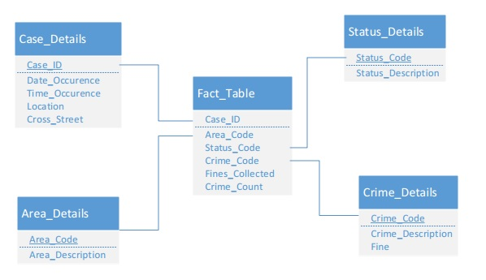
Logical Diagram

Slide 12
Describe ETL
ETL is short for extract, transform and load three database functions that are combined into one tool to pull data out of one database and place it into another database.

Slide 13

Which ETL tool used?

Slide 14
How Many Rows? How Many Fields?
There are 3 source files.
CentralData.xls – 1179 rows
HollywoodData.xls – 2099 rows
FoothillData.xls – 2328 rows
Number of Fields – 15

Slide 15
Is this a one-time ETL? Or scheduled? If so how often?
This is one-time ETL.
In real world it is not a one time event as new data is added to the Data Warehouse periodically – monthly, daily, hourly.

Slide 16
State source systems
CaseID
Date.Rptd
DR.NO
DATE.OCC
TIME.OCC
AREA
AREA.NAME
RD
Crm.Cd
Crm.Cd.Desc
Status
Status.Desc
LOCATION
Cross.Street
Location

Slide 17
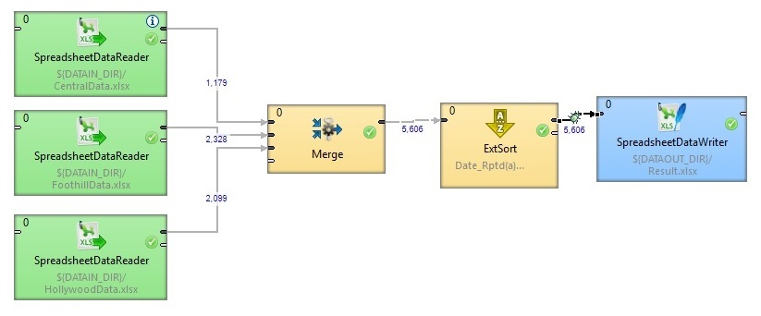
Choose a transformation to describe
Merge source data

Slide 18
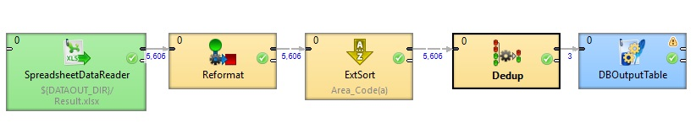
Area_Details

Slide 19
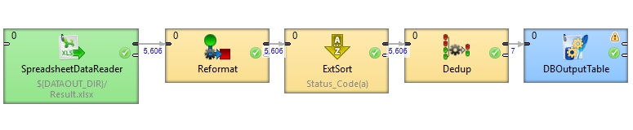
Status_Details

Slide 20
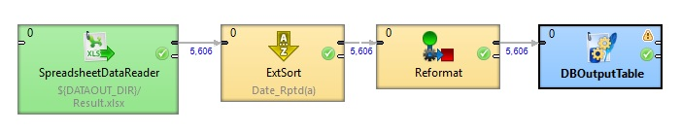
Case_Details

Slide 21
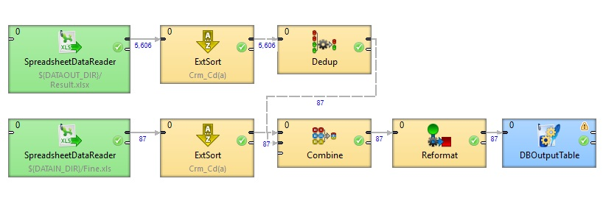
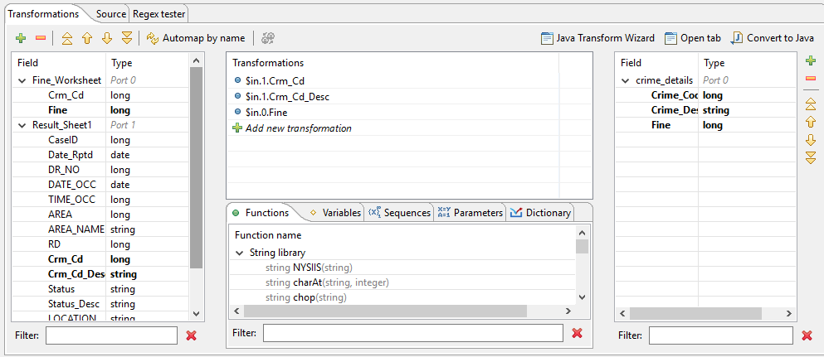
Crime_Details

Slide 22
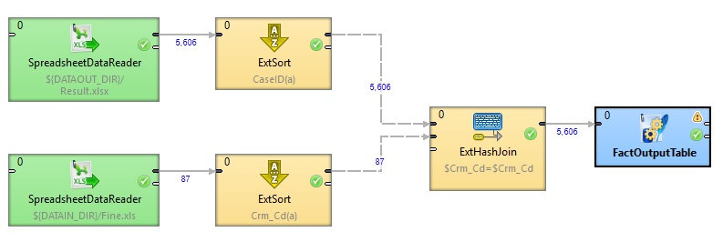
Fact_table

Slide 23

Business Intelligence platform

Slide 24
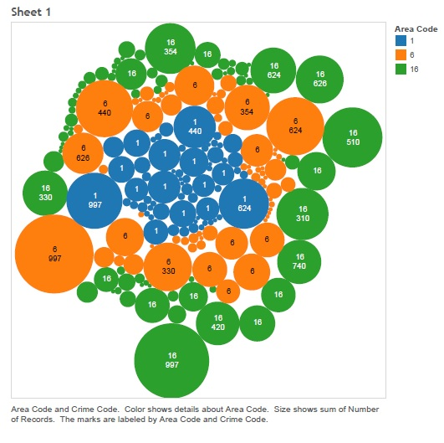
Reports

Slide 25
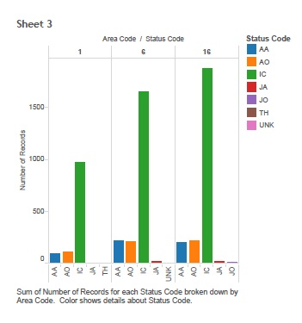
Reports

Slide 26
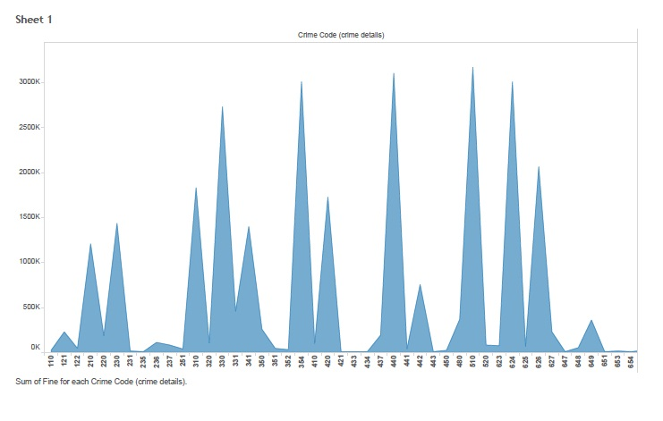
Reports

Slide 27
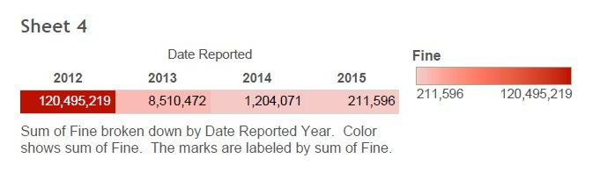
Reports

Slide 28
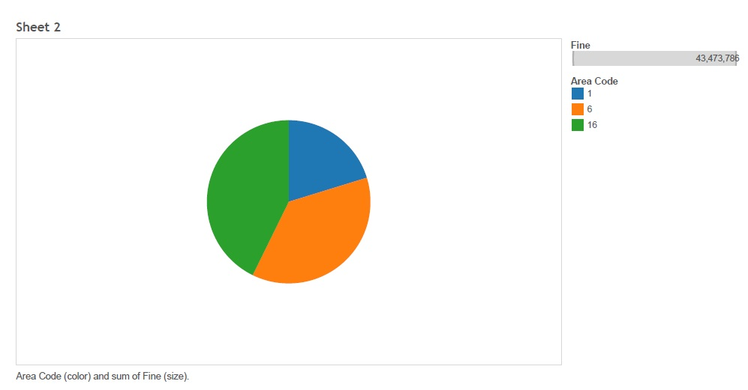
Reports

Slide 29
Project Summary
In summary, our group business motivation is to get the right output based on the client demand. By the end of this project, we combine with each part of DW/BI system. The Extraction, Transformation and Load (ETL) process was the important component of a data warehousing. Then, we use Tableau Software to analyze the data. In addition, we also learn how to cooperate with each other as a team, that was very important in our project.

Slide 30
Thank You

