Slide 1
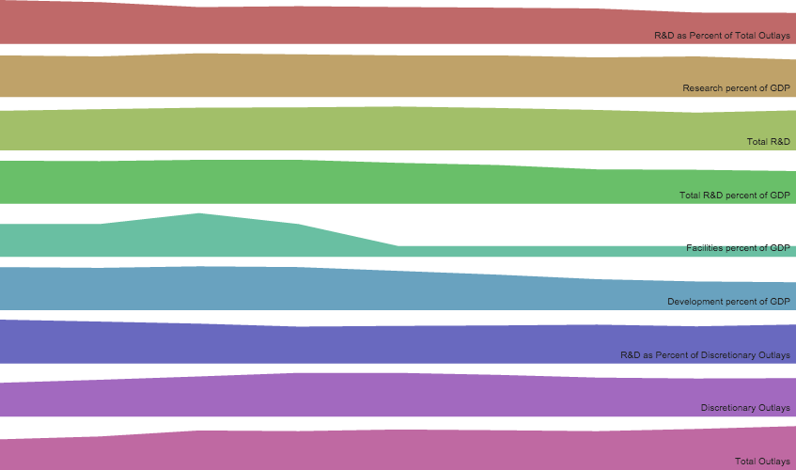
Federal Funding of Research and Development
Down 1.40%
Down 0.03%
Down 0.24%
Down 1.39%
2007
2015*

Slide 2
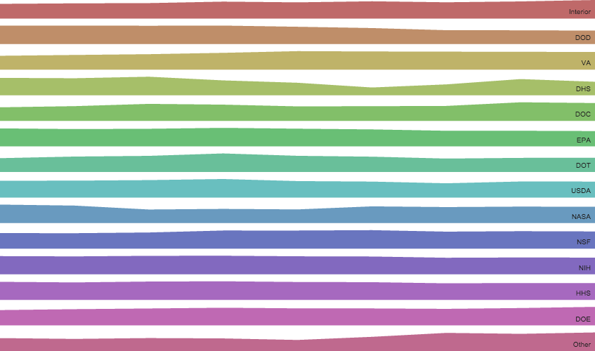
Funding By agency
Total Funding Down 15%
Down 8%
Down 22%
2007
2015*

