Slide 1



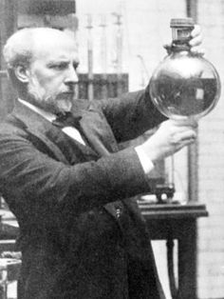
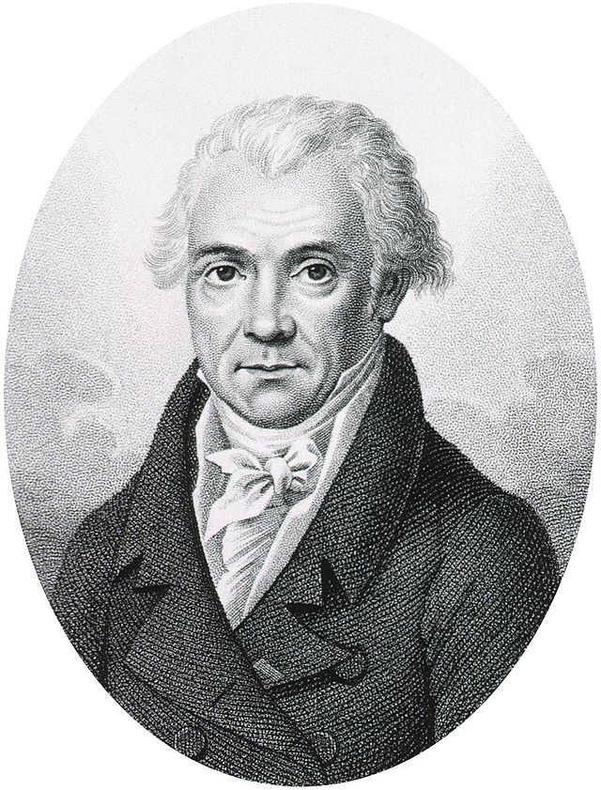
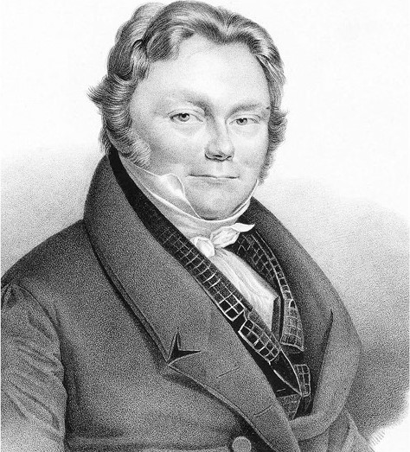
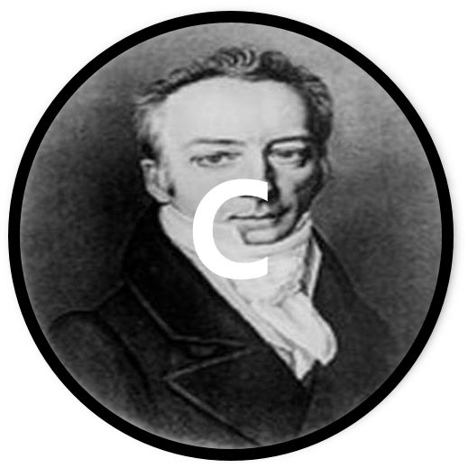
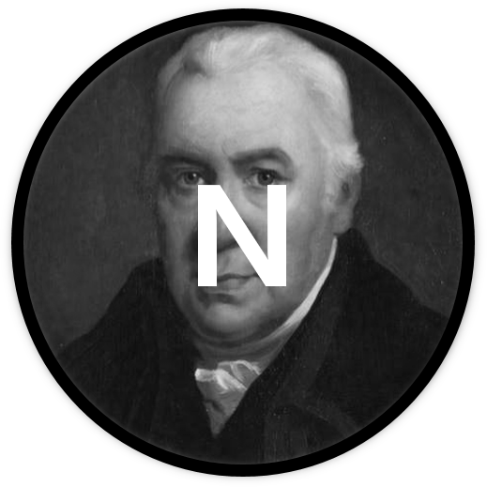
Hydrogen #1 Hydrogen #2 Hydrogen #3 Hydrogen #4
H
H
H
H
Beryllium #1 Boron #1 Carbon #1 Nitrogen #1
Be
B
C
N

Slide 2




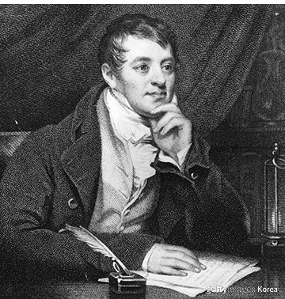
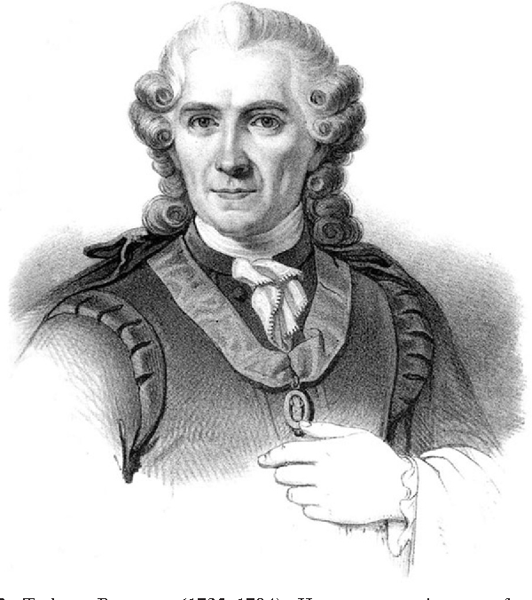

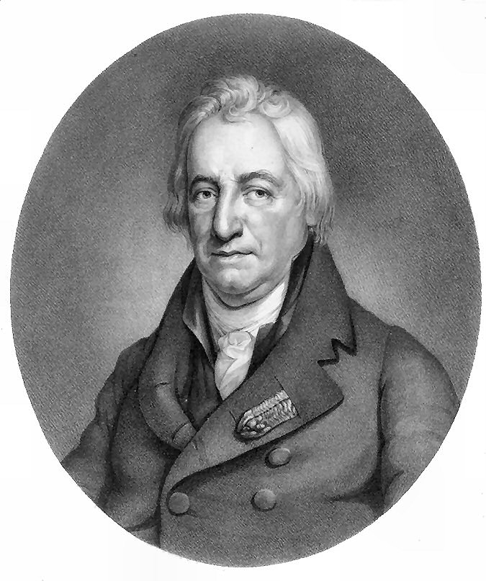
Nitrogen #2 Oxygen #1 Oxygen #2 Fluorine #1
N
O
O
F
Fluorine #2 Chlorine #1 Chlorine #2 Chlorine #3
F
Cl
Cl
Cl

Slide 3
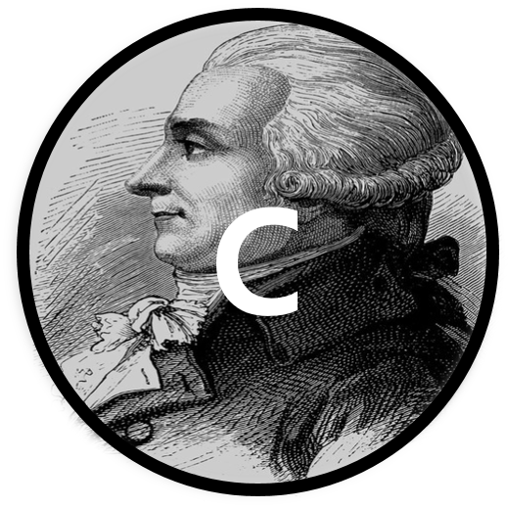

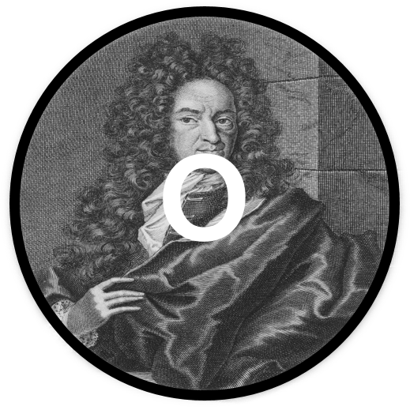

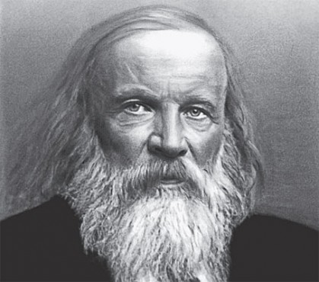
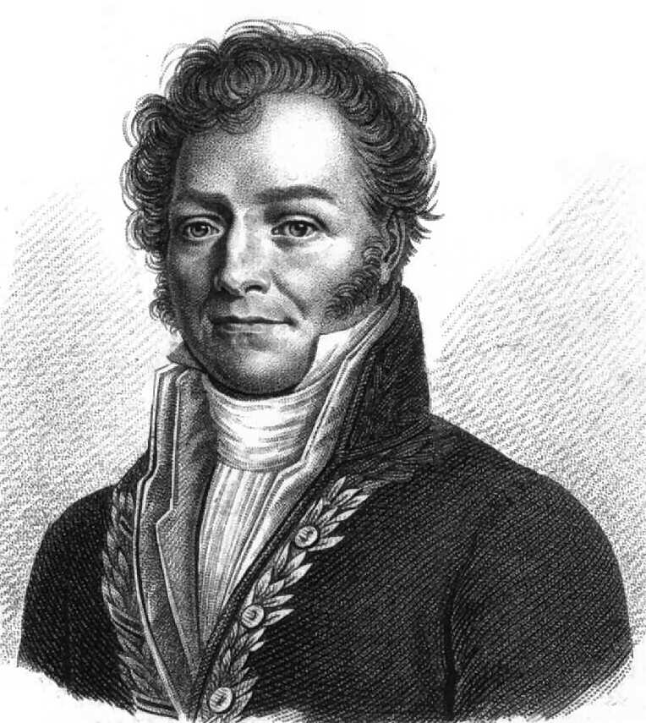
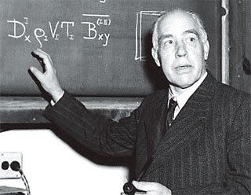
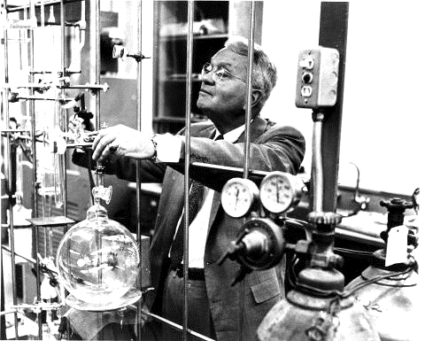
Carbon #2 Oxygen #3 Oxygen #4 Fluorine #3
C
O
O
F
Fluorine #4 Chlorine #4 Hydrogen #5 Hydrogen #6
F
Cl
H
H

Slide 4
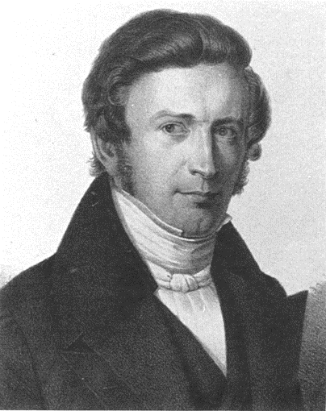

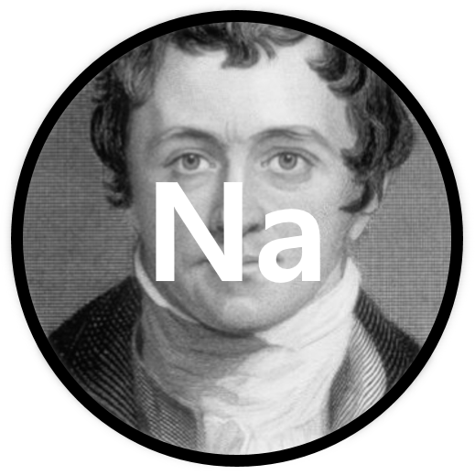
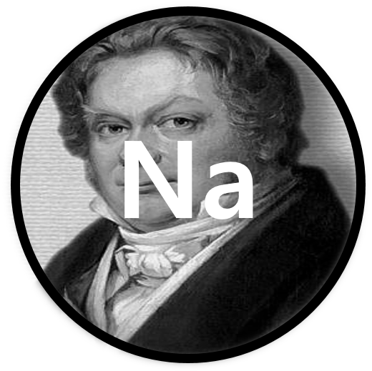
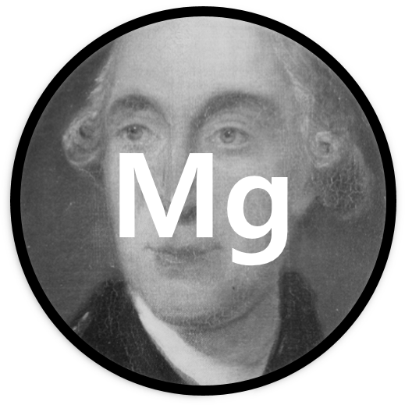
Lithium#1 Lithium#2 Sodium#1 Sodium #2
Li
Li
Na
Na
Magnesium #1
Mg

