Slide 1
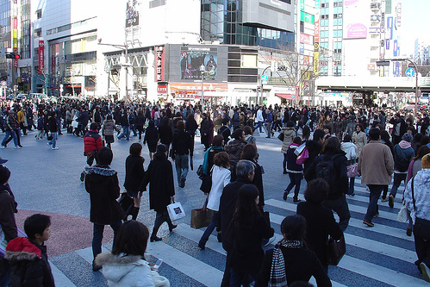
Concurrency in Python

Slide 2
Summary
This is an overview of various approaches to concurrency with an emphasis on network servers (like nginx and Apache) and frameworks (like Tornado Web and gevent).
Find out how stacks, locks, and callbacks each provide their own challenges!

Slide 3
About Me
Shannon -jj Behrens <jjinux@gmail.com>
http://jjinux.blogspot.com

Slide 4
Motivation: Writing a Web Server
Concurrency is doing multiple things at the same time
Imagine a non-concurrent Web server

Slide 5
What I Won't Focus On
Parallel computing
  MPI
Distributed computing
  Creating a Google-like server farm
  MapReduce
  Grid computing
  Erlang (which takes these ideas to their logical conclusion!)

Slide 6
I/O vs. CPU Throughput
Do you have a lot of requests or a lot of data to crunch?
The solutions sometimes blur this distinction
Threads try to address both
I'm going to focus on I/O throughput

Slide 7
Approaches to Multitasking
Time slicing
Non-preemptive schedulers
Preemptive schedulers

Slide 8
Time Slicing
A way of getting one CPU to pretend like many CPUs

Slide 9

Non-preemptive Schedulers

Slide 10
Non-preemptive Schedulers
One program does something and then "yields" to the others
If one program gets wedged, then the whole system is wedged
It's easy to reason about, because it's more deterministic

Slide 11
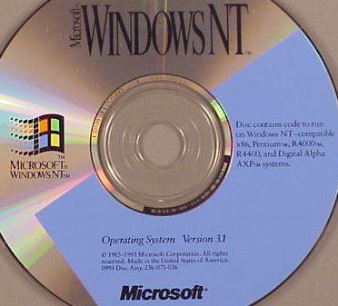
Preemptive Schedulers

Slide 12
Preemptive Schedulers
You can be interrupted at any time
No one program is going to block your whole system

Slide 13
Locking
Race conditions
Fine grained vs. coarse grained locking
Lockless data structures

Slide 14
The Canonical Race Condition
Process A sees that John's balance is $25
Process B sees that John's balance is $25
Process A deducts $25 and sets balance to $0
Process B deducts $25 and sets balance to $0
John gets a free $25
...which he promptly loses on a horse race

Slide 15
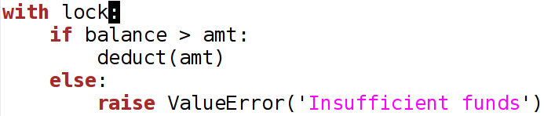
Locking with ”with”

Slide 16
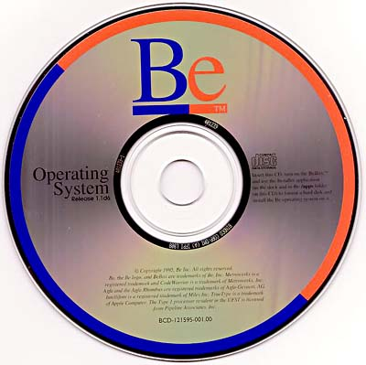
Fine vs. Coarse Grained Locking

Slide 17
Fine vs. Coarse Grained Locking
How many locks do you need?
FreeBSD 4 ("giant") and Python ("the GIL") are coarse grained
FreeBSD 5 and especially BeOS are fine grained
Fine grained has some real benefits, but can be hard and expensive

Slide 18
Lockless Data Structures
Some abstract data type implementations can do atomic updates without needing locks

Slide 19
Threads vs. Processes
When UNIX first came out, it was just processes
Processes don't share the same address space
Multiple threads within a process do share the same address space

Slide 20
Which Should You Use?
Apache 1 didn't use threads
Apache 2 lets you mix and match processes and threads
Processes are heavy
Threads aren't free either

Slide 21
When Do You Need to Lock?
Let's remember that you only need locking when there is sharing
Immutable data doesn't need locking
If each Web request is independent, you have fewer locking issues

Slide 22
Native Threads vs. Green Threads
Native threads are implemented by the OS
Green threads are implemented by the interpreter or VM
OS threads are heavier
Green threads can't use multiple CPUs
Erlang uses multiple OS threads under the covers, but provides green threads to the user

Slide 23
Python's Native Threads
Python has native threads, but there's a catch!
The Global Interpreter Lock (GIL) only allows one thread at a time to ”use Python”
  Blocking I/O doesn't ”use Python”
Supporting native threads in a thread-safe way is hard

Slide 24
When to use Python Threads
Python threads are great for I/O concurrency
They're useless if you're CPU-bound on Python code
Using Python threads for CPU-bound code on a multicore system will make your code slower!
David Beazley explains why and how: http://blip.tv/file/2232410

Slide 25
Asynchronous Programming
What happens if you have thousands of sockets that are in the wait state?
"Call my callback when you actually have something for me"

Slide 26
Asynchronous Programming
select, poll, kqueue, aio, and epoll
Squid, nginx
asyncore, Twisted, Tornado Web
Stackless Python, eventlet, gevent
Notice that the biggest difference between nginx and Apache is that nginx is asynchronous whereas Apache uses processes or threads.

Slide 27

A Synchronous Example

Slide 28
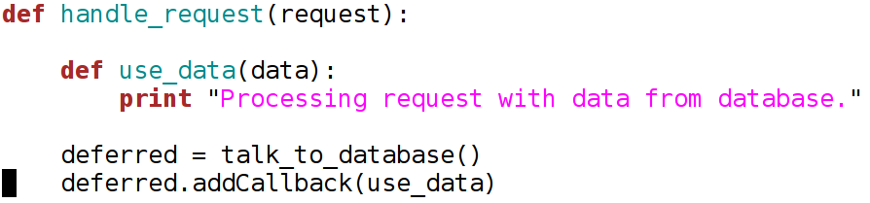
An Asynchronous Example

Slide 29
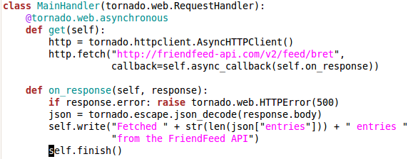
An Example from Tornado Web

Slide 30
Continuation Passing Style
Continuation passing style is when you have to use callbacks everywhere instead of using the stack
It can be a bit painful
It's pervasive throughout the code

Slide 31
WSGI
Continuation passing style and WSGI don't mix.
”Tornado comes with limited support for WSGI. However, since WSGI does not support non-blocking requests, you cannot use any of the asynchronous/non-blocking features of Tornado in your application if you choose to use WSGI instead of Tornado's HTTP server."

Slide 32
Subroutines vs. Coroutines
Coroutines are just like subroutines, but they don't return
  f() calls g() which calls h() which returns to g() which returns to f()
  f() yields to g() which yields to h() which yields to f()
Very simple cooperative multitasking

Slide 33
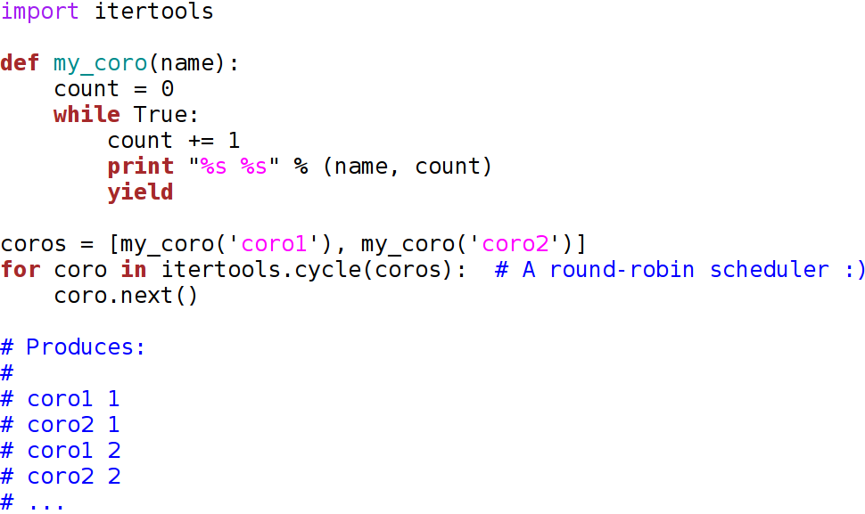
Generator-based Coroutines

Slide 34
Generator-based Limitations
You can only yield in the generator
What happens if my_coro calls f and f wants to yield?
http://jjinux.blogspot.com/2006/08/python-limitations-of-coroutines-via.html

Slide 35

Stackless

Slide 36
Stackless
A stackless interpreter does not use the C stack in order to implement its own stack
Some interpreters are, some aren't
Python isn't, but, of course, there's a version that is stackless

Slide 37
Coping When you Aren't
Getting around the generator limitations
Stack copying
Greenlets is a library to do stack copying
Implementing your own green thread libraries

Slide 38
Custom Thread Libraries
Why on Earth would you want a custom thread library?
I/O-based schedulers
  Looks like threads
  Behaves like asynchronous code
  Locking is simplified
Yahoo Groups (i.e. eGroups), IronPort, Slide, and EVE Online all use this trick

Slide 39
gevent
gevent is a coroutine-based Python networking library that uses greenlet to provide a high-level synchronous API on top of the libevent event loop.
  convenient API around greenlets
  socket module that cooperates
  WSGI server on top of libevent-http
  monkey patching utility to get pure Python modules to cooperate

Slide 40
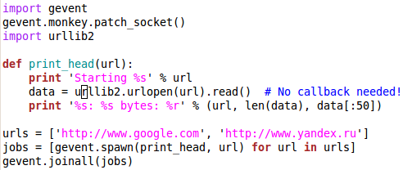
An Example from gevent

Slide 41

Comet

Slide 42
Comet
”In web development, Comet is a neologism to describe a web application model in which a long-held HTTP request allows a web server to push data to a browser, without the browser explicitly requesting it.” [Wikipedia]

Slide 43
Building a Chat Application
Whenever you implement comet, generally the first demo application you write is a chat application
Most asynchronous web frameworks have such a demo
This is something you can't do if you give each request its own thread or process–you can't have 10,000 threads or processes on the same box

Slide 44
Building a Chat Application
Tornado Web's example: http://github.com/facebook/tornado/tree/master/demos/chat/
gevent's example: http://code.google.com/p/gevent/source/browse/#hg/examples/webchat (built on top of Django!)
I built one back in 2006 using Aquarium, Dojo, and stackless Python ;)

Slide 45
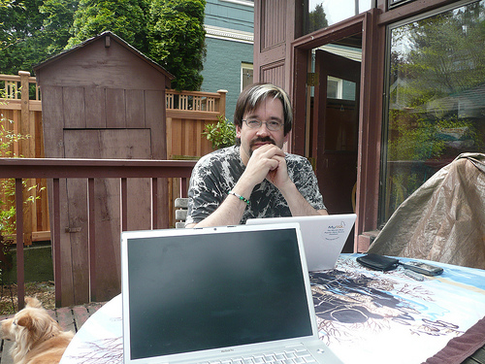
Coping with MySQL

Slide 46
Coping with MySQL
Generally, Web applications have to talk to a backend data store such as MySQL
This is a real challenge for asynchronous frameworks since MySQL's database driver is written in C and isn't asynchronous
If you block while talking to a database, you block all the requests, not just yours!

Slide 47
Coping with MySQL
Twisted handles this by putting the MySQL connection in its own thread
I don't see anything in Tornado Web to handle this, but I know they're using MySQL synchronously
At IronPort, we had a proprietary Python driver built on top of Stackless Python
MySQL Connector/Python is a pure Python driver that might be able to work asynchronously in gevent

Slide 48
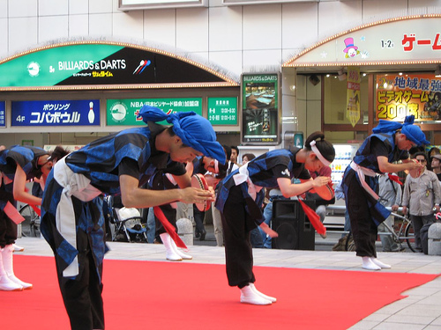
Thanks for Coming

Slide 49
Thanks for Coming
The slides are already online:
http://jjinux.blogspot.com/2009/12/python-concurrency.html

Slide 50
Creative Commons Images
http://flickr.com/photos/19838221@N00/442349474/
http://www.flickr.com/photos/rene-germany/15571970/
http://www.flickr.com/photos/dvorscak/262939592/
http://www.flickr.com/photos/strandloper/360831841/
http://www.flickr.com/photos/fallenpegasus/2500679208/

