Slide 1
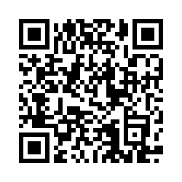
NCyTE would appreciate your feedback!
Before leaving, please take our brief survey
https://tinyurl.com/NCYTEPD

