Slide 1
Cellular response to perturbations with batch effects
Jeremy J Jones

Slide 2
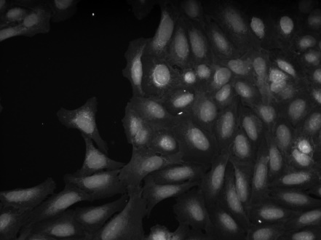
Cellular microscopy images
Microscopy images are of different cell types being subjected to different types of perturbations.
There are two types of perturbations in the set of assays; there are chemical and genetic perturbations.

Slide 3
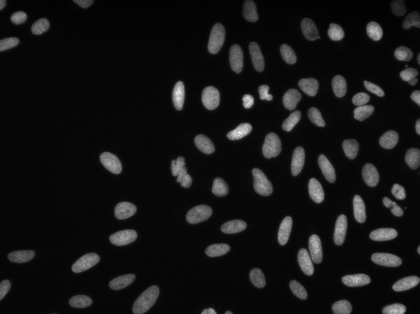
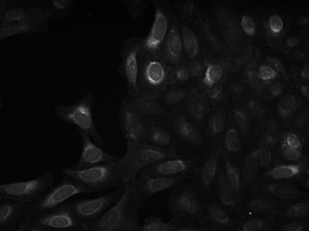
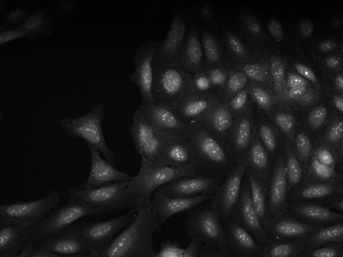
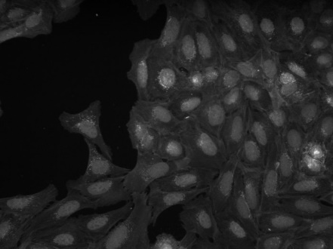
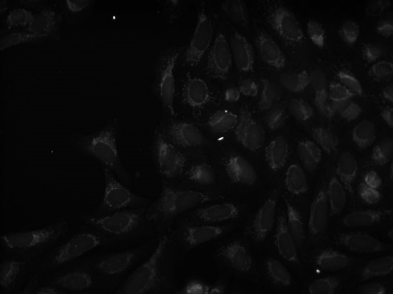
Combining multiple imaging channels to create signal image
The experimental images consists of 5 imaging channels. The channels were combined to one signal image for modeling.
Channel 1 Nucleus
Channel 2 ER
Channel 3 Mitochondria
Channel 4 Actin/Golgi
Channel 5 Nucleoli/cyto RNA
Combined Channels

Slide 4
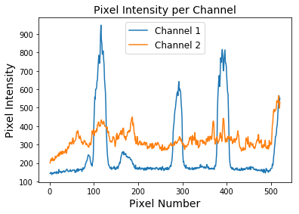
Pixel intensity per cellular image
Pixel intensity varies across microscopy images.
The peaks in pixel intensity are indicative of the nucleus of the cells while midlevel intensity signifies the intracellular environment.

Slide 5
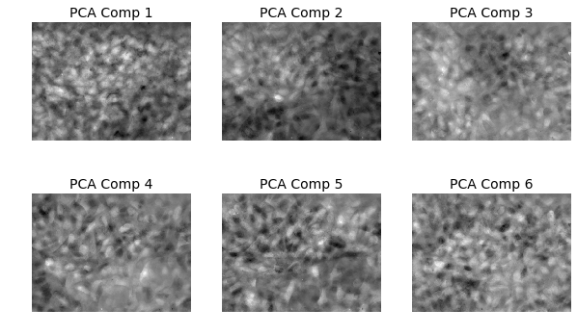
Principle components of cellular images
Principle components of the cellular images does not so anything spectacular.

Slide 6
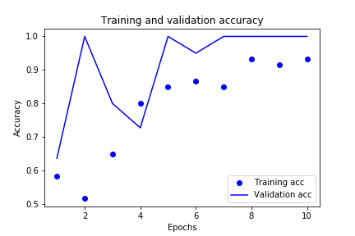
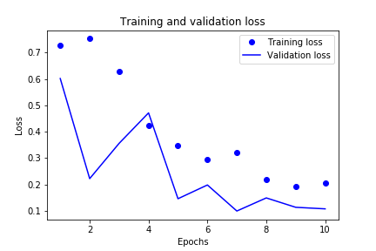
Modeling results: 1 chemical assay and 1 genetic assay (2 classes)
When comparing just one chemical assay and one genetic assay the machine learning model improves with training.
Ultimately being able to differentiate a chemical assay from a genetic assay is highly accurate after training.

Slide 7
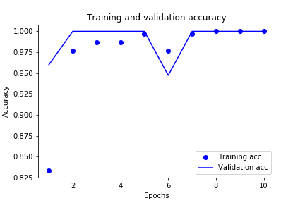
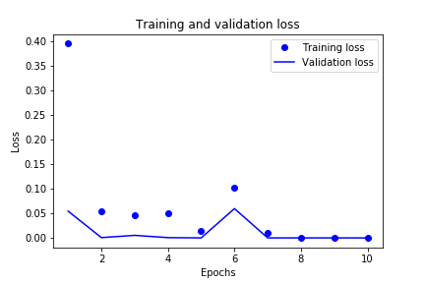
Modeling results: 5 chemical assay and 5 genetic assay (2 classes)
When comparing just 5 chemical assays and 5 genetic assays the machine learning model improves with training.
Ultimately being able to differentiate a chemical assay from a genetic assay is highly accurate even early in training.

Slide 8
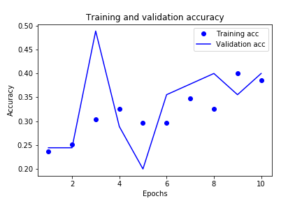
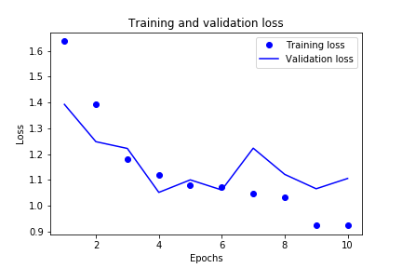
Modeling results: 5 chemical assay and 5 genetic assay (10 classes)
When comparing just 5 chemical assays and 5 genetic assays and differentiating all of the assays from one another training moderately improves model accuracy.
Random guessing would yield an accuracy of 10% however the model produces a training accuracy around 40%.

Slide 9
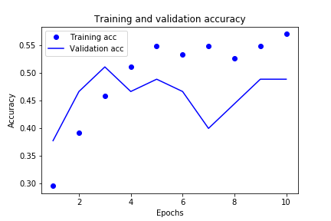
Modeling results: 5 chemical assay (5 classes)
When comparing just 5 chemical assays and differentiating all of the assays from one another training moderately improves model accuracy.
Random guessing would yield an accuracy of 20% however the model produces a training accuracy around 40%.

Slide 10
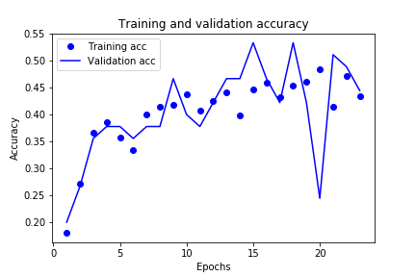
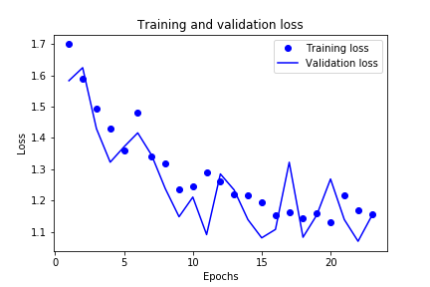
Modeling results: 5 chemical assay (5 classes) with data augmentation
Here, data augmentation is used to see if it will improve the model accuracy for differentiating 5 chemical assays
When comparing just 5 chemical assays and differentiating all of the assays from one another training moderately improves model accuracy.
Random guessing would yield an accuracy of 20% however the model produces a training accuracy around 45%.

Slide 11
Conclusions
Differentiating chemical and genetic perturbations from one another can be readily accomplished using a simple transfer learning convolutional neural network.
Differentiating assays within the chemical or genetic classes is more difficult and may not be easily done because of lack of quality images and/or too subtle of physical differences between the different assays.
Data augmentation offers some improvement in model accuracy but gains are minimal.

