Slide 1
Using news to predict stock market movements
Jeremy J Jones

Slide 2
Problem statement
Stock market movements are highly unpredictable and trading strategy still largely rely on data as well as intuition.
Market news about companies logically should impact the stock returns.
Using news articles and sentiment analysis metrics from those news articles can the stock market movement be predicted?
Goal :
Predict stock movements using market and news data.
Model as a classification problem were the predictor is the probability of the 10-day market adjust leading return is either positive or negative.
Final scoring metric is an effective 10-day Sharpe ratio.

Slide 3
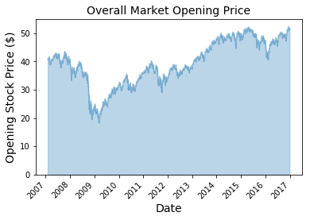
Stock Market Prices – What Causes Market Fluctuations?
Overall stock market prices fluctuate on both a long term and short term basis.
Long term fluctuations are based on major events and overall health of the market.
Short term fluctuations tend to be more erratic and have characteristics of noise data.
Recession of 2008
Oil Price Crash Early 2016

Slide 4
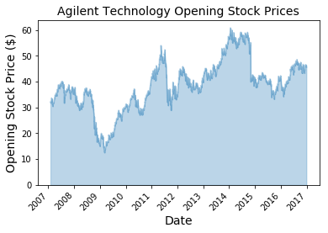
Stock Market Prices Per Company
Daily opening stock prices for individual companies are related to the overall market effects and company health in general. News data may also play a role in the individual company’s stock movement.
Notice, Agilent Technologies also suffered from the 2008 recession however the subsequent peaks and valleys are not as obviously related to the overall market trends.

Slide 5
Project Flowchart
Data Processing
Collect news and market data
Clean data and look for anomalies
Data Analysis
Understand data and look for trends
Use statistics to better prepare for data modeling
Modeling
Using cross validation and grid search to tune parameters in testing several modeling techniques
Take additional steps to improve model (e.g. feature engineering, multimodel approach, collect more information, etc.)
Merge data sets on the companies and time stamp

Slide 6
Data Description
Market data contains information pertaining to the stock market such as company name, open and close ticker price, volume, a variety of return values and the target (10-day market adjusted leading return)
News data includes information about articles in the news for particular days with information such as the company the article pertains to, the sentiment analysis metrics, article word count and text information such as the article headline.
Data range from a time period of 2007-2018.

Slide 7
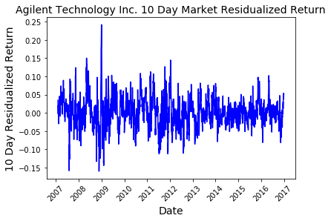
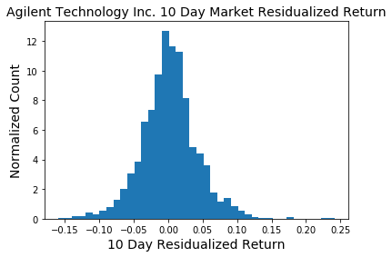
10-Day Market Adjust Leading Return
The 10-day market adjust leading return measures the effective return over the next 10 days.
This is the target used in this project to help determine the market movement.
Agilent Technology Inc. shows that the day-to-day 10 day return is very noisy however the distribution is nearly normal with a slight bias toward positive values.

Slide 8
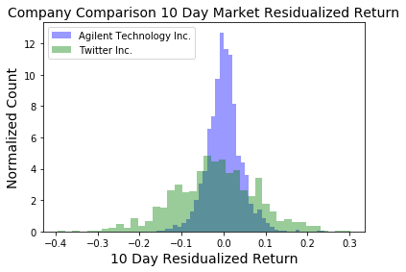
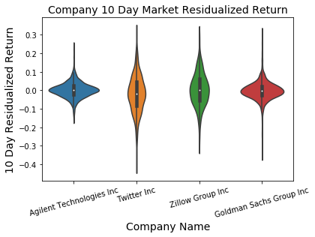
10-Day Market Adjust Leading Return Company Comparison
The 10-day market adjust leading return can vary widely depending on the company.
Agilent Technology Inc. has a significantly smaller variance in the return compared to Twitter Inc.
Because of the high variance Twitter Inc. has the potential to earn or lose a great deal of money depending on trading strategy.

Slide 9
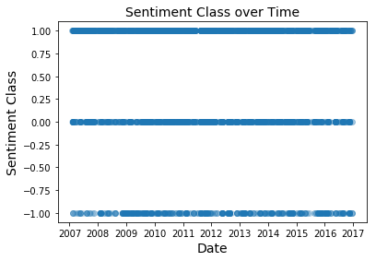
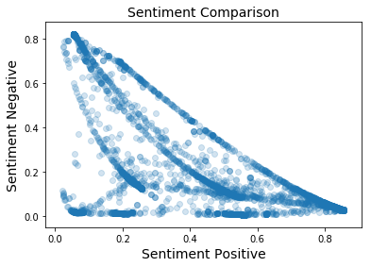
News Article Sentiment Analysis (Agilent Technologies)
The number of news articles and the frequency in which those articles change between being positive, negative or neutral makes it difficult to see temporal trends in the article sentiment class.
As one would expect as an article tends to be more positive the metric for sentiment negative decreases. This is not always the case therefore one could imagine the ambiguity of the articles sentiment can play a role in errors when modeling.

Slide 10
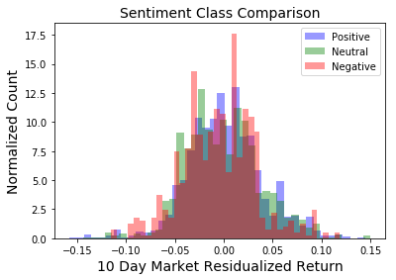
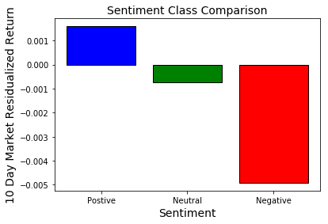
News Article Sentiment Analysis (Agilent Technologies)
Histograms of the 10-day market adjust leading return for different sentiment classes are compared and it is difficult to distinguish each class from one another.
Taking the mean market return and comparing the different sentiment classes, as expected, a positive sentiment leads to a slightly positive market return while a negative sentiment leads to a negative market return.

Slide 11
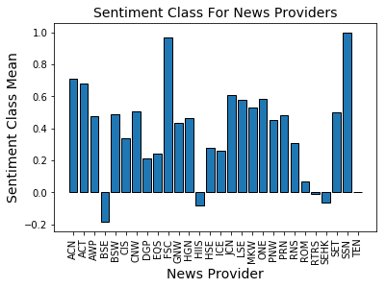
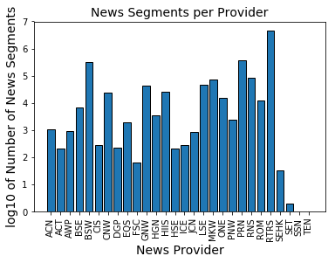
News Providers and Sentiment Class Score
Ultimately news providers tend to be more positive towards companies on average than negative.
There is also a large range of news article published by each news provider and in some cases the lack of data gives inaccurate measures of the mean sentiment for the provider.
It is not surprising that news articles are more positive on average because ultimately the market increased over the dataset time period.

Slide 12
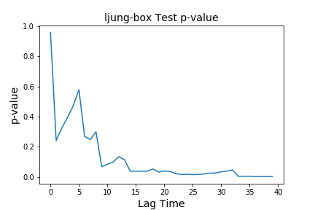
Statistical Analysis: Daily Return Autocorrelation
The question asked is: does the daily return show characteristics of noise or is there a autocorrelated trend over a specific lag time?
Performed a Ljung-box test on the daily return for Agilent Technologies Inc which showed that at small lag times the data looks like noise (large p-value) while at longer lag times there is an autocorrelation (small p-value).
Small p-value rejects null hypothesis of the data being random noise.

Slide 13
Statistical Analysis: Daily Return Autocorrelation
The question asked is: does the daily return show characteristics of noise or is there a autocorrelated trend over a specific lag time?
Performed a Ljung-box test on the daily return for Agilent Technologies Inc which showed that at small lag times the data looks like noise (large p-value) while at longer lag times there is an autocorrelation (small p-value).
Small p-value rejects null hypothesis of the data being random noise.

Slide 14
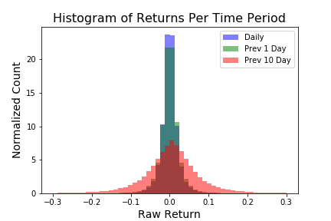
Statistical Analysis: Returns Per Time Period
Longer time period over which returns are calculated results in a wider distribution of raw return values.
The mean return also increases with increasing return period.
This suggests that long periods for returns have higher volatility and also have higher mean earnings.

Slide 15
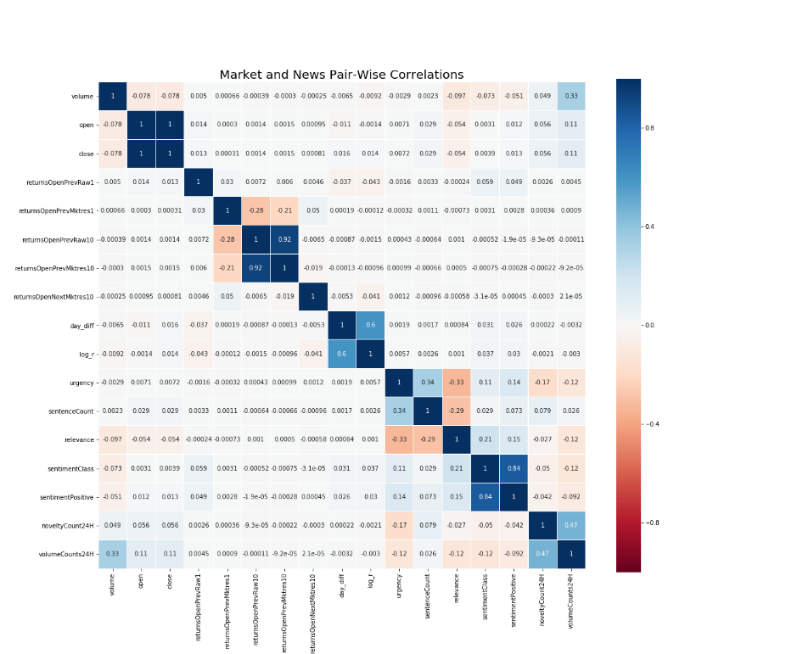
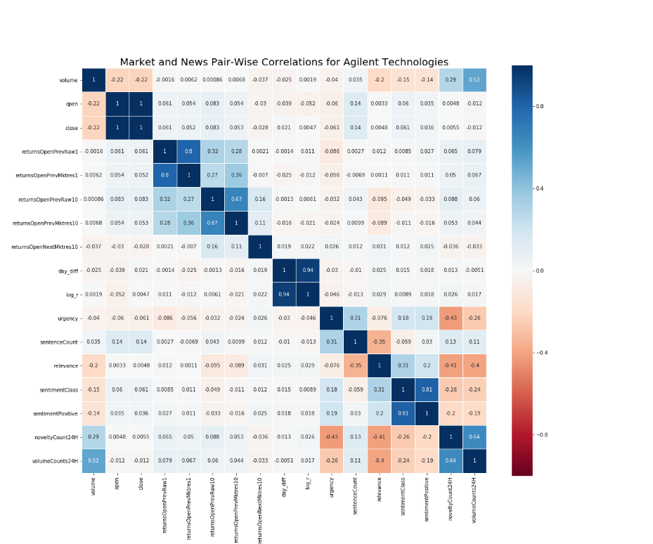
Statistical Analysis: Feature Cross Correlation Matrices
There is a difference between the feature cross correlations of the overall market versus individual companies.
Implies that individual companies may have to be modeled separately.
Overall Market
Agilent Technologies Inc

Slide 16

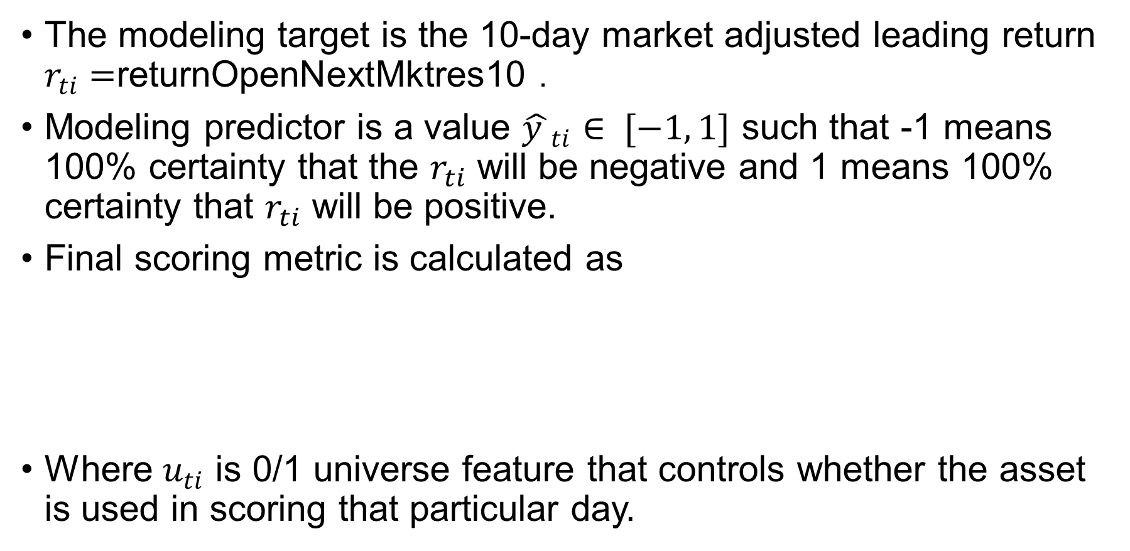

Machine Learning Modeling: Modeling Goal and Target
The modeling target is the 10-day market adjusted leading return $r_{ti}=$returnOpenNextMktres10 .
Modeling predictor is a value ${\hat{y }}_{ti}∈ [−1, 1]$ such that -1 means 100% certainty that the $r_{ti}$ will be negative and 1 means 100% certainty that $r_{ti}$ will be positive.
Final scoring metric is calculated as
Where $u_{ti}$ is 0/1 universe feature that controls whether the asset is used in scoring that particular day.
$$x_{t}=\sum_{i}{{\hat{y }}_{ti}r_{ti}}u_{ti}$$
$$score= \frac{{\overline{x}}_{t}}{σ\left(x_{t}\right)}$$

Slide 17
Machine Learning Modeling: Feature Engineering
During model testing it was discovered that the 2008 recession data is poorly predicted and therefore it was removed from the dataset.
Added features from market data:
Company names where assigned numerical values
Log return: log10(Close/Open)
The 5 and 10 day rolling average of returnOpenPrevRaw10
The 5 and 10 day rolling average of sentimentClass

Slide 18
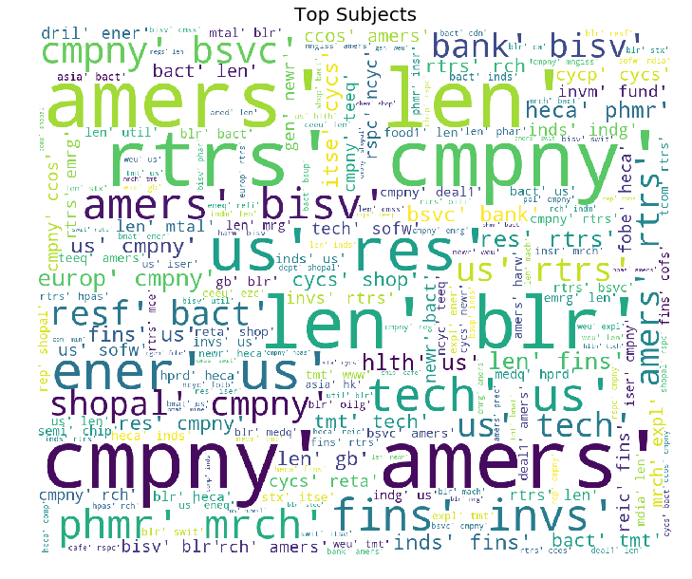
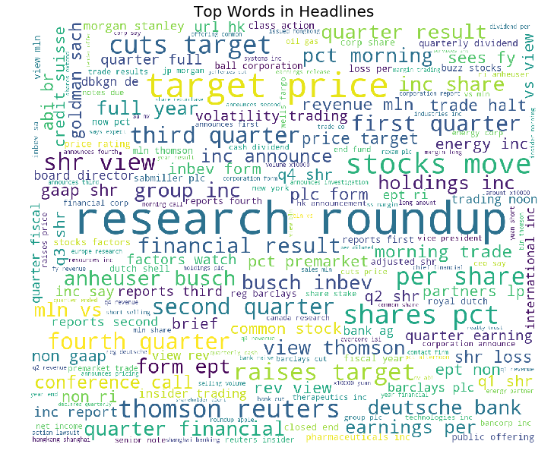
Machine Learning Modeling: Feature Engineering, Word Embedding
Subjects and headlines features contain text data.
Rich with data not being utilized in numerical model.

Slide 19
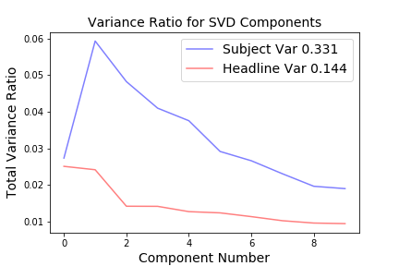
Machine Learning Modeling: Feature Engineering, Word Embedding
Text data within the subjects and headline features from news data was vectorized using a countvectorizer.
Word embedding produces too many features therefore the word matrices were broken down into principle components.
10 components from subjects and headlines each were added to modeling feature set.

Slide 20
Machine Learning Modeling: Algorithms
XGBoost : Gradient boosting algorithm that uses decision trees. Made to be efficient and flexible and provides parallel tree boosting.
LightGBM : Gradient boosting framework that uses tree based learning algorithms. Created to support lower memory usage and higher training speed. Sacrifices on some accuracy for speed.
Naïve Bayes : Supervised training algorithm that applies Bayes’ theorem with the “naïve” assumption of conditional independence between every pair of features.
KNN : Non-parametric learning algorithm that classifies data into different classes based on the feature space nearest neighbors.
Random Forest : An ensemble learning method for classification that operates by constructing many decision tress and taking the mode of the classes in a classification problem.

Slide 21
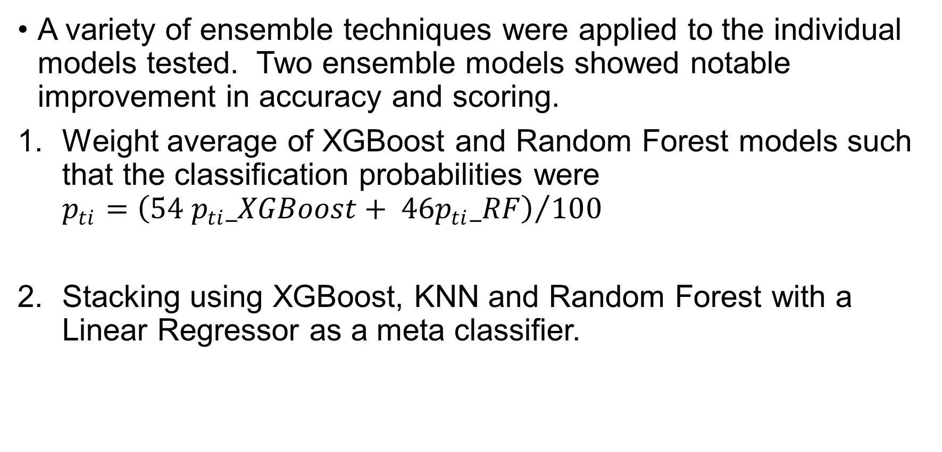
Machine Learning Modeling: Ensemble Models
A variety of ensemble techniques were applied to the individual models tested. Two ensemble models showed notable improvement in accuracy and scoring.
Weight average of XGBoost and Random Forest models such that the classification probabilities were $p_{ti}={\left(54 p_{ti}_XGBoost+ {46p}_{ti}_RF\right)}/{100}$
Stacking using XGBoost, KNN and Random Forest with a Linear Regressor as a meta classifier.

Slide 22
Machine Learning Modeling: Results
Both ensemble methods provide the best accuracy and scoring.
Model | Accuracy | AUC | Score
XGBoost | 0.5867 | 0.624 | 0.9241
LightGBM | 0.5738 | 0.606 | 0.8275
Naïve Bayes | 0.5052 | 0.509 | 0.0810
KNN | 0.5251 | 0.536 | 0.4241
Random Forest | 0.5635 | 0.590 | 0.8597
Weight Average | 0.5822 | 0.619 | 0.9541
Stacking | 0.5892 | 0.588 | 0.9547

Slide 23
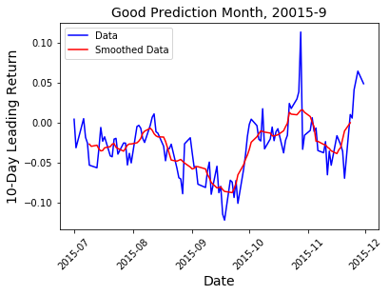
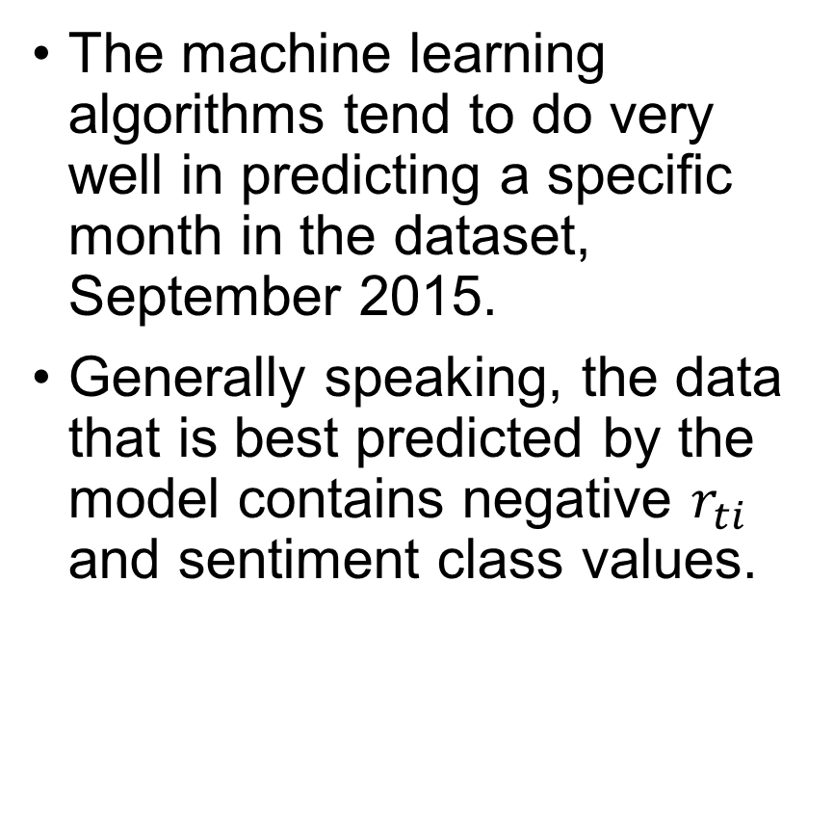
Machine Learning Modeling: Good Modeling Performance
The machine learning algorithms tend to do very well in predicting a specific month in the dataset, September 2015.
Generally speaking, the data that is best predicted by the model contains negative $r_{ti}$ and sentiment class values.

Slide 24
Conclusions
Ensemble stacking with XGBoost, KNN and Random Forest with Logistic Regressor as a meta classifier gave best accuracy and scoring.
The final score of 0.9547 is sufficient to be 34 out of 693 in the Two Sigma Kaggle competition.
The best algorithm best predicted returns and sentiment class that was negative. Thus, modeling is best for declining stocks with negative news articles.

