Slide 1
COVID-19 Impacts around the world
Jahangir Dewan, Sofia Mbega, Cody Miracle & Sajad Yarzada

Slide 2
Questions we explored
How has covid-19 impacted the world? What countries have the most # of Cases and # Deaths?
Does population density has any impact on the rise of covid-19 cases or deaths?
Is there a relationship between life-expectancy and rise of covid-19 in countries?
Does Diabetes Prevalence have any relationship with the rise of covid-19 deaths?
Do countries with less hospital beds have more # of deaths?

Slide 3
”
—Dr. Michael J. Ryan, WHO Informal Advisory Group.
“We need to learn the lessons that are being shown from this virus”

Slide 4
Data Cleanup & Analysis Process
01
02
03
Searched for complete and updated dataset that included key research question indicators
Created a repo in Github, uploaded the owid_covid_main data file as the basis for the work
Removed the NaN values using dropna() to get a new clean file
04
05
06
New DataFrame was created to include the main columns needed to answer the research questions
Using groupby and sum() fucntion total case # and total deaths were calculated for all locations
A series of pie charts and regression analysis were conducted to find the answer for research questions

Slide 5
Data set
Here is the link to the dataset from “Our World in Health” for all covid-19 data as of September 28,2020:
https://github.com/jjjdewan/ucb-data-visualization-msgrp-project1-covid-19/blob/master/Resources/owid-covid-data_updated_main.csv

Slide 6
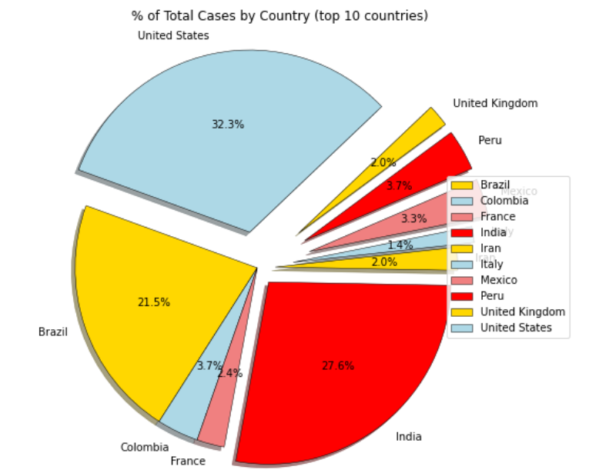
Total cases by country (top 10)
United State: 7,115,046
India: 6, 074, 702
Brazil: 4, 732,309
Russia: 1,151,438
Colombia: 813,056

Slide 7
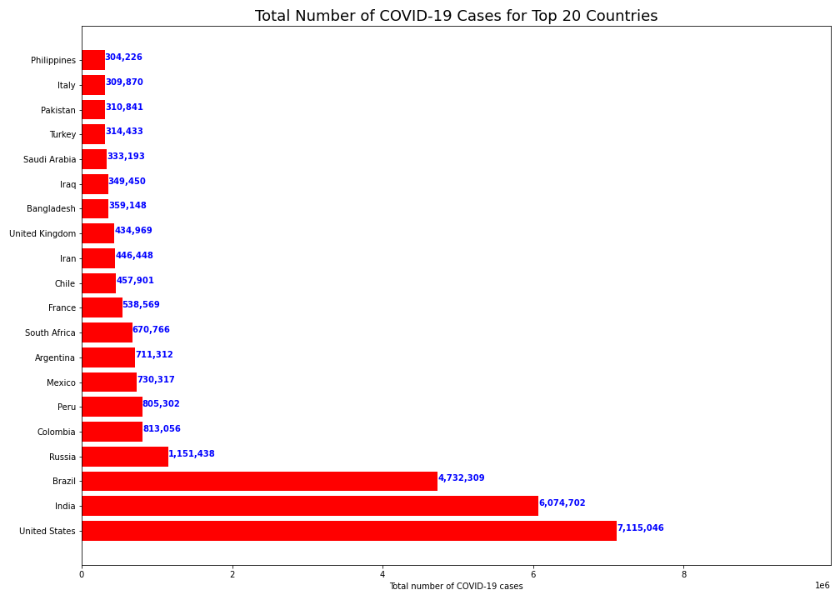
Total cases by country (top 10)

Slide 8
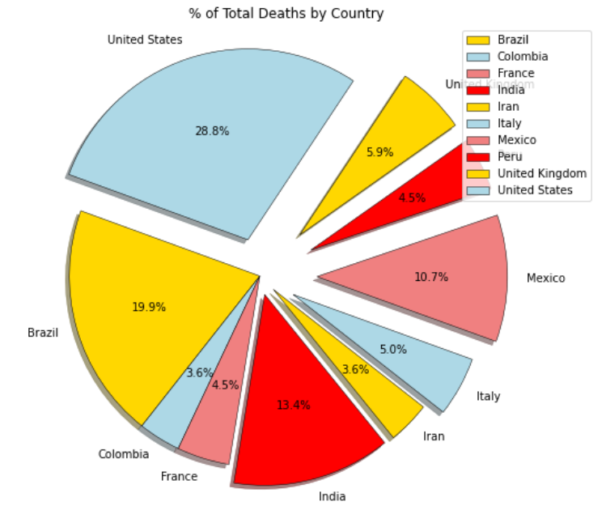
Total death by country (top 10)
United States: 204,75
India: 141,741
Brazil: 95, 542

Slide 9
Total death by country (top 10)

Slide 10
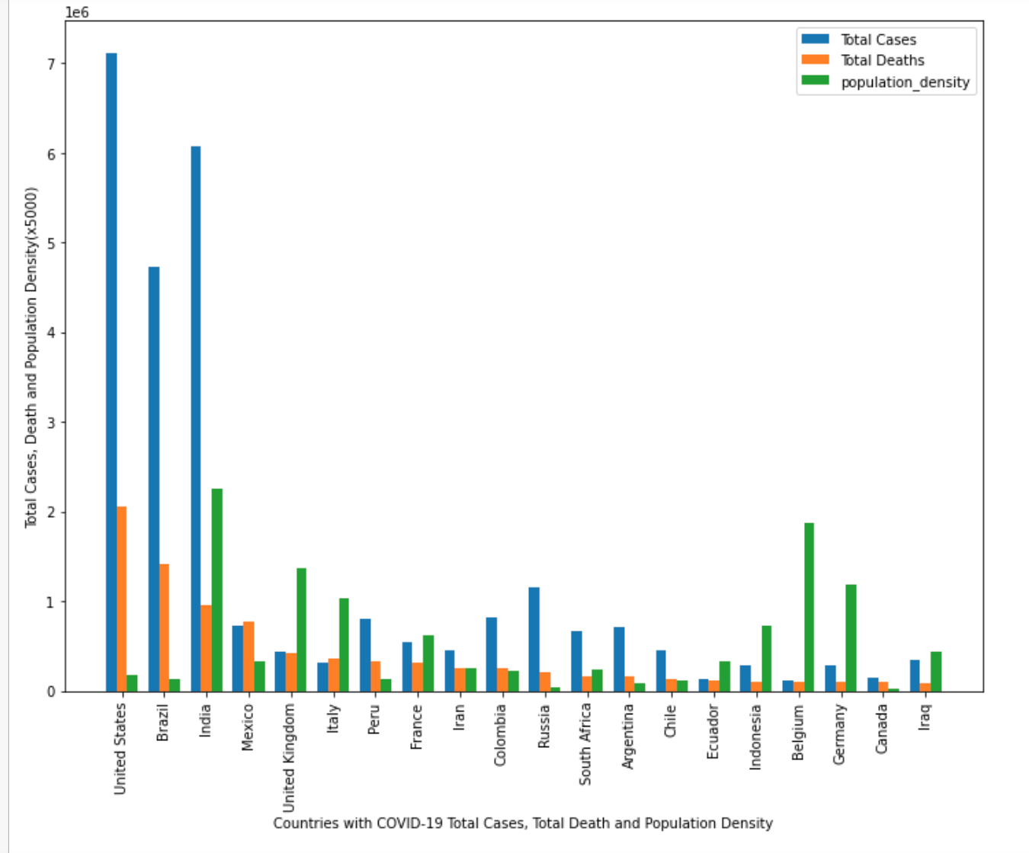
total cases, total deaths and population density
The effects of population density on covid-19 cases and deaths varies
Some countries like India have higher death rates for having a higher population density
US despite having a lower population density has the highest # of cases and deaths

Slide 11
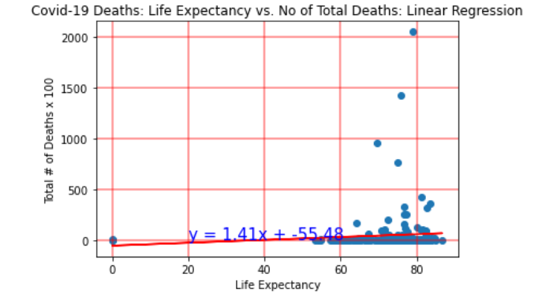
Life expectancy vs death rate
Most deaths occur between ages 60-80
The r value is 0.08
There is a positive correlation between the countries who have a higher life expectancy due to the old age and the total # of deaths by Covid
Elderly population are more vulnerable to Covid related death

Slide 12
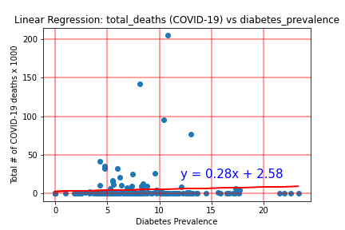
Diabetes prevalence vs covid-19
The r value is 0.09
There is a week positive correlation between the countries who have a higher diabetes prevalence rate and the total # of cases by Covid
Countries who have higher rates of diabetes have slightly more vulnerable to covid-19

Slide 13
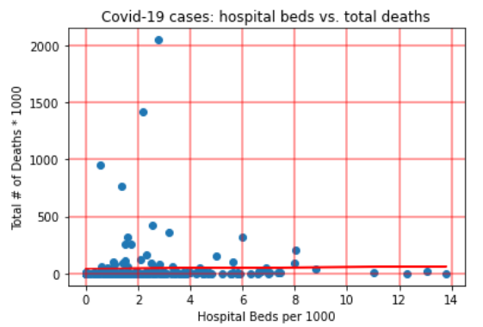
Availability of hospital beds vs total deaths
The r value is 0.02
There is a weak but positive correlation between availability of hospital beds and the total # of covid-deaths
Countries which have lower beds available in hospitals, have a slightly higher death rate

Slide 14
Summary
A summary of key highlights:
The United States has both the highest # of cases and highest # of deaths
Countries with a higher expectancy life have a higher mortality rate
Countries with a higher Diabetes Prevalence rate have slightly more cases
Countries with less hospital facilities and beds have more # of deaths

Slide 15

THANKS!
Do you have any questions?

