Slide 1
Browser
Server

Slide 2
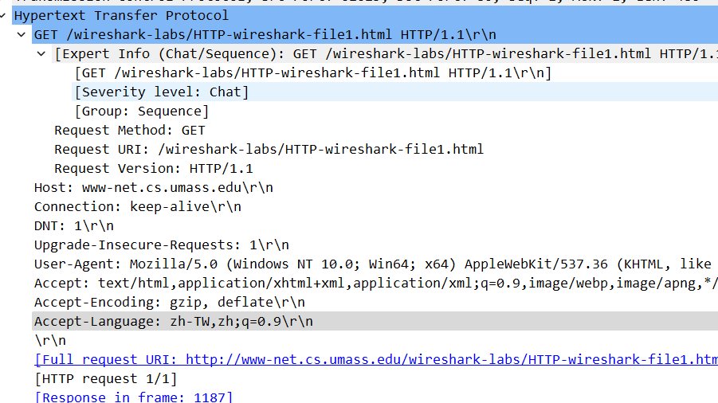

Slide 3
gaia.cs.umass.edu server IP
My computer IP

Slide 5
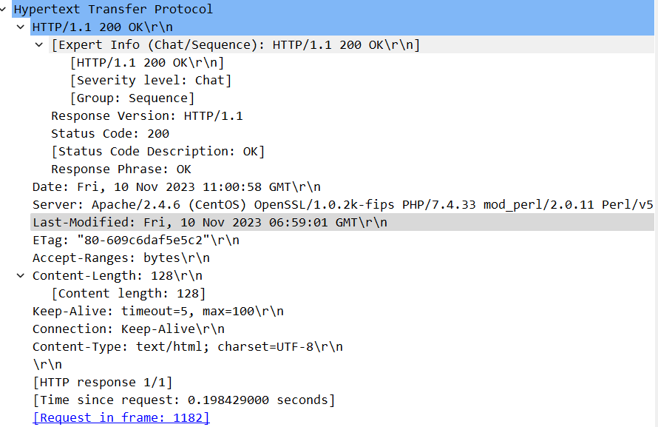

Slide 7
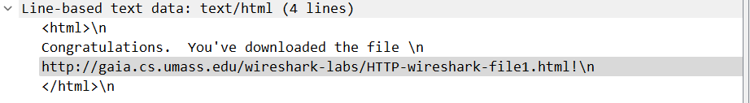

Slide 8
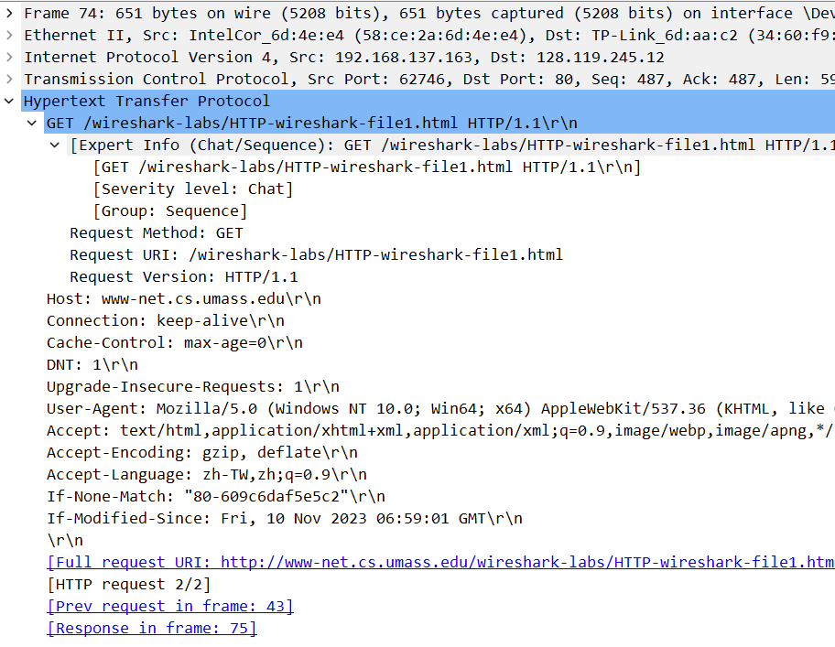

Slide 9
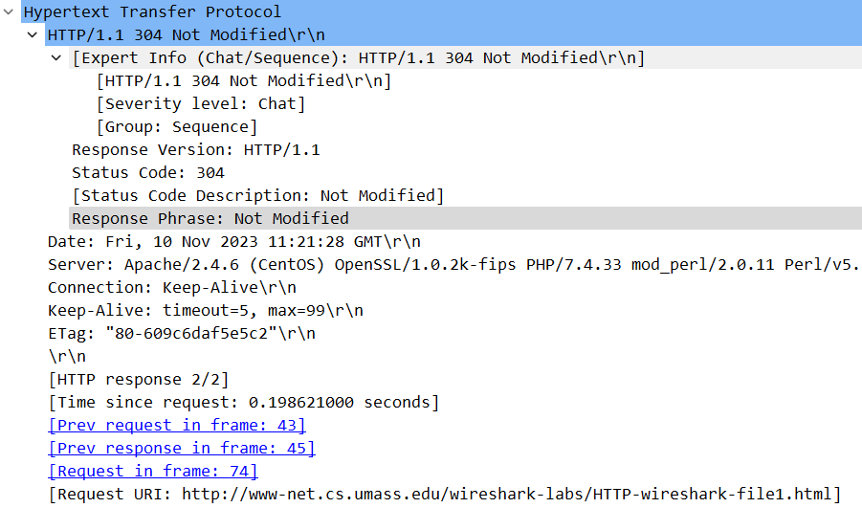

Slide 10
1 request, packet number = 43

Slide 11
packet number = 45

Slide 12
packet number = 45

Slide 13
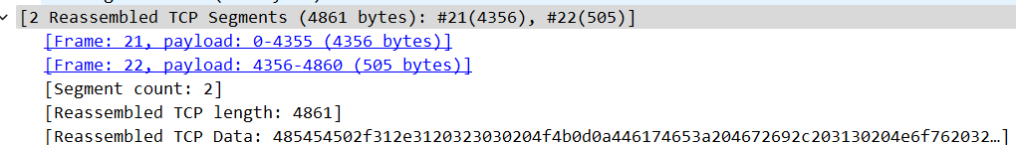

Slide 14
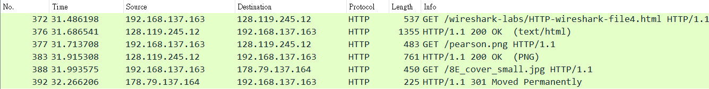

Slide 17
